Slide 1

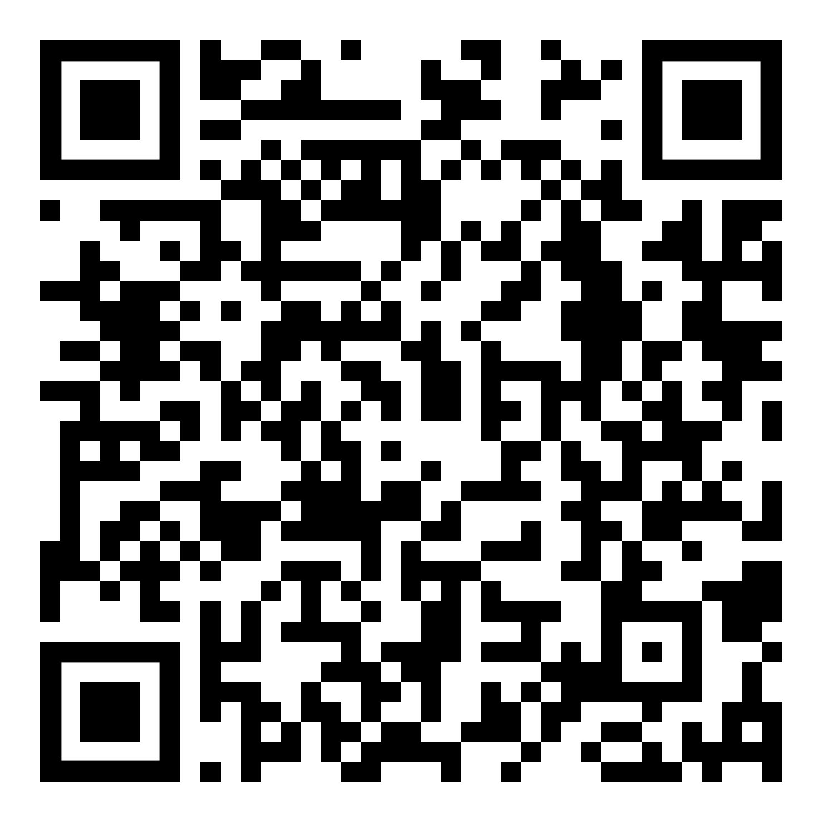
The Accessibility Resource Center (A.R.C.) is the student disability support office at Grossmont College providing access to education for students with disabilities.
Accommodations and support services are available for your college classes.
Classroom accommodations
Testing accommodations
Alternate Media/Audiobooks and Assistive Technology
ASL Interpreters, Real-Time Captioning services, and Assistive Listening Devices
Individualized academic, career, personal counseling
Disability management and support
Supplemental instruction (i.e. developmental writing, study skills courses)
All services are voluntary and confidential.
Grossmont College students with disabilities may be eligible.
To get started:
Apply to the A.R.C. online. Go to grossmont.edu/arc and click on “Apply to the A.R.C.”
Complete your intake appointment with an A.R.C. Counselor/Specialist. Get your accommodations approved and receive your Authorized Academic Accommodations letter.
Activate accommodations every semester. This is only necessary for certain accommodations that require A.R.C. coordination. Go to grossmont.edu/arc and click on “Activate Accommodations". Dialogue with instructors regarding accommodations; show/provide an accommodations letter.
Location: Building 60, Room 120
Phone: 619-644-7112
Email: grossmont.arc@gcccd.edu
Website: grossmont.edu/arc
Go online to learn more about our program, how to get started, and how to use your accommodations!

