Slide 1



Slide 2
A traveling exhibition that examines the motives, pressures and fears that shaped Americans’ responses to Nazism, war and genocide in Europe during the 1930s and 1940s.

Slide 3

Grossmont College
April 11 - May 23, 2026
Notes:
Delivery and set-up dates – took one of my cohort's 6 people working for ½ day to set up.
Estimate 45 minutes to visit and another 30 minutes for reflection and to visit the complementary display (working on getting RUTH)

Slide 4
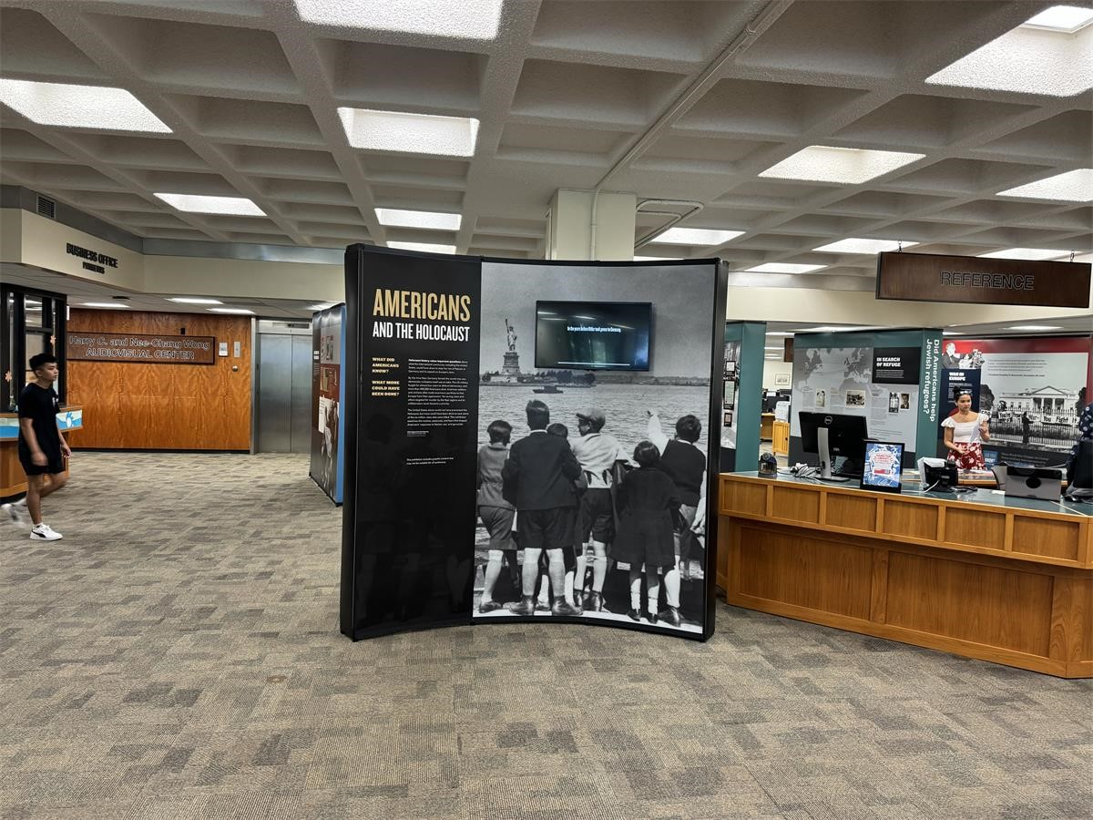
Notes:
University of Hawai'i at Manoa

Slide 5
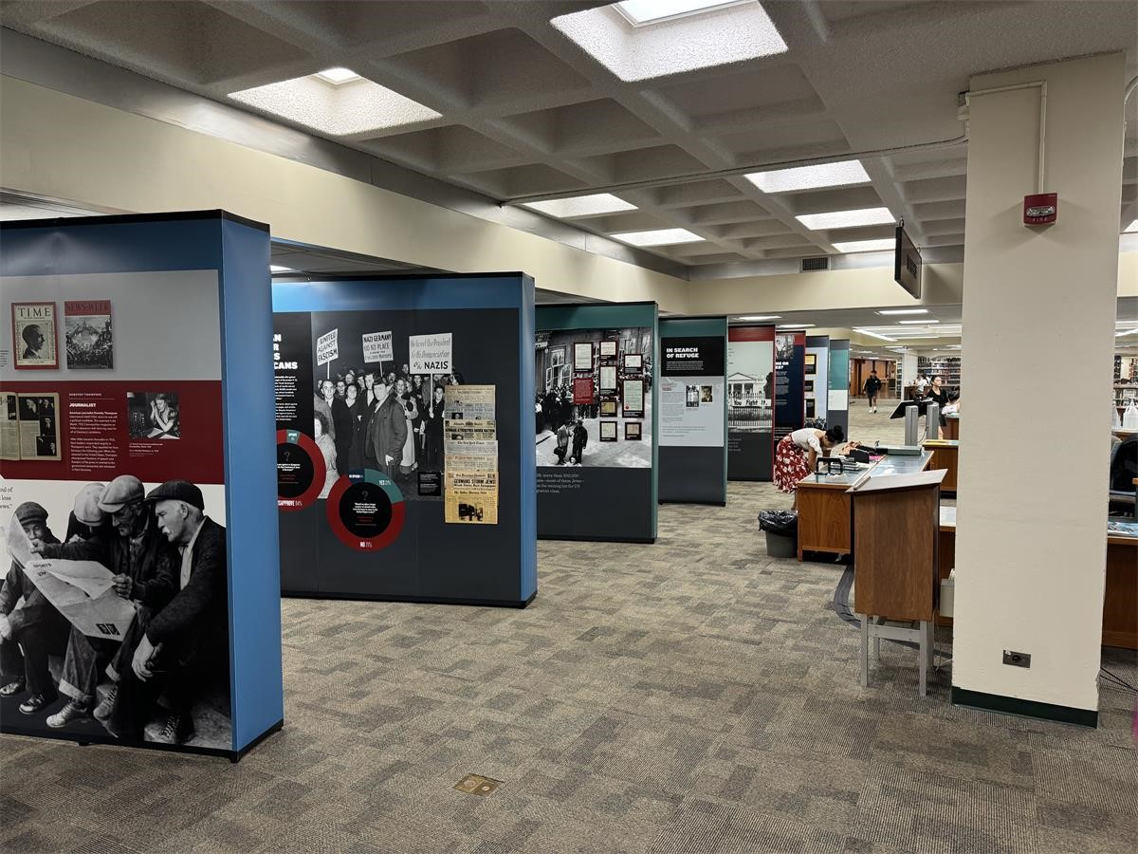

Slide 6
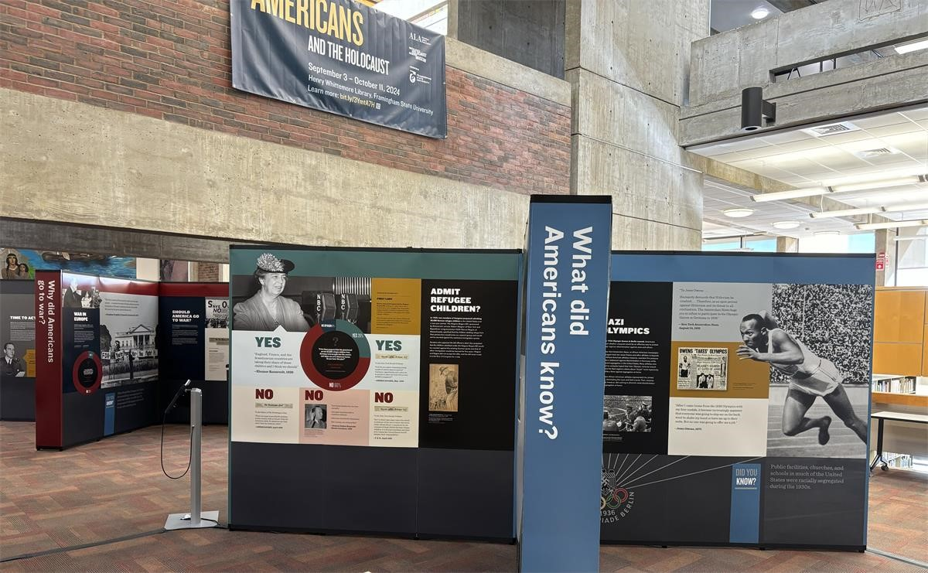

Slide 7
The Initiative aims to promote:​
An examination of how all parts of American society – the government, organizations, the media, popular culture, and the general public – responded during the rise of the Nazi threat and as news of the genocide became publicly known
Self-reflection and critical thinking about the various factors that shaped attitudes and actions during that moment of crisis and the factors that influence us today

Slide 8
GUIDING QUESTIONS
What did Americans know?​
Did Americans help Jewish refugees?​
Why did Americans go to war?​
How did Americans respond to the Holocaust?

Slide 9
KEY CONCEPTS
Americans Had Information​
Americans Faced Many Competing Priorities​
Americans Debated​
Americans Responded​
Americans Focused on Winning the War

Slide 10
Goal #1: Use this topic along with library resources, to aid instructors in a variety of subjects to teach students how to verify the accuracy of news sources and verify reliable resources. Draw parallels between today's "fake news" and "lying press" or Lugenpresse.
Goal #2: Bring community members to the exhibit and planned events for honest conversations that will inspire and cultivate empathy within our community.
Goal #3: Promote Holocaust and Human Rights education and help students understand the Holocaust's global and enduring consequences by making connections between themes/factors of the 1930s and 1940s

Slide 11
Program Planning
Film Showings
Book Discussions
Holocaust Survivor Stories
Guest Lecturers & Panel Presentations
Butterfly Project*
Amit Peled*
Ideas for curriculum integration:
  Journalism: analyze propaganda
  Art: depict aftermath, emotions associated with the exhibit
  Poli. Sci., Humanities, & History: explore how racism and antisemitism manifested in German and the U.S. in the 1930s
  Literature: Study of History on Trial: My Day in Court with a Holocaust Denier
Middle & High School Field Trips
Notes:
Must present four public programs on topics relevant to the exhibition's themes, at least on these programs must be for high school or university students.

Slide 12
Resources
Exhibition Tour Script
Americans and the Holocaust Online Exhibition
Holocaust Encyclopedia
History Unfolded: US Newspapers and the Holocaust
Experiencing History: Holocaust Sources in Context
Grant Support Materials
USCShoah Foundation IWitenss

