Slide 1

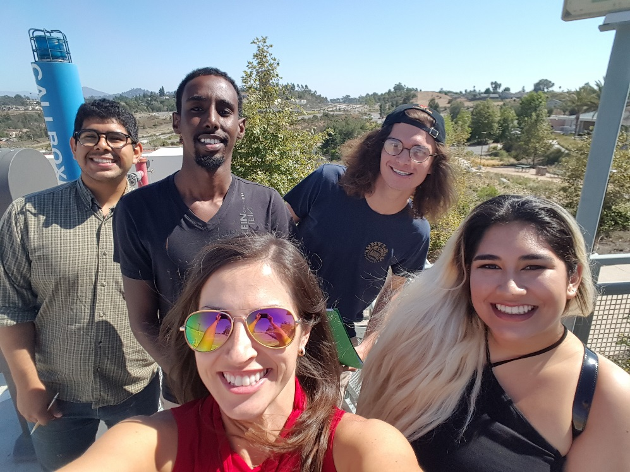
Peer Mentoring at
Grossmont College
What is peer mentoring?
Getting new students involved
Recruiting peer mentors
Peer mentor training
Peer Mentoring Funded through
Title V: Via Rápida!

Slide 2
Peer Mentoring Funded through
Title V: Via Rápida!
Want to succeed at
Grossmont College?
New students are matched with peers to work on making their first semester a successful one.
A peer mentor will….
Introduce you to the campus and to other students
Show you how to access and use resources on campus
Listen to personal problems
Help you with time management and study skills
Share their knowledge to prepare you for your journey at Grossmont College
Sign up today!
Go to https://goo.gl/JgXfL0
or text 81010 with message @viarapida

Slide 3
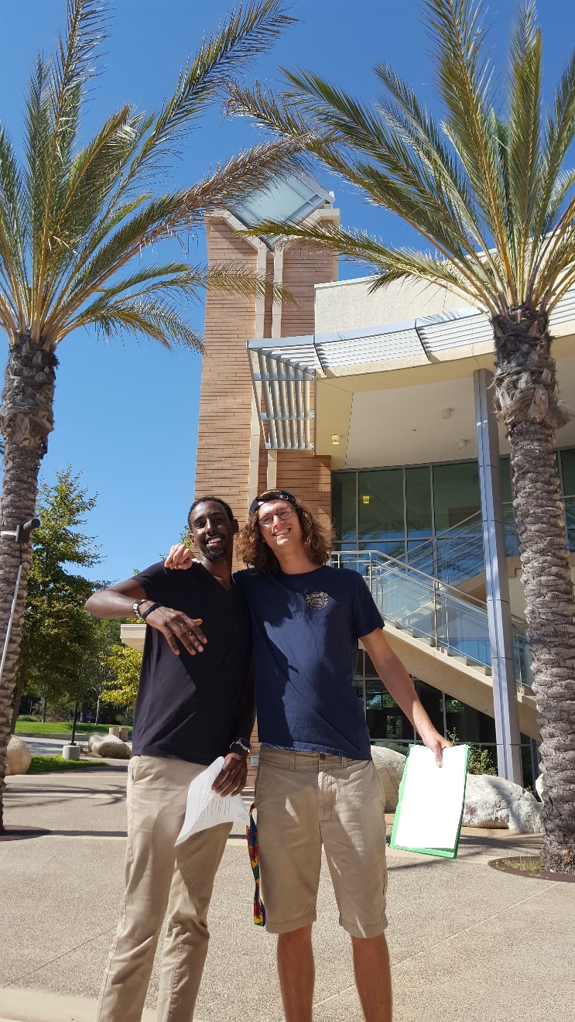
Recruiting Peer Mentors
Faculty and Staff Recommendation
Job Description
Interviews Week 10 of the semester
Hiring for Spring 2018
Contact:
irene.palacios@gcccd.edu
phone: 619-644-7834
Office: 10-102

Slide 4
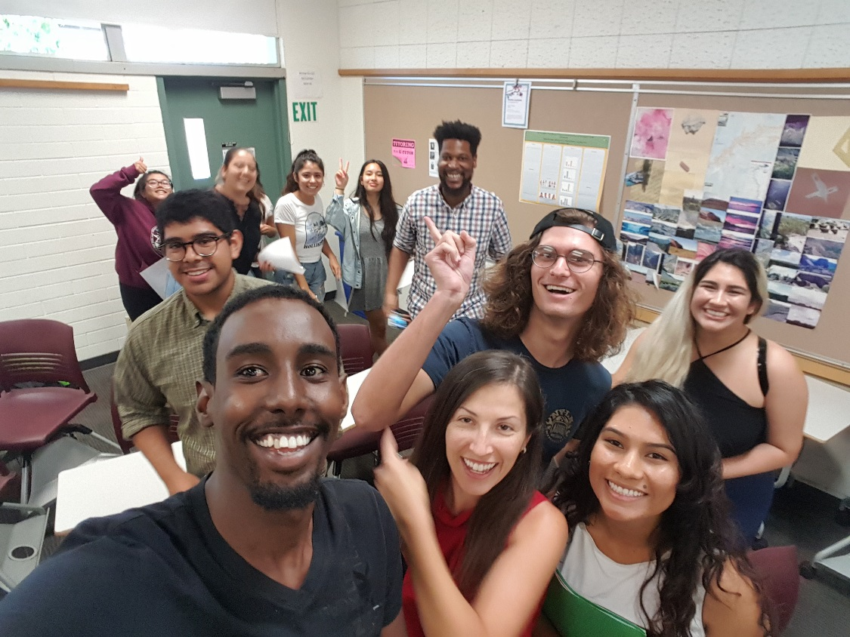
Peer Mentoring Training
Two to three weeks before the start of classes
Team building activities, learning about student services, mentoring logistics and strategies
Assigned mentees one week before classes begin then continues up to week 4 depending on availability

Slide 5
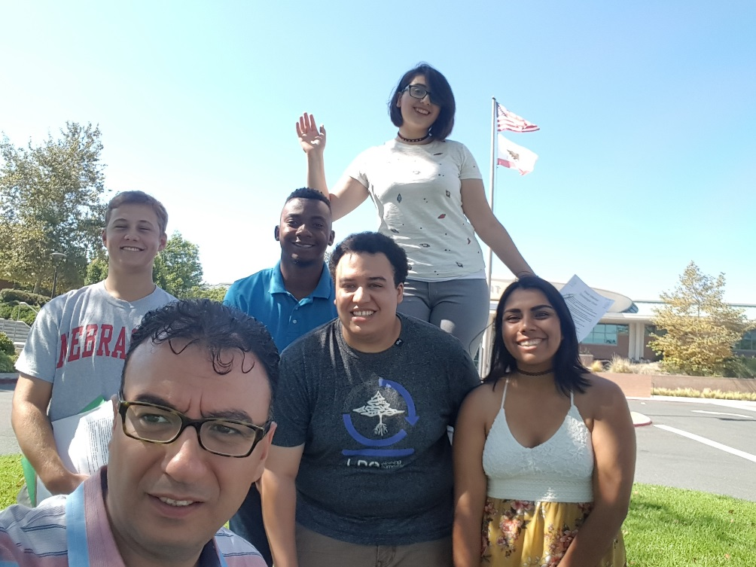
Questions?
Irene Palacios – Peer Mentor and Embedded Tutor Coordinator
Contact Information:
Office: 10-102
Phone: 619-644-7834
irene.palacios@gcccd.edu

