Slide 1
Matter and Energy: The Origin of the Universe
Chapter 1
Outline
Scientific Method
Matter
Units of Measurement
Significant Figures
Dimensional Analysis

Slide 2
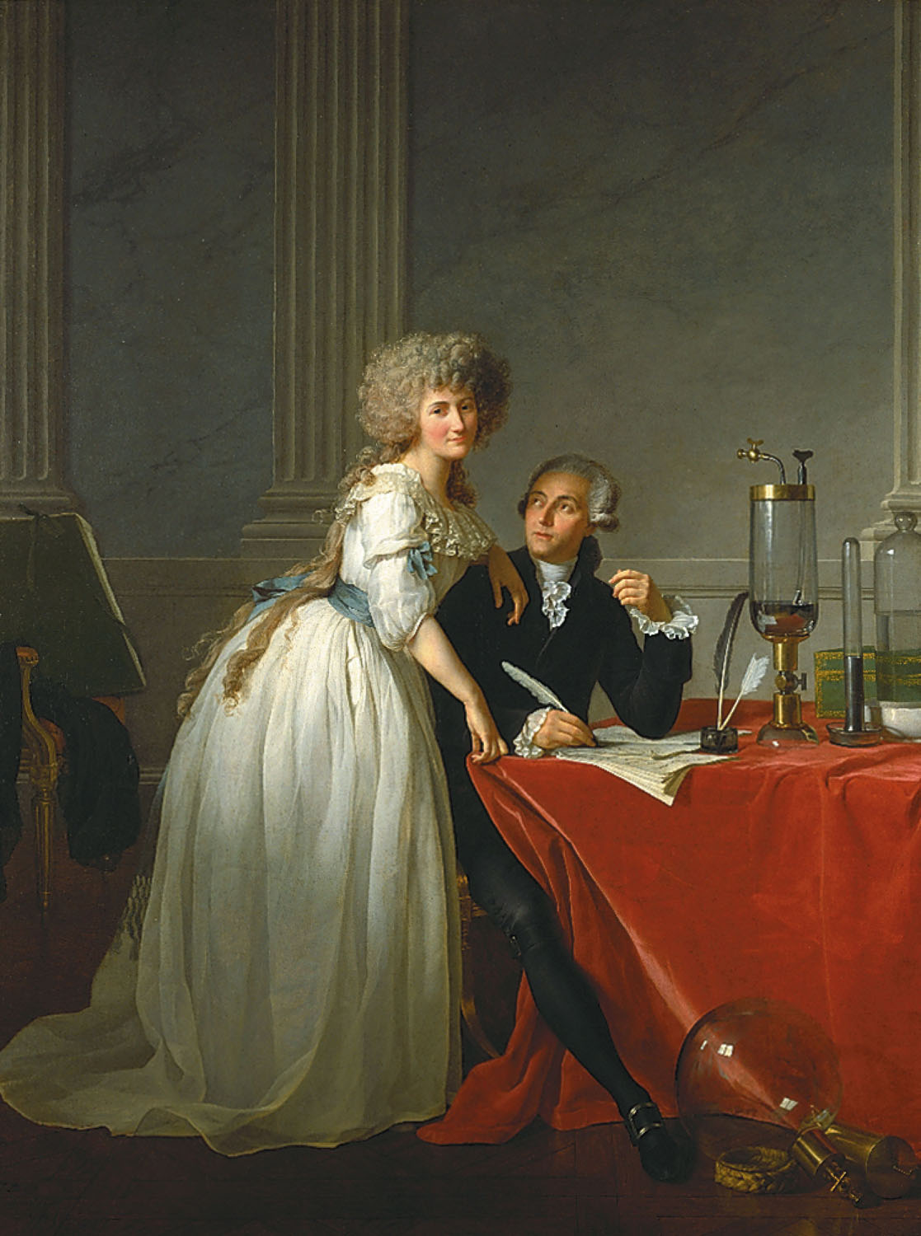
Antoine Lavoisier, the “Father of modern chemistry” and Marie Lavoisier
p2
Notes:
Antoine Lavoisier and his wife, Marie. They were married in 1771, when he was 28 and she was only 14. Marie was Antoine’s laboratory assistant and secretary.

Slide 3
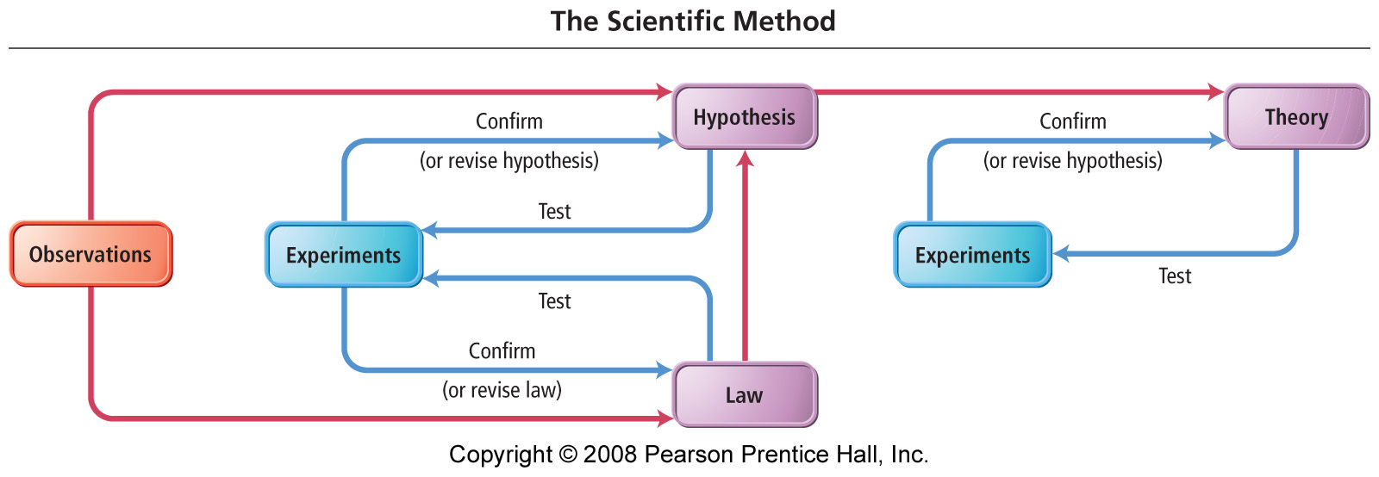
What are the parts of the scientific method?
Notes:
Figure: 01-02
Title:
The Scientific Method
Caption:
The scientific method.

Slide 4
From Scientific Method
Empirical facts
  (observations, data)
Scientific laws
  (tested generalizations, consistent observations)
Hypothesis
  (tentative explanation)
Theory or Models
  (tested explanation, unifying explanation for a set of observations, facts and laws)

Slide 5
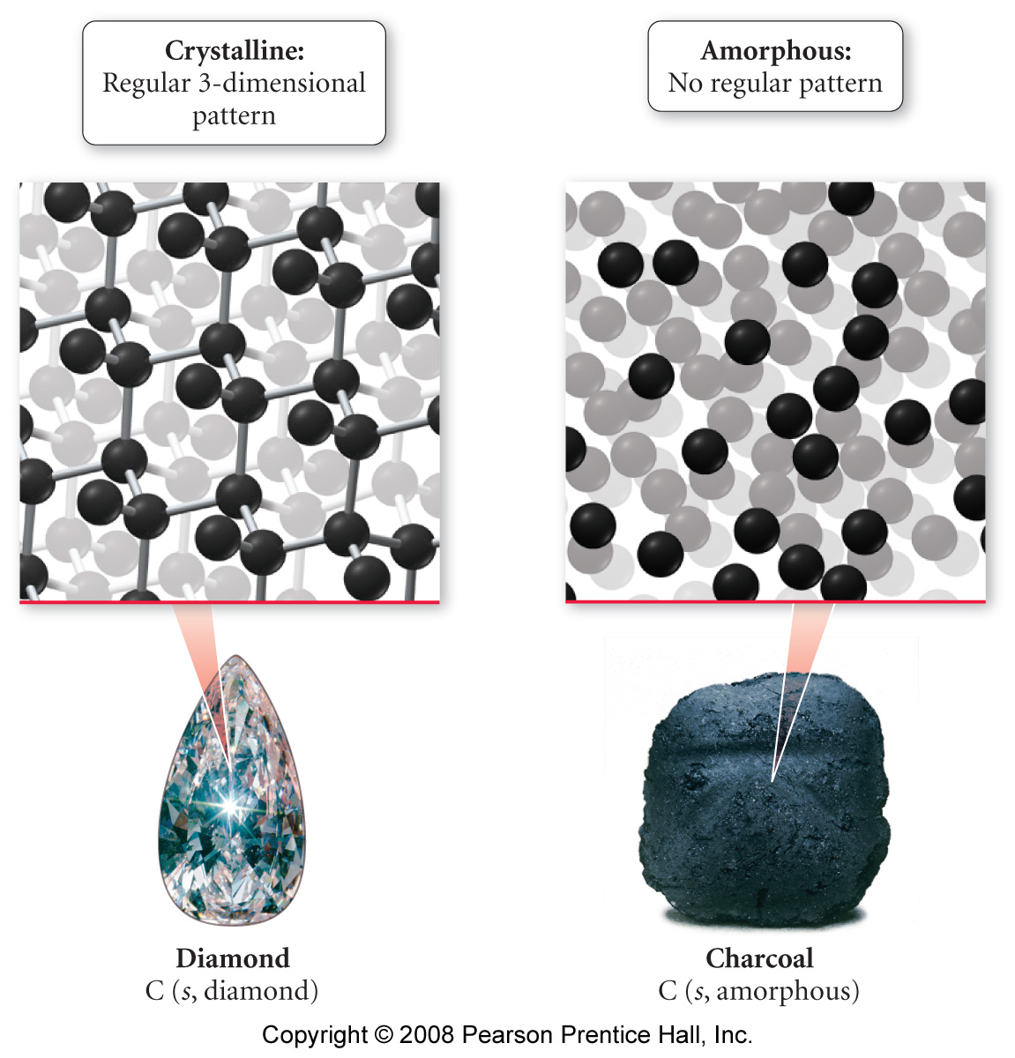
How are solids ordered?

Slide 6
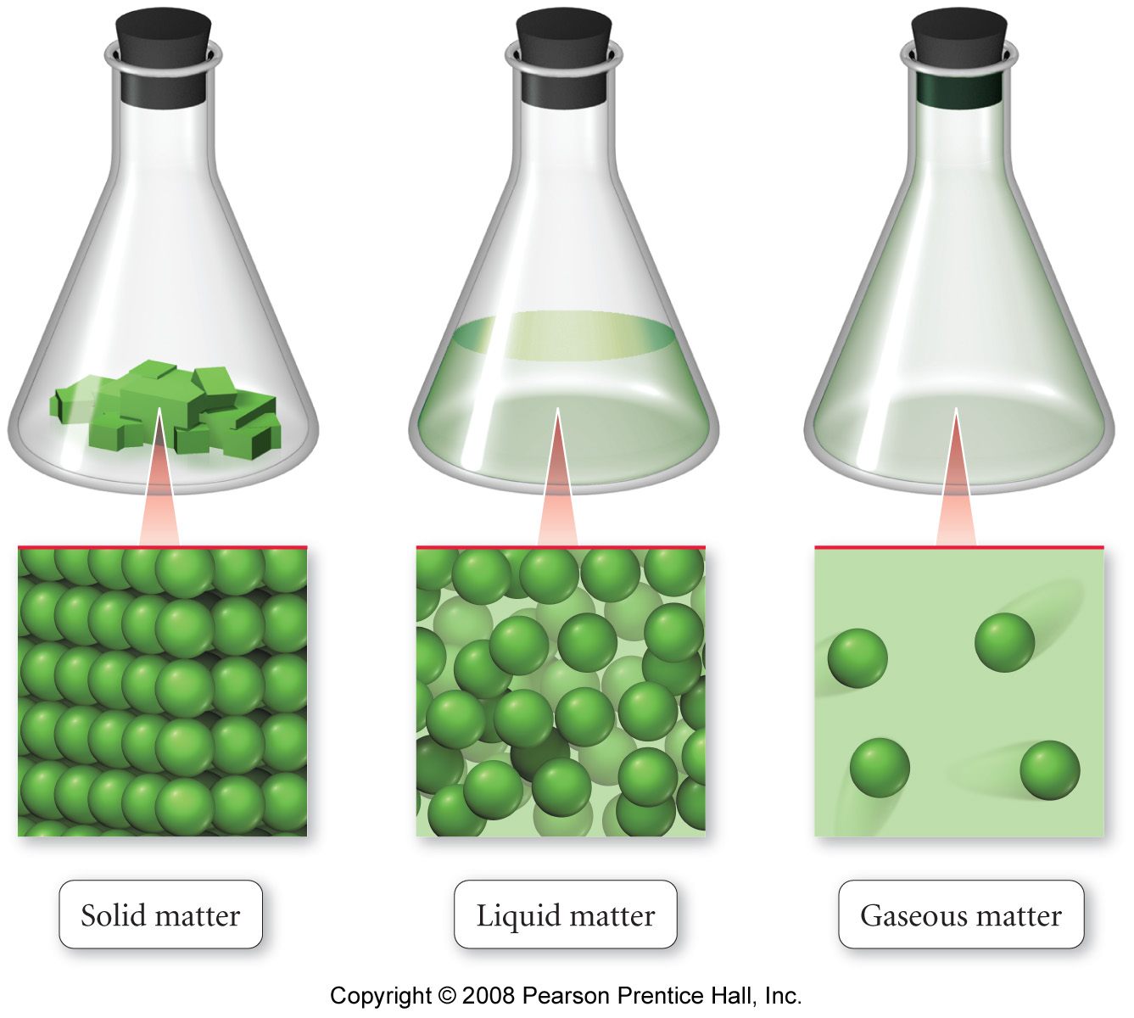
How do the states of matter compare?
Notes:
Figure: 01-02-01UN
Title:
Solid, liquid, gaseous states
Caption:
In a solid, the atoms or molecules are fixed in place and can only vibrate. In a liquid, although the atoms or molecules are closely packed, they can move past one another, allowing the liquid to flow and assume the shape of its container. In a gas, the atoms or molecules are widely spaced, making gases compressible as well as fluid.

Slide 7
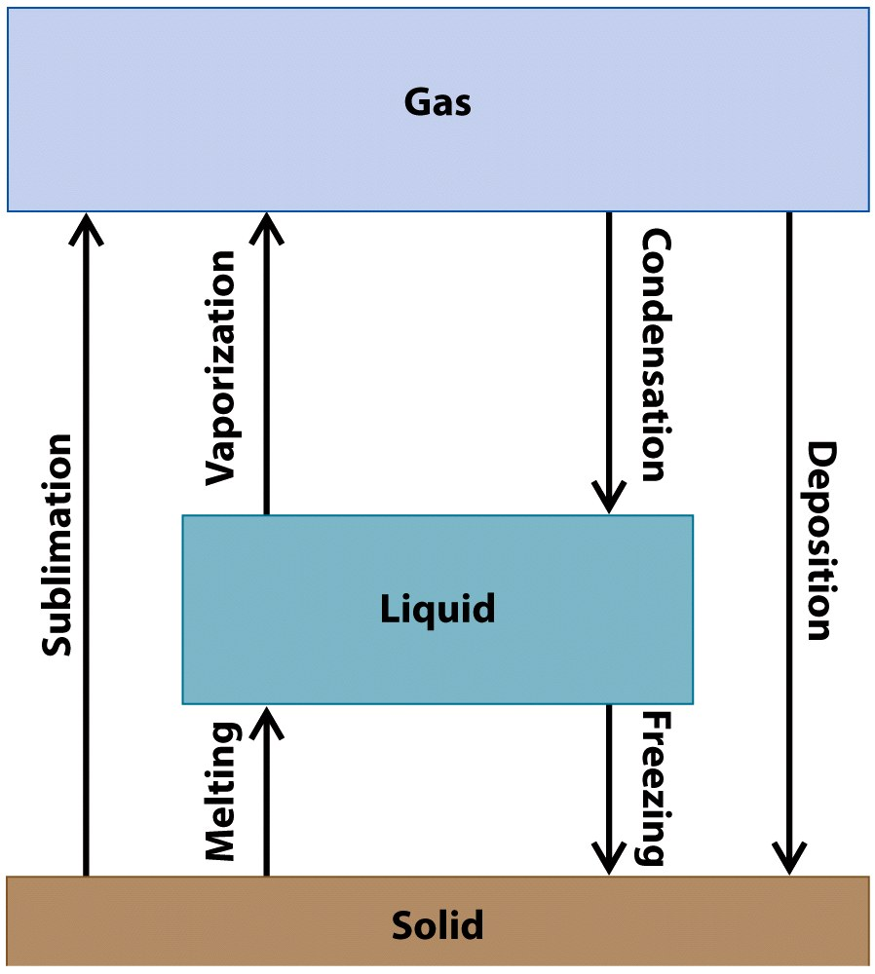
How do the states of matter interconvert?

Slide 8
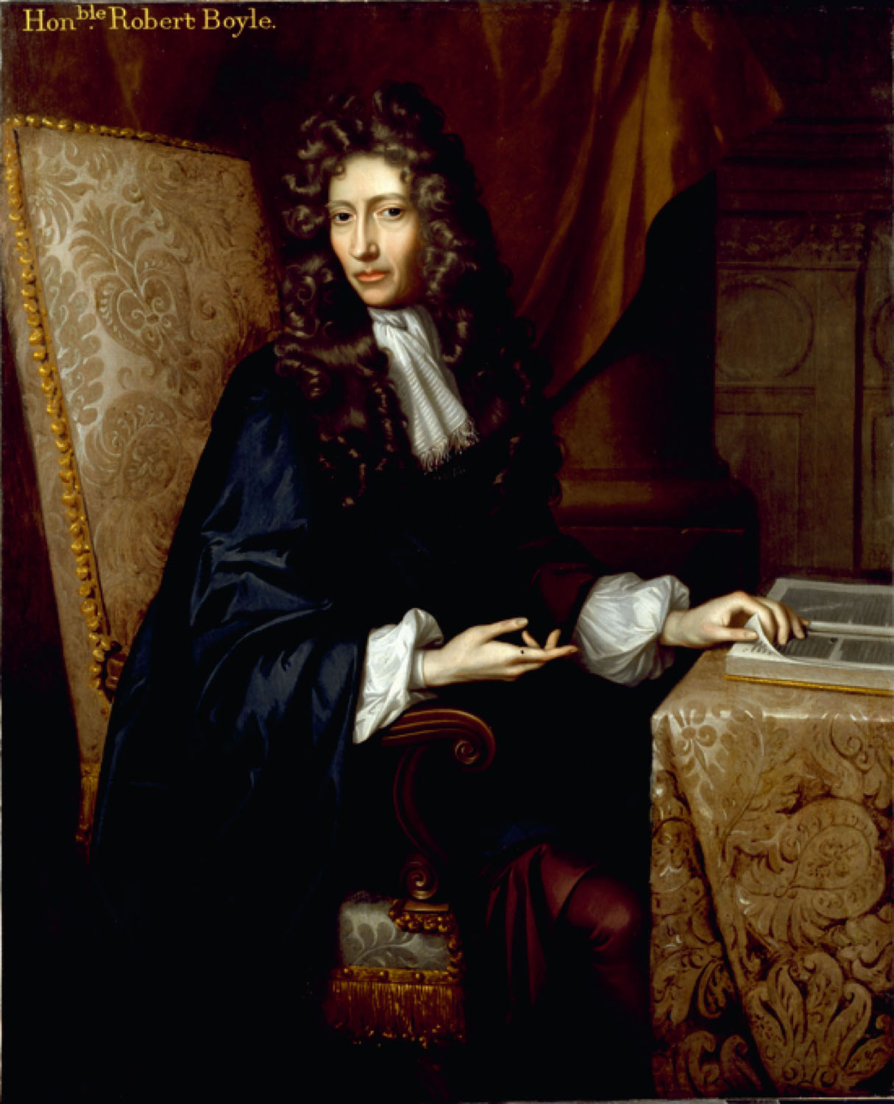
p112
Notes:
Robert Boyle’s (1627–1691) book The Sceptical Chymist argued for an experimental approach to scientific investigation. Although this seems to be obviously necessary today, it was a radical position in 1661.

Slide 9
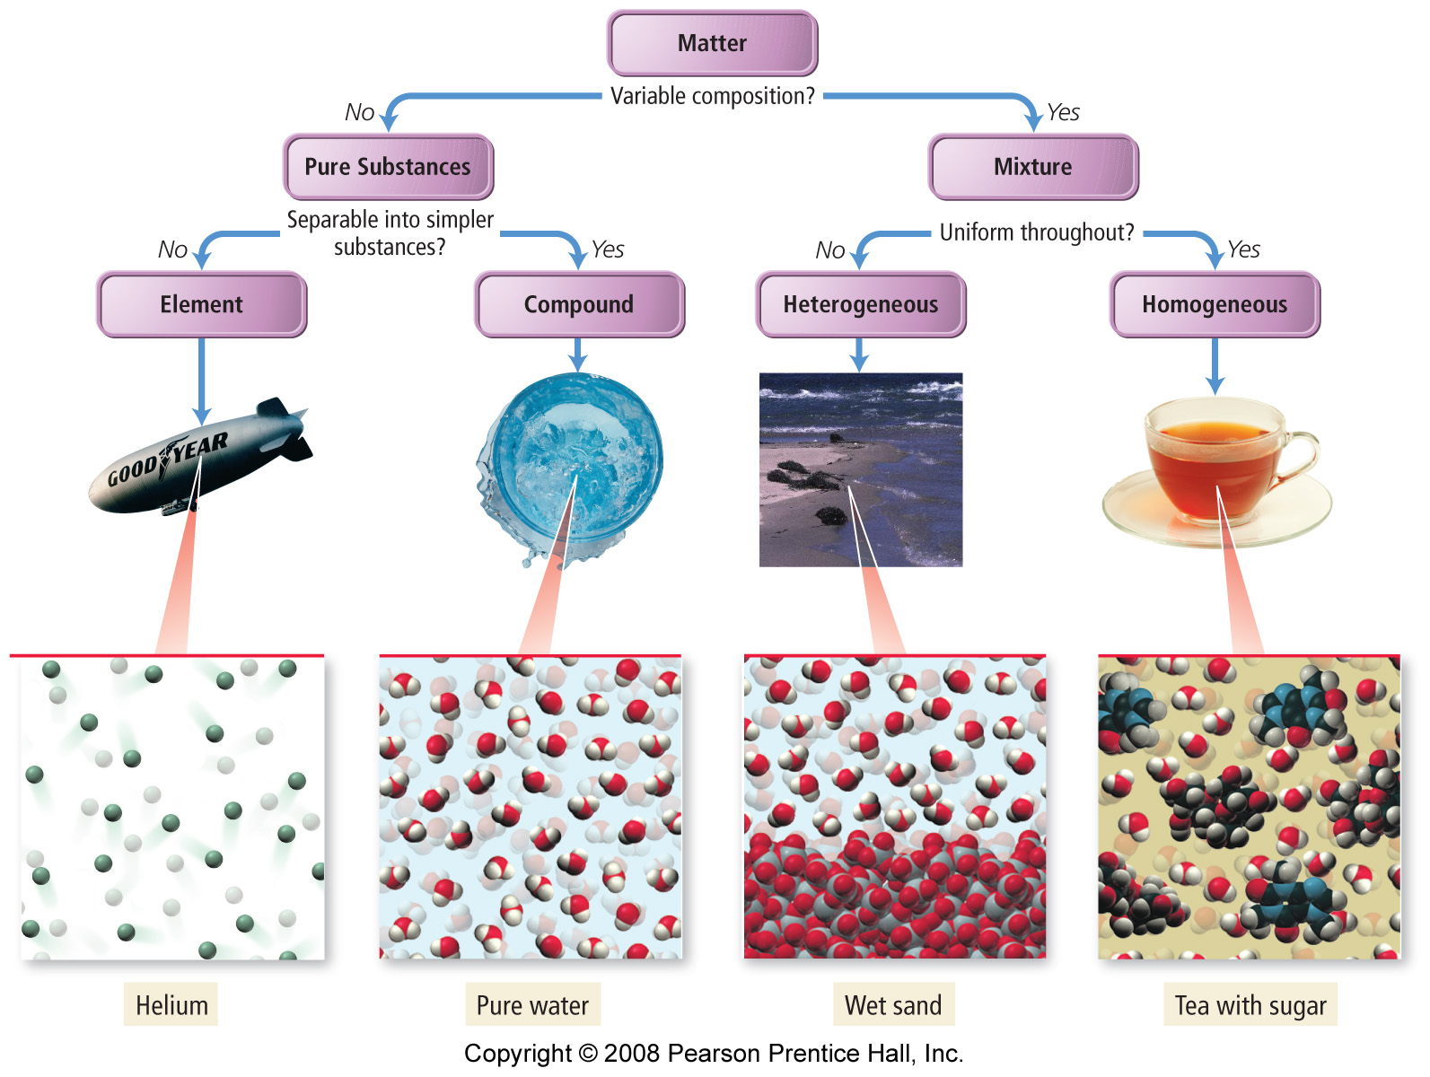
How is matter classified?
Notes:
Figure: 01-04-01
Title:
Classification of mixtures
Caption:
An example of a flowchart to classify or categorize substances.

Slide 10
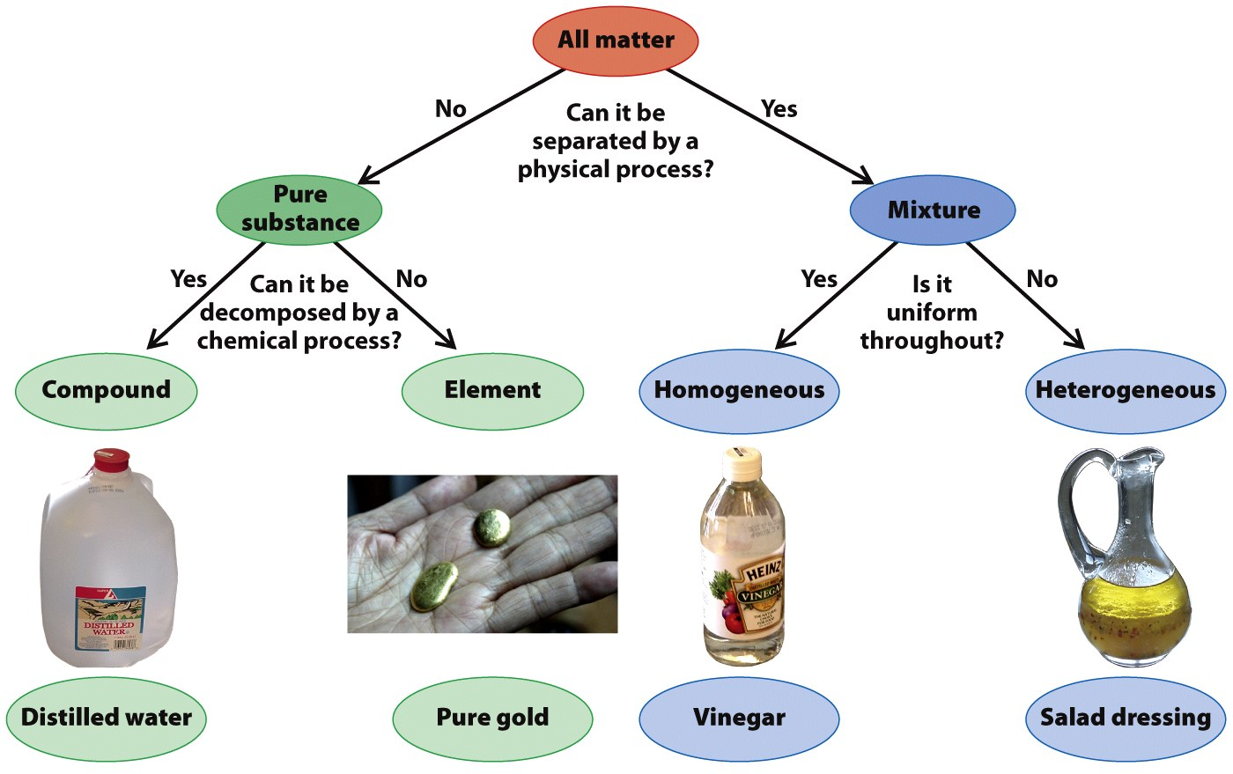

Slide 11
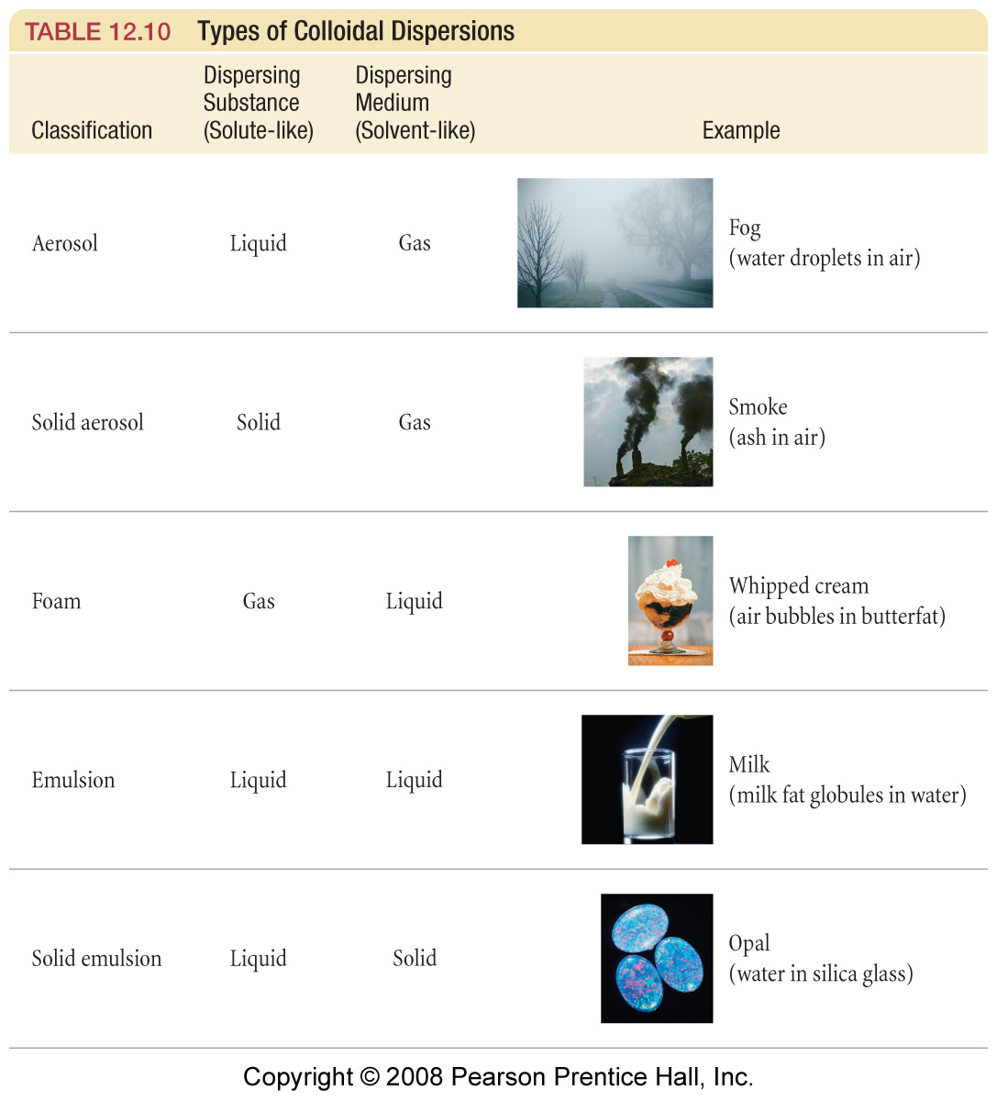
What are the types of colloids?
Aerosol – liquid in gas
Solid Aerosol – solid in gas
Sol -- solid in liquid like protein particles in milk

Slide 12
Emulsion – liquid in liquid like oil droplets in mayonnaise.
Foams – gases in liquids like whipped cream
Solid emulsion – liquid in a solid like milk in butter
Gel – a solid emulsion which is soft but holds its shape like Jell-O
Notes:
Figure: 12-T10
Title:
TABLE 12.10 Types of Colloidal Dispersions
Caption:
A colloidal dispersion (colloid) is a mixture in which a dispersed substance is finely divided in a dispersing medium.

Slide 13
Notes:
13
Figure: 12-T10
Title:
TABLE 12.10 Types of Colloidal Dispersions
Caption:
A colloidal dispersion (colloid) is a mixture in which a dispersed substance is finely divided in a dispersing medium.

Slide 14
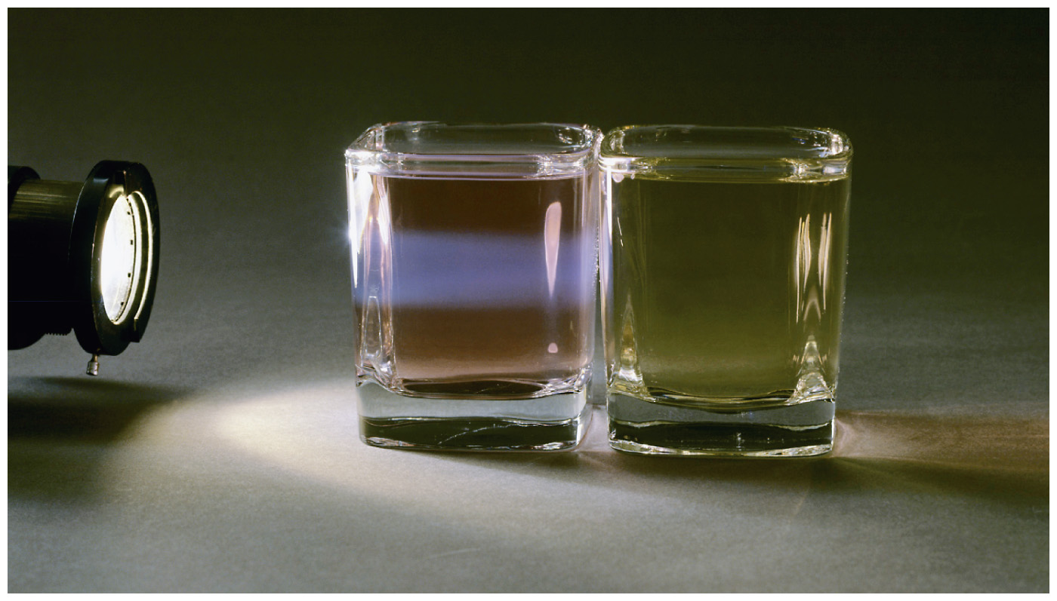
What type of mixture exhibits the Tyndall Effect?
Notes:
Chapter 12, Figure 12.23 The Tyndall Effect
Colloids exhibit the Tyndall Effect, while pure water does not.

Slide 15
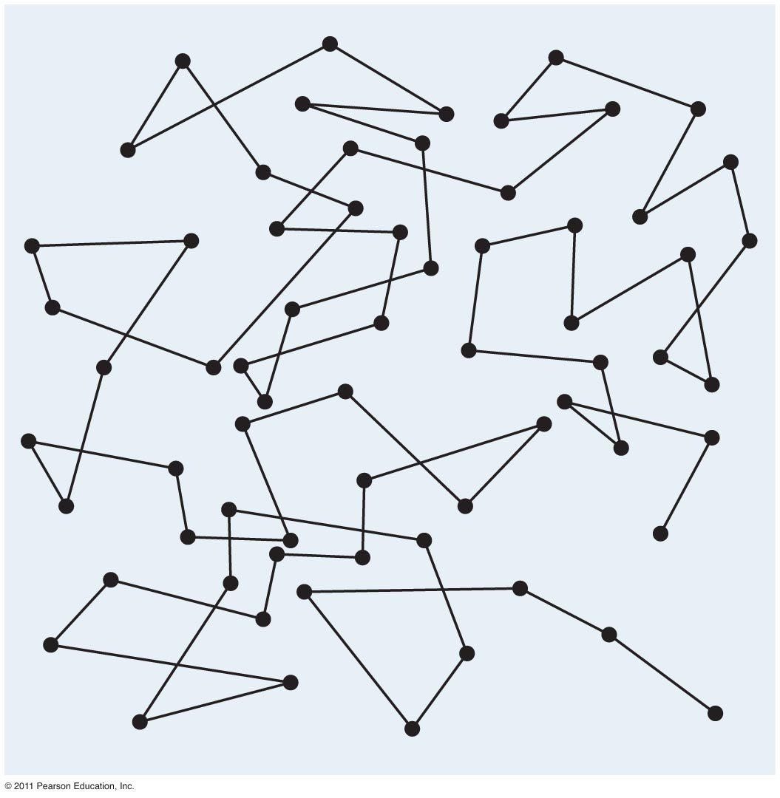
What is Brownian motion?
Tro: Chemistry: A Molecular Approach, 2/e

Slide 16
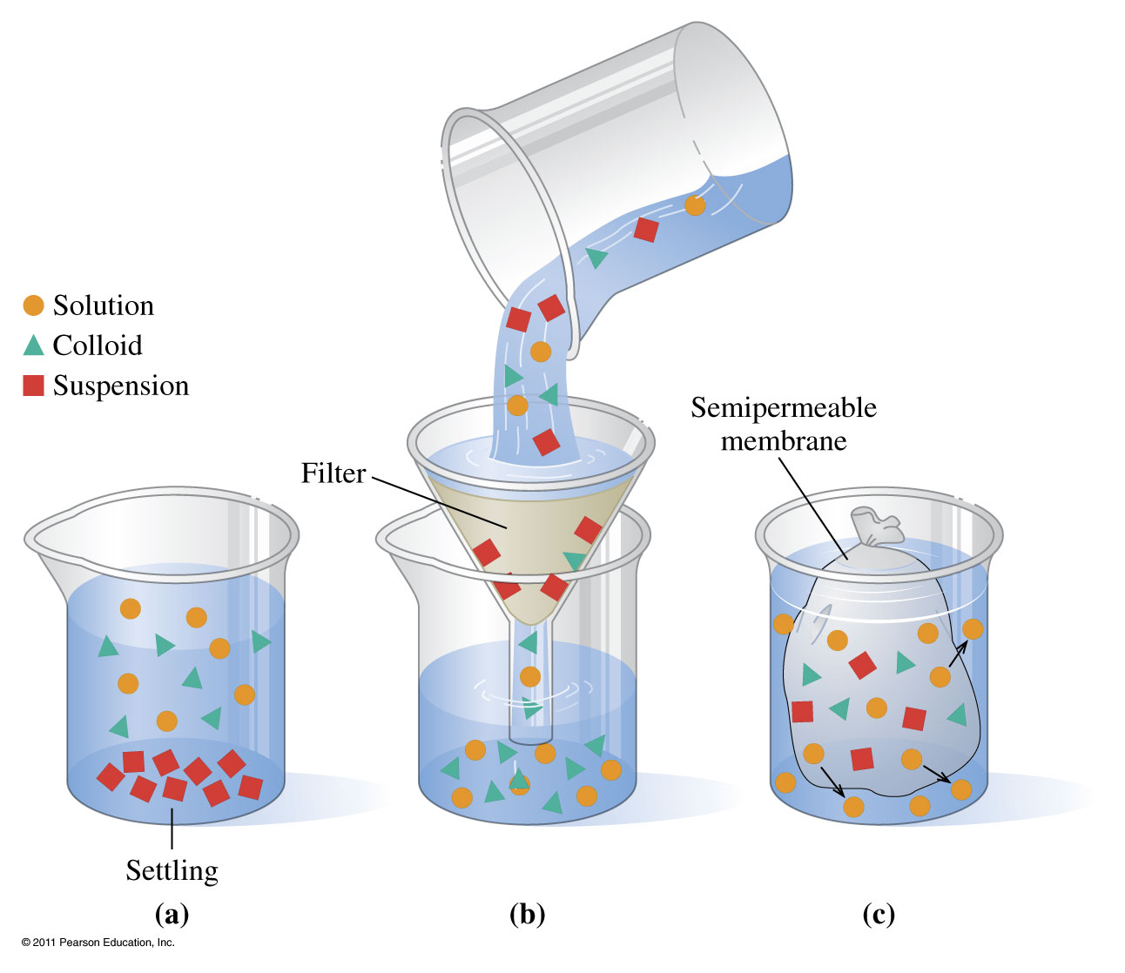
How do mixtures differ?

Slide 17
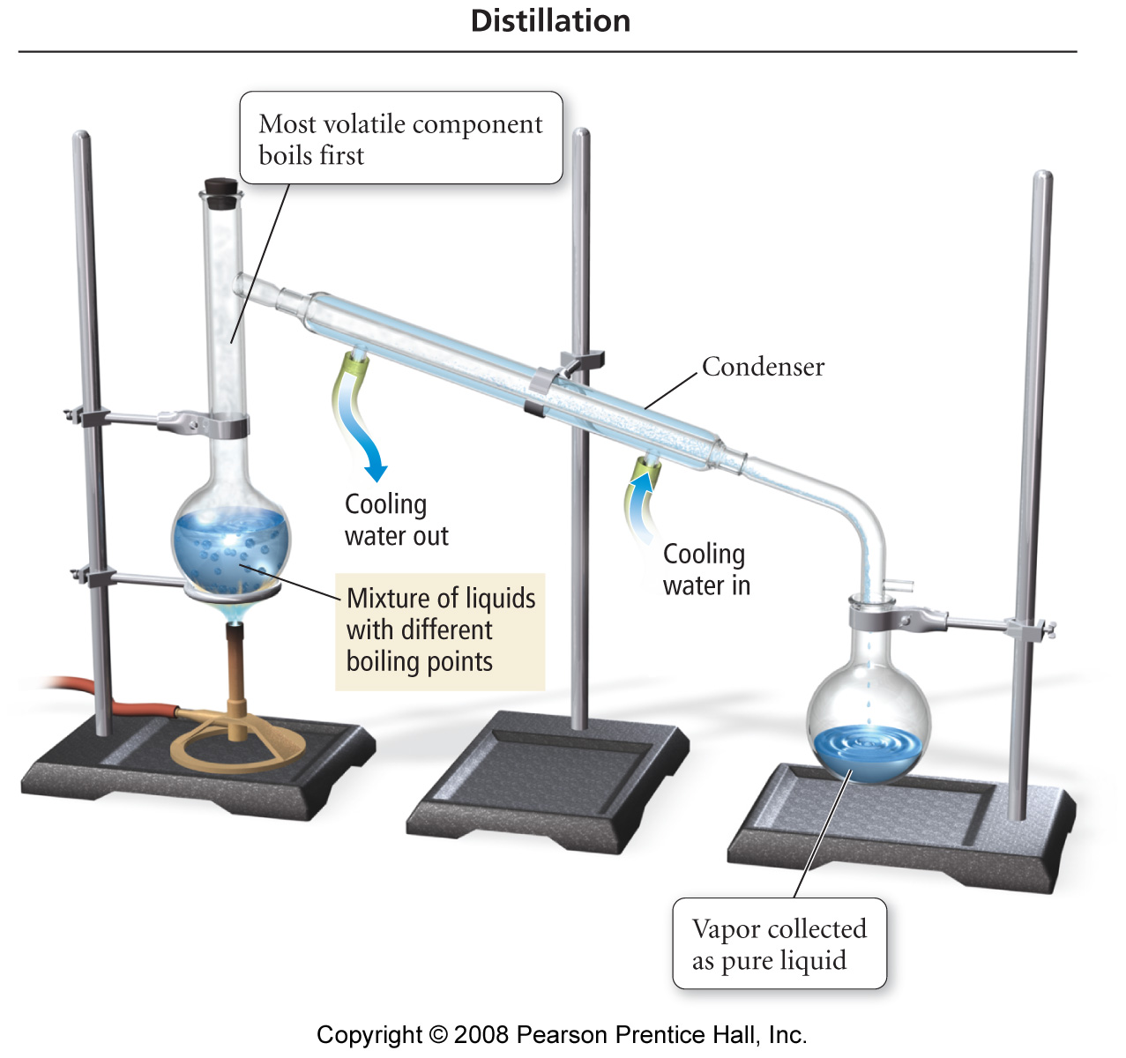
How can mixtures be separated?

Slide 18
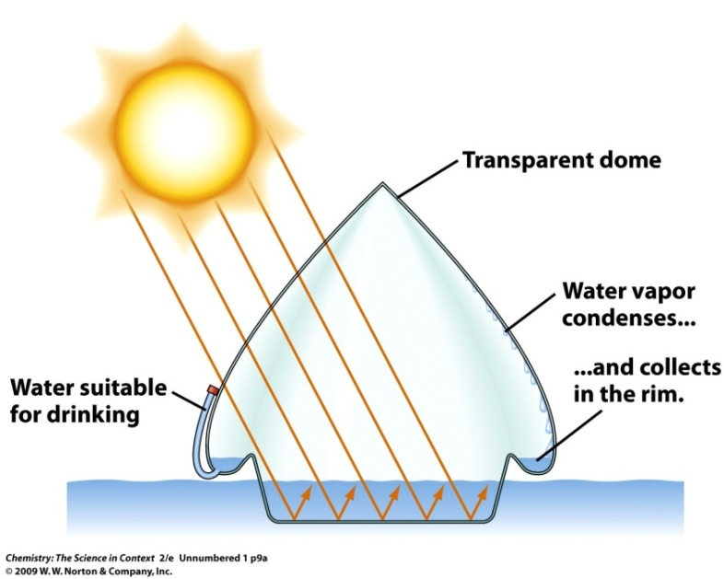
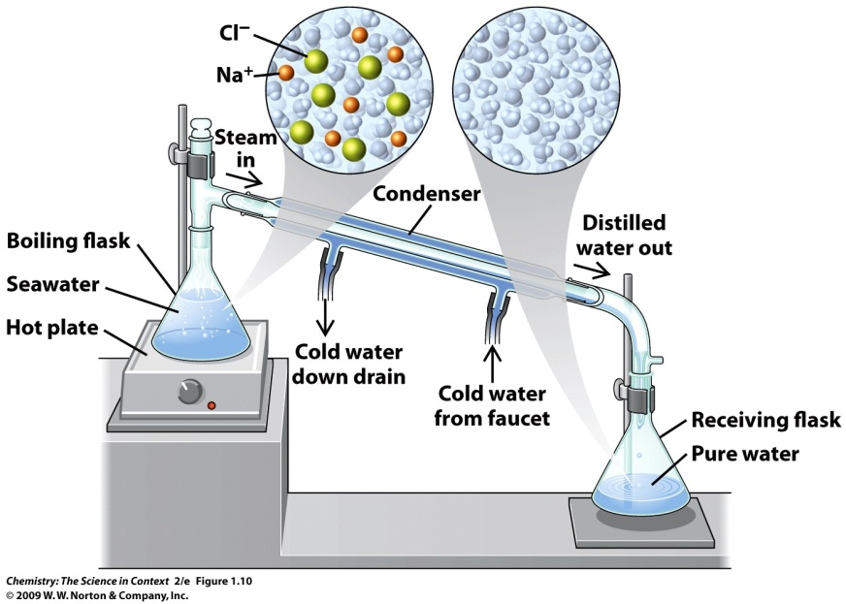
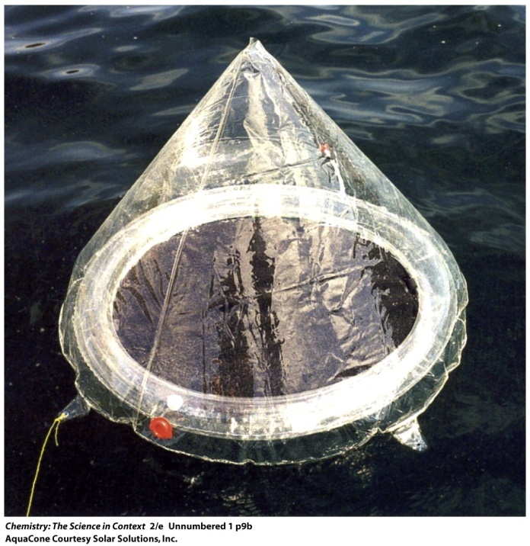
How can mixtures be separated?

Slide 19
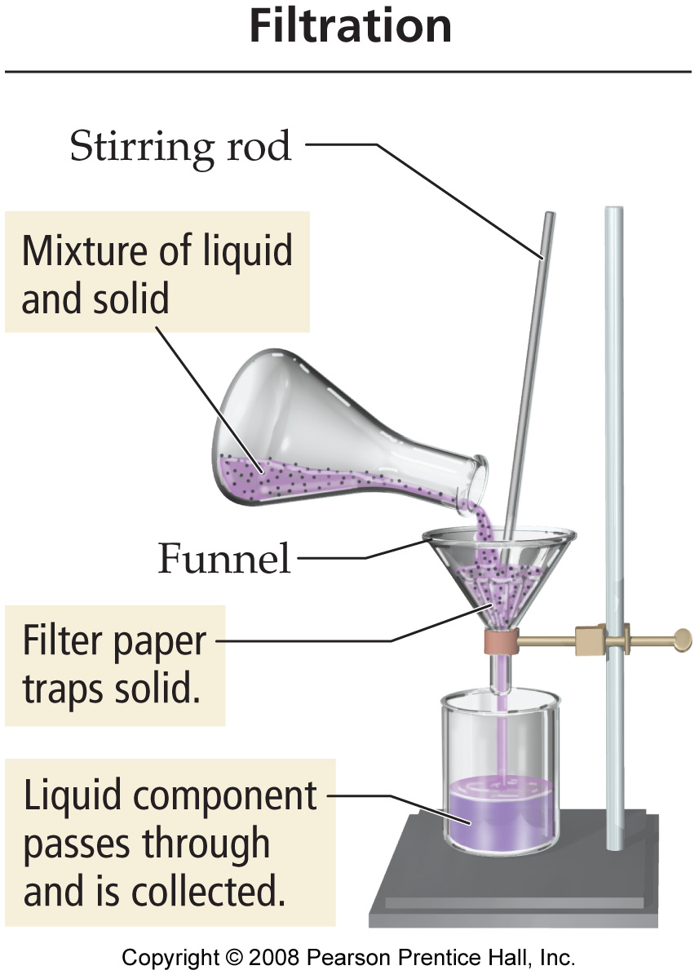
How can mixtures be separated?

Slide 20
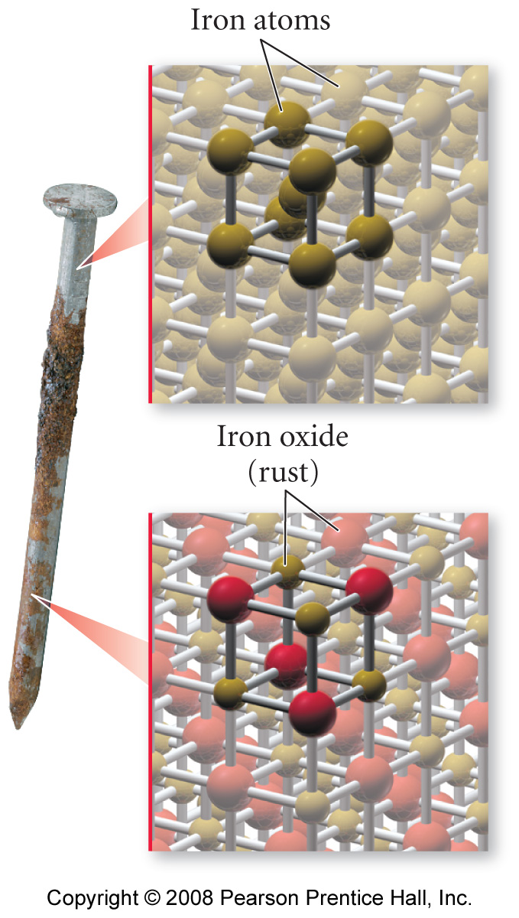
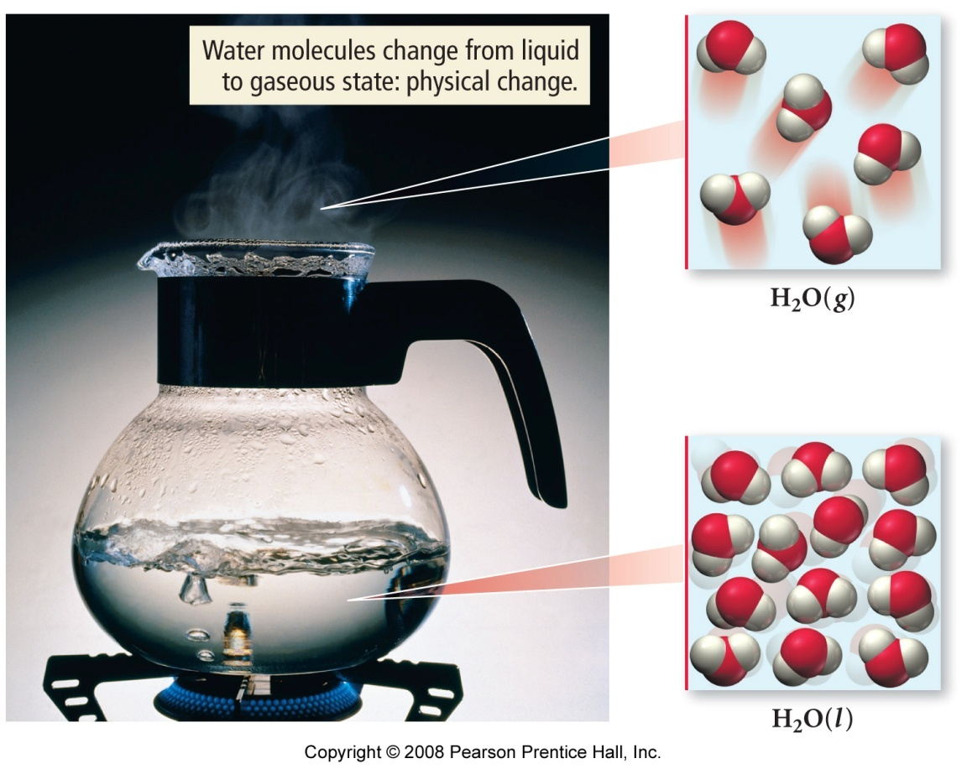
How do physical and chemical properties differ?

Slide 21
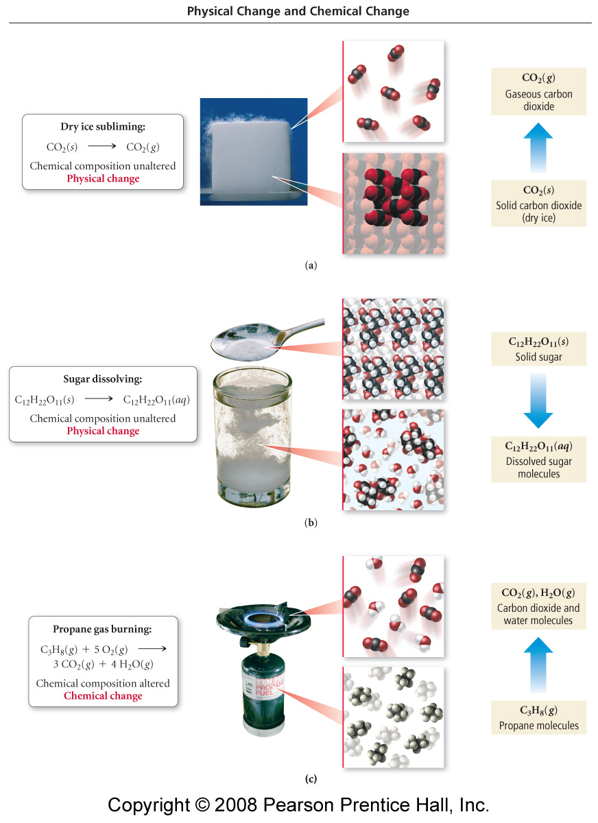
Notes:
Figure: 01-09
Title:
Physical and Chemical Changes
Caption:
(a) The sublimation of dry ice (solid CO₂) is a physical change. (b) The dissolution of sugar is a physical change. (c) The burning of propane is a chemical change.

Slide 22
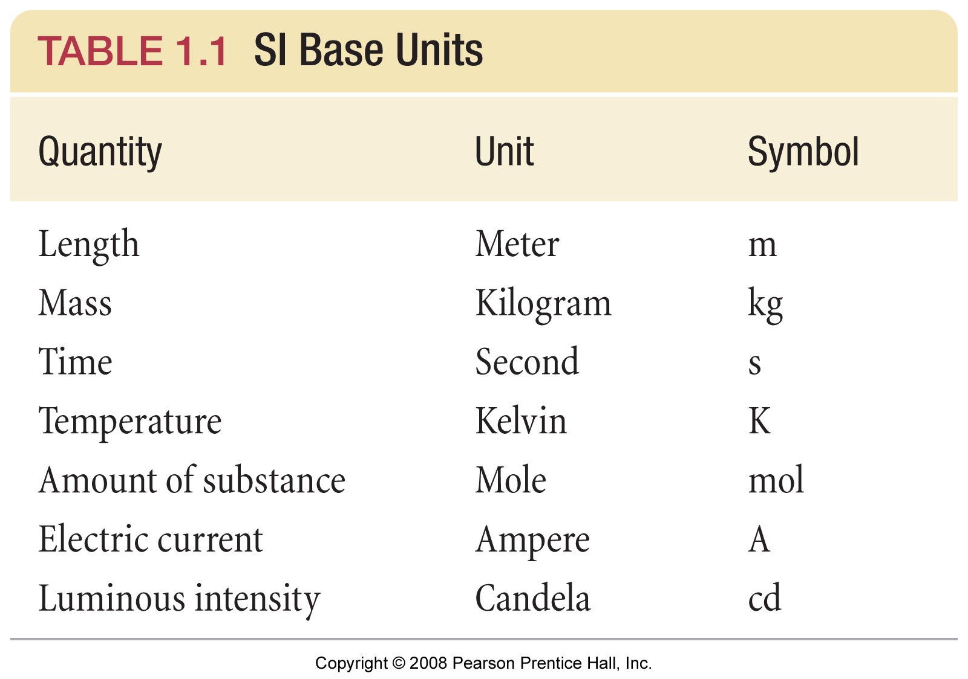
What are the SI base units?
Notes:
Figure: 01-T01
Title:
TABLE 1.1 SI Base Units
Caption:
These seven units form the basis for the SI system, sometimes called the metric system. In the SI system, measurements are made of these units, or of combinations of two or more of the units.

Slide 23
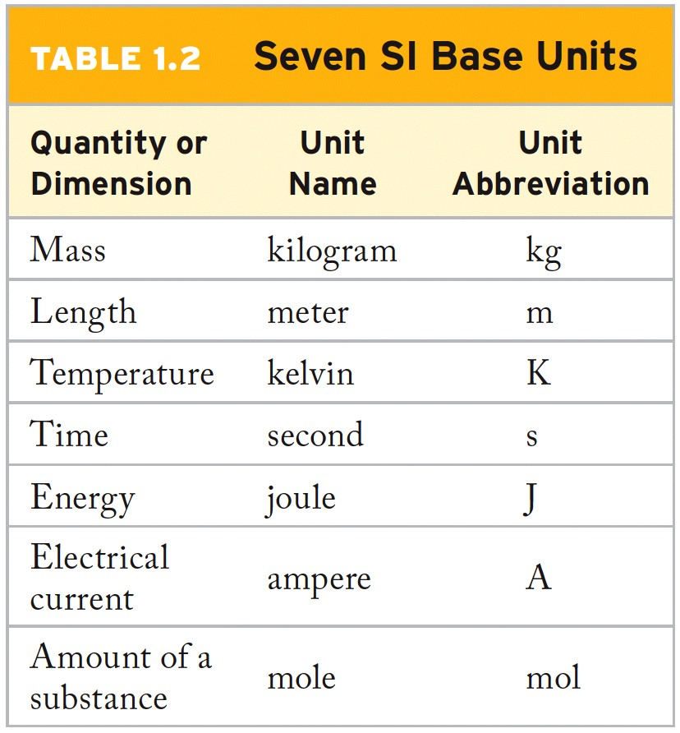
What are the SI base units?
Notes:
Figure: 01-T01
Title:
TABLE 1.1 SI Base Units
Caption:
These seven units form the basis for the SI system, sometimes called the metric system. In the SI system, measurements are made of these units, or of combinations of two or more of the units.

Slide 24
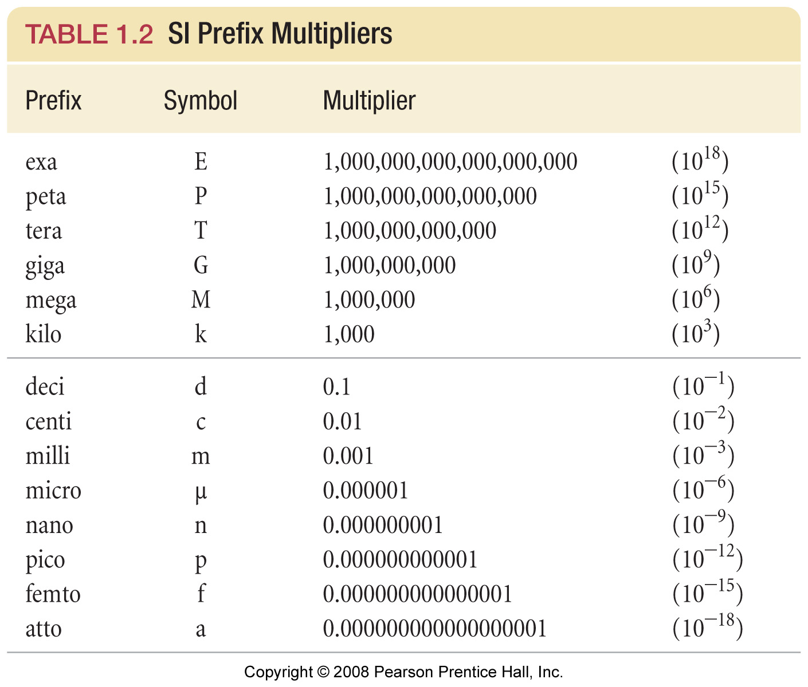
What are the prefix multipliers?
Notes:
Figure: 01-T02
Title:
TABLE 1.2 SI Prefix Multipliers
Caption:
Prefix multipliers provide an alternative to scientific notation for expressing very large or very small quantities.

Slide 25
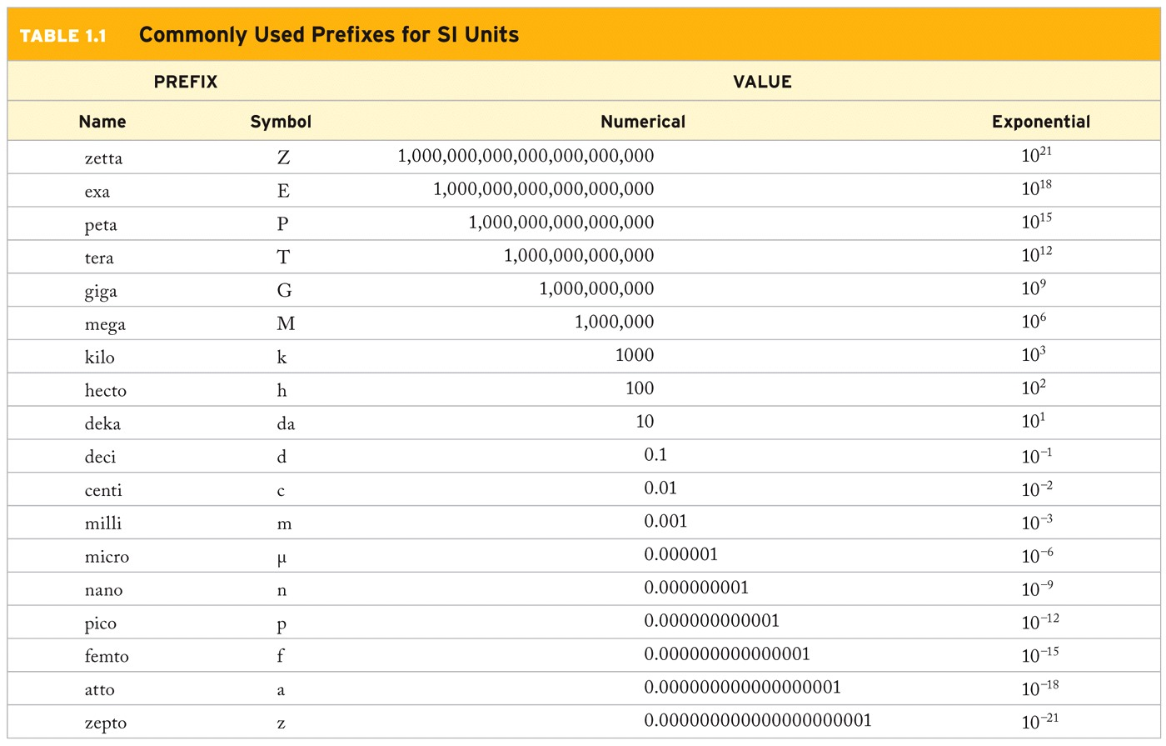
What are the prefix multipliers?
Notes:
Figure: 01-T02
Title:
TABLE 1.2 SI Prefix Multipliers
Caption:
Prefix multipliers provide an alternative to scientific notation for expressing very large or very small quantities.

Slide 26
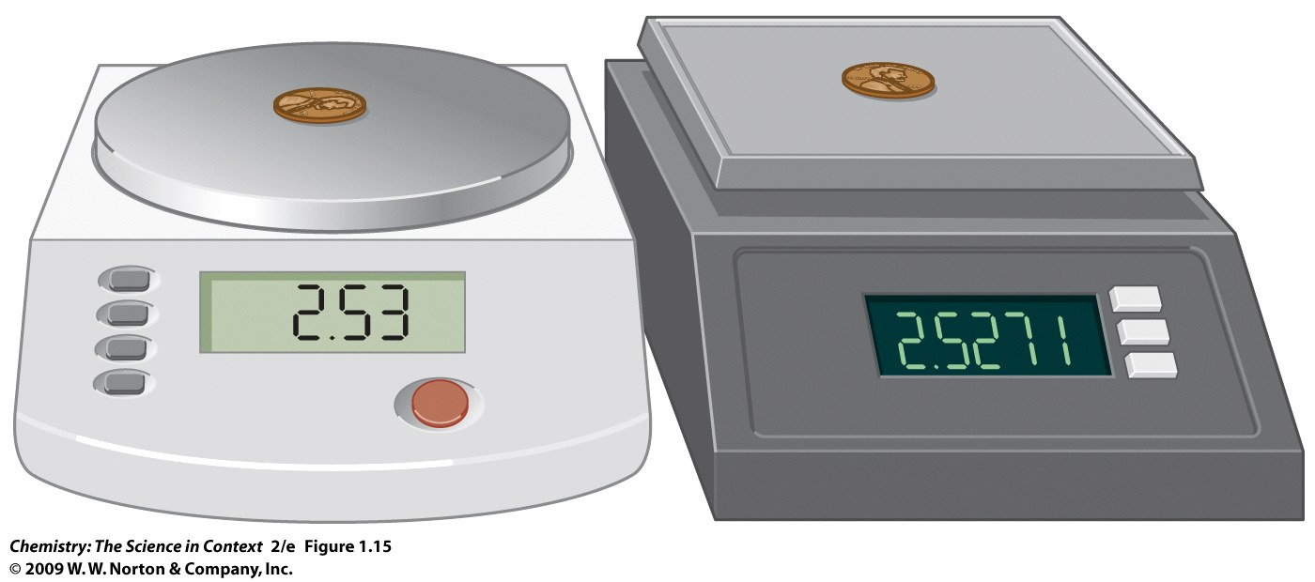
Which measurement has greater certainty?

Slide 27
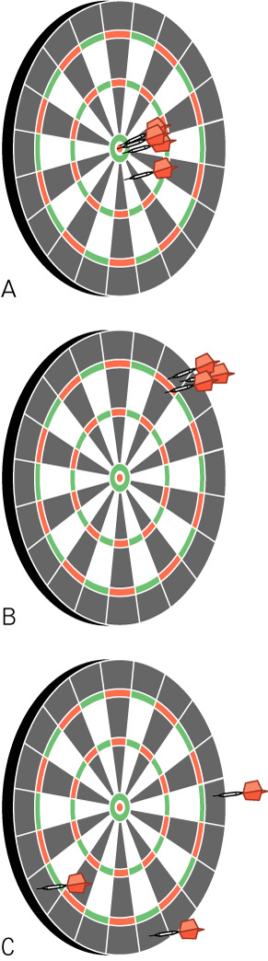
What is the difference between precision and accuracy?

Slide 28
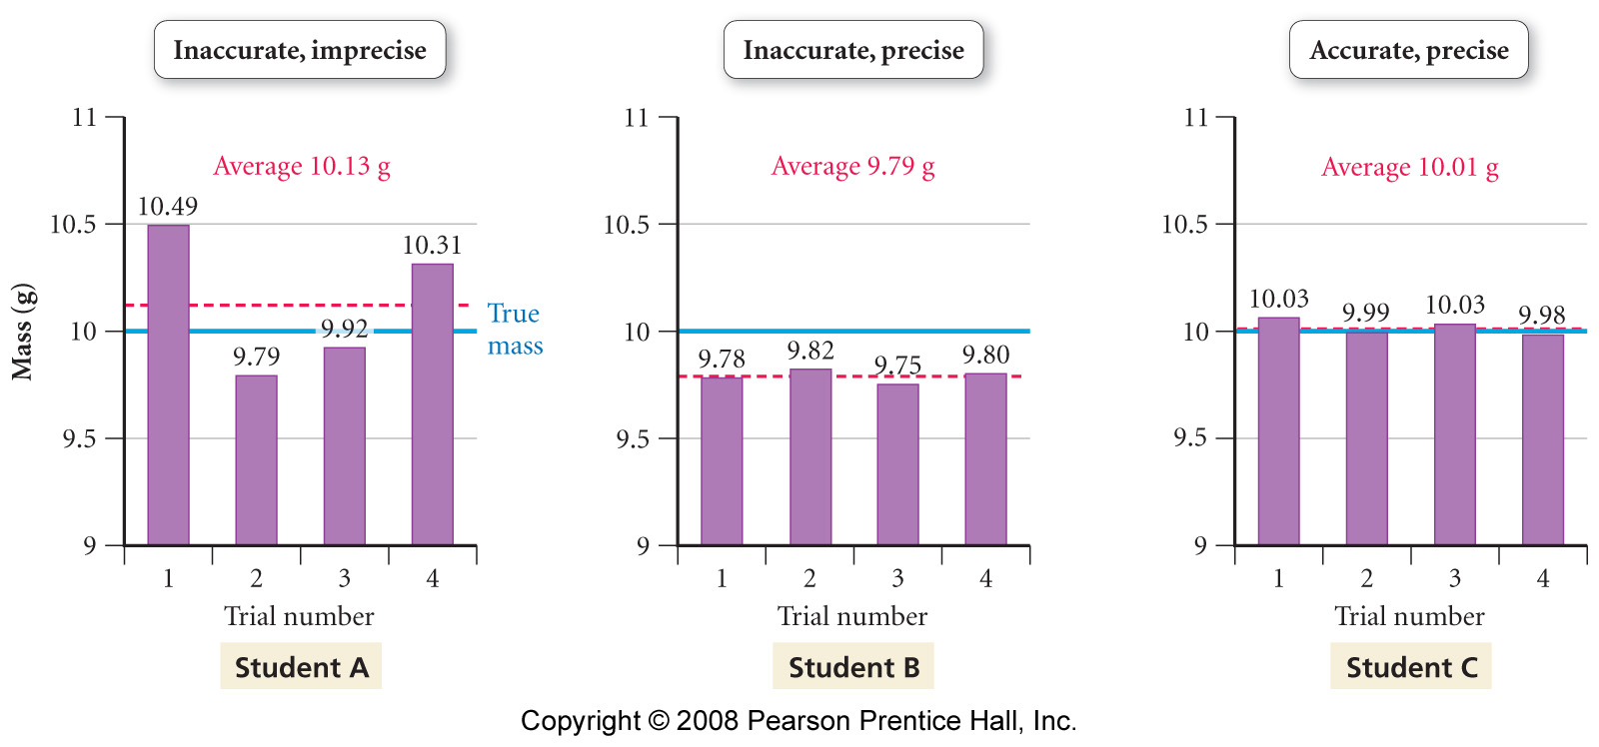
What is the difference between accuracy and precision?
Notes:
Figure: 01-14-08
Title:
Precision graphs
Caption:
Measurements are said to be precise if they are consistent with one another, but they are accurate only if they are close to the actual value.

Slide 29
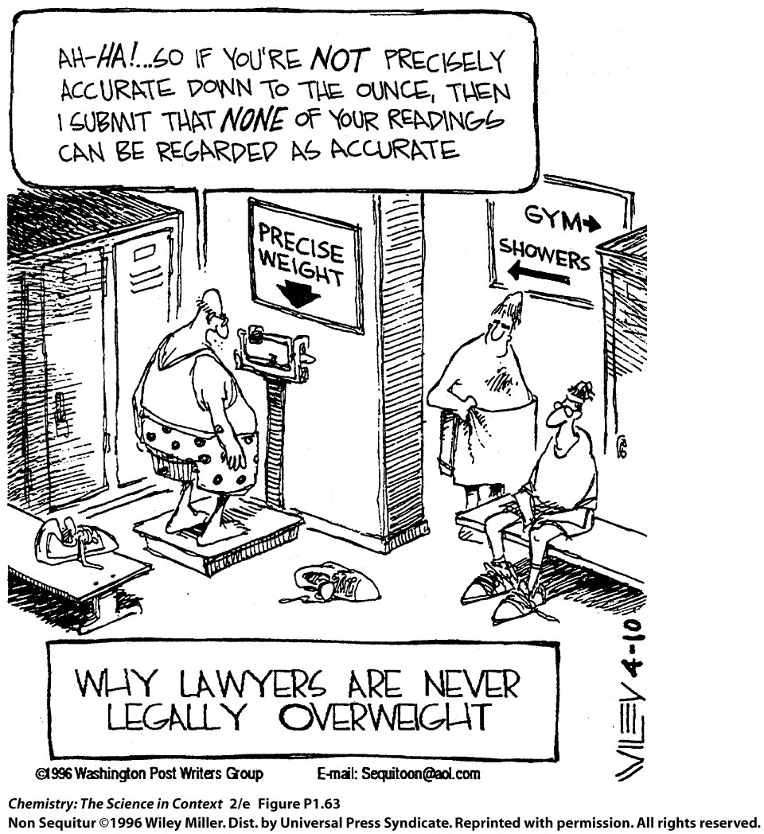

Slide 30
Analyze the following data:
Trial | Mass (g)
1 | 9.6
2 | 9.8
3 | 10.3
4 | 10.0
5 | 10.8
6 | 9.5
Calculate the average.
What is the median?
Calculate the deviation.

Slide 31
Analyze the following data:
Trial | Mass (g) | d (g)
1 | 9.6 | -0.4
2 | 9.8 | -0.2
3 | 10.3 | +0.3
4 | 10.0 | 0.0
5 | 10.8 | +0.8
6 | 9.5 | -0.5
Mean | 10.0
Calculate the average.
What is the median?
Calculate the deviation.
Calculate the deviation squared.

Slide 32
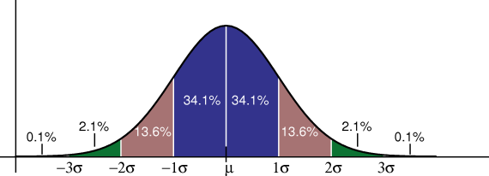
What does standard deviation show?

Slide 33
Analyze the following data:
Trial | Mass (g) | d (g) | (d)²
1 | 9.6 | -0.4 | .16
2 | 9.8 | -0.2 | .04
3 | 10.3 | +0.3 | .09
4 | 10.0 | 0.0 | .00
5 | 10.8 | +0.8 | .64
6 | 9.5 | -0.5 | .25
Sum |  | 0.0 | 1.18
Calculate the average.
What is the median?
Calculate the deviation.
Calculate the deviation squared.
Calculate the standard deviation.

Slide 34
What does a graph of the data look like?

Slide 35
Analyze the following data:
Trial | Mass (g)
1 | 9.6
2 | 9.8
3 | 10.3
4 | 10.0
5 | 10.8
6 | 9.5
Mean | 10.0
St. dev. | 0.5
Is the precision good, fair or poor?
 | low |  | high | #within
68% of values fall within |  | and
95% of values fall within |  | and
>99% of values fall within |  | and

Slide 36
What should the data fall within?

Slide 37
Where does the data fall?

Slide 38
Analyze the following data:
Trial | Mass (g)
1 | 9.6
2 | 9.8
3 | 10.3
4 | 10.0
5 | 10.8
6 | 9.5
Mean | 10.0
St. dev. | 0.5
Calculate the average.
What is the median?
Calculate the deviation.
Calculate the deviation squared.
Calculate the standard deviation.
Is the precision good, fair or poor?
If the true value is 9.85 g, what is the percent error?
Is the accuracy good, fair, or poor?

Slide 39
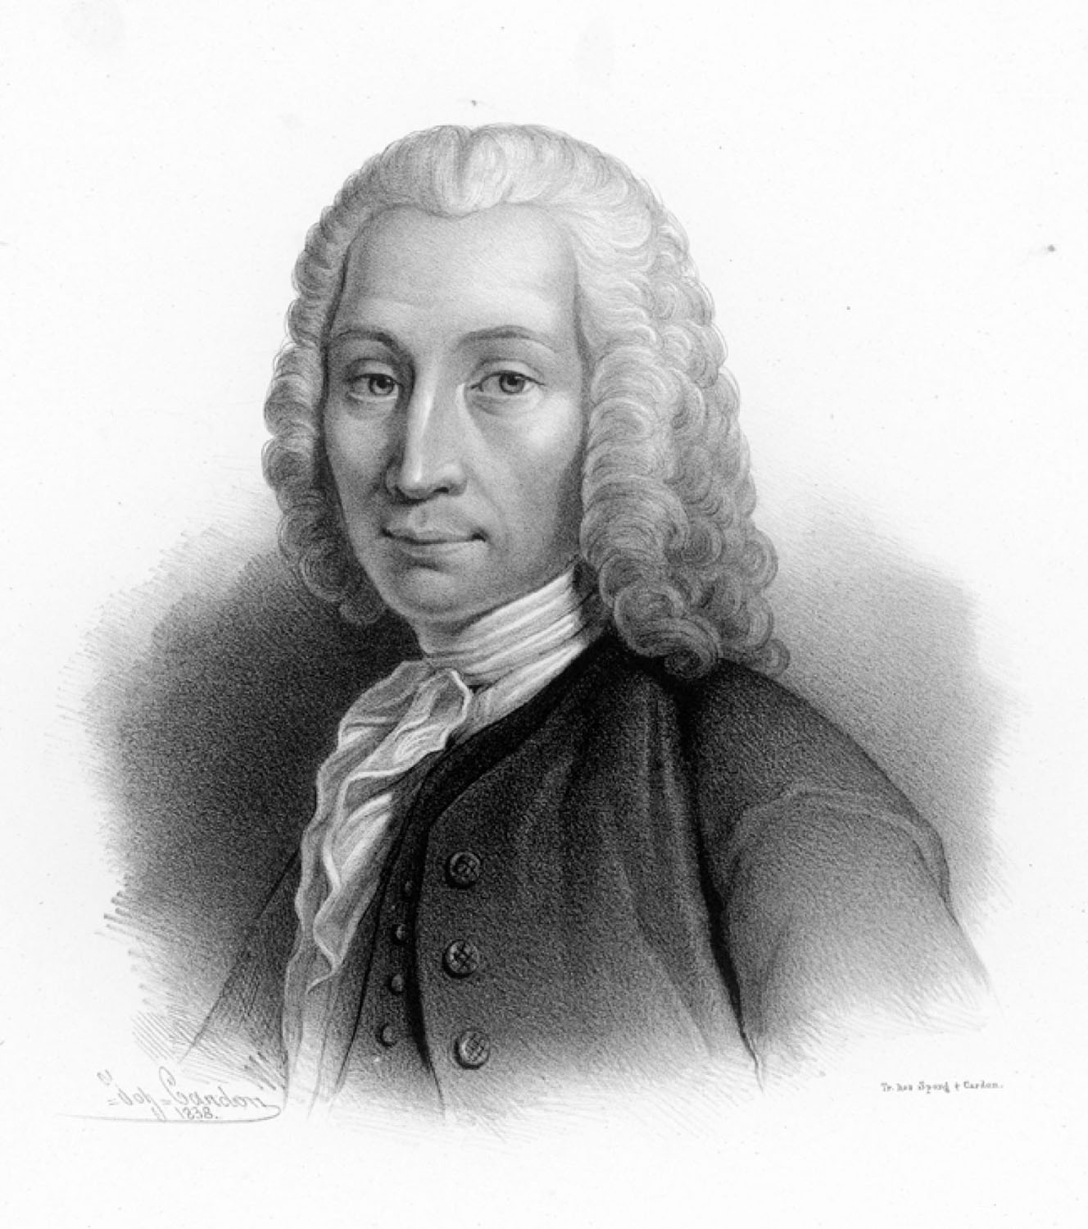
Anders Celsius
p79
Notes:
Anders Celsius (1701–1744), a Swedish scientist, first proposed setting the freezing point of water at 100° and the boiling point at 0°. The scale was reversed after his death.

Slide 40
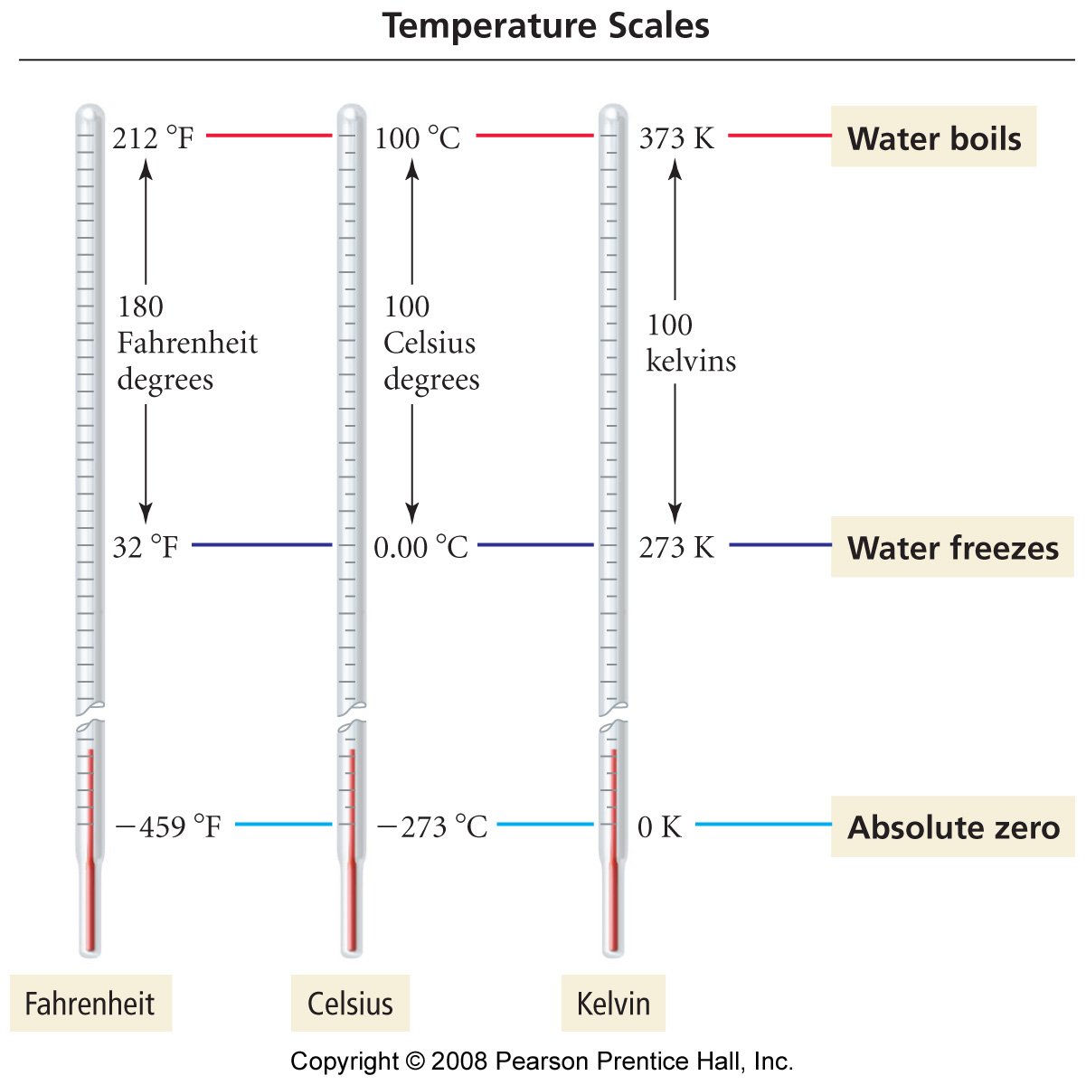
How do the temperature scales compare?
Notes:
Figure: 01-12
Title:
Comparison of the Fahrenheit, Celsius, and Kelvin Temperature Scales
Caption:
The Fahrenheit degree is five-ninths the size of the Celsius degree and the kelvin. The zero point of the Kelvin scale is absolute zero (the lowest possible temperature), whereas the zero point of the Celsius scale is the freezing point of water.

Slide 41
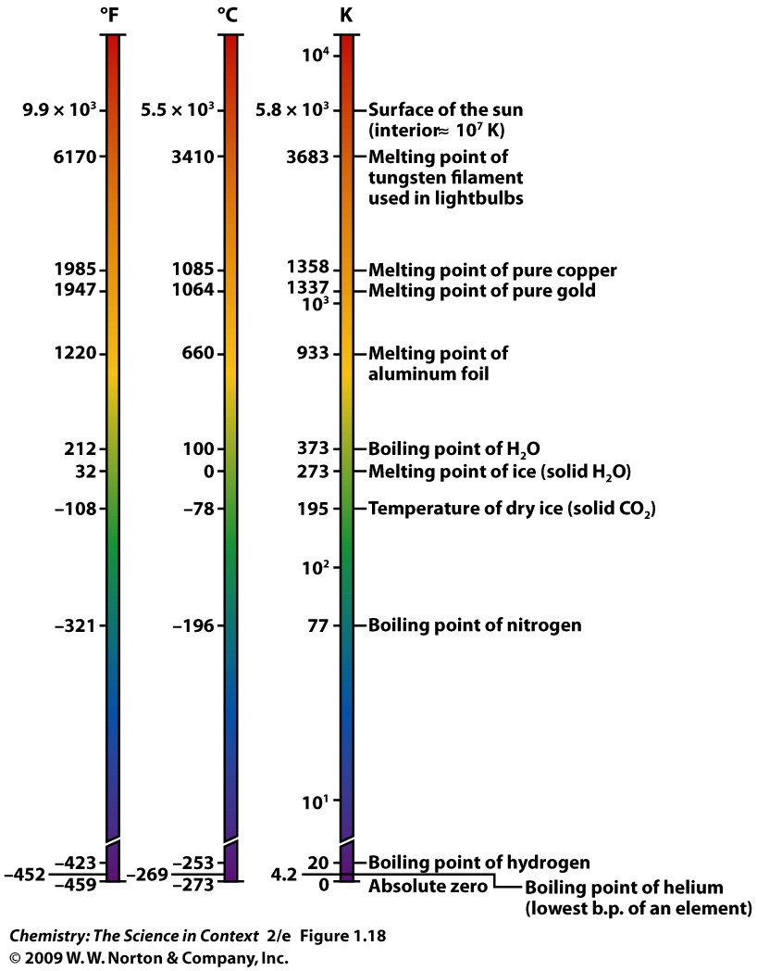

Slide 42
Example - Temperature
The temperature of interstellar space is 2.73 K. What is this temperature in degrees Celsius and degrees Fahrenheit?

Slide 43
Example - Temperature
Rankine is an absolute-temperature scale in which a measurement interval equals a Fahrenheit degree and 0 ˚F is equal to 459.67 ˚R, so that the freezing point of water is 491.67 ˚R. Derive a relationship between Rankine and Celsius.

Slide 44
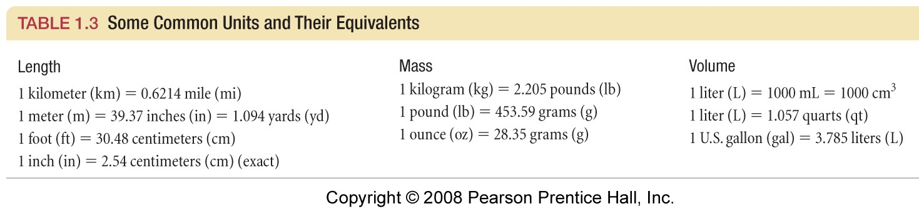
What are some conversions to know?

Slide 45
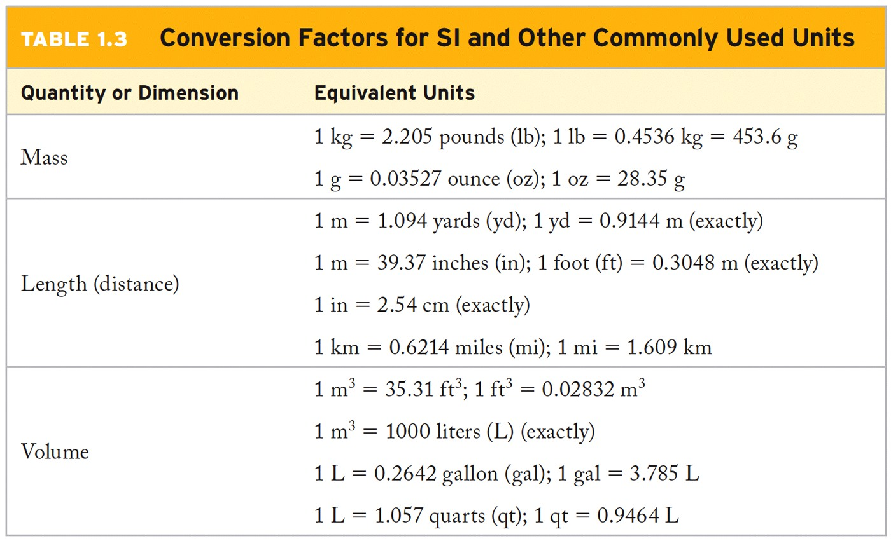
What are some conversions to know?

Slide 46
Example – Dimensional Analysis
A supplier packages hydrochloric acid in liters, but we need 2.00 quarts. What volume in liters corresponds to 2.00 qts?

Slide 47
Example – Dimensional Analysis
The diameter of a typical aerosol smog particle is 0.1 μm. Express this diameter in inches.

Slide 48
Example – Dimensional Analysis
A meter monitoring the supply of oxygen gas to an incubator recorded the volume of gas delivered as 25.4 in³. Convert this value to centimeters cubed.

Slide 49
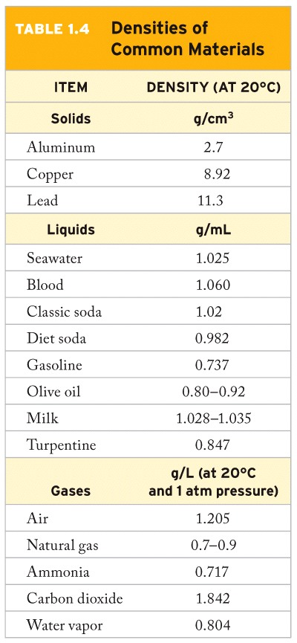

Slide 50
Example – Derived Units
Aspirin has a density of 1.40 g/cm³.
What is the volume in cm³ of a tablet weighing 500 lbs?
How many cubic feet is that?

Slide 51
Example – Derived Units
The concentration of gold in seawater is 0.011 μg/L. What is the mass of gold in kg in the Atlantic Ocean, which has a volume of 3.23 x 10¹¹ km³?

Slide 52
Example – Derived Units
The distance for a marathon is 26 miles and 385 yards. Convert this distance to kilometers. (1 mile = 1,760 yards)

Slide 53
Example – Derived Units
The “acre” (1 acre = 4,840 yd²) was originally the area of land a team of oxen could plow in one working day. What is the rate in m²/hr, if we assume that oxen can work for 8.0 hours in 1.0 days?

Slide 54
Example – Derived Units
The density of gold is 19.3 g/cm³. What volume of water will a gold nugget of mass 16.7 kg displace when placed in a graduated cylinder containing water? The density of water at room temperature is 1.00 g/cm³.

Slide 55
Example – Derived Units
The density of benzene at 20 °C is 0.88 g/mL. How many liters of benzene would you get if you bought a pound of benzene?

Slide 56
Example – Derived Units
Which is more dense lead (ρ = 11.34 g/cm³) or platinum (ρ = 0.3515 kg/in³)?

