Slide 1
Measuring Food Energy by Calorimetry
Chemistry 102 Lab

Slide 2
Objective
We did the Peanut Lab so that we could do an experiment to find the number of calories in a peanut. We made a calorimeter and out of a soda can, a metal rod, and a paper clip. We set the peanut on fire and measured the increase in heat so that we could tell how many calories were in the peanut

Slide 3
Heat is measured in joules or calories. The SI unit of energy is the joule (J). The unit calorie
is the amount of energy needed to raise the temperature of 1 g of water by 1 °C.
  4.184 joules (J) = 1 calorie (cal)
  1 kJ = 1000 J
  1 kilocalorie (kcal) = 1000 calories (cal)
On food labels, energy is shown as the nutritional Calorie, written with a capital C.
In countries other than the United States, energy is shown in kilojoules (kJ).
1 Cal = 1000 calories
1 Cal = 1 kcal

Slide 4
Calorimetry
The measurement of heat flow.
Heat flow depends on three things:
1. Mass of the object (m)
2. The temperature change (ΔT)
3. The material itself.

Slide 5
Specific heat equation
q = mc Δt
Q = energy
M = mass
C = heat capacity (1cal/g°C)
T = temperature
Specific heat capacity is the amount of heat required to raise the temperature of a (specific) substance by one degree Celsius.

Slide 6
Endothermic/ Exothermic Reactions
Reaction Energy Heat Sign of
Type Change in Reaction ΔH
Endothermic Heat absorbed Reactant side +
Exothermic Heat released Product side –

Slide 7
Energy in food
Whether outside the body or inside the body, when oxygen reacts with molecules producing carbon dioxide, water, and energy, the process is called combustion.
Even though our cells combust the molecules differently, the calorimeter provides an accurate caloric value because the end products of the two reactions are the same.
The food we eat contains different amounts of energy.

Slide 8
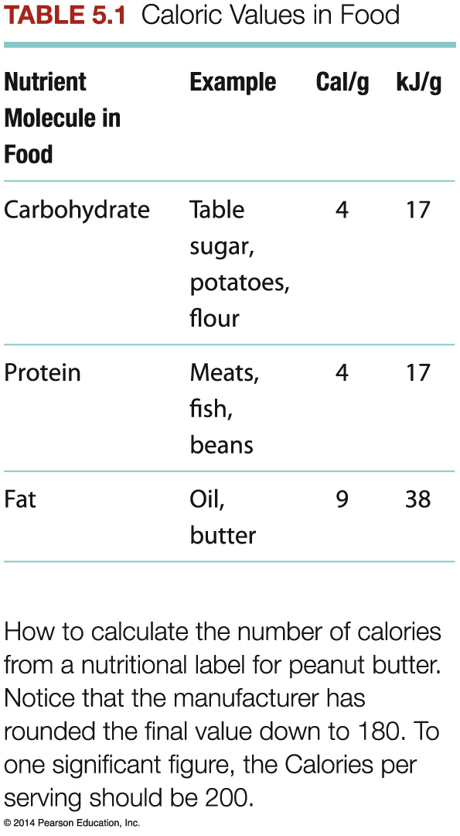

Slide 9
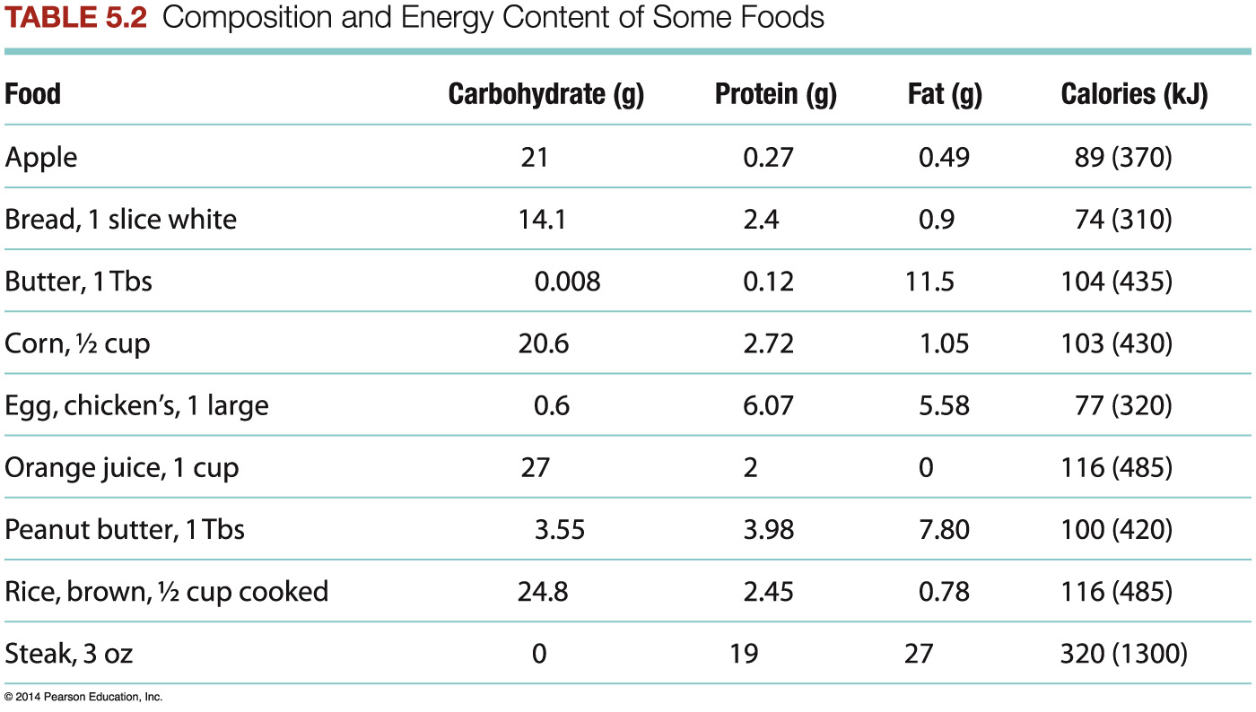

Slide 10
Procedure
Use a graduated cylinder to measure 200.0 mL of tap water into the can; water should be close to room temperature. Record the amount of water on your data sheet. Cover the calorimeter and insert thermometer into the can. Record the initial temperature of water.
Weigh a whole peanut and record its mass and type on the data sheet.
Ignite the peanut with a match. As soon as peanut begins to burn, position it underneath the can.
As soon as peanut stops burning, carefully swirl the water in the can and record its temperature immediately.
Allow peanut to cool then weigh the residue on the balance.
Repeat all steps using the same brand of peanut. You may need to run a third trial to improve your technique.

Slide 11
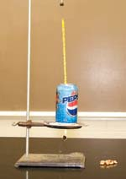
Set-up

