Slide 1
Equivalents and Milliequivalent

Slide 2
Electrolytes in Body Fluids: Equivalents and Milliequivalents
What happens if NaCl and KBr are dissolved in the same solution? The cations and anions are all mixed together so an identical solution could just as well be made from KCl and NaBr. We can only speak of having a solution with four different ions in it.
A similar situation exists for blood and other body fluids, which contain many different anions and cations. Since they are all mixed together, it is difficult to talk about specific ionic compounds.
Instead, we are interested only in individual ions and in the total numbers of positive and negative charges. We need a new term, equivalents of ions.

Slide 3
Equivalents
An equivalent (Eq) is the amount of an electrolyte or an ion that provides 1 mole of electrical charge (+ or –).
1 mole Na⁺ = 1 Eq
1 mole Cl⁻ = 1 Eq
1 mole Ca²⁺ = 2 Eq
1 mole Fe³⁺ = 3 Eq

Slide 4
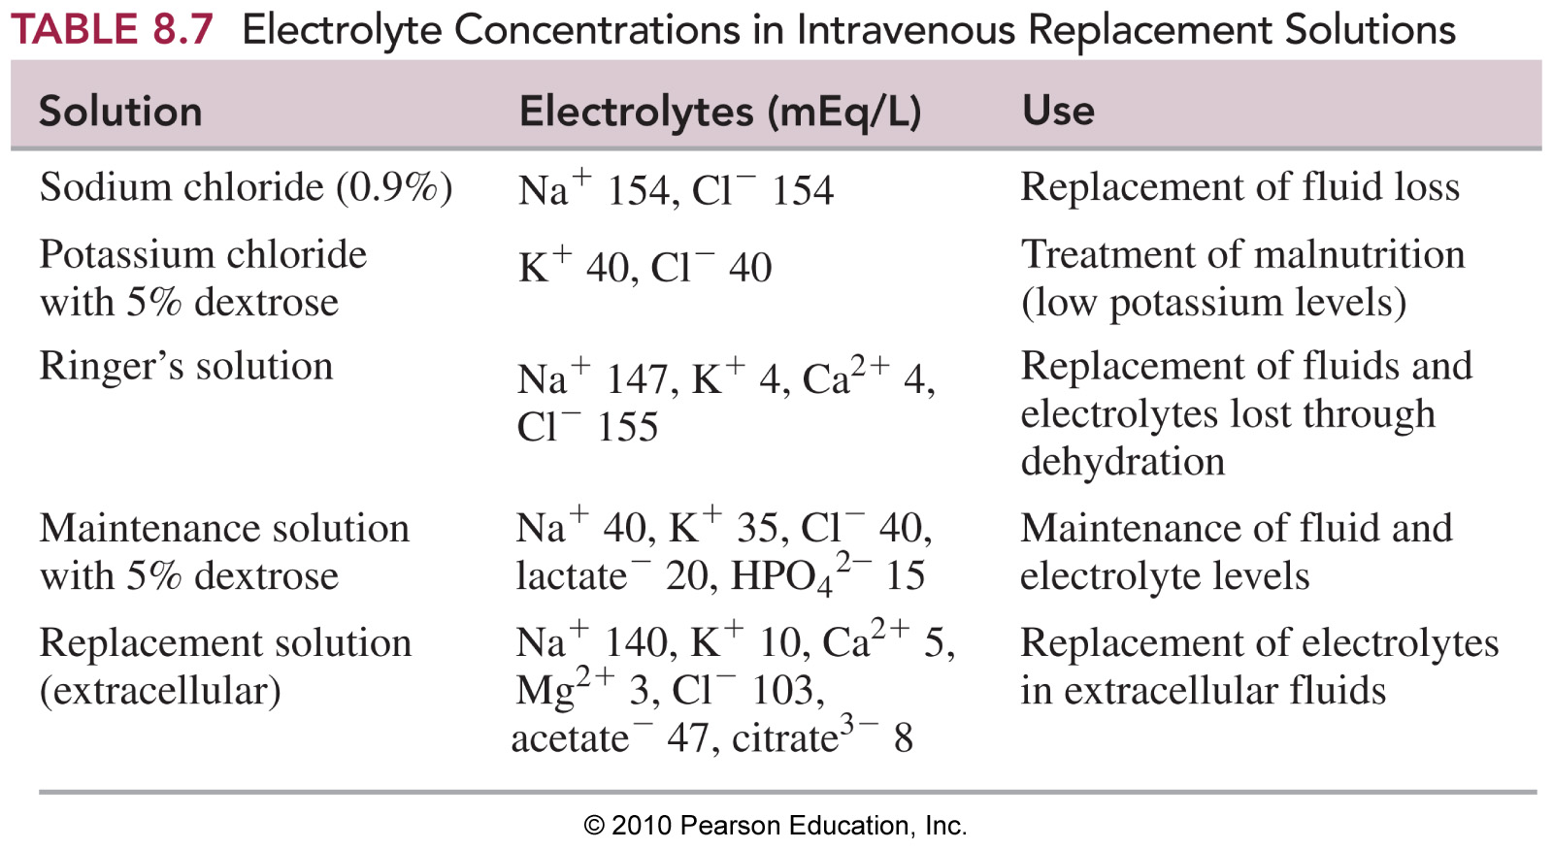
Electrolytes in IV Solutions

Slide 5
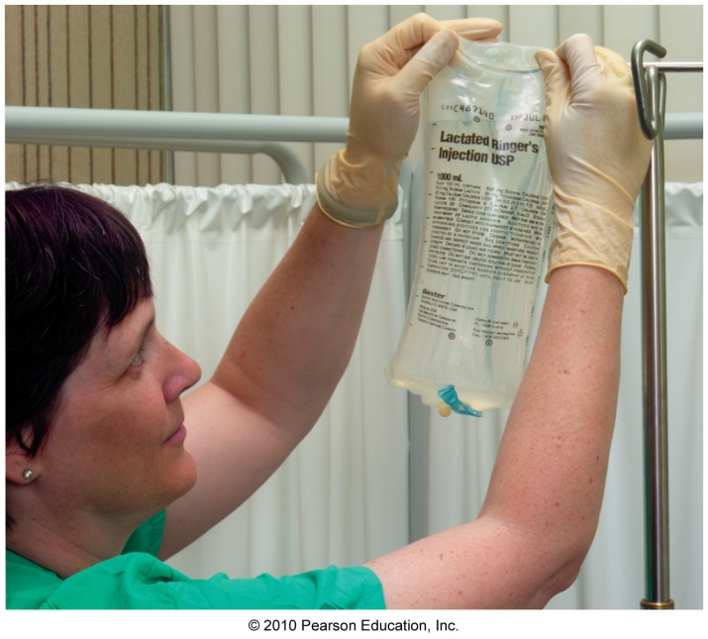
Electrolytes in Body Fluids
In replacement solutions for body
fluids, the electrolytes are given in
milliequivalents/L (mEq/L).
Ringer’s Solution
Cations Anion_____
Na⁺ 147 mEq/L Cl⁻ 155 mEq/L
K⁺ 4 mEq/L
Ca²⁺ 4 mEq/L
155 mEq/L = 155 mEq/L

Slide 6
Practice
A. In 1 mole of Fe³⁺, there are
1) 1 Eq 2) 2 Eq 3) 3 Eq
B. In 2.5 mole of SO₄²⁻, there are
1) 2.5 Eq 2) 5.0 Eq 3) 1.0 Eq
C. An IV bottle contains only NaCl. If the Na⁺ is
34 mEq/L, the Cl⁻ is
1) 34 mEq/L 2) 0 mEq/L 3) 68 mEq/L

Slide 7
Solution
A. In 1 mole of Fe³⁺, there are
3) 3 Eq
B. In 2.5 mole of SO₄²⁻, there are
2) 5.0 Eq
2.5 moles SO₄²⁻ x 2 Eq = 5.0 Eq of SO₄²⁻
1 mole SO₄²⁻
C. An IV bottle contains only NaCl. If the Na⁺ is
34 mEq/L, the Cl⁻ is
1) 34 mEq/L

Slide 8
One equivalent (Eq) of an ion is an amount equal to the molar mass of the ion divided by the number of its charges:
1 milliequivalent (mEq) = 0.001 equivalent (Eq)
1 Eq = 1000 mEq

Slide 9

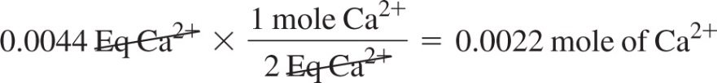
Sample Problem 7.2 Electrolyte Concentration
The laboratory tests for a patient indicate a blood calcium level of 8.8 mEq/L.
a. How many moles of calcium ion are in 0.50 L of blood?
b. If chloride ion is the only other ion present, what is its concentration in mEq/L?
Solution
  a. Using the volume and the electrolyte concentration in mEq/L, we can find the number of equivalents in 0.50 L of blood.
We can then convert equivalents to moles (for Ca²⁺ there are 2 Eq per mole).
b. If the concentration of Ca²⁺ is 8.8 mEq/L, then the concentration of Cl– must be 8.8 mEq/L to balance the charge.
Study Check 7.2
A Ringer’s solution for intravenous fluid replacement contains 155 mEq of Cl– per liter of solution. If a patient receives 1250 mL of Ringer’s solution, how many moles of chloride ion were given?

