Slide 1
Chapter 6 Carbohydrates—Life’s Sweet Molecules
Classes of Carbohydrates
Functional Groups in Monosaccharides
Stereochemistry in Monosaccharides
Reactions of Monosaccharides
Disaccharides
Polysaccharides

Slide 2
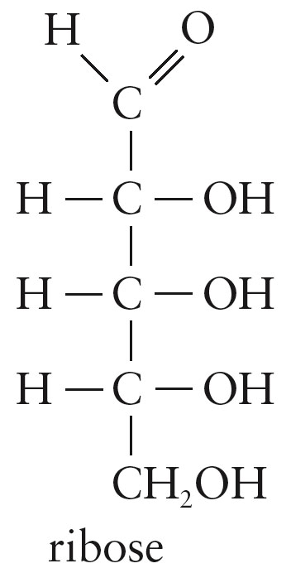
Carbohydrates
Carbohydrate: A polyhydroxyaldehyde or polyhydroxyketone, or a substance that gives these compounds on hydrolysis.
Molecular formula (CH₂O)_{n}

Slide 3
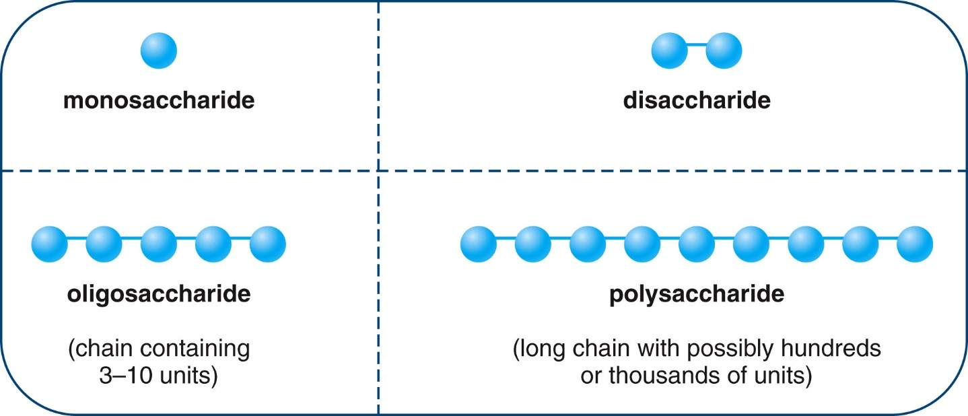
Classes of Carbohydrates
Carbohydrates are classified according to size:
Monosaccharide – a single polyhydroxy aldehyde or ketone unit
Disaccharide – composed of two monosaccharide units
Polysaccharide – very long chains of linked monosaccharide units

Slide 4
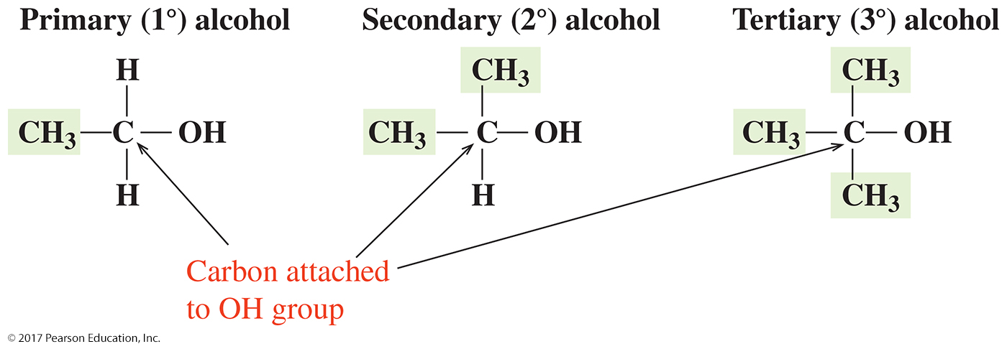
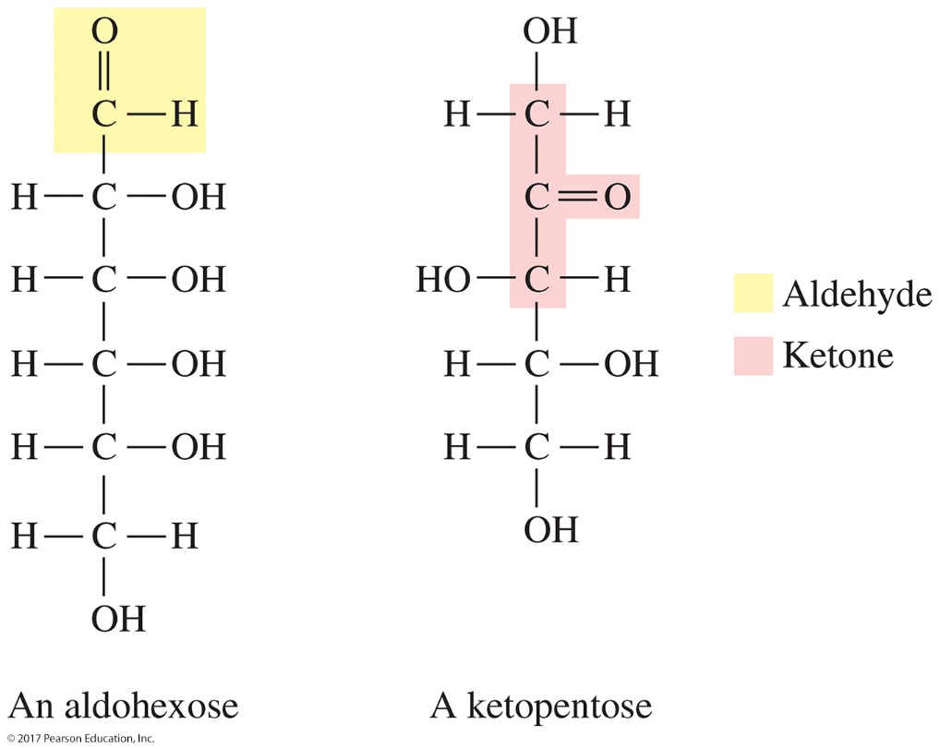
Functional Groups in Monosaccharides
Aldose: A monosaccharide containing an aldehyde group.
Ketose: A monosaccharide containing a ketone group.

Slide 5
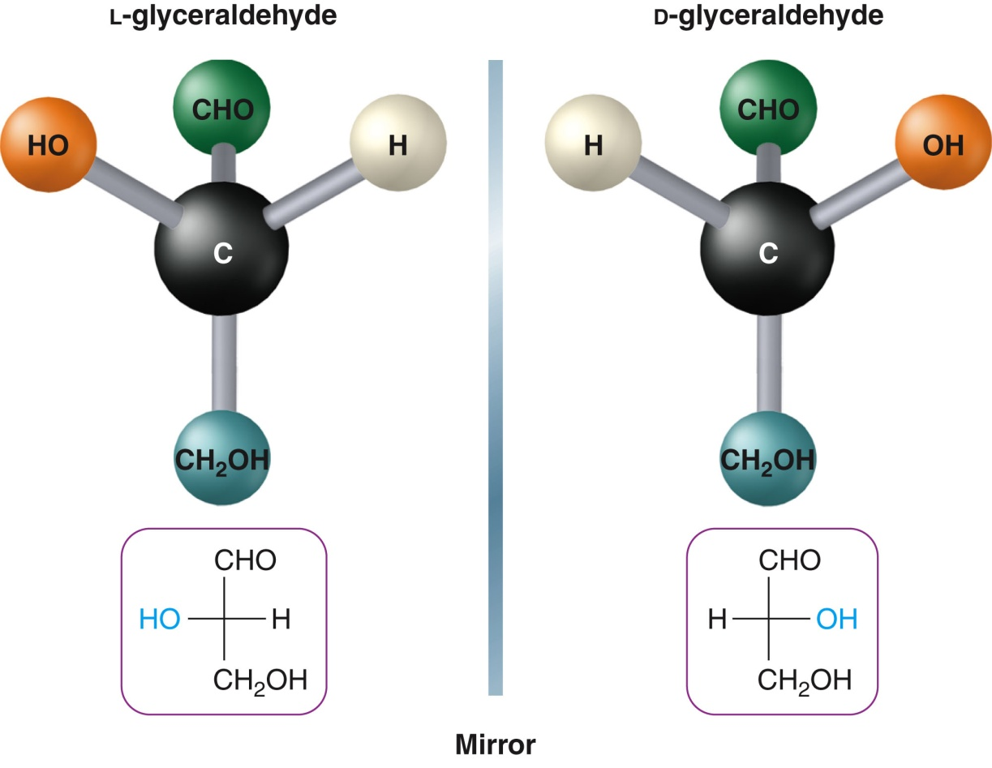
FISCHER PROJECTIONS
Fischer projections depict three-dimensional shapes for chiral molecules, with the chiral carbon represented by the intersection of two lines.

Slide 6
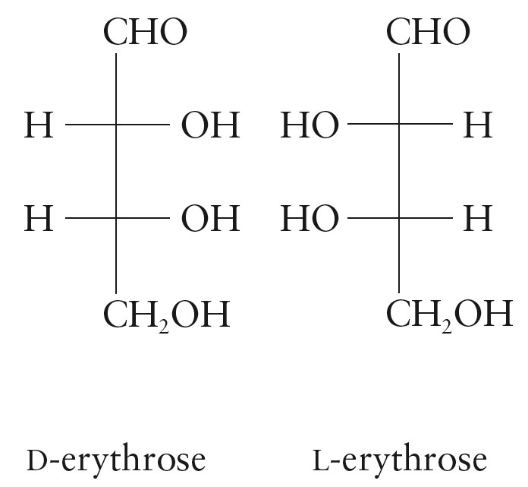
FISCHER PROJECTIONS (continued)
Fischer projections of carbohydrates have the carbonyl (C=O) at the top. It is projecting away from the viewer behind the plane in which it is drawn as is the other vertical bond at the bottom of the image.
The hydroxyl group on the chiral carbon farthest from the C=O group determines whether the carbohydrate is D (OH on right) or L (OH on left). The two horizontal bonds are coming toward the viewer out of the plane in which they are drawn.

Slide 7
For each of the following molecules, indicate if it is D- or L- and
classify it according the number of carbons and whether it is an
aldose or a ketose.

Slide 8
Draw the fisher projection structures for D-glucose and D-fructose

Slide 9
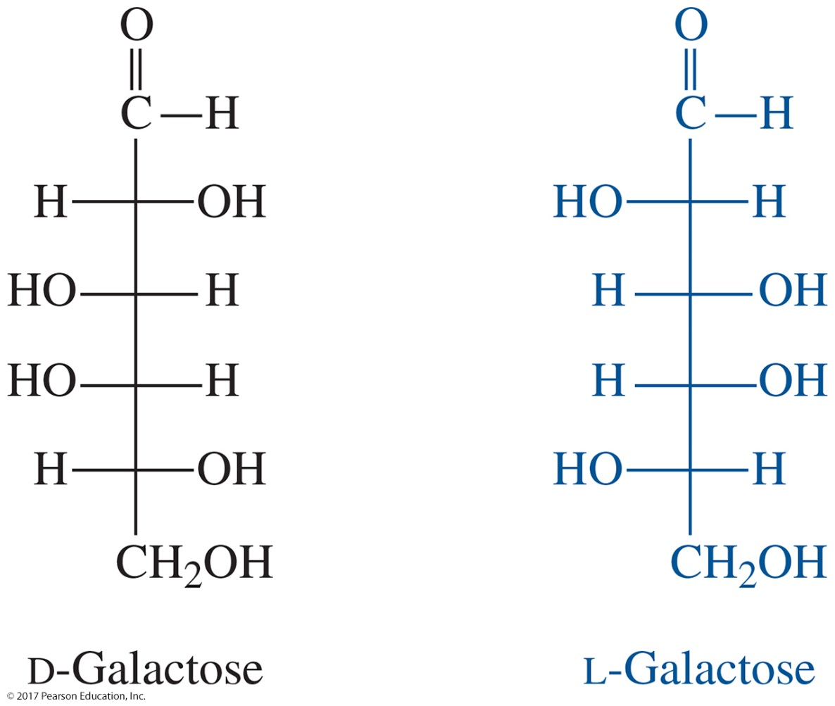
Stereochemistry in Monosaccharides
Drawing an Enantiomer in a Fischer Projection
STEP 1 Locate the chiral centers.
STEP 2 Switch horizontal groups on the chiral centers.

Slide 10
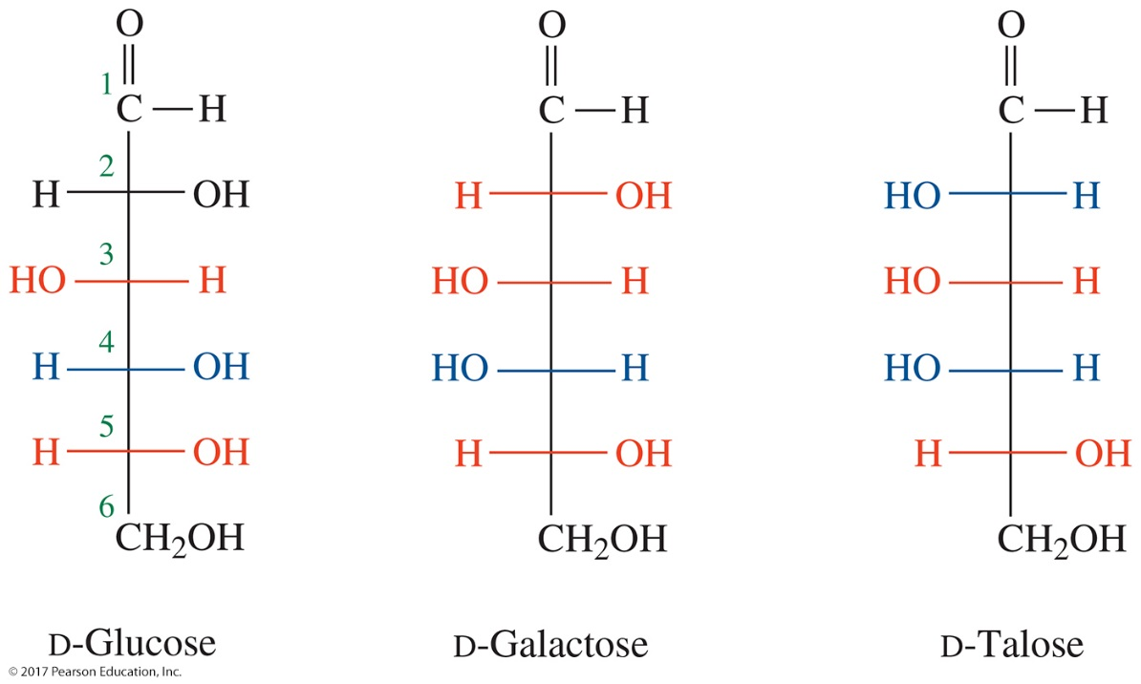
Stereochemistry in Monosaccharides
Stereoisomers That Are Not Enantiomers
Stereoisomers that are not enantiomers are called diastereomers.
Diastereomers are stereoisomers that are not exact mirror images.

Slide 11
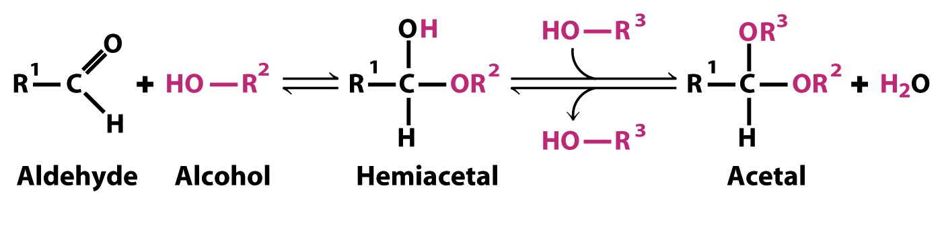
Hemiacetals and Hemiketals
Notes:
11
FIGURE 7-5 Formation of hemiacetals and hemiketals. An aldehyde or ketone can react with an alcohol in a 1:1 ratio to yield a hemiacetal or hemiketal, respectively, creating a new chiral center at the carbonyl carbon. Substitution of a second alcohol molecule produces an acetal or ketal. When the second alcohol is part of another sugar molecule, the bond produced is a glycosidic bond (p. 243).

Slide 12
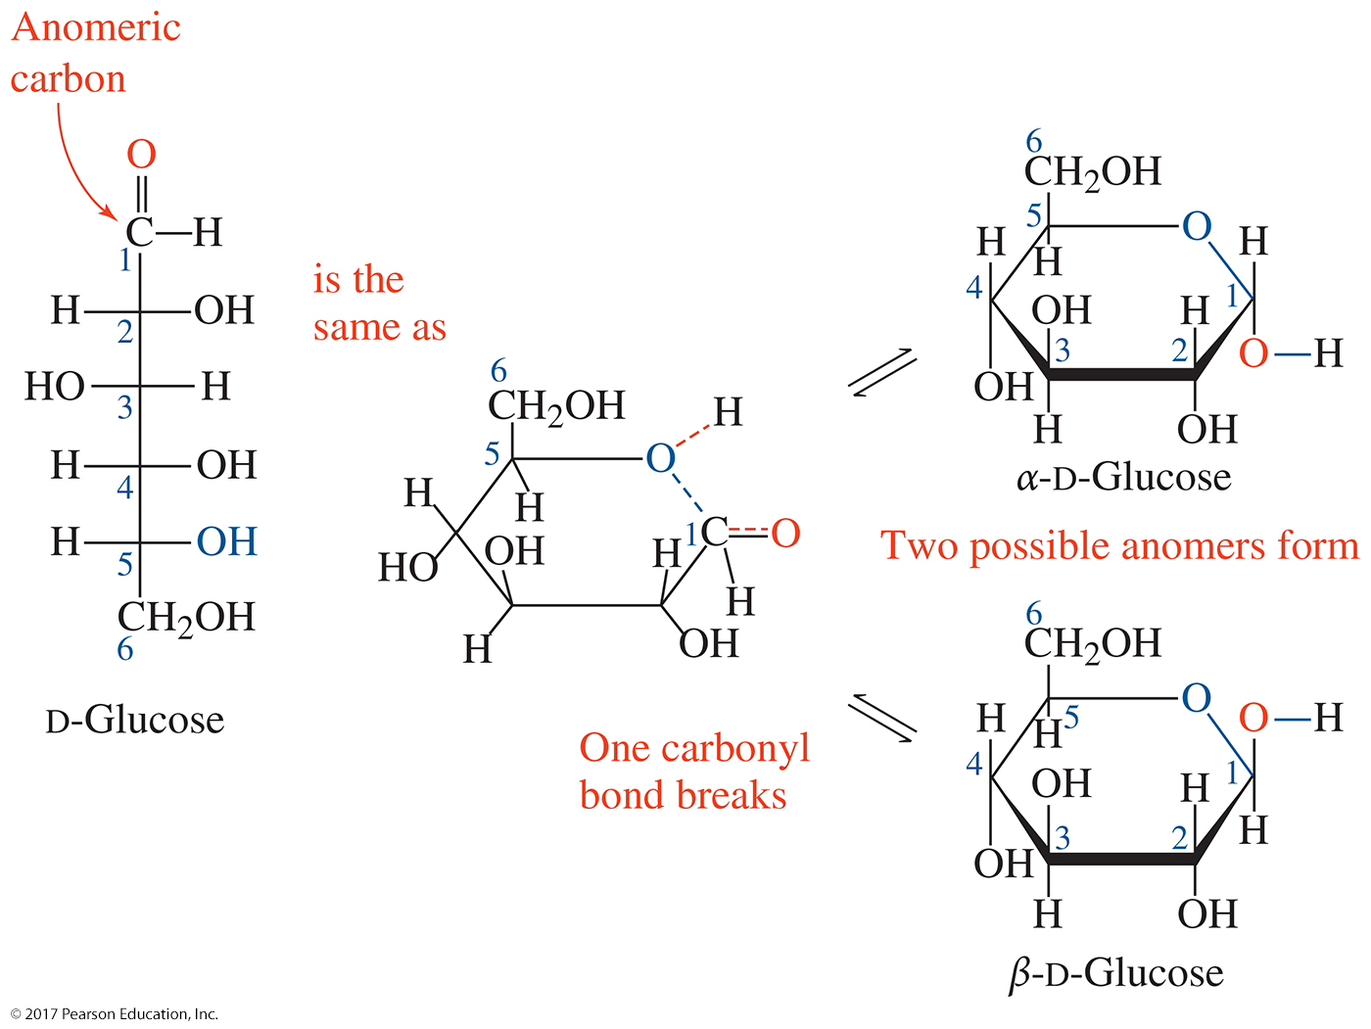
Reactions of Monosaccharides
Monosaccharides exist in a ring form most of the time because the carbonyl group reacts readily with a hydroxyl to form this hemiacetal ring.

Slide 13
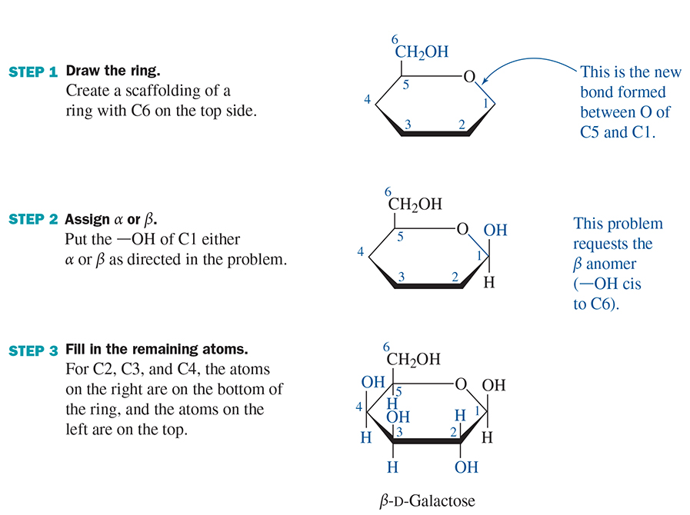
6.4 Reactions of Monosaccharides
Drawing Pyranose Rings—Steps I, 2, and 3

Slide 14
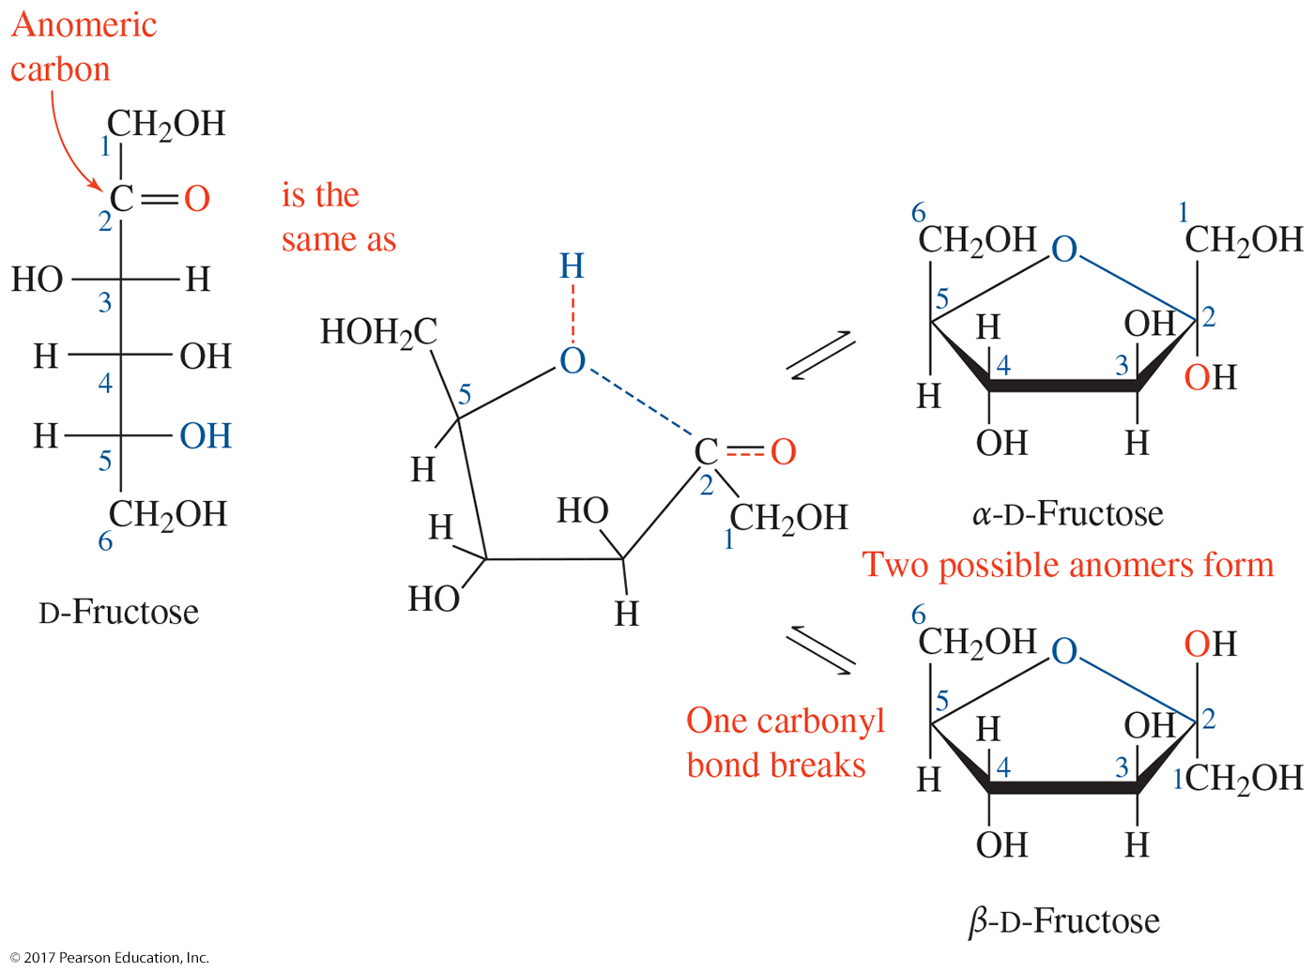
6.4 Reactions of Monosaccharides

Slide 15
The Fischer projections for D-ribose and D-mannose are shown
below and draw α -D-ribofuranose and ß-D-mannopyranose.

Slide 16
For the following carbohydrate molecules, circle and identify the
hemi-carbon, label it as hemi-acetal or hemi-ketal and label them
as α or β.

Slide 17
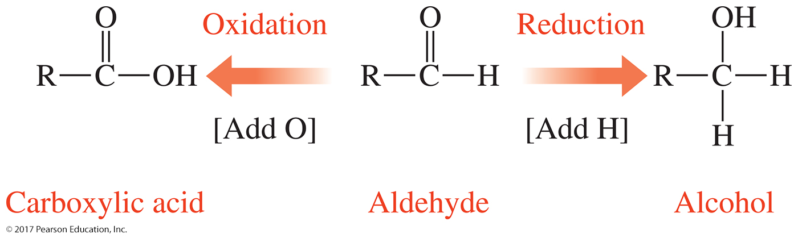
Reactions of Monosaccharides
The carbonyl group in aldoses can also undergo organic oxidation and reduction.
In monosaccharides, oxidation produces sugar acid and reduction produces sugar alcohol.

Slide 18
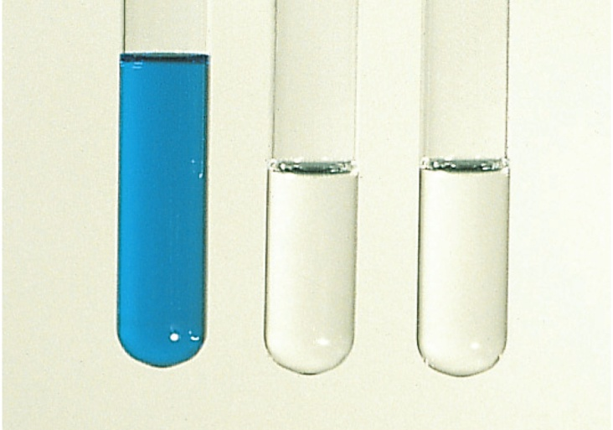
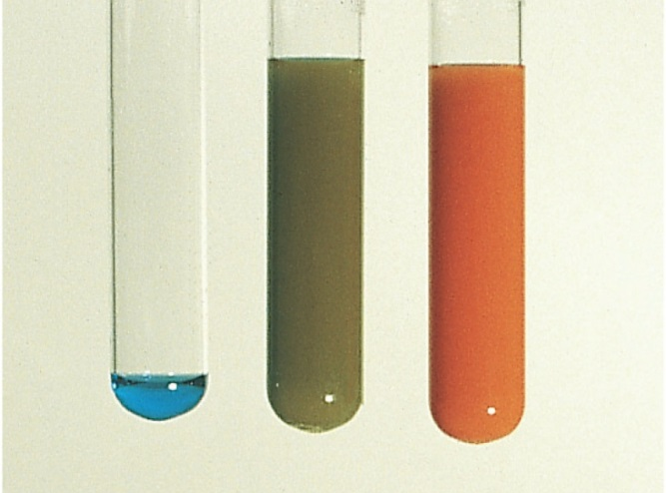
MONOSACCHARIDE REACTIONS (continued)
A reducing sugar can be easily oxidized.
All monosaccharides are reducing sugars (even fructose, since it has an adjacent OH).
Benedict’s reagent tests for reducing sugars:
Reducing sugar + Cu²⁺ → oxidized compound + Cu₂O
blue
orange-red precipitate
From left to right, three test tubes
containing Benedict’s reagent, 0.5%
glucose solution, and 2.0% glucose
solution
The addition of Benedict’s reagent
produces colors (due to the red Cu₂O)
that indicate the amount of glucose
present.

Slide 19
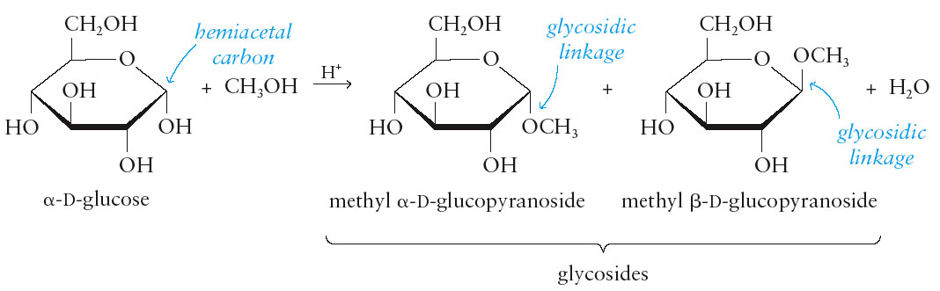
MONOSACCHARIDE REACTIONS (continued)
Cyclic monosaccharide hemiacetals and hemiketals react with alcohols to form acetals and ketals, referred to as glycosides.
The new carbon-oxygen-carbon linkage that joins the components of the glycoside is called a glycosidic linkage.
Glycosides do not exhibit open-chain forms.
Glycosides are not reducing sugars.

Slide 20
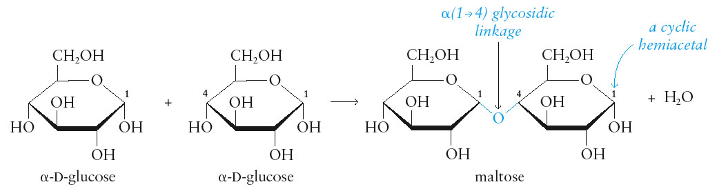
DISACCHARIDES
Disaccharides are two monosaccharide units linked together by acetal or ketal glycosidic linkages.
A glycosidic linkage is identified by:
the numbers associated with the carbon atoms joined together by the linkage.
the configuration of the linkage for any anomeric carbon atom joined by the linkage.

Slide 21
Draw the following disaccharides:
glucose-glucose in an α 1,6 linkage
glucose-glucose in a β 1,4 linkage
glucose-fructose in an α- 1-β-2 linkage

Slide 22
What type of glycoside linkage (β 1-3, α1-4, etc.) is present in each of
the following disaccharides? Indicate which of the following disaccharides is
a reducing sugar.

Slide 23
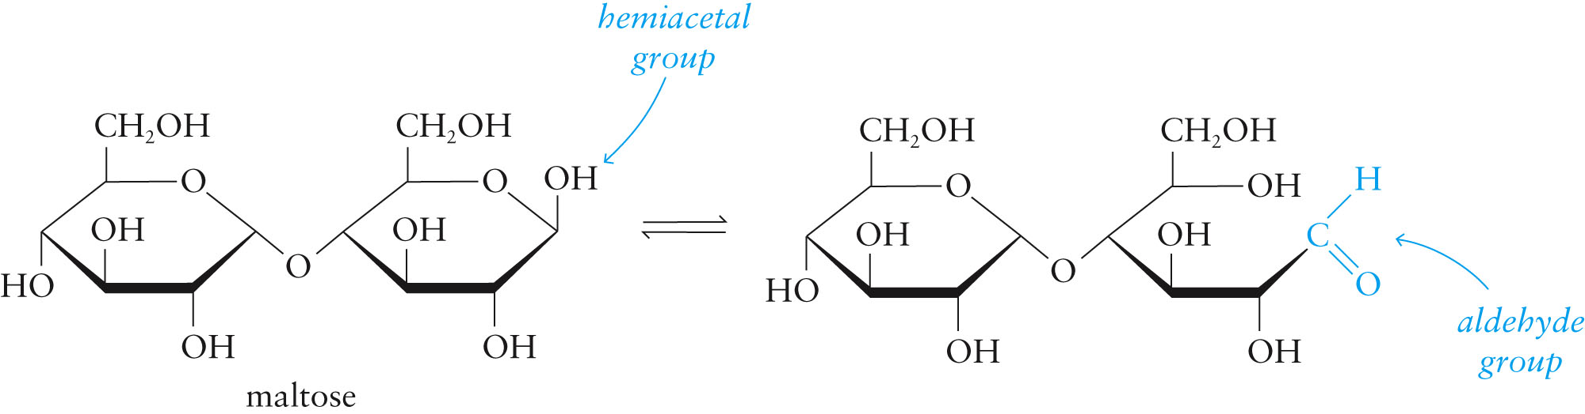
IMPORTANT DISACCHARIDES
Maltose is:
malt sugar.
two glucose units joined by α(1→4) glycosidic linkage.
formed during the digestion of starch to glucose.
found in germinating grain.
a hemiacetal, which means maltose is a reducing sugar.
hydrolyzed to form two molecules of D-glucose.

Slide 24
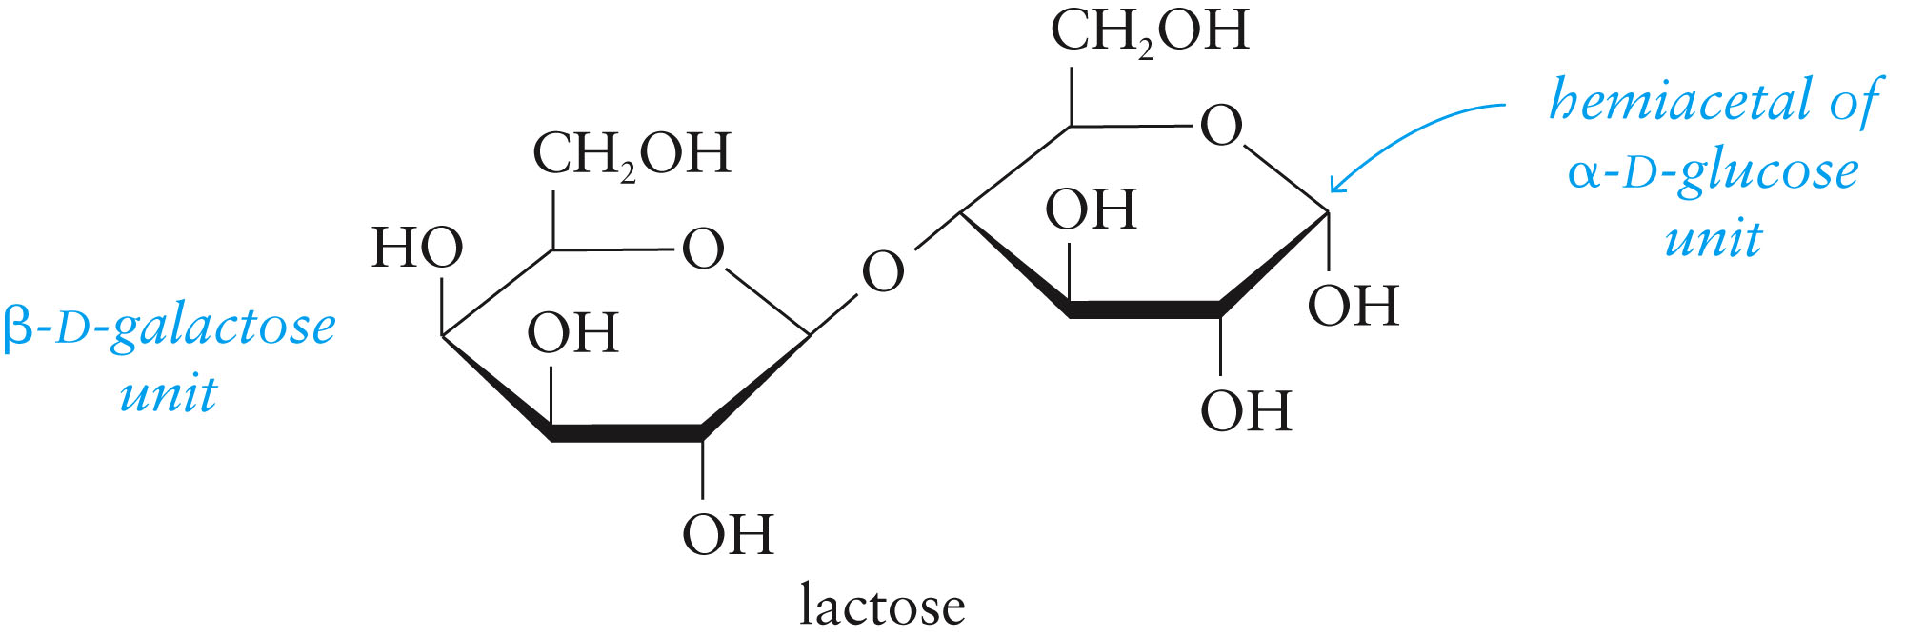
IMPORTANT DISACCHARIDES (continued)
Lactose is:
milk sugar (5% cow milk, 7% human milk by weight).
composed of galactose and glucose units joined by β(1→4) glycosidic linkage.
a hemiacetal, which means lactose is a reducing sugar.
β(1→4)

Slide 25
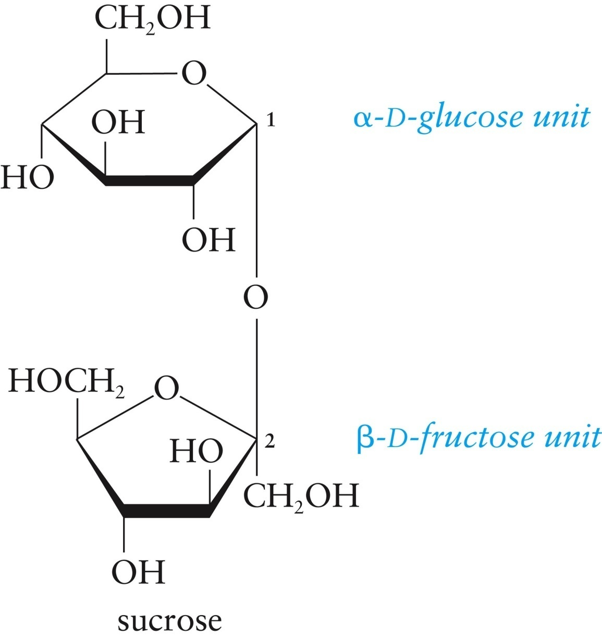
IMPORTANT DISACCHARIDES (continued)
Sucrose is:
common household sugar.
composed of fructose and glucose units joined by α1→β2 glycosidic linkage.
found in many plants (especially sugar cane and sugar beets).
not a reducing sugar.
hydrolyzed to produce invert sugar (a mixture of equal amounts glucose and fructose).
α 1→ β 2

Slide 26
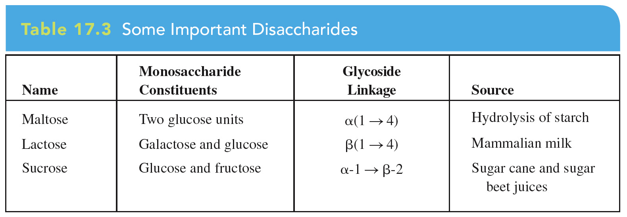
IMPORTANT DISACCHARIDES (continued)

Slide 27
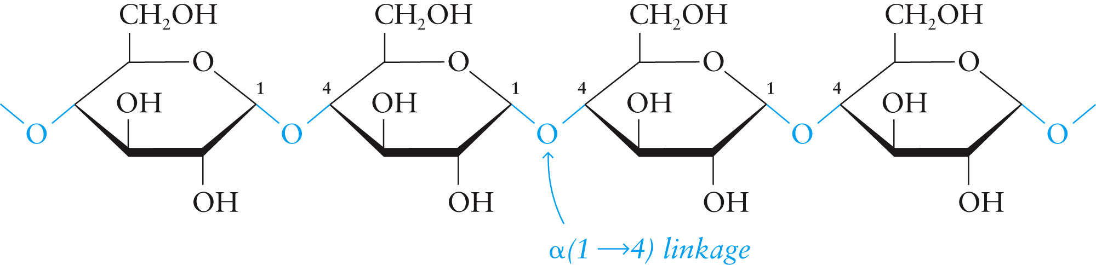
IMPORTANT POLYSACCHARIDES
Starch is:
a polymer consisting of glucose units.
a major storage form of D-glucose in plants.
one of two forms, which are:
unbranched amylose (10-20%), which is composed of 1000-2000 glucose units with α(1→4) glycosidic linkages;

Slide 28
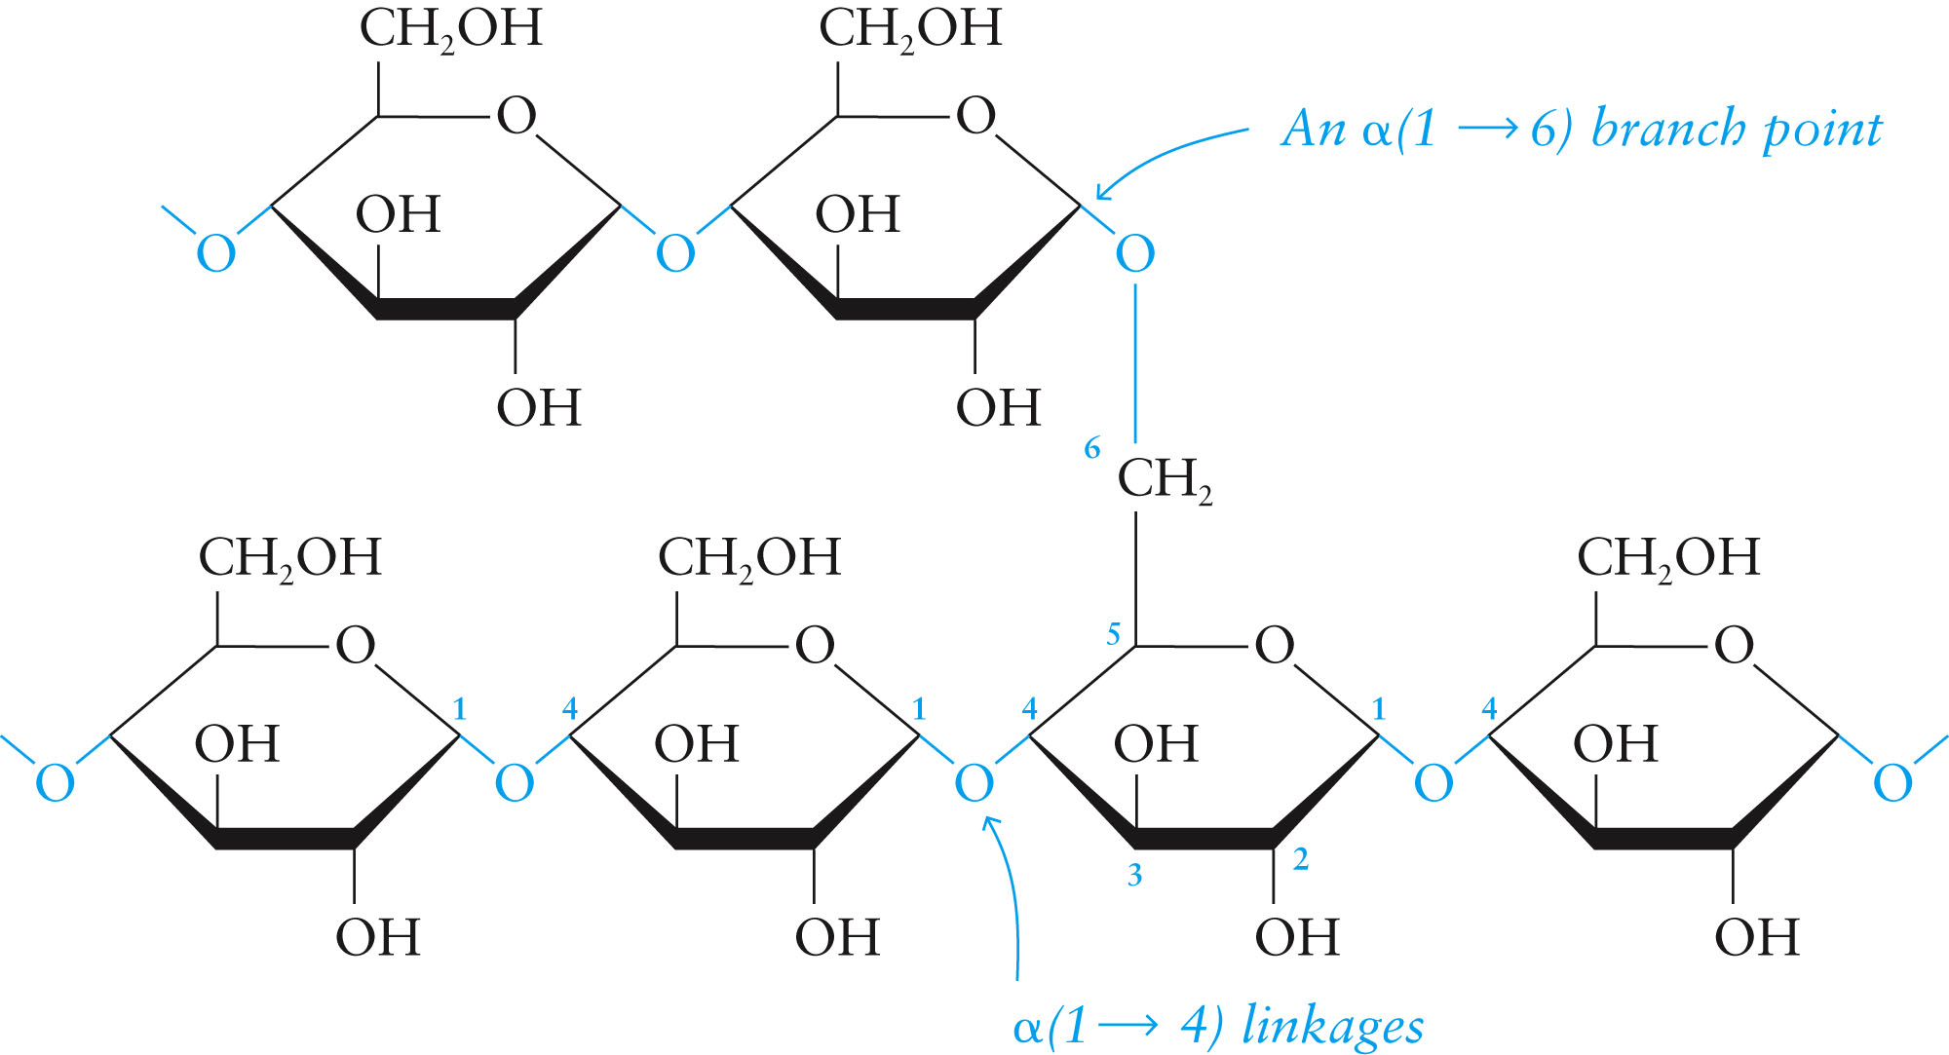
IMPORTANT POLYSACCHARIDES (continued)
and branched amylopectin (80-90%) with α(1→4) and α(1→6) glycosidic linkages.

Slide 29
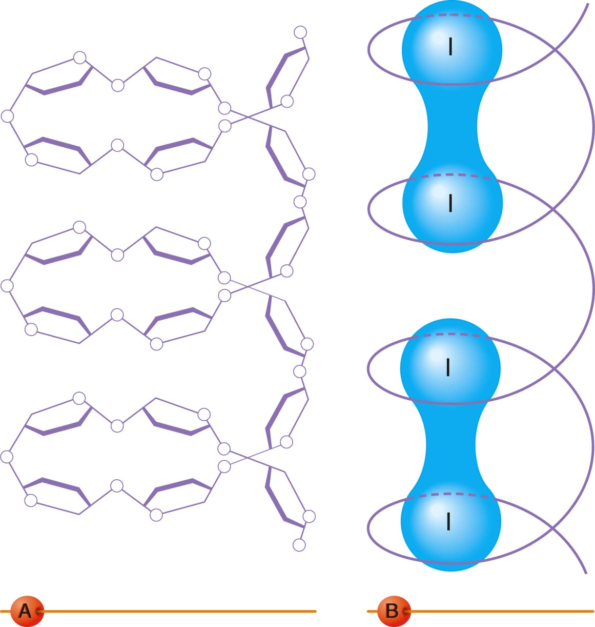
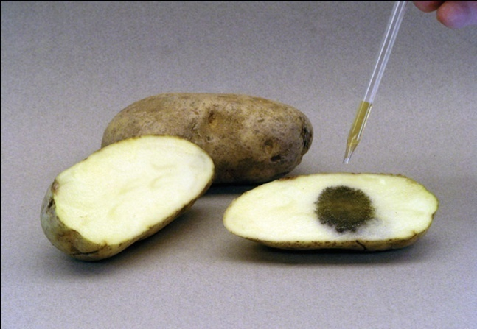
IMPORTANT POLYSACCHARIDES (continued)
Amylose complexes with iodine to form a dark blue color.
The molecular conformation of starch and the starch-iodine complex: (a) the helical conformation of the amylose chain and (b) the starch-iodine complex.

Slide 30
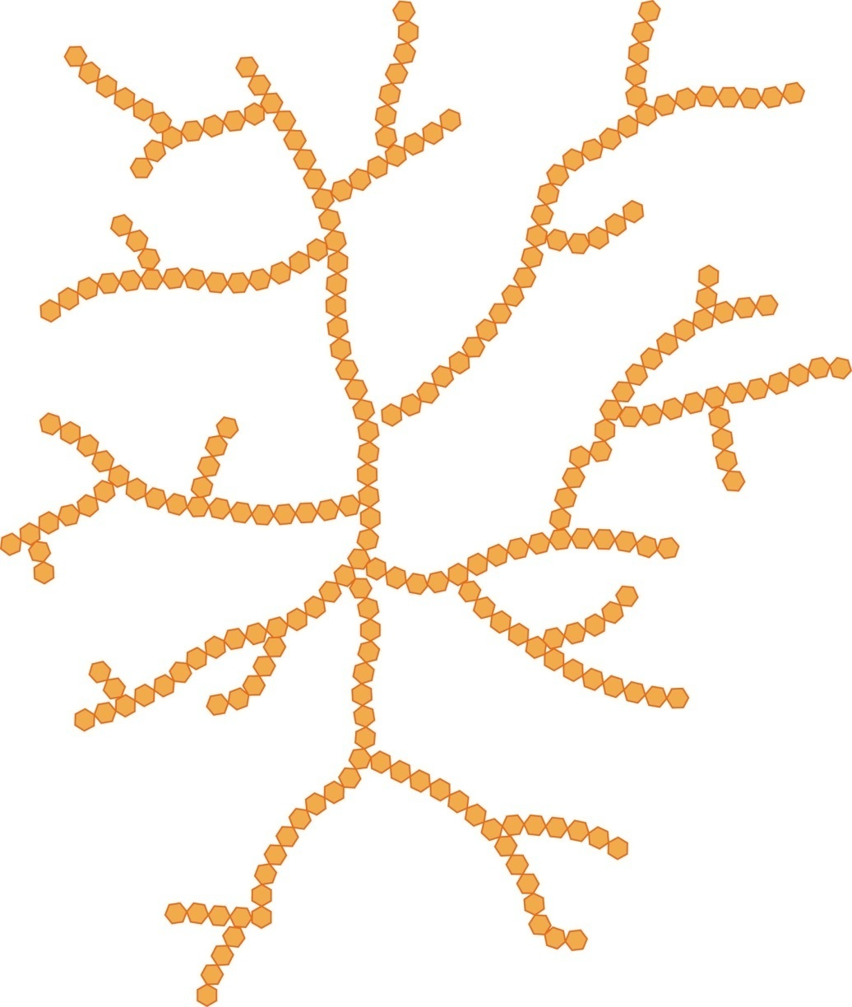
IMPORTANT POLYSACCHARIDES (continued)
Glycogen (animal starch) is:
a polymer of glucose units.
used by animals to store glucose, especially in the liver and muscles.
structurally similar to amylopectin with α(1→4) and α(1→6) linkages, but more highly branched.

Slide 31
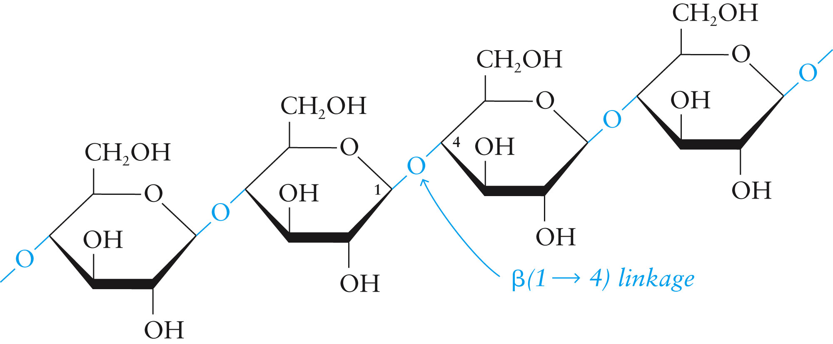
IMPORTANT POLYSACCHARIDES (continued)
Cellulose structure

Slide 32
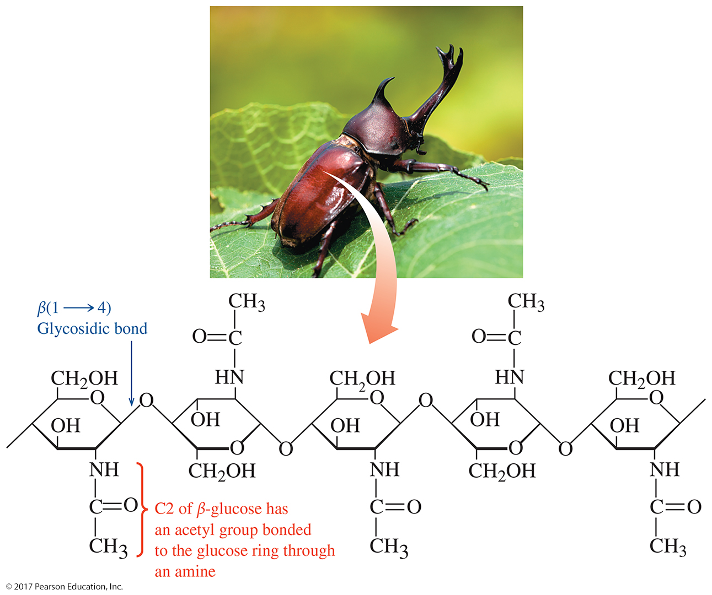
Polysaccharides

Slide 33
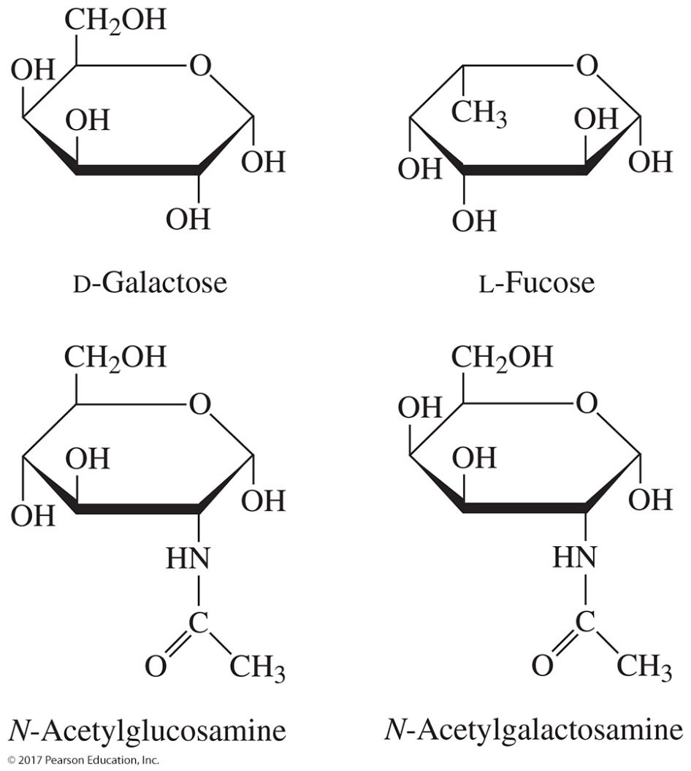
Carbohydrates and Blood
Red blood cells have a number of chemical markers bonded to the cell, including the ABO blood markers, which contain three or four monosaccharides.

Slide 34
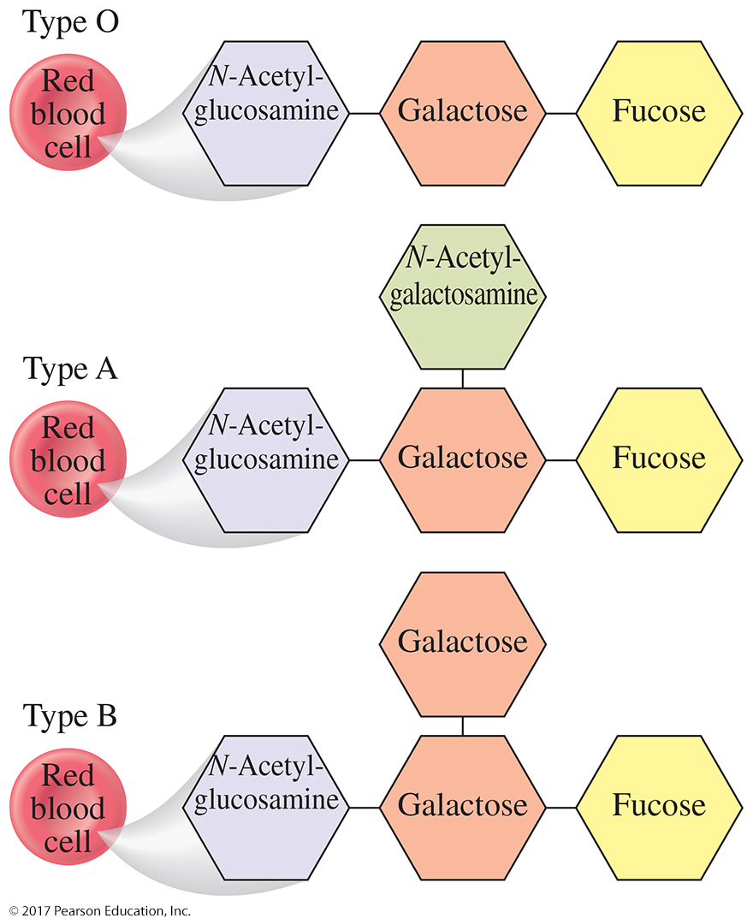
6.7 Carbohydrates and Blood

Slide 35
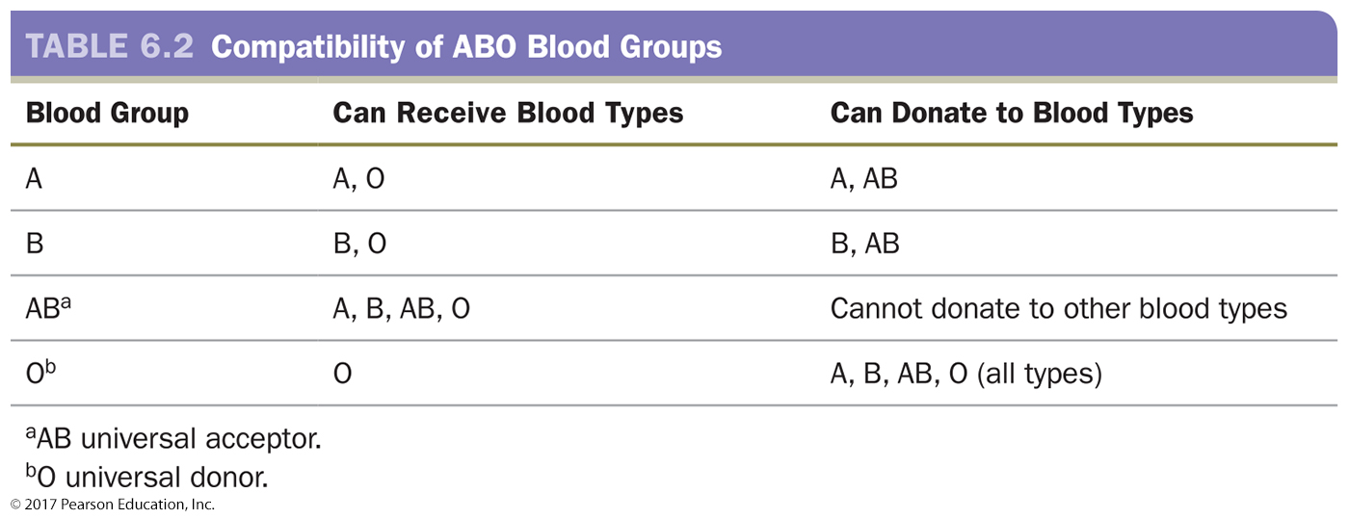
Carbohydrates and Blood

