Slide 1
Chapter 5
Chemical Reactions
Thermodynamics
Kinetics
Chemical Reactions
Oxidation and Reduction
Organic Reactions: Condensation and Hydrolysis
Organic Addition Reactions to Alkenes

Slide 2
Thermodynamics
Reaction Energy Heat
Type Change in Reaction
Endothermic Heat absorbed Reactant
Heat + NH₄NO₃(s) → NH₄NO₃(aq)
Exothermic Heat released Product
NaC₂H₃O₂(aq) → NaC₂H₃O₂(s) + Heat

Slide 3
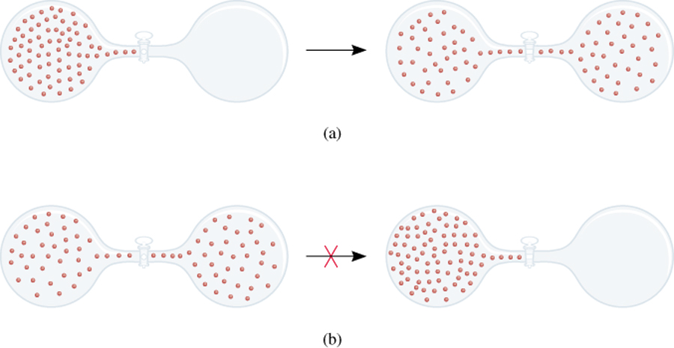
spontaneous
nonspontaneous
The spontaneity of a reaction does not tell us how fast a reaction occurs

Slide 4
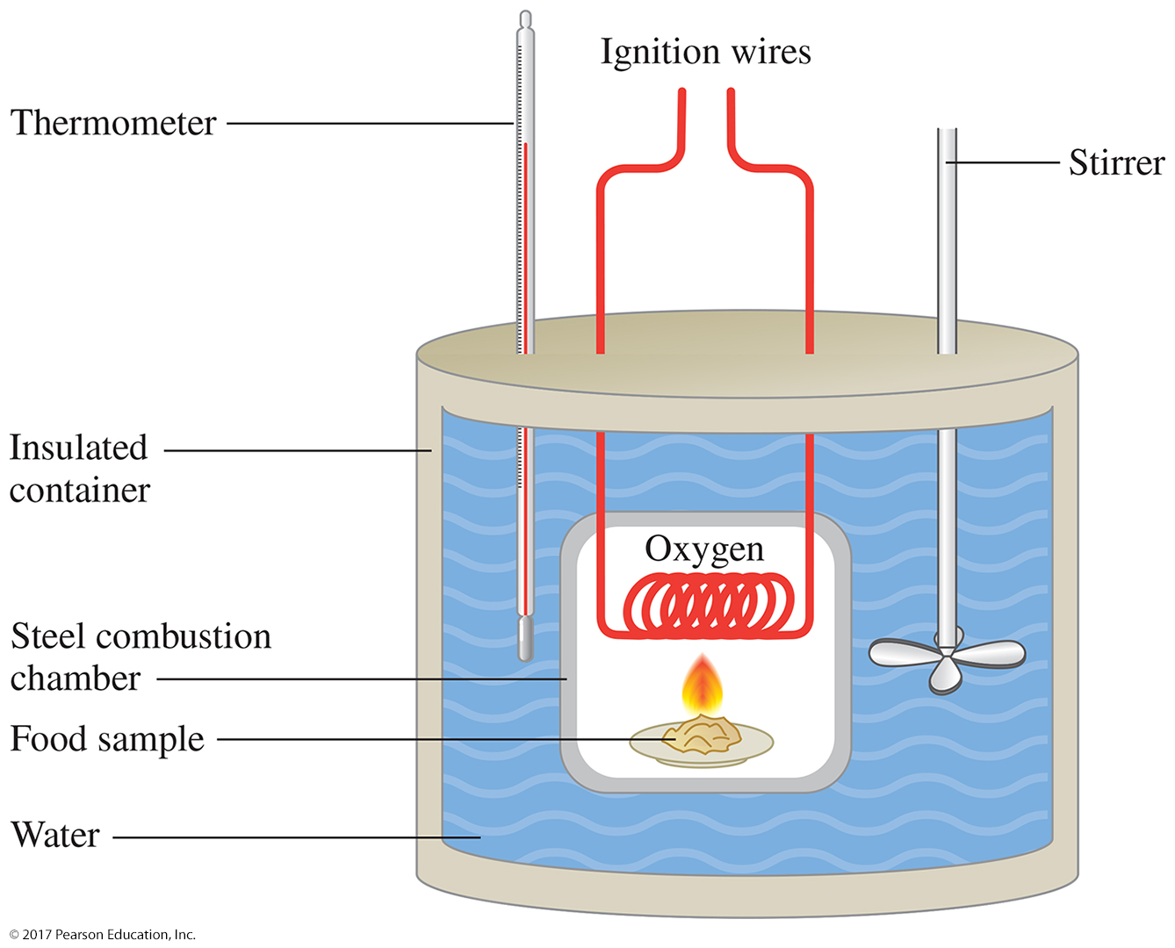
Thermodynamics
Heat of reaction: The heat released
during a chemical reaction.
Calorimetry: is the science of
measuring the heat of
chemical reactions.

Slide 5
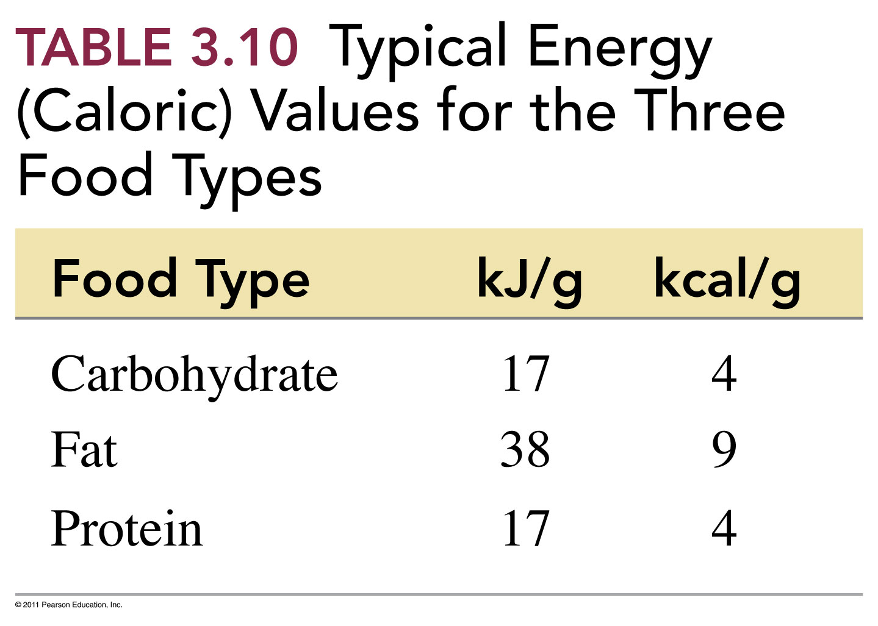

Slide 6
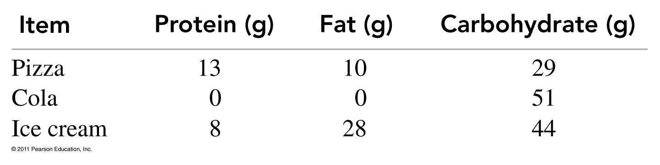
How many calories will you get from eating one slice of pizza?

Slide 7
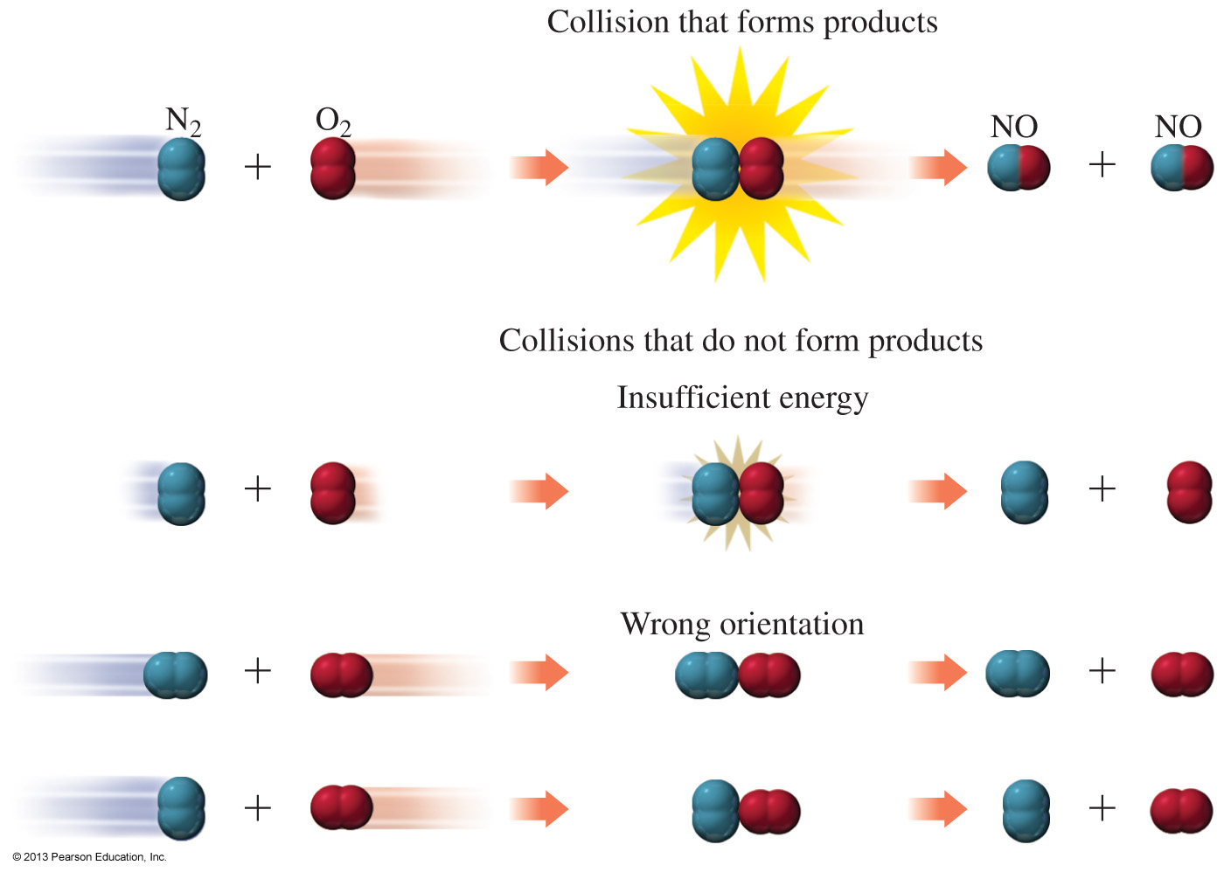
Kinetics
The rate of reaction is determined by measuring the amount of reactant used up or product formed in a certain period of time.
The rate or reaction is affected by
temperature changes.
changes in amount.
the presence of a catalyst.

Slide 8
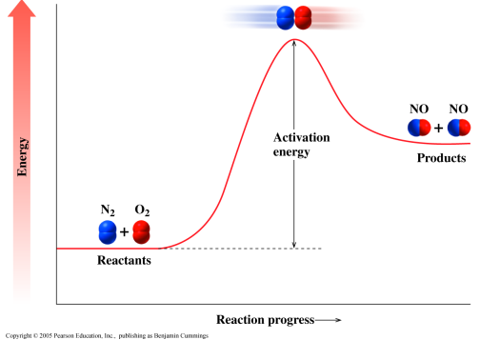
Activation Energy
The activation energy is the minimum energy needed for a reaction to take place.

Slide 9
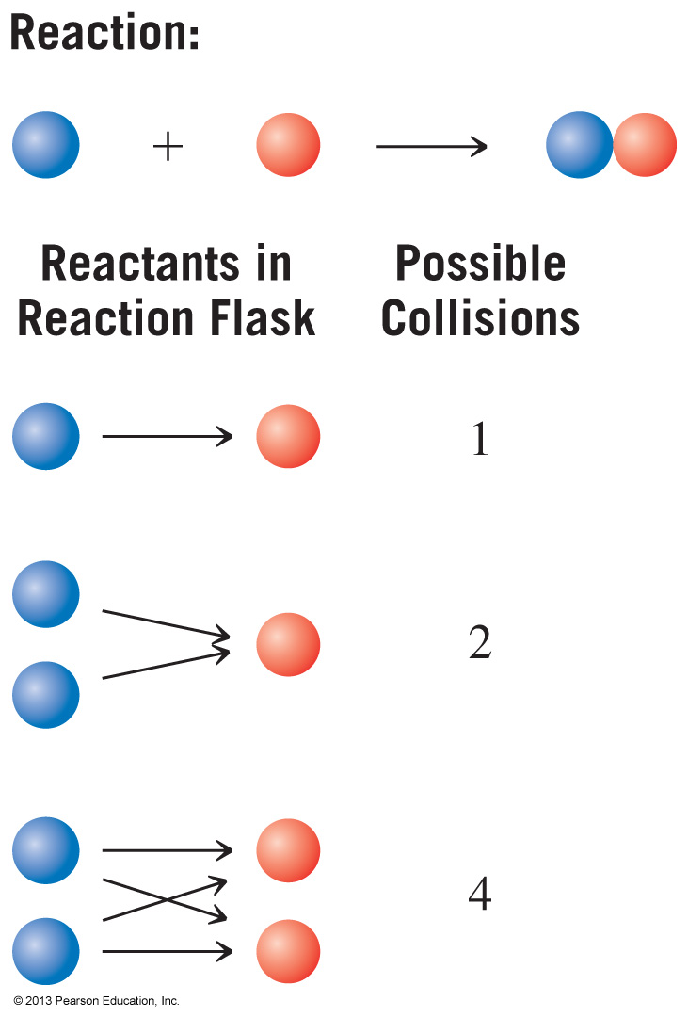

Slide 10
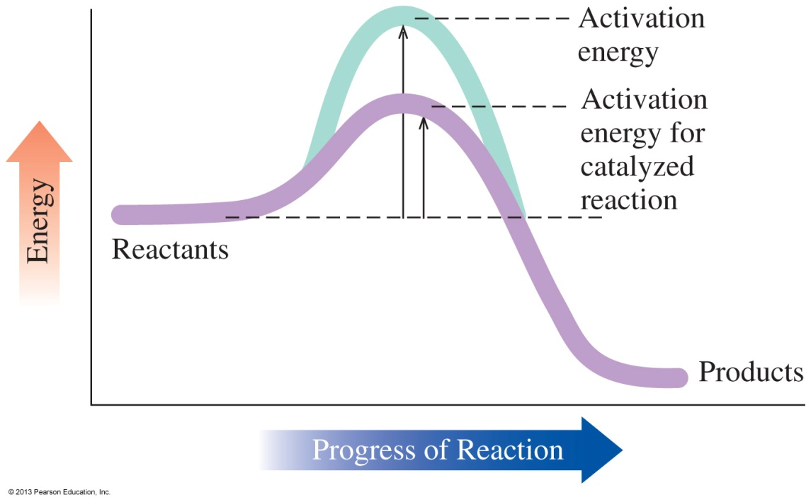
A catalyst
speeds up the rate of a reaction.
lowers the energy of activation.
is not used up during the reaction.

Slide 11
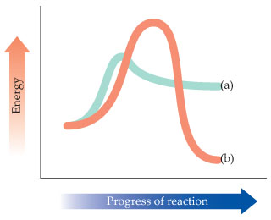
Practice
Use the following reaction energy diagram to answer the questions:
Which curve represents the faster reaction, and
which represents the slower?
Which curve represents an endothermic reaction, and which curve represents an exothermic reaction?

Slide 12
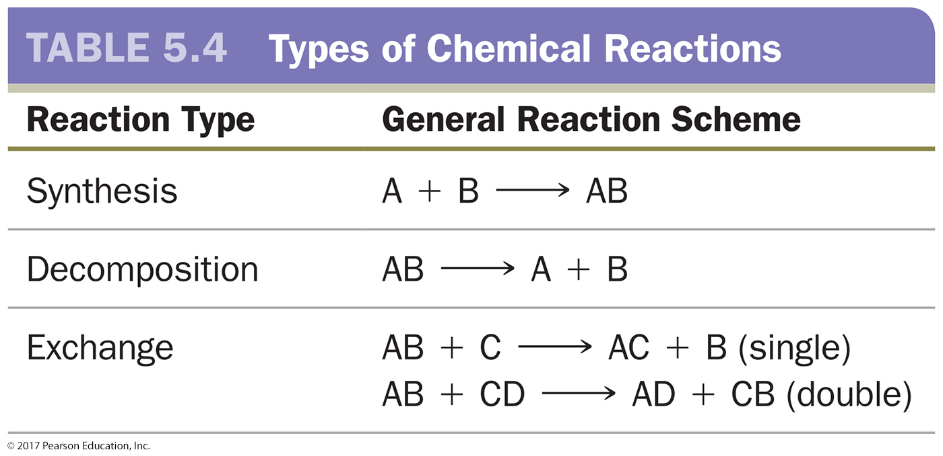
Overview of Chemical Reactions

Slide 13
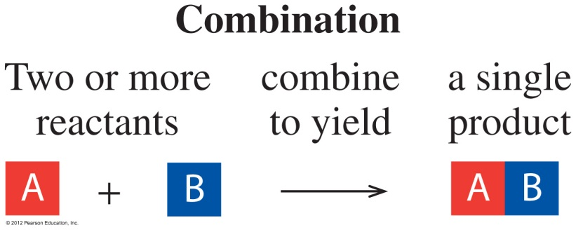
Combination Reactions
In a combination reaction,
two or more elements form one product
or simple compounds combine to form one product
2Mg(s) + O₂(g) 2MgO(s)
2Na(s) + Cl₂(g) 2NaCl(s)
SO₃(g) + H₂O(l) H₂SO₄(aq)

Slide 14
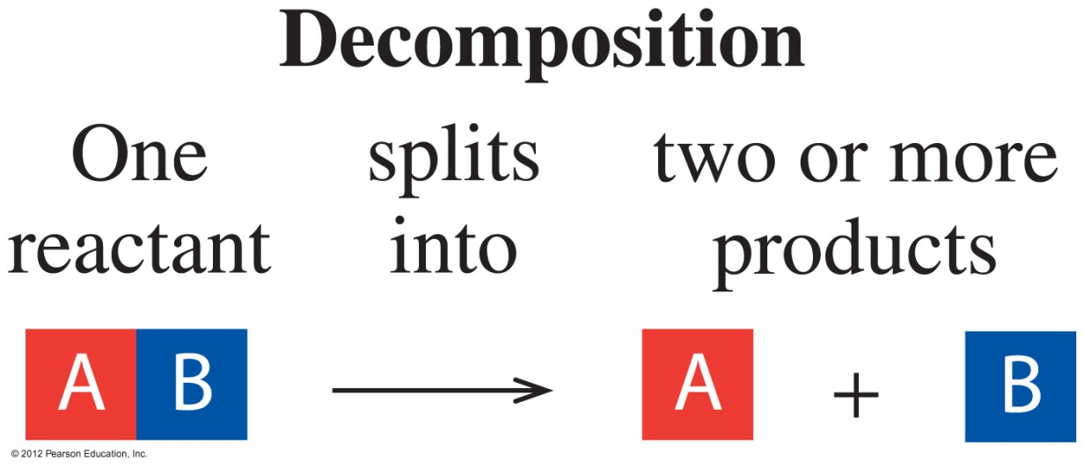
Decomposition Reaction
In a decomposition reaction, one substance splits into
two or more simpler substances.
2HgO(s) 2Hg(l) + O₂(g)
2KClO₃(s) 2KCl(s) + 3O₂(g)

Slide 15
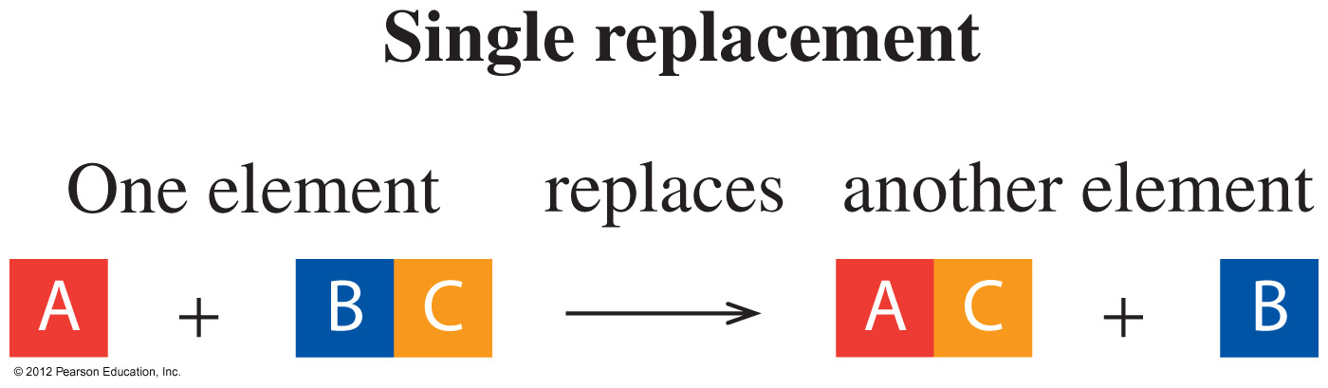
Single Replacement Reaction
In a single replacement reaction, one element takes the
place of a different element in another reacting a compound.
Zn(s) + 2HCl(aq) ZnCl₂(aq) + H₂(g)
Fe(s) + CuSO₄(aq) FeSO₄(aq) + Cu(s)

Slide 16
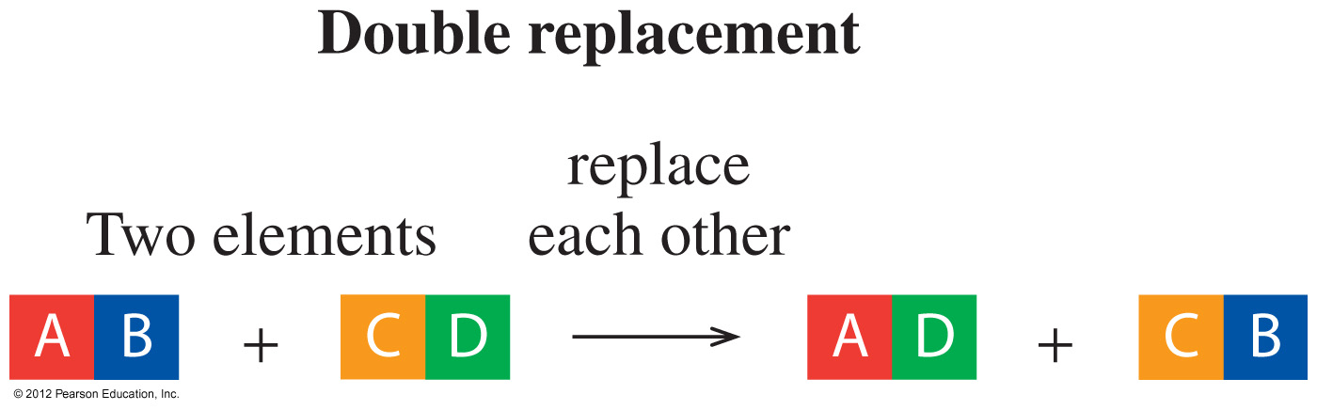
Double Replacement Reaction
In a double replacement, two elements in the reactants
exchange places.
AgNO₃(aq) + NaCl(aq) AgCl(s) + NaNO₃(aq)
ZnS(s) + 2HCl(aq) ZnCl₂(aq) + H₂S(g)

Slide 17
Practice
Classify each of the following reactions as combination,
decomposition, single replacement, double replacement, or
combustion.
A. 2Al(s) + 3H₂SO₄(aq) Al₂(SO₄)₃(s) + 3H₂(g)
B. Na₂SO₄(aq) + 2AgNO₃(aq) Ag₂SO₄(s) + 2NaNO₃(aq)
C. 3C(s) + Fe₂O₃(s) 2Fe(s) + 3CO(g)
D. C₂H₄(g) + 2O₂(g) 2CO₂(g) + 2H₂O(g)

Slide 18
Equilibrium
chemical equilibrium- At the point when both the forward and the reverse reaction are occurring at the same rate
Reversible reaction - Reaction that can occur in both the forward and reverse direction.
Irreversible reaction - A reaction which proceeds only in the forward direction.

Slide 19
Practice
Determine if the reactions are reversible or irreversible.
C₆H₁₂O₆(aq)→2C₂H₆O(aq)+2CO₂(g)
2H₂(g)+O₂(g) → 2H₂O(g)
NaOH(aq)+HCl(aq)→NaCl(aq)+H₂O(l)

Slide 20
Combustion Reaction
In a combustion reaction,
a carbon-containing compound burns in oxygen gas to form carbon dioxide (CO₂) and water (H₂O)
energy is released as a product in the form of heat
Combustion reactions tend to be highly exothermic and are considered irreversible.
CH₄ + 2O₂ → CO₂ + 2H₂O + 212.8 kcal/mol

Slide 21
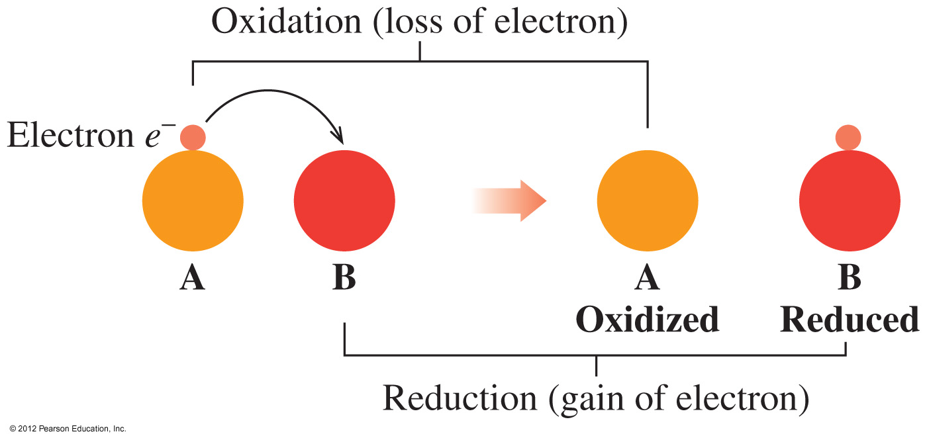
Oxidation−Reduction
In an oxidation–reduction reaction, electrons are
transferred from one substance to another.

Slide 22
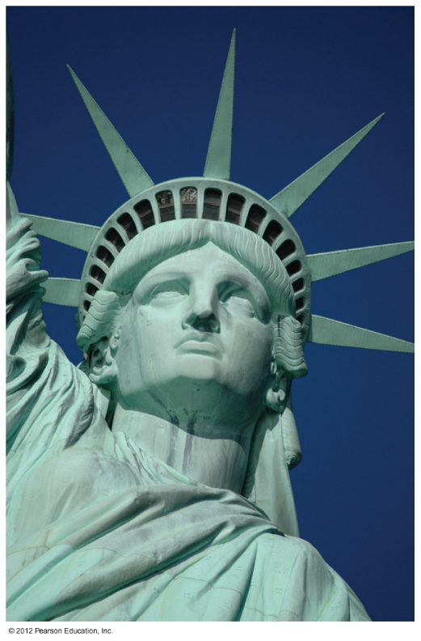
Oxidation and Reduction
2Cu(s) + O₂(g) 2CuO
OIL RIG
Oxidation is loss of electrons.
2Cu(s) 2Cu²⁺(s) + 4e⁻
Reduction is gain of electrons.
O₂(g) + 4e⁻ 2O²⁻ (s)
The green patina on copper is due to oxidation

Slide 23
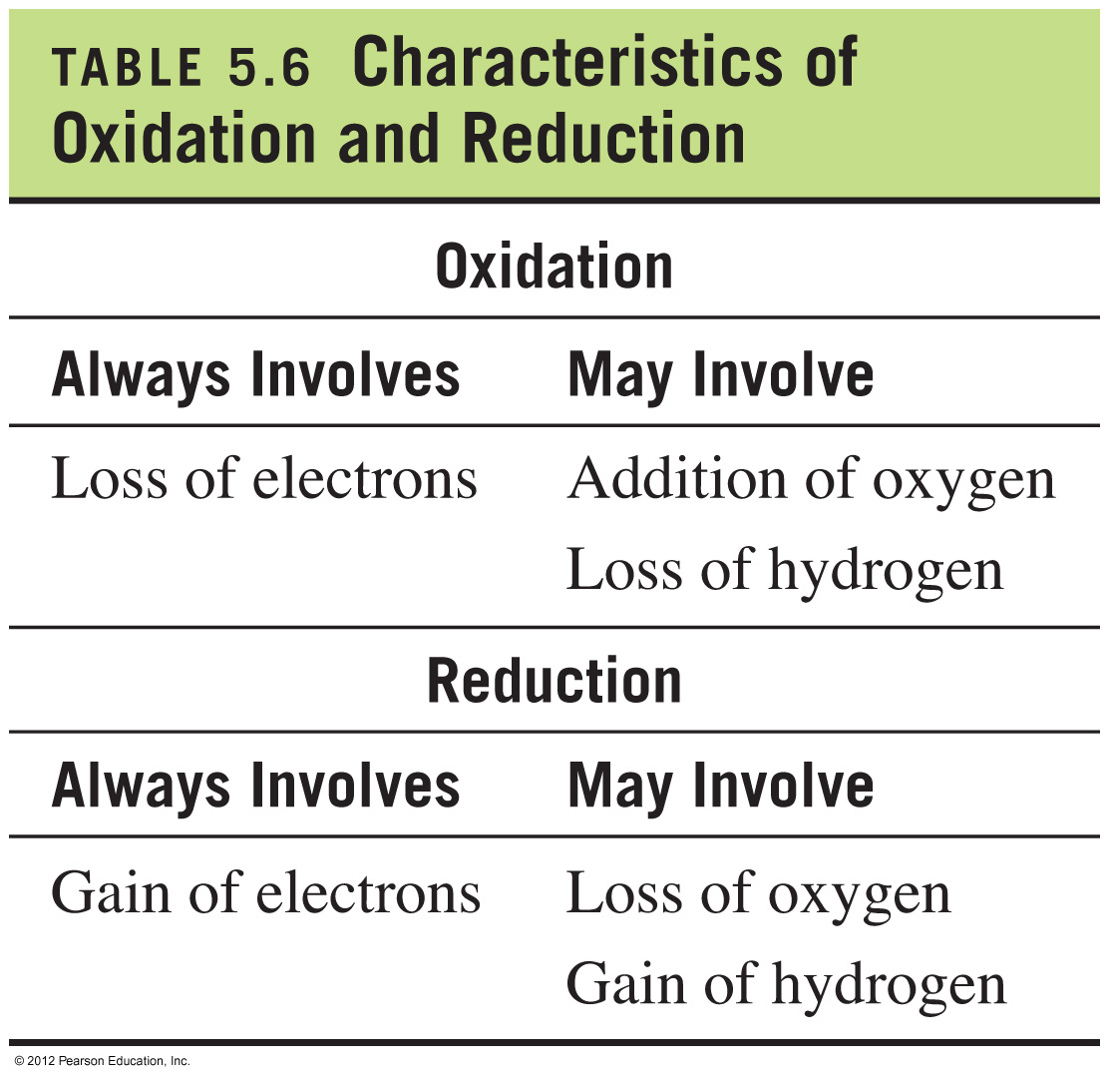
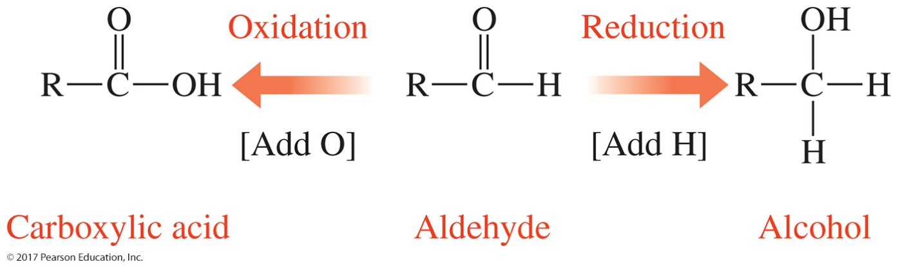
Characteristics of Oxidation and Reduction

Slide 24
Reducing agent:
Loses one or more electrons
Causes reduction
Undergoes oxidation
Becomes more positive (or less negative)
Oxidizing agent:
Gains one or more electrons
Causes oxidation
Undergoes reduction
Becomes more negative (or less positive)

Slide 25
Although we mine most sodium chloride, it can be synthesized by the reaction shown.
Identify the substance oxidized and the substance reduced.
2Na(g)+Cl₂(g)→2NaCl(s)

Slide 26
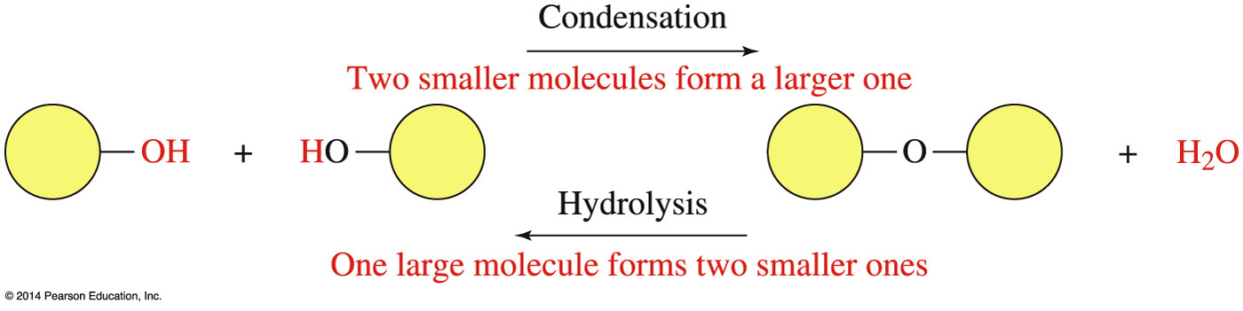
Organic Reactions: Condensation and Hydrolysis
condensation reaction, water is produced as two organic molecules are joined. Condensation reactions occur among functional groups that contain an —H and —OH group that can be removed to form water.
hydrolysis reaction (hydro- means “water”, lysis means “break”), water is consumed as a reactant and the reactant molecule is split into two smaller molecules.

Slide 27
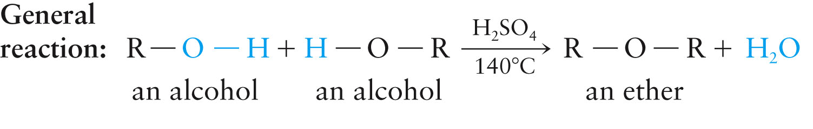
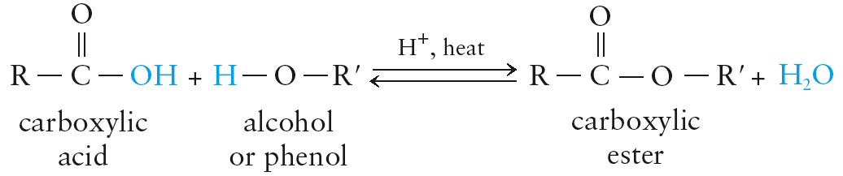
condensation

Slide 28
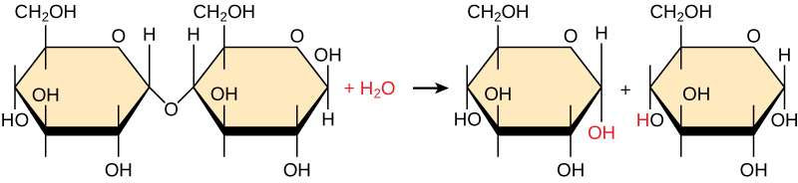
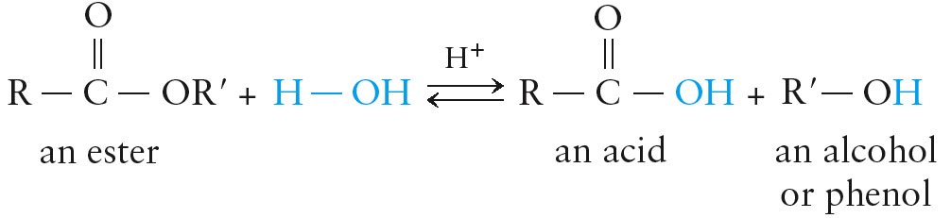
hydrolysis

Slide 29
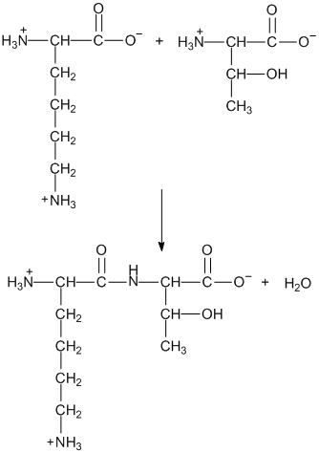
Identify the main organic reaction shown as either condensation, hydrolysis, oxidation, hydration, or reduction:

Slide 30
Organic Reactions
Addition of Symmetrical Reagents: H-H Cl-Cl Br-Br
( H₂ Cl₂ Br₂ )
Each Reagent breaks into two groups (2 H atoms, 2 Cl atoms, etc.)
Each Carbon of the Double Bond forms a new bond to the new atoms:

Slide 31
Organic Reactions
Addition of Unsymmetrical Reagents: H-Cl H-Br H-OH HOCH₃
(HCl HBr H₂O HOCH₃)
Each Reagent breaks into a H atom and the rest of the molecule
Each Carbon of the Double Bond forms a new bond to the new groups:

Slide 32
Organic Reactions
Addition of Symmetrical Reagents is Stereospecific
2a. Reaction with H-H gives cis addition product:
Cis addition product is formed, but single bond rotation obscures the stereochemistry
However, H-H addition to a cycloalkane illustrates cis addition:

Slide 33
Organic Reactions
Addition of Unsymmetrical Reagents is Regiospecific

Slide 34
Organic Reactions
The same regiochemistry is observed for ALL unsymmetrical reagents:

Slide 35
Practice
Draw the expected product for each reaction:

