Slide 1
Chapter 4
Introduction to Organic
Compounds
Structures of Organic Compounds
Alkanes
Functional Groups
Nomenclature of Simple Alkanes
Isomerism in Organic Compounds

Slide 2
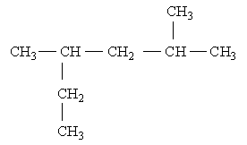
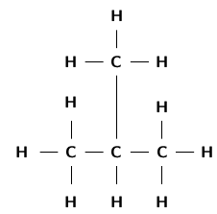
Representing Organic Compounds
Chemical formula - A description of the number C₃H₈
and types of atoms present in a molecule.
Condensed formula - A condensed representation
of a chemical structure that minimizes the
vertical bonds and shows the most of structure
on one line.
Structural formula - A representation of a
structure that emphasizes the bond connection
between atoms.

Slide 3
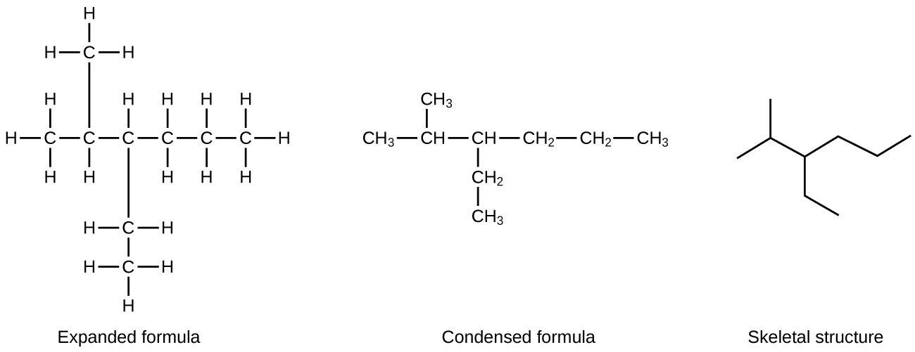
Representing Organic Compounds
Line formula - A simplified representation of a structural formula in which only the bonds are drawn. Carbons are located at the junctions of bonds and hydrogens fill all vacant bonding positions.

Slide 4
Give the structural formula, the condensed formula, and skeletal formula for C₅H₁₂ (no branching).
Structural formula:
b) Condensed formula:
c) Skeletal formula:

Slide 5
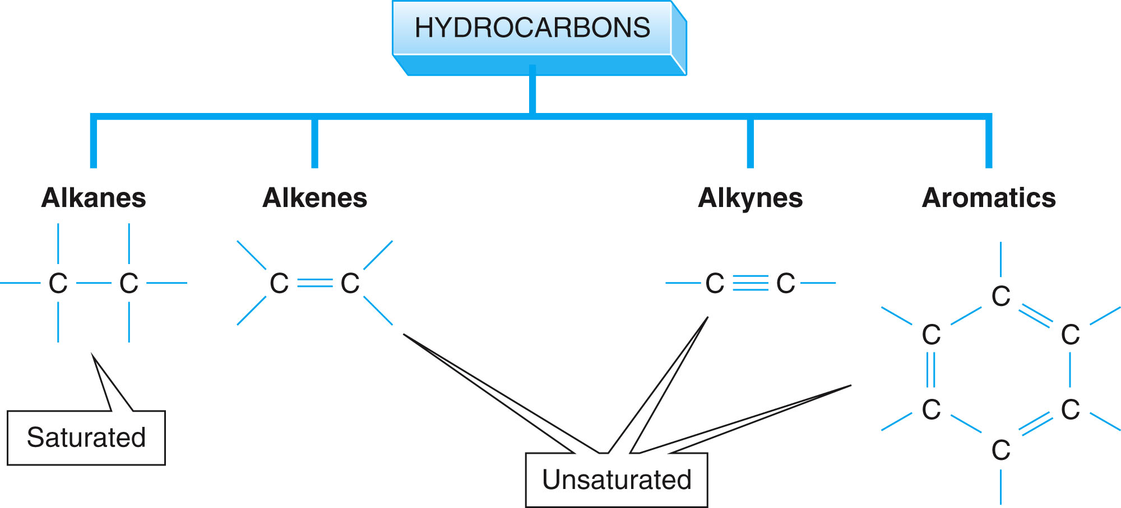
Hydrocarbons

Slide 6
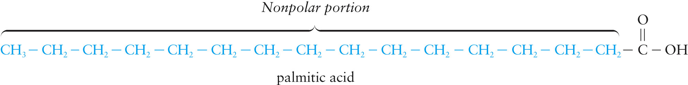
PHYSICAL PROPERTIES OF ALKANES
Non-polar molecules with weak intermolecular forces
Not soluble in water (hydrophobic)
Low density (less dense than water)
Melting points increase with molecular size
Boiling points increase with molecular size

Slide 7
the first 10 alkanes with unbranched chains
the suffix -ane: shows that the compound is a saturated hydrocarbon

Slide 8
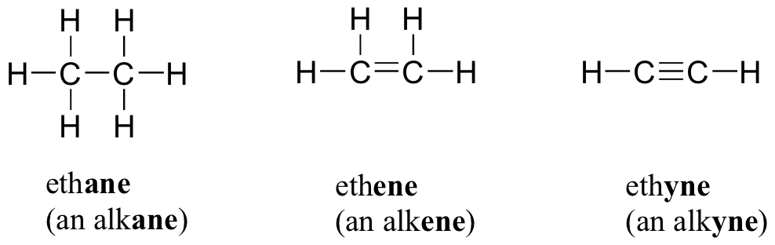
Alkane/ Alkene /Alkyne

Slide 9
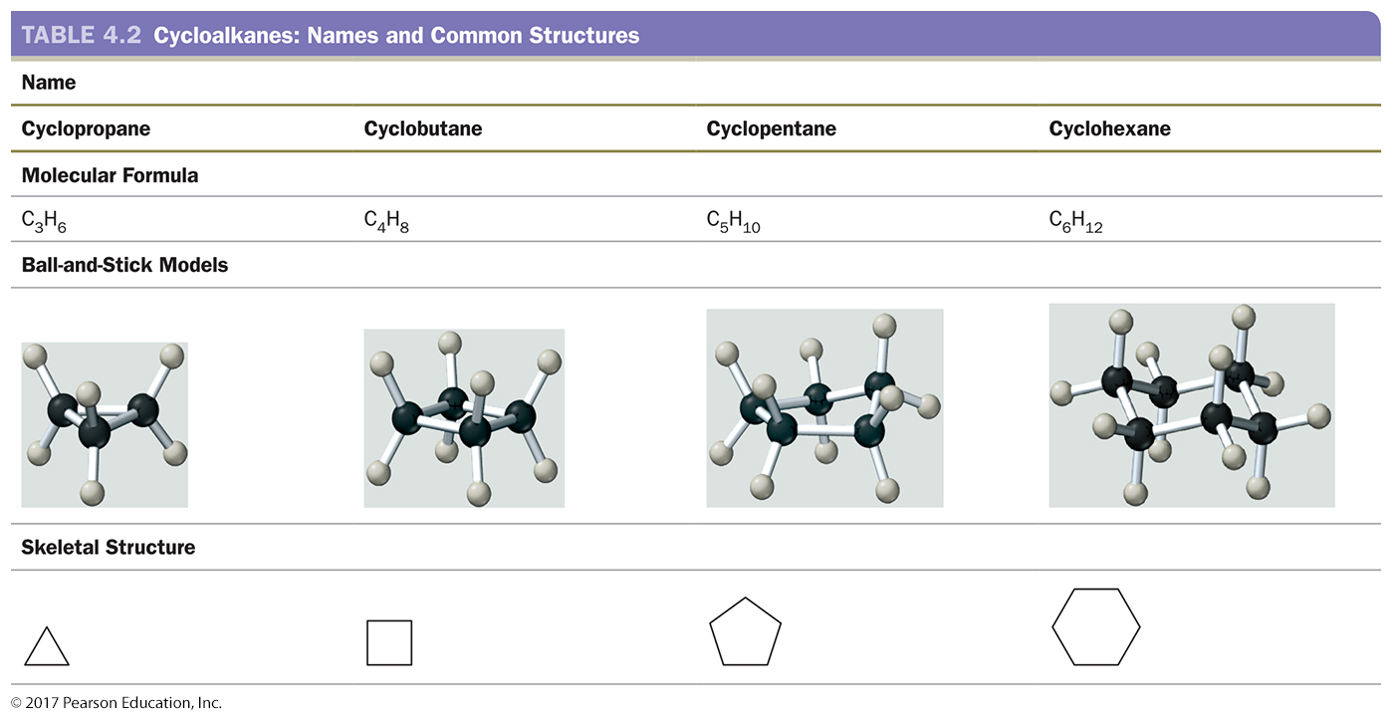
Cycloalkanes

Slide 10
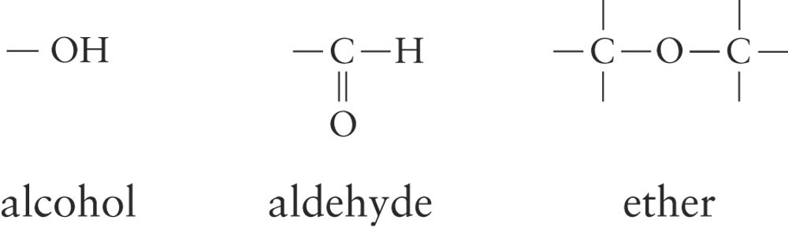
Functional Groups
functional group: A group of atoms bonded in a particular way and has specific properties and chemical reactivity
Examples:

Slide 13

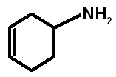

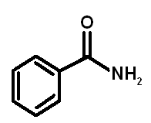

Identify the functional groups in each of the following organic compounds:

Slide 14
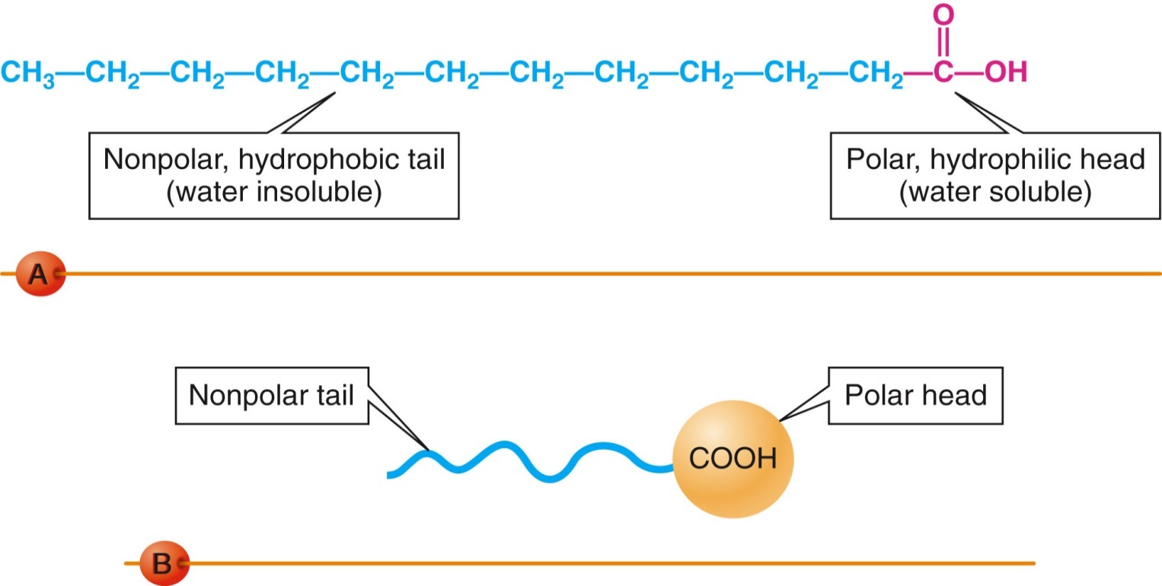
Fatty acids
Fatty acids:
  are the building blocks of many lipids.
  are long chain carboxylic acids (12 to 22 carbon atoms).
  have long nonpolar tails responsible for fatty/oily characteristics.
  have no other functional group than the COOH, but may have carbon-carbon double bonds.

Slide 15
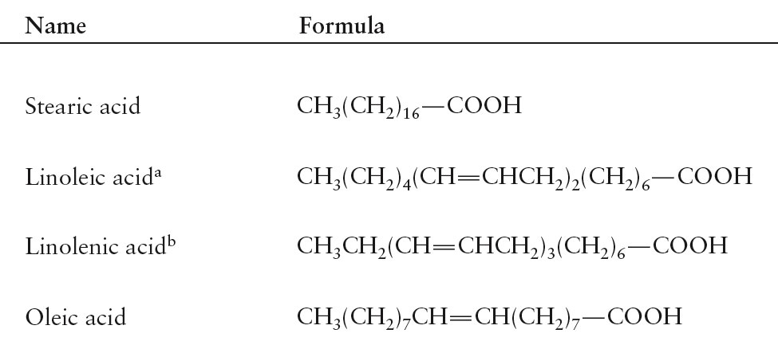
Examples
Examples of saturated, monounsaturated, and polyunsaturated fatty acids containing 18 carbon atoms include:

Slide 16
Notation | common name | systematic name | structure
12:0 | Lauric acid | dodecanoic acid | CH₃(CH₂)₁₀COOH
14:0 | Myristic acid | tetradecanoic acid | CH₃(CH₂)₁₂COOH
16:0 | Palmitic acid | Hexadecanoic acid | CH₃(CH₂)₁₄COOH
18:0 | Stearic acid | Octadecanoic acid | CH₃(CH₂)₁₆COOH
16:1^{Δ9} | Palmitoleic acid | Hexadecenoic acid | CH₃(CH₂)₅CH=CH-(CH₂)₇COOH
18:1^{Δ9} | Oleic acid | 9-Octadecenoic acid | CH₃(CH₂)₇CH=CH-(CH₂)₇COOH
18:2^{Δ9,12} | Linoleic acid | 9,12-Octadecadienoic acid | CH₃(CH₂)₄(CH=CHCH₂)₂(CH₂)₆COOH
18:3^{Δ9,12,15} | α-Linolenic acid | 9,12,15-Octadecatrienoic acid | CH₃CH₂(CH=CHCH₂)₃(CH₂)₆COOH
20:4^{Δ5,8,11,14} | arachidonic acid |  | you draw it!

Slide 17
1. What information is given by the notation in the left column (12:0, 16:0, etc.)?
2. What information is given by the delta sign and superscripts in the left column (^{Δ9, 12, 15} etc.)?
3. Draw a bond line structure for Oleic acid 18:1^{Δ9}

Slide 18
NAMING ORGANIC COMPOUNDS
Find the longest carbon chain which contains the functional group or multiple bond if present and name it (using the correct ending).
Number the longest chain (left to right or right to left) so that the functional group/multiple bond/longest side chain (branch) is on the lowest numbered carbon possible.
Alkyl group: a substituent group derived from an alkane by removal of a hydrogen atom
    named by dropping the -ane from the name of the parent alkane and adding the suffix -yl

Slide 20
NAMING ORGANIC COMPOUNDS
Use a prefix di-, tri-, tetra-, etc. to denote how many side groups of each length are present.
Before naming the side group give the number of the carbon to which the side group is attached.
Arrange the side groups in alphabetical order ignoring the prefixes di-,tri-, etc.

Slide 21
Examples

Slide 22


Practice
What is the correct name for the compounds below?
Draw the structure of the following 3-ethyl-2,5-dimethylhexane

Slide 23
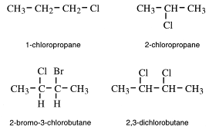
Haloalkanes
Halo alkanes have one or more halogens replacing hydrogen on an alkane
The halogens are numbered and named as substituents
- F = fluoro
- Cl = chloro Example
- Br = bromo
- I = iodo

Slide 24
NAMING CYCLOALKANES
Cycloalkanes are alkanes containing rings of carbon atoms.
The prefix cyclo- is used before the alkane name.
When two or more substituents are attached to the cycloalkanes, the ring numbering begins with the first group alphabetically and proceeds to give lowest numbers possible.
Example:
CH₂CH₃
1
2
3
CH₃
1-ethyl-3-methylcyclopentane

Slide 25
Give the name for each of the following structures:

Slide 26
Draw the structure for each of the following names:
3-chloro-2 methylpentane
trans-1,2-dimethylcyclobutane
cis-1,3-dibromocyclopentane

Slide 28
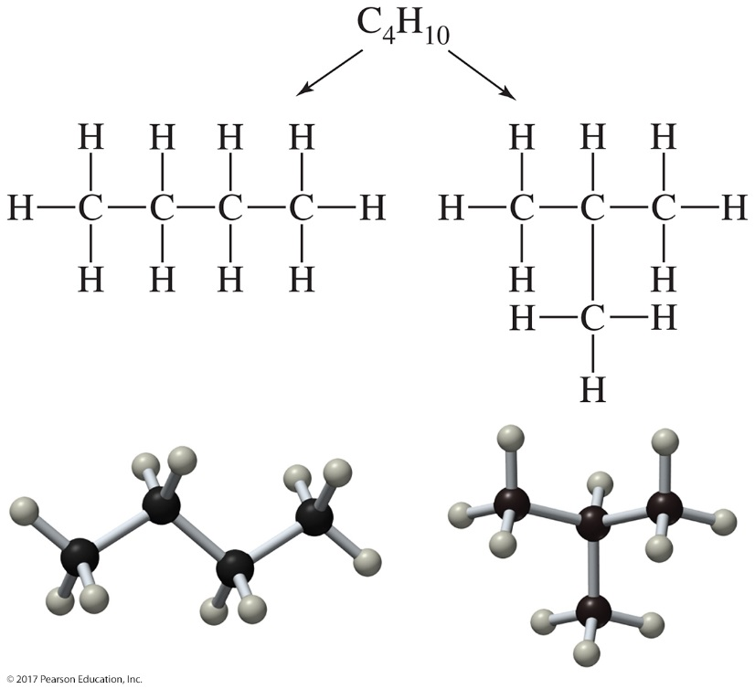
structural or constitutional isomers
structural isomers: When two molecules have the same molecular formula but different connectivity

Slide 29
Practice
There are two structural isomers with the formula C₃H₇Br; draw a structural formula for each compound.
Draw all the structural isomers of hexane, C₆H₁₄

Slide 30
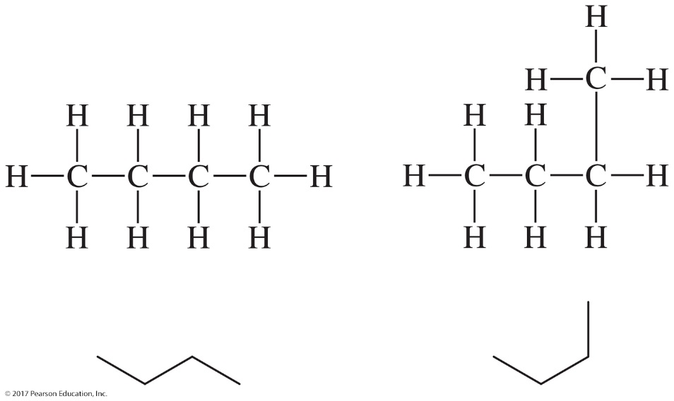
Conformational Isomers
Conformational Isomers two different representations of the same molecule

Slide 31
Stereoisomers
Geometric isomers are molecules with restricted rotation around C-C bonds that differ in the three-dimensional arrangements of their atoms in space and not in the order of linkage of atoms.
Stereoisomers are compounds with the same structural formula but different spatial arrangements of atoms.

Slide 32
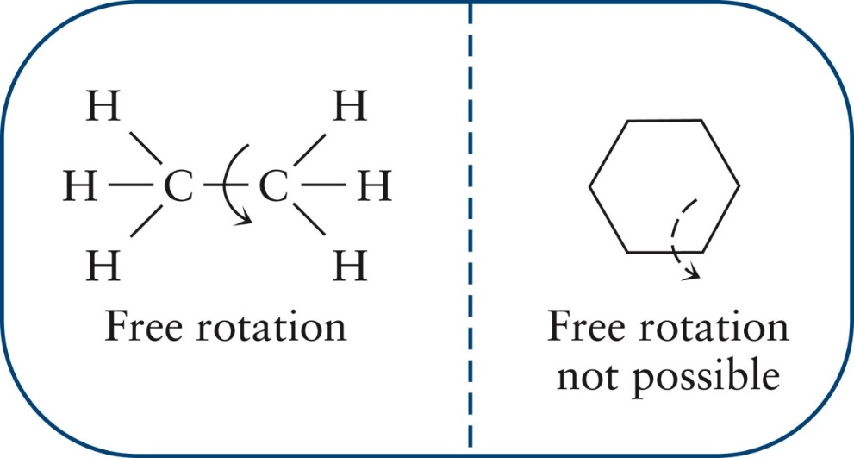
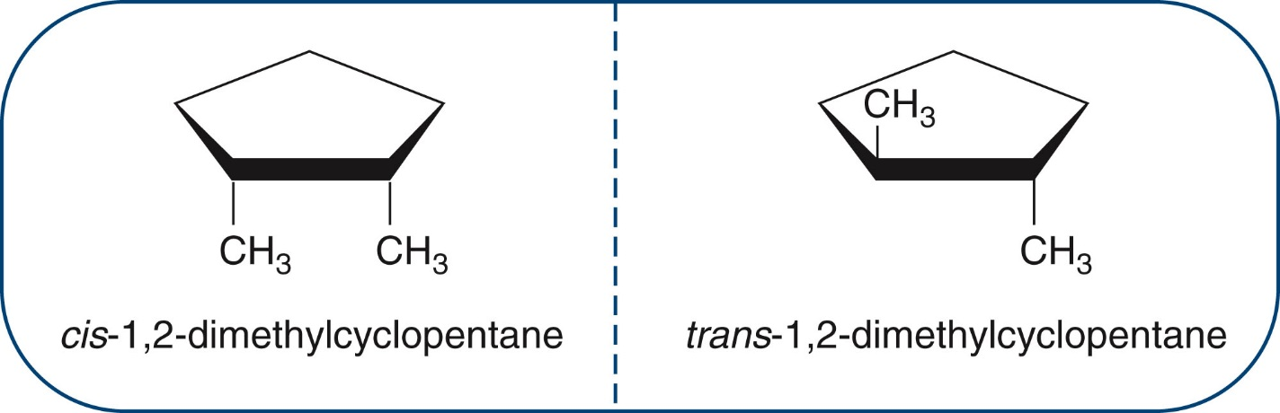
Geometric isomers

Slide 33
The relationship of the following two structures is
(A) same (B) constitutional isomers (C) geometric isomers
(D) not isomers (E) structural isomers

Slide 34
Chiral
chiral - Greek for hand - used to describe objects that cannot be superimposed on their mirror images.
achiral - used to describe objects that can be superimposed on their mirror images.
enantiomers - a pair of stereoisomers that are nonsuperimposable mirror images of each other - enantiomers are chiral molecules - they are always in pairs.

Slide 35
chirality
chirality - a property of handedness which determines a molecule’s biological behavior.
Identifying Chiral Carbons in a Molecule
  STEP 1 Locate the tetrahedral carbons (carbons with four atoms bonded to them).
  STEP 2 Inspect the tetrahedral carbons. Determine if the four groups attached to the tetrahedral carbons are different.
  STEP 3 Assign the chiral centers. Typically, an asterisk is drawn next to the chiral carbon

Slide 36
Determine if the following molecules are chiral. If so, then label the chiral centers with an asterisk (*). Some molecules may have more than one chiral center.

