Slide 1
Chapter 3
Compounds—How Elements Combine
Electron Arrangements
Octet
Ionic Compounds
Covalent Bond
The Mole
Shape
Electronegativity and Molecular Polarity

Slide 2
Electron Arrangements
Electrons have both particle-like and wave-like properties.
The behavior of electrons can be described using an equation called a wave function.
Electrons are not perfectly free to move. They are restricted to certain energy values, or quantized.

Slide 3
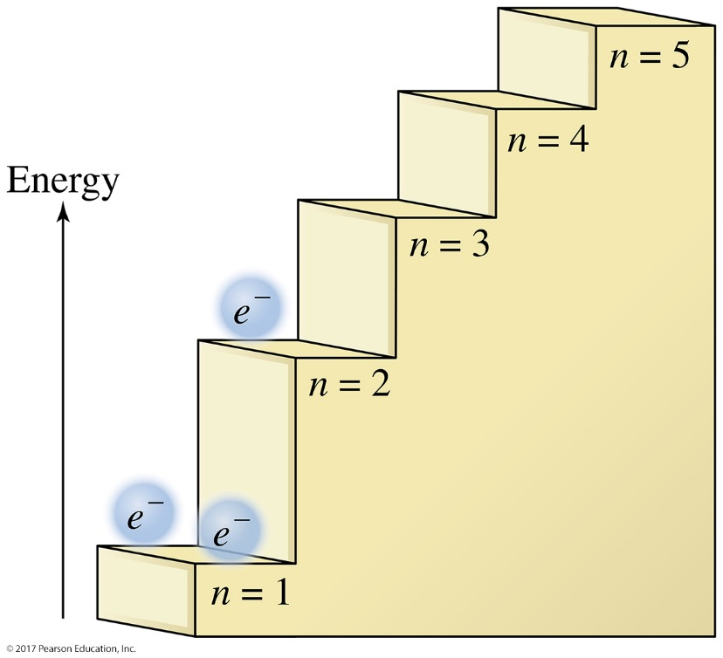
Quantized Energy Levels
Principal quantum number (n) indicates the relative size and energy of atomic orbitals.
Electrons exist only at distinct energy levels (steps on the staircase), not in between.

Slide 4
Electron Energy Level
Energy levels are broken up into sublevels
There are at least 4 possible types of sublevels—given labels: s, p, d, or f
Atomic orbitals are regions of space around the nucleus of an atom where an electron is likely to be found.

Slide 5
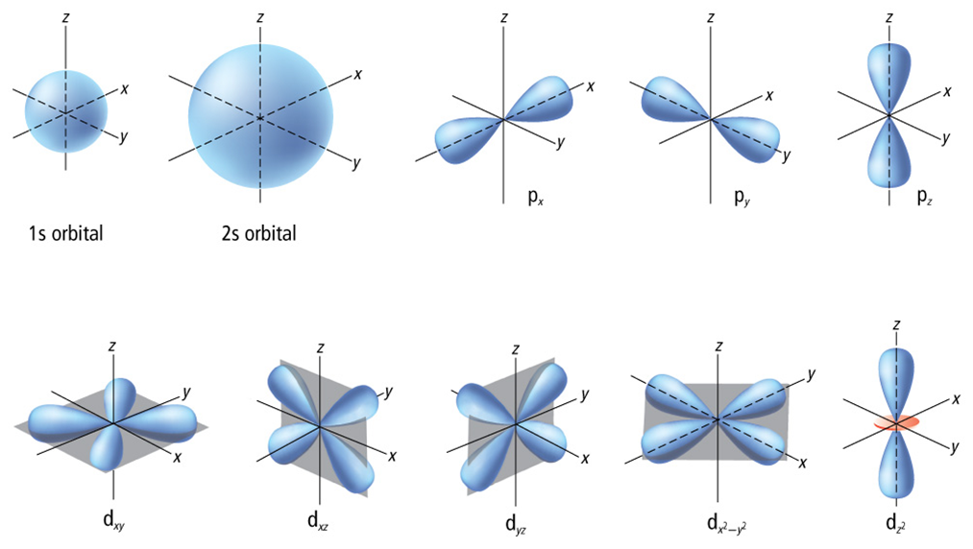
Each energy sublevel relates to orbitals of different shape.

Slide 6
Electronic Configuration
electron configuration: The arrangement of electrons in the atom
Rules for filling orbitals
1. Lowest energy orbitals are filled first (Principal quantum number).
2. Only 2 electrons (of different spin) allowed in each orbital.
3. When sublevels are filling, fill each orbital with 1 electron of same spin and then pair openly

Slide 7
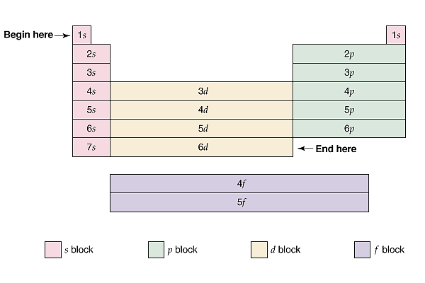
Energy Level and Sublevel

Slide 8
Orbital diagrams
Orbital diagrams are pictorial descriptions of the electrons in an atom.
Pauli exclusion principle states that a maximum of two electrons can occupy a single orbital, but only if the electrons have opposite spins.
Hund’s rule states that single electrons with the same spin must occupy each equal-energy orbital before additional electrons with opposite spins can occupy the same energy level orbitals.

Slide 9
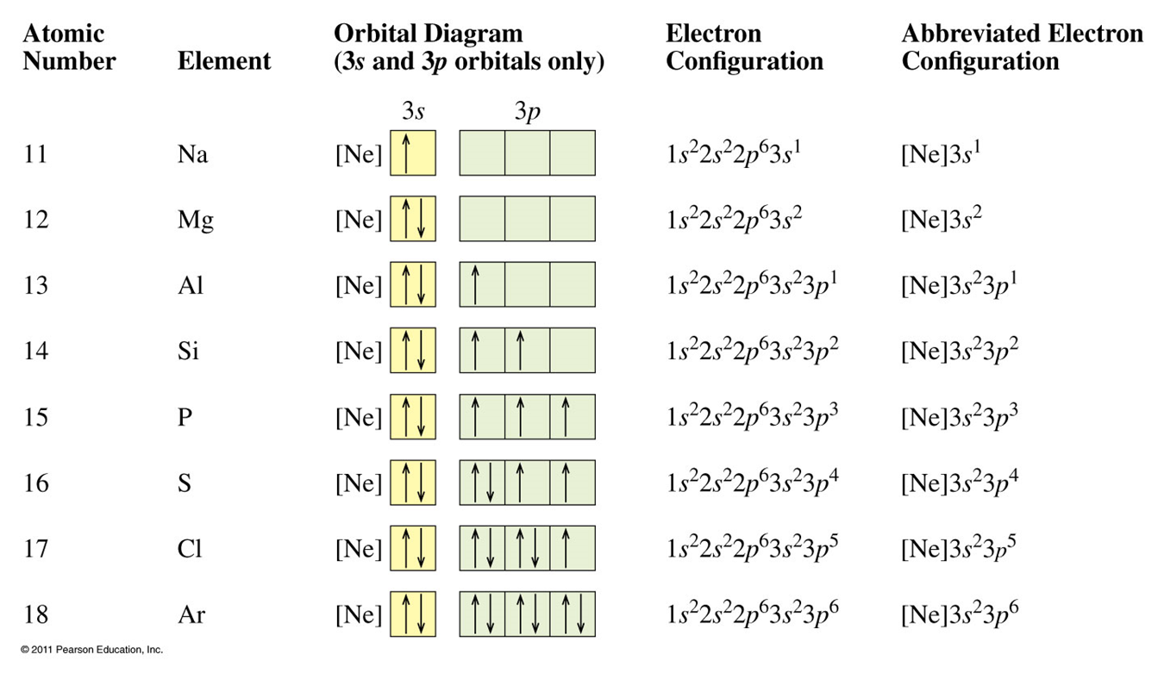

Slide 10
Practice
How many electrons can occupy a 4d orbital?
How many electrons can occupy a 5p sublevel?

Slide 11
Practice
What is the electron configuration of C?
What element has an electron configuration of 1s² 2s² 2p⁶ 3s¹?
What is the electron configuration of vanadium, V?
If a p sublevel has 4 electrons, which orbitals will they occupy? Draw the sublevel using arrows to represent electrons and show spin based on the direction of the arrow in the orbital diagram.

Slide 12
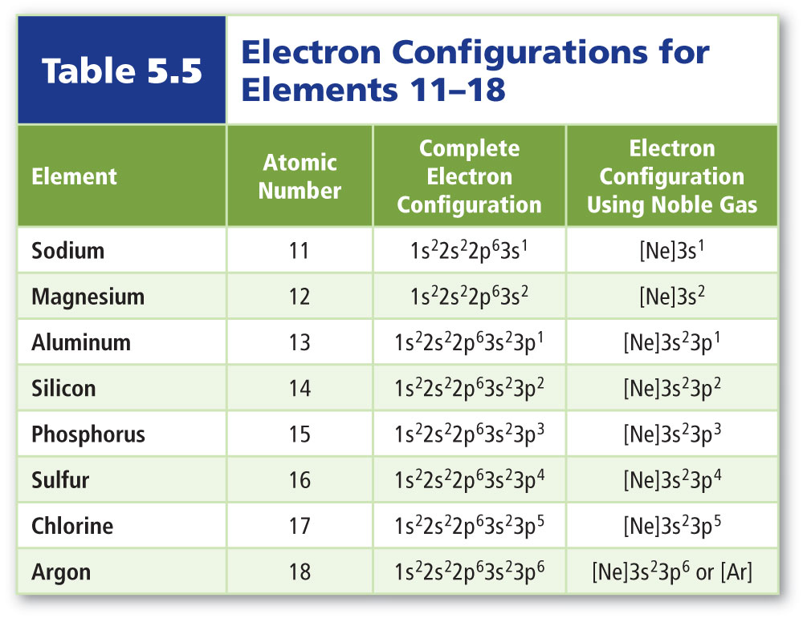
Shorthand Electron Configuratrion
Valence electrons are defined as electrons in the atom’s outermost orbitals—those associated with the atom’s highest principal energy level.
Noble gas or core notation uses noble gas symbols in brackets to shorten inner electron configurations of other elements.

Slide 13
Practice
Write the shorthand electron configuration for an atom of antimony (Sb).
Write the shorthand electron configuration for an atom of zirconium(Zr).

Slide 14
Ions
atoms or groups of atoms that have gained or lost electrons.
cation -- positive ion
anion -- negative ion
Isoelectronic species have the same electron configuration.
Atoms tend to gain or lose electrons to become isoelectronic with noble gases
Ne 1s² 2s² 2p⁶
Na⁺¹ 1s² 2s² 2p⁶
F⁻¹ 1s² 2s² 2p⁶

Slide 15
Electronic Configuration of the Ions
Cations - Electrons are removed from the highest energy occupied orbital
Anions - Electrons are added to the lowest energy unoccupied orbital
For transition metals -- The highest ns electrons are removed first (even though they are not the last added)

Slide 16
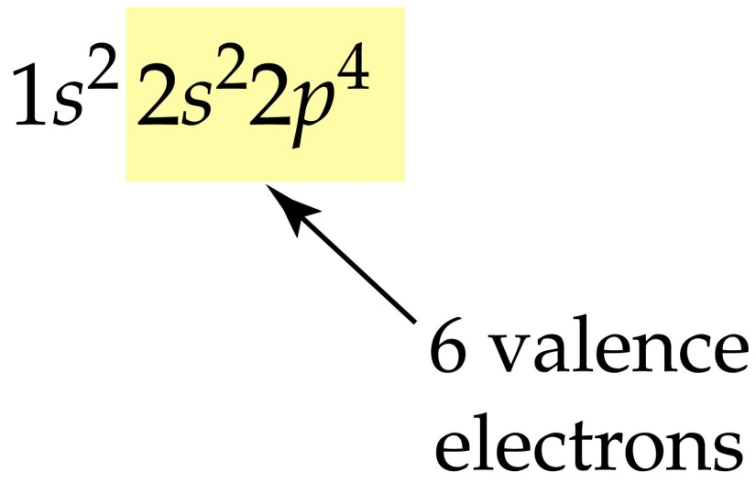
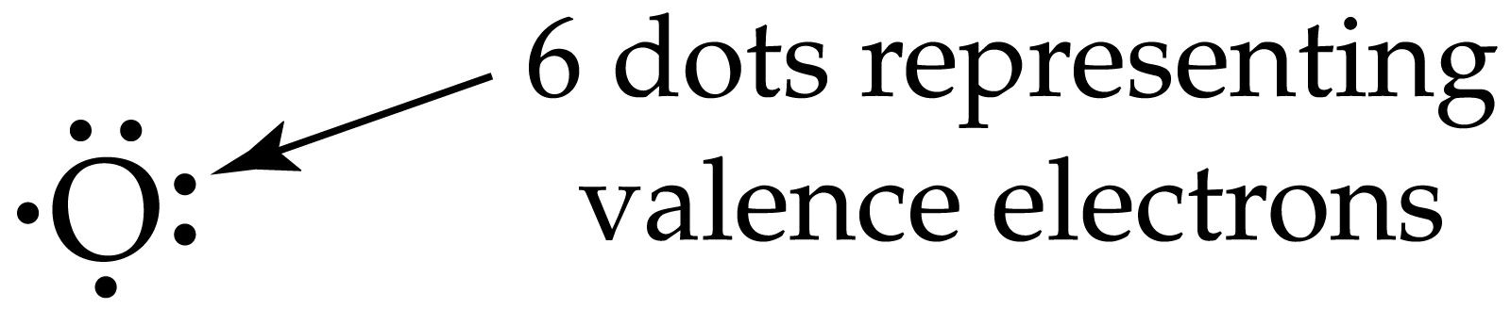
Lewis Electron Dot Structures
For elements
  Composed of elemental symbol + dots representing the outer shell or valence electrons
  For oxygen --

Slide 17
Practice
Draw a Lewis electron dot structure for
N
Ca
Br

Slide 18
Bonding
Atoms like to have a full outer shell and will gain lose or share electrons to achieve a full outer shell
Representative elements gain, lose, or share electrons to have 8 electrons in their outer shell corresponding to full s and p orbitals.
  This is the octet rule.

Slide 19
Naming
An ionic compound can be recognized by the presence of a metal and a nonmetal in the formula or name. Ions held together by electrostatic forces
A covalent compound can be recognized by the presence of two or more nonmetals present in the formula or name. Atoms held together by shared electron
In an ionic compound, metals form positive ions (cations) and non-metals form negative ions (anions).
Chemical formulas of ionic compounds result from combining cations with anions in ratios that result in a net charge of zero for the compound.

Slide 20

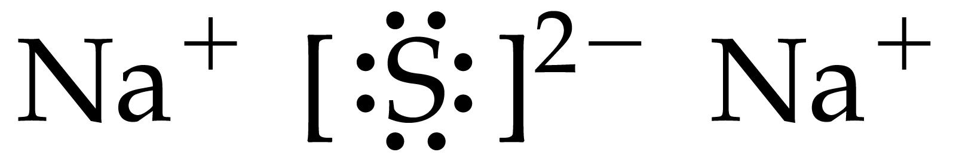
What compound will be formed by the reaction of sodium and sulfur?

Slide 21


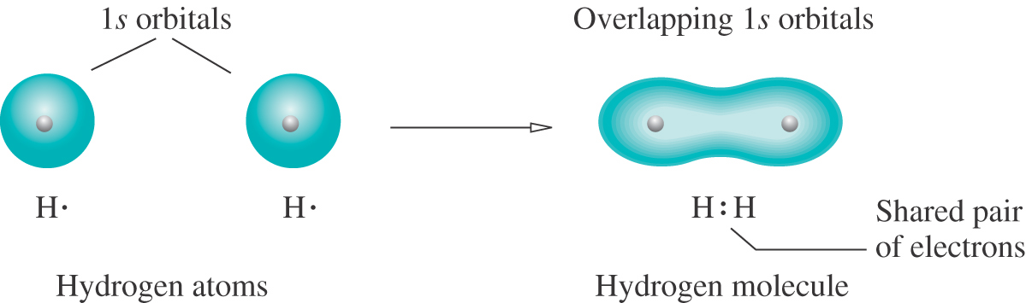
Show bonding in H₂
+

Slide 22
Terminology
Molecule - The simplest representative particle in a compound composed of nonmetals
Formula unit - The simplest representative particle in a compound composed of ions.

Slide 23
Rules for ionic compounds (cation+anion)
List cations first, then anions. Note: if there are more than two types of atoms in the formula, a polyatomic ion is present.
Cations: name (only one possible charge)
  Groups IA to IIIA elements silver (Ag), zinc (Zn) and cadmium (Cd) form only one type of ion each:
  Group IA elements form +1 ions: Li ⁺ , Na ⁺ , K ⁺ , Rb ⁺ , Cs ⁺
  Group IIA elements form +2 ions: Be⁺², Mg⁺², Ca⁺², Sr⁺², Ba⁺²
  Group IIIA elements form +3 ions: Al⁺³ – silver ion = Ag ⁺ ; zinc ion = Zn⁺²; cadmium ion = Cd⁺²
Cations: name (more than one possible charge on the cation)
  metal name and Roman numeral corresponding to the charge on the cation

Slide 24
Rules for ionic compounds (cation+anion)
Anions: in monatomic anion, change ending to –ide;
For ionic compounds:
Write the symbol for each element or polyatomic ion.
Determine the charges on the cation and the anion.
If charges are not equal (they do not add to 0), balance the charges to make a neutral formula. To do this, determine how many of each charged particle must be present to balance out to neutral charge.
Write the formula with subscripts showing how many of each ion is present in the compound.

Slide 25
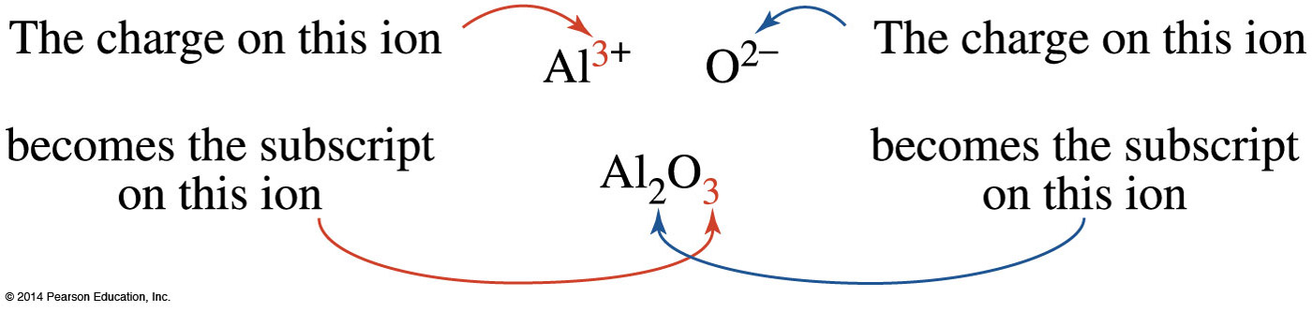
Cross Over Rule
use crossover rule to get formula of the compound
– superscript for cation becomes subscript for anion
– superscript for anion becomes subscript for cation
– simplify subscripts to get lowest ratio of atoms (Note: Only the numbers cross down, not the signs!)

Slide 26
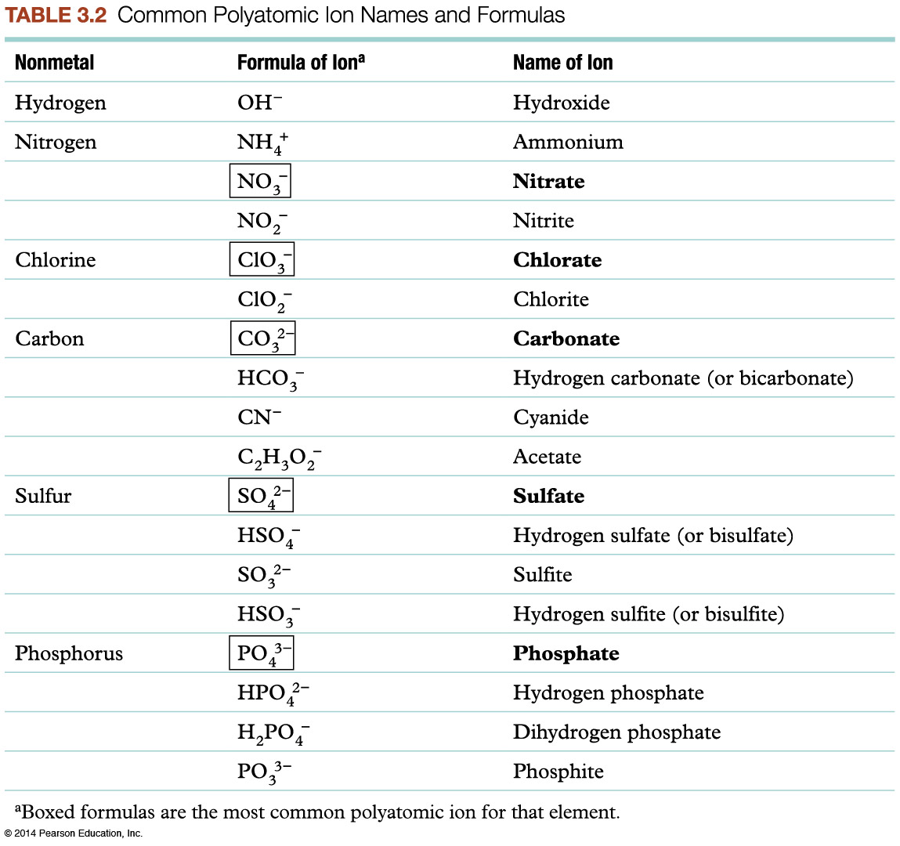
Polyatomic ions
Polyatomic ions consist of a group of nonmetals that form an ion. The charge is for the entire group of atoms.

Slide 27
Rules for Covalent Compounds
STEP 1: Name the first nonmetal as an element.
STEP 2: Name the second nonmetal with an ide ending.
STEP 3: Use prefixes to indicate the number of atoms (subscript) of each element.
1 | mono- | 6 | hexa-
2 | di- | 7 | hepta-
3 | tri- | 8 | octa-
4 | tetra- | 9 | nona-
5 | penta- | 10 | deca-

Slide 28
Practice
Name | Formula |  | Formula | Name
Sodium phosphate |  |  | NH₄OH
Calcium nitrite |  |  | VCl₃
Iron(III) bromide |  |  | Ag₂SO₃
Carbon disulfide |  |  | CaCO₃

Slide 29
Rules for drawing Lewis covalent Structures
Calculate the total number of valence electrons available in the molecule by adding together the valence electron counts for all atoms in the molecule.
Write the chemical symbols of the atoms in the molecule in the order in which they are bonded to one another, and the place a single covalent bond, involving two electrons, between each pair of bonded atoms.
Add nonbonding electron pairs to the structure such that each atom bonded to the central atom has an octet of electrons. Remember that for hydrogen, it is a duet.
Place any remaining electrons on the central atom structure.
If there are not enough electrons to give the central atom an octet, then use one or more pairs of nonbonding electrons on the atoms bonded to the central atom to form double or triple bonds.
Count the total number of electrons in the completed Lewis structure to make sure it is equal to the total number of valence electrons available for bonding as calculated in step 1.

Slide 30
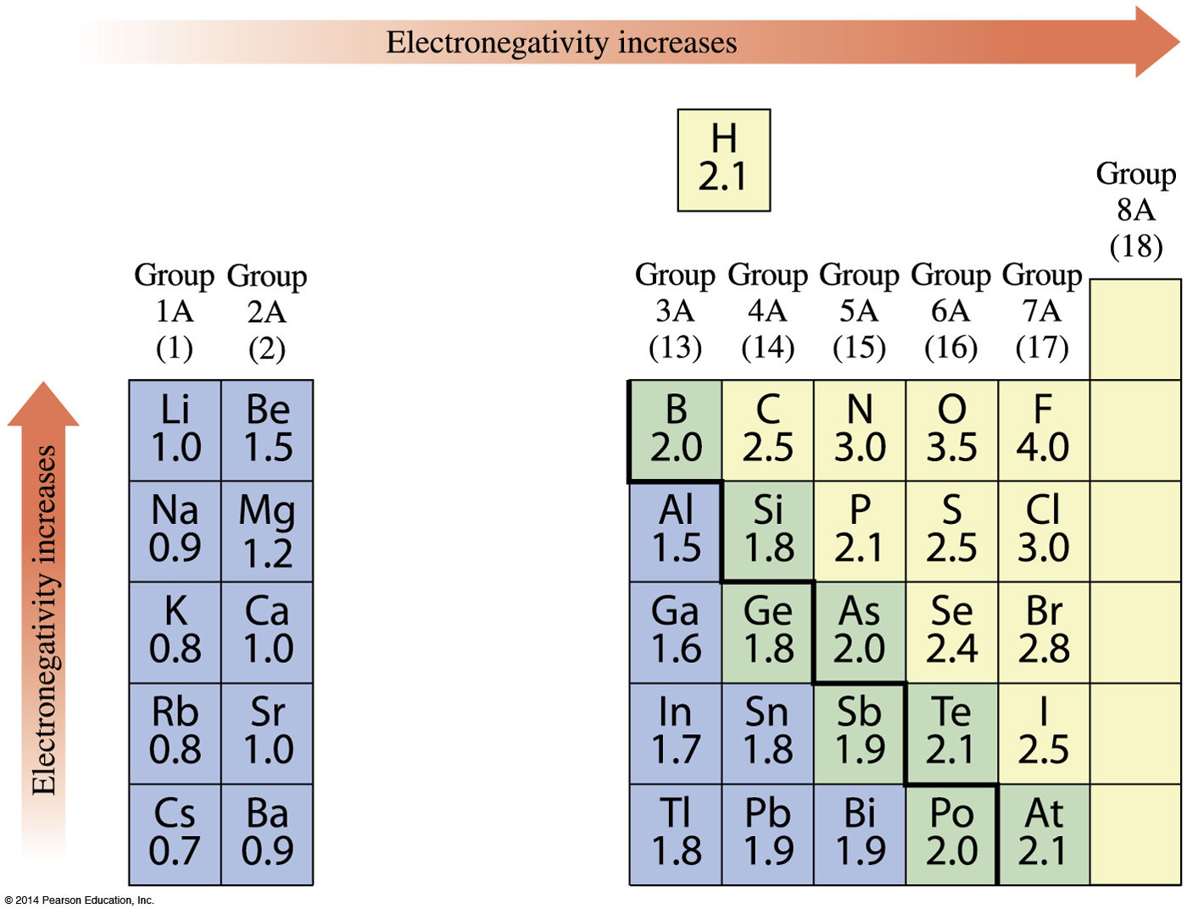
Electronegativity
The ability of an atom to attract the bonding electrons of a covalent bond to itself

Slide 31
Determining the Central Atom
Almost always, the least electronegative atom is the central atom.
For example, in ClO₂, the Cl is the central atom; in SO₃ the S is the central atom.
Select the unique atom, even when it is the most electronegative: e.g., the O in Cl₂O.
A wrong choice usually will be indicated by your being unable to write a valid structure.
Carbon, when present, is always the central atom. Hydrogen can never be the central atom since it can have only one bond.

Slide 32
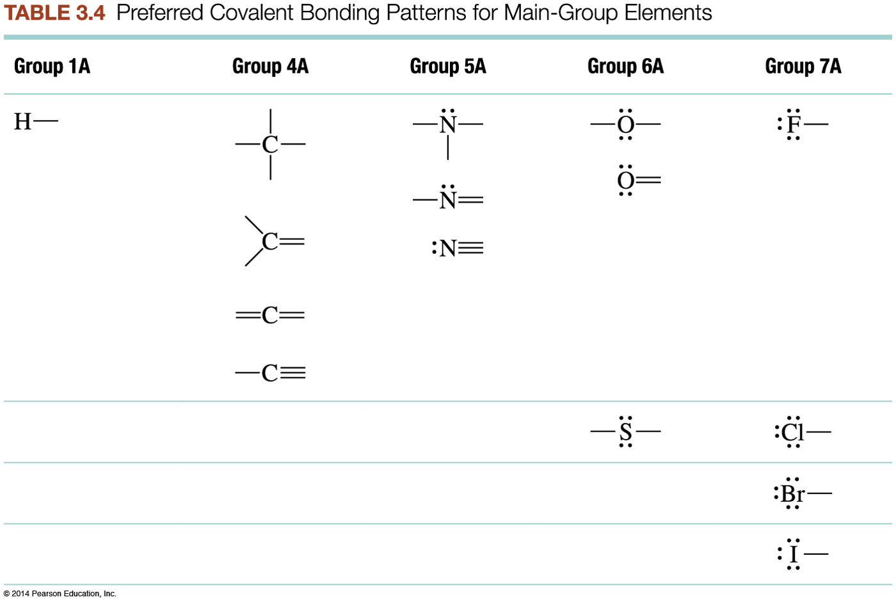

Slide 33
Practice
Write a Lewis structure for H₂CO.
Write the Lewis structure for the NH₄⁺ ion.
Write a Lewis structure for the ClO– ion.

Slide 34
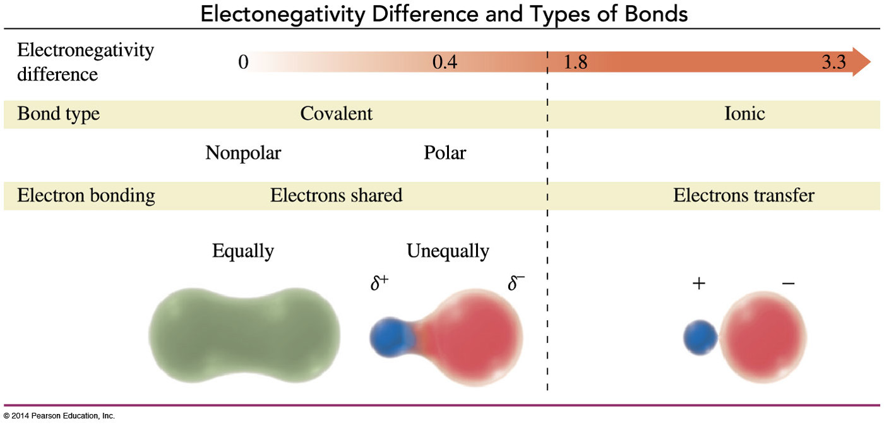
Polar Bonds
Bonds in which electrons are not shared equally due to the electronegativity differences.

Slide 35
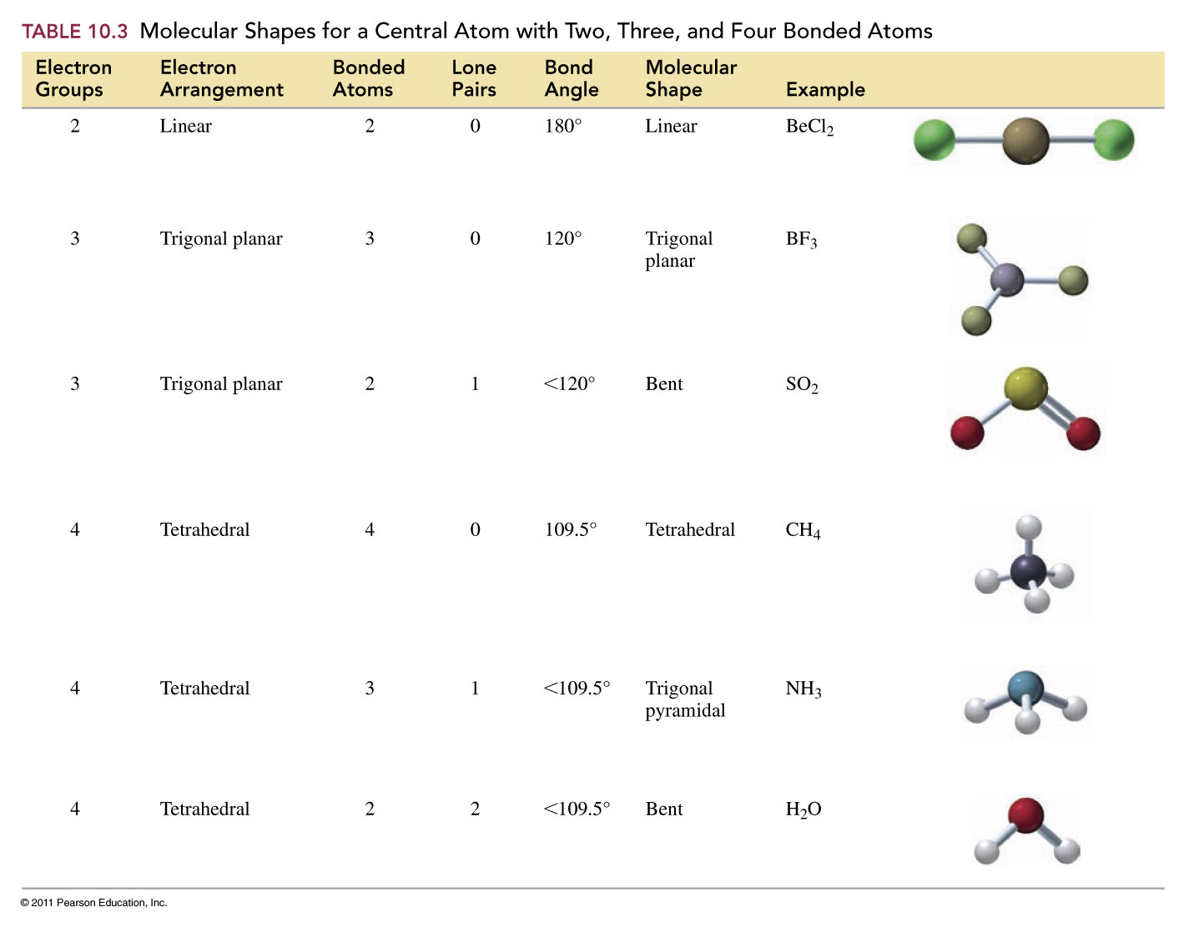
Determining the Shape of a Molecule

Slide 36
Determine the electron arrangement (orbital geometry)
and molecular geometries for each of the following molecules.
molecule | electron arrangement | molecular geometry

Slide 37
Molecular Polarity
A polar molecule has an uneven distribution of electrons over the molecule.
A nonpolar molecule has an even distribution of electrons over the entire molecule.
In order to be a polar molecule, two criteria must be met:
There must be at least one polar bond
The bond polarities must not ‘cancel out’ based on symmetry .

Slide 38
Is the molecule polar or non-polar?
To determine this;
Show the electron tally for each molecule. Draw the Lewis Structure.
Show the structural formula, and name the shape of each compound.
Determine polarity of each bond, add δ ⁻and δ ⁺ symbols onto the structures if necessary.
Indicate with an arrow any net dipole in the molecule and then state whether each molecule is polar or non-polar.
Practice
Cl₂ PCl₃ CCl₄

Slide 39

Mole
mole The mass of an element in grams to the number of atoms it contains.
Avogadro’s number (N): 1 mole particle = 6.022 x 10²³ particles
example
molar mass in grams numerically equal to the atomic mass of that element.
Molar mass – mass of a compound
  = Σ atomic masses of constituent elements
C₂H₆ = 2(12.01) + 6(1.008) = 30.08 g/mol
Ca₃(PO₄)₂ = 3(40.08) + 2(30.97) + 8(16.00) = 310.18 g/mol

Slide 40
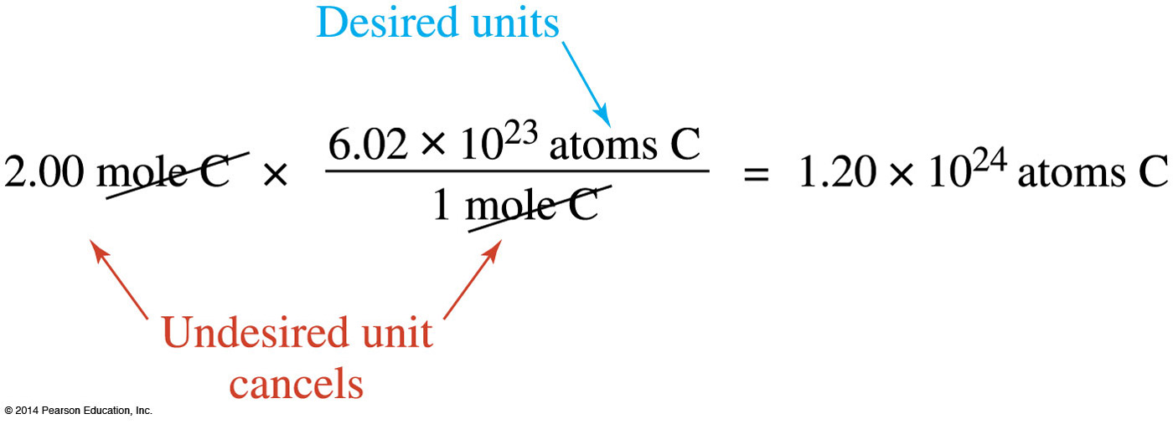

Finding the Number of Molecules in a Sample
Step 1: Calculate the molar mass of the compound.
Step 2: Apply conversion factors to reach the desired unit.

Slide 41
Dimethyl sulfoxide also known as DMSO has the chemical formula (CH₃)₂SO.
  Calculate the molar mass of DMSO.
  Calculate the mass of 4.63 mol of DMSO.
  Calculate the number of molecules of DMSO in 2.53 mol of DMSO.
  Calculate the number of atoms of hydrogen in 6 molecules of DMSO.

