Slide 1
Chapter 11
Nucleic Acids—Big Molecules with a Big Role
Components of Nucleic Acids
Nucleic Acid Formation
DNA
RNA and Protein Synthesis
Putting It Together: The Genetic Code and Protein Synthesis
Genetic Mutations
Viruses
Recombinant DNA Technology

Slide 2
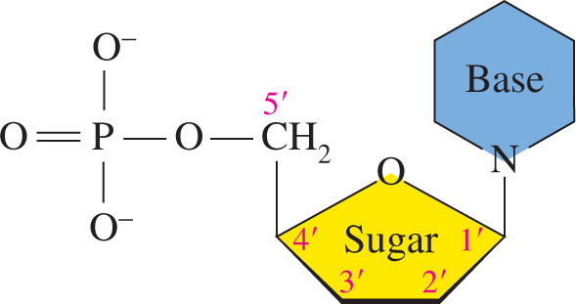
Nucleic Acids
The nucleic acids DNA and RNA
consist of monomers called
nucleotides that consist of a
pentose sugar
base
phosphate
nucleotide

Slide 3
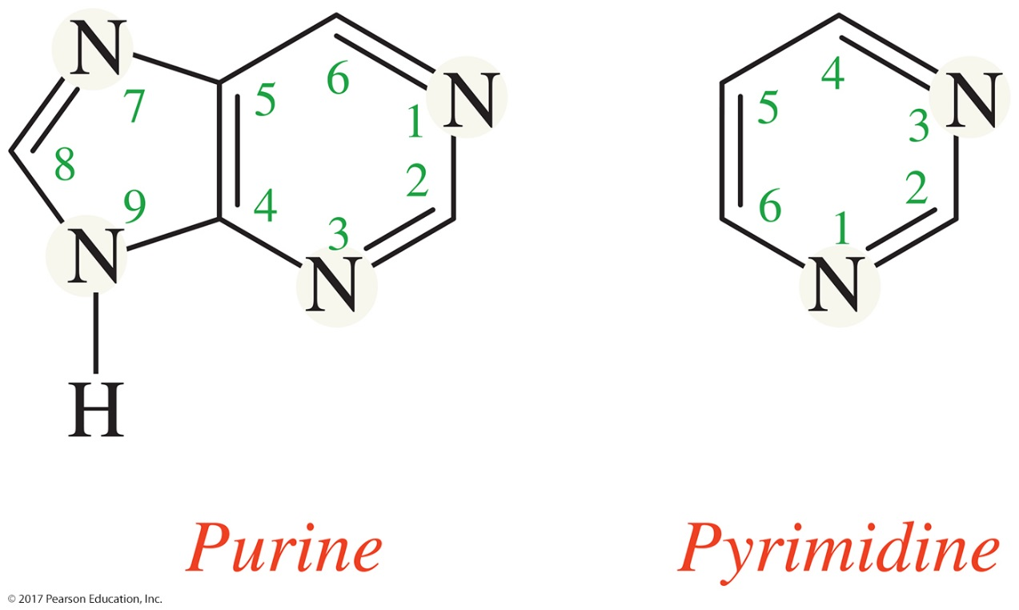
Components of Nucleic Acids
Nitrogenous Bases
There are four different nitrogenous bases found in a nucleic acid.
Each of the bases has one of two nitrogen-containing aromatic rings, either a purine or a pyrimidine.
© 2017 Pearson Education, Inc.

Slide 4
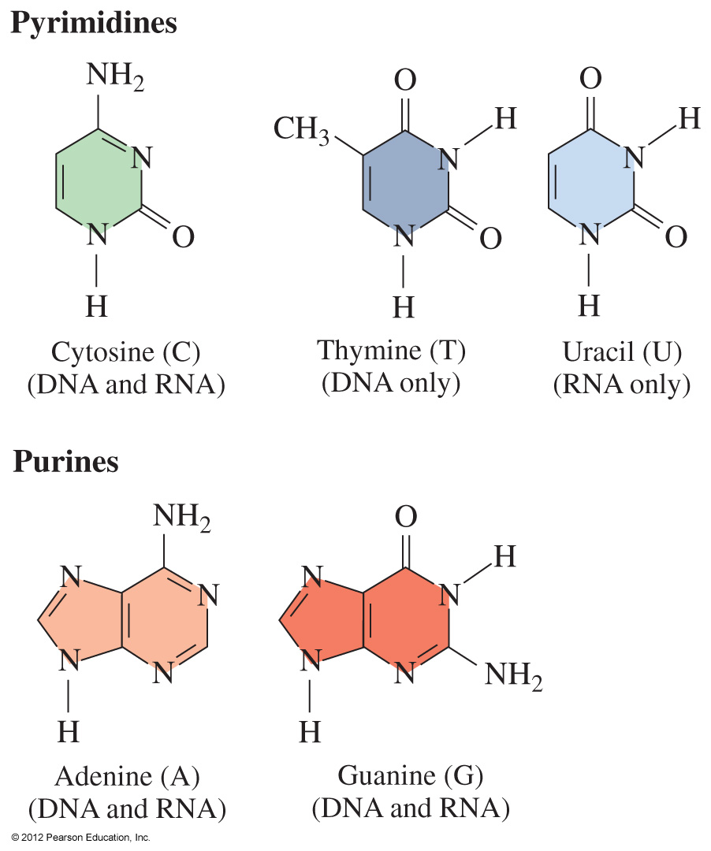
Bases
The bases in DNA and RNA are
pyrimidines C, T, and U
purines A and G

Slide 5
Bases in DNA and RNA
DNA contains the bases
Cytosine (C)
Guanine (G) same in both DNA and RNA
Adenine (A)
Thymine (T) different in DNA than in RNA
RNA contains the bases
Cytosine (C)
Guanine (G) same in both DNA and RNA
Adenine (A)
Uracil (U) different in RNA than in DNA

Slide 6
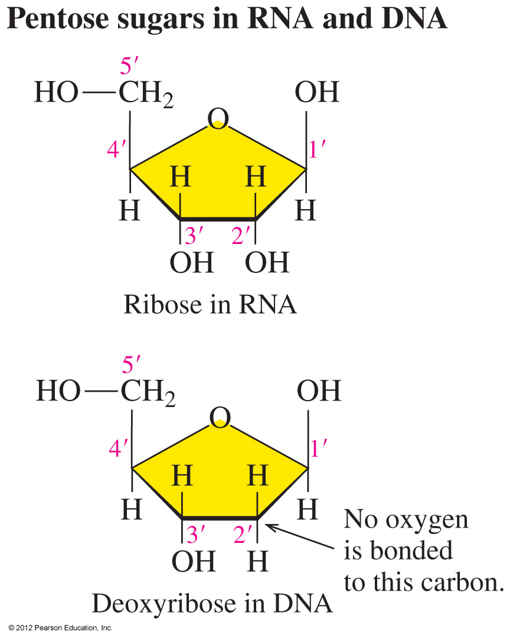
Pentose Sugars
The pentose (five-carbon) sugar
in RNA is ribose
in DNA is deoxyribose, with no O atom on carbon 2'
has carbon atoms numbered with primes to distinguish them from the atoms in the bases

Slide 7
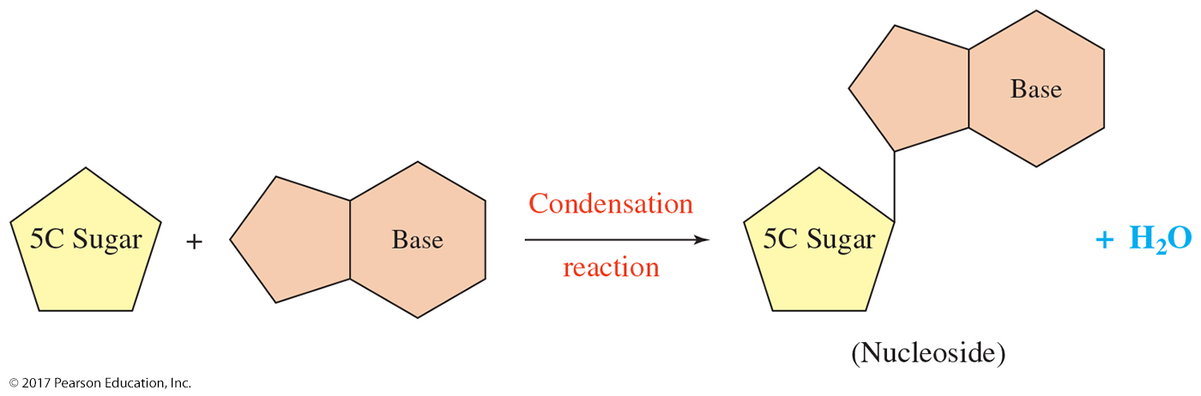
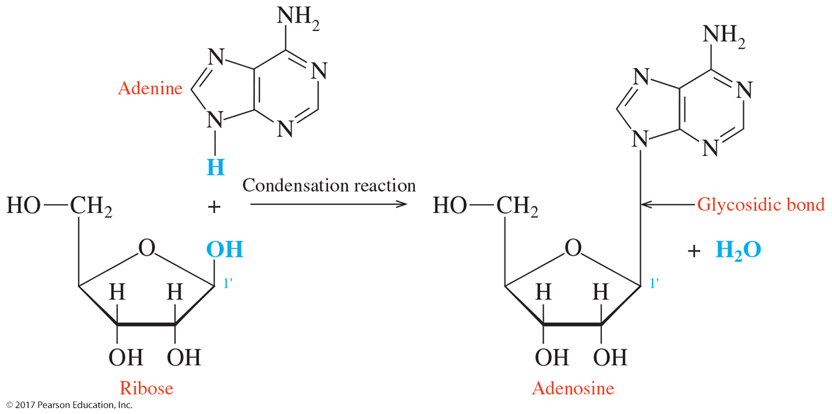
Components of Nucleic Acids
Condensation of the Components
© 2017 Pearson Education, Inc.

Slide 8
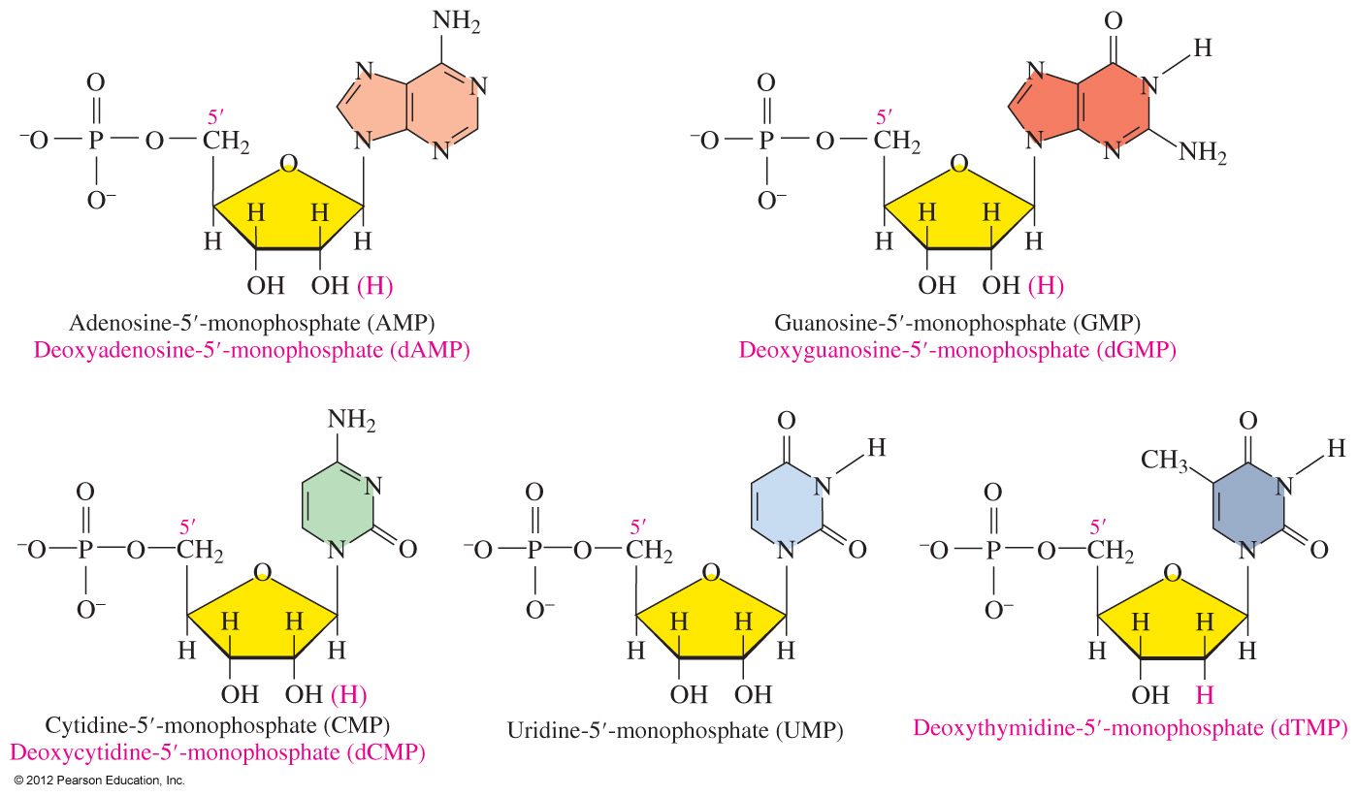
Nucleotides
The nucleotides of RNA are identical to those of DNA, except in DNA the sugar is deoxyribose and deoxythymidine replaces uridine.

Slide 9
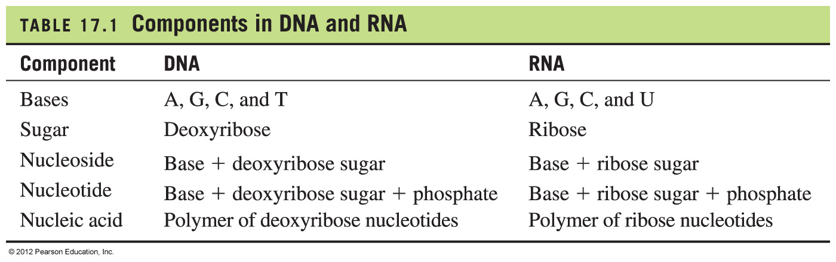
Components in DNA and RNA

Slide 10
Naming Nucleosides and Nucleotides
Nucleosides
that contain a purine end with osine
that contain a pyrimidine end with idine
of DNA add deoxy to the beginning of their name
Corresponding nucleotides in RNA and DNA are named by
adding -5'-monophosphate.
Abbreviations for bases A, G, C, U, and T are often used in
respective nucleosides and nucleotides.

Slide 11
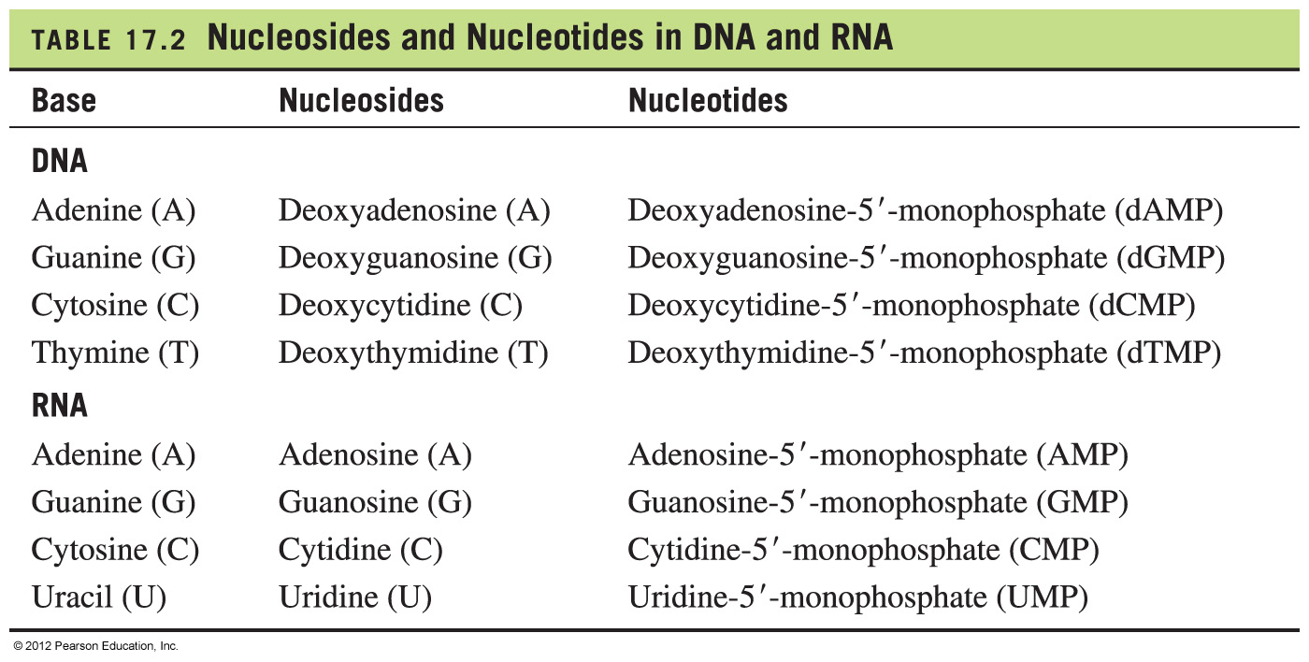
Nucleosides and Nucleotides in DNA, RNA

Slide 12
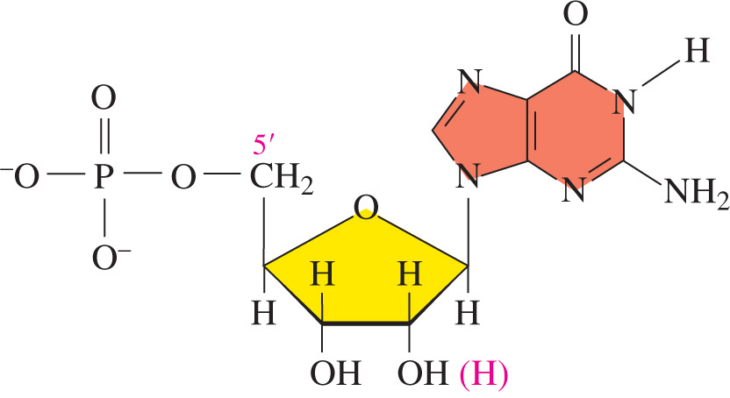
Practice
Give the name and abbreviation for the following and list its base and sugar.

Slide 13
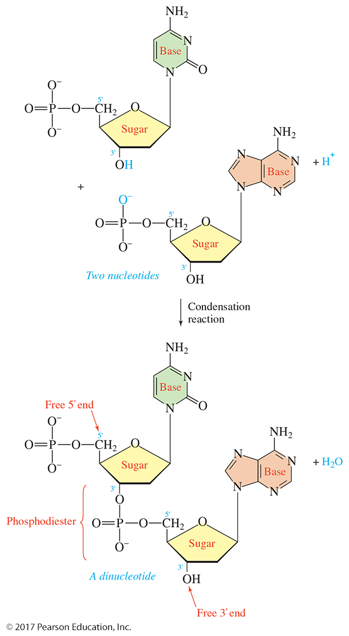
Nucleic Acid Formation
Many nucleotides linked together form nucleic acids.
Nucleotides are linked through phosphodiester bonds.
Oxygens in the phosphate are connected between the 3′ and 5′ carbons of adjacent sugar molecules.
© 2017 Pearson Education, Inc.

Slide 14
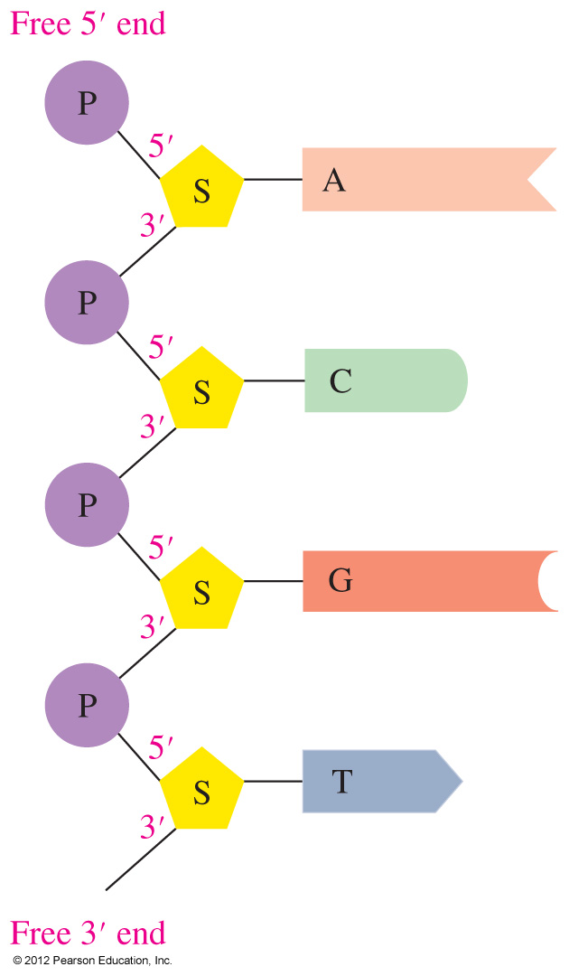
Primary Structure of
Nucleic Acids
In the primary structure of nucleic acids in
DNA and RNA chains,
each sugar in a sugar−phosphate backbone is attached to a base
the bases extend out from the nucleic acid backbone
are labeled starting with the free 5' end to the 3' end.
In this nucleic acid, the sequence of bases is
represented by 5'−A−C−G−U−3'.

Slide 15
Practice
Draw the structure of the dinucleotide A−C in RNA

Slide 16
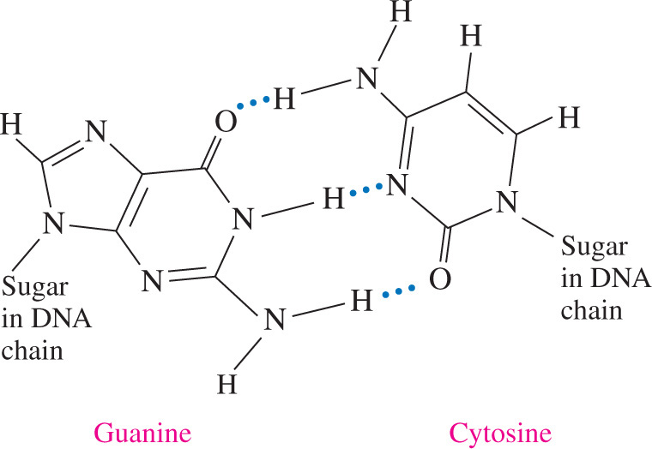
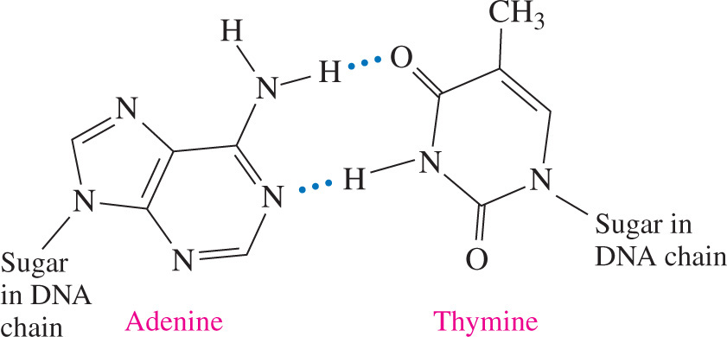
Complementary Base Pairs
  DNA contains complementary base pairs, equal amounts of A and T and equal amounts of G and C bases in which
  adenine is always linked by two hydrogen bonds with thymine (A−T)
  guanine is always linked by three hydrogen bonds with cytosine (G−C)

Slide 17
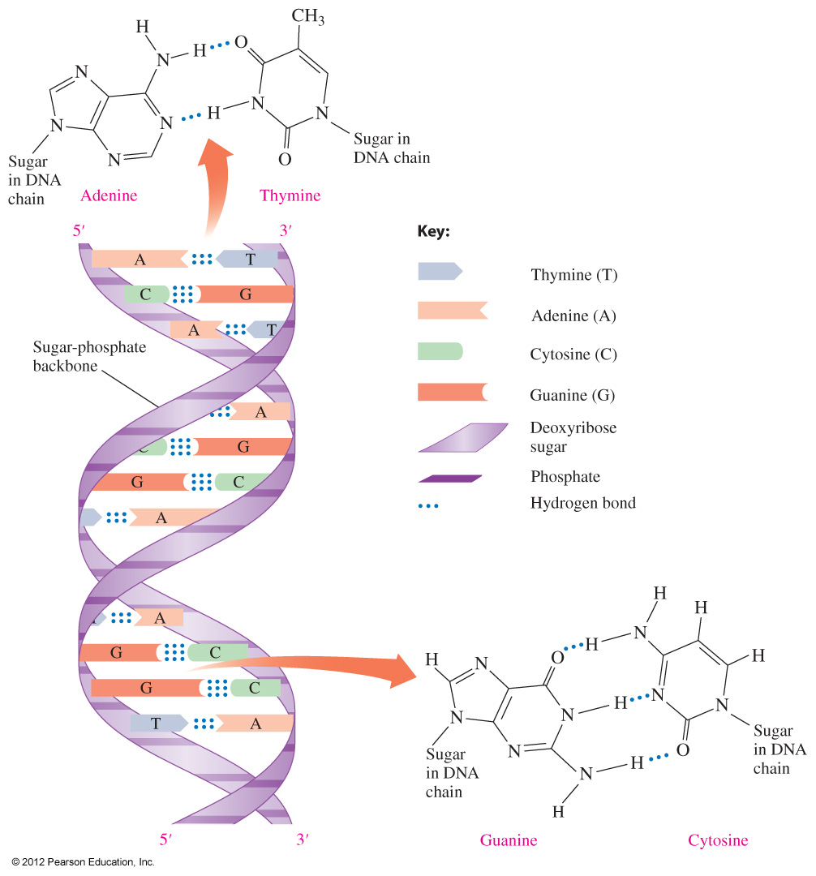
DNA Double Helix
In the double helix of DNA,
the two chains are held together by hydrogen bonds that link bases
A–T and G–C
the bases along one strand complement the bases
along the other

Slide 18
Practice
Write the complementary base sequence for the matching strand in the following DNA section:
—A—G—T—C—C—A—A—T—C—

Slide 19
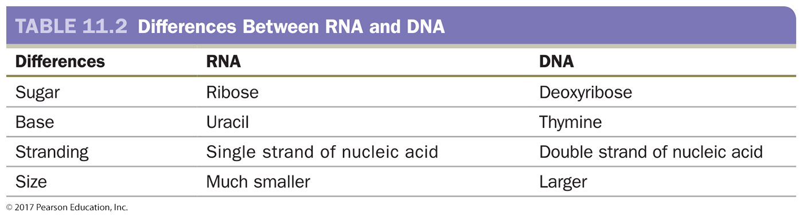
RNA and Protein Synthesis
RNA is the “middleman” in the process of creating a protein from a gene in DNA.
Like DNA, RNA is a string of nucleotides.
RNA does not contain thymine.
The base uracil is substituted, and it is complementary to adenine, forming two hydrogen bonds (A=U).
© 2017 Pearson Education, Inc.

Slide 20
Types of RNA
RNA transmits information from DNA to make proteins and has several types:
Messenger RNA (mRNA) carries genetic
information from DNA to the ribosomes.
Transfer RNA (tRNA) brings amino acids to the
ribosome to make the protein.
Ribosomal RNA (rRNA) makes up 2/3 of ribosomes,
where protein synthesis takes place.

Slide 21
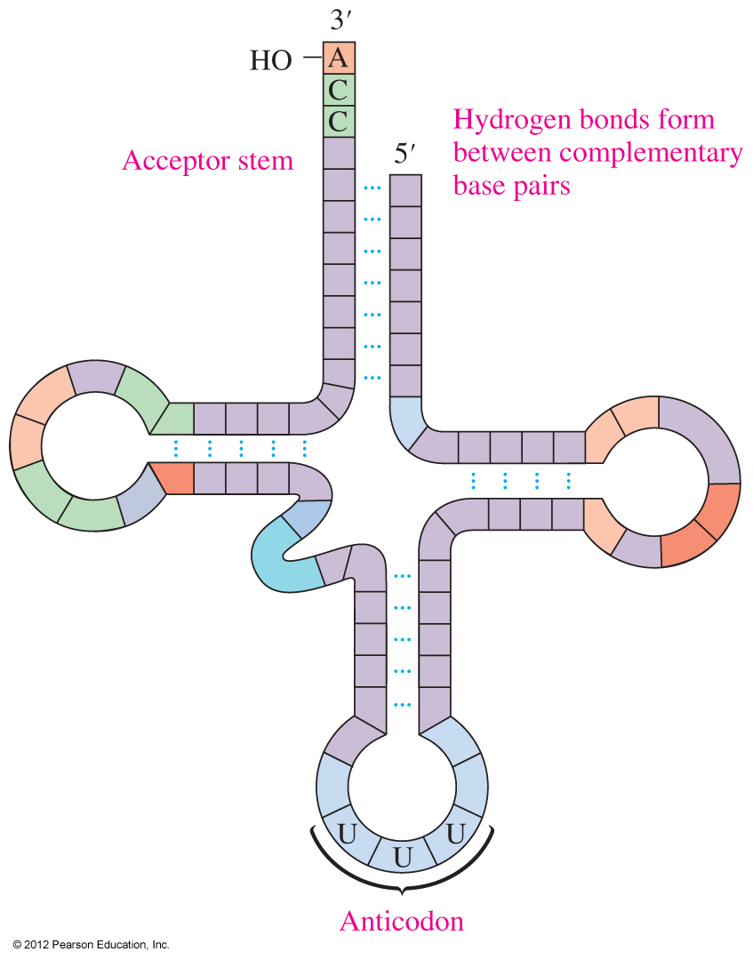
tRNA
tRNA, the smallest RNA, is the only type of RNA that can translate genetic information into amino acids for proteins.
tRNA has a cloverleaf shape when hydrogen bonds form between its complementary bases.
The acceptor stem attaches to an amino acid and its anticodon bonds with a codon on mRNA.
Insert Figure 17.10 pg 612.

Slide 22
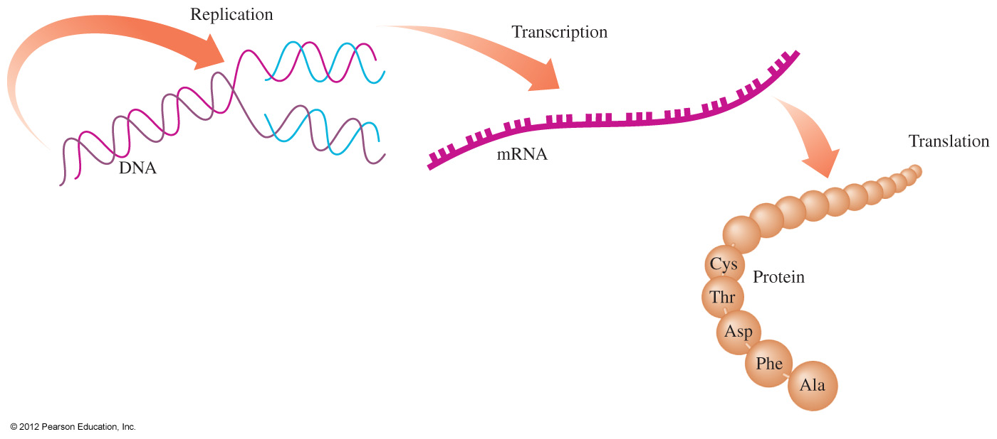
Protein Synthesis
Protein synthesis involves
transcription: mRNA is formed from a gene on a DNA strand
translation: tRNA molecules bring amino acids to mRNA to
build a protein
The genetic information in DNA is replicated in cell division and used to produce mRNAs that code for the amino acids needed for protein synthesis.

Slide 23
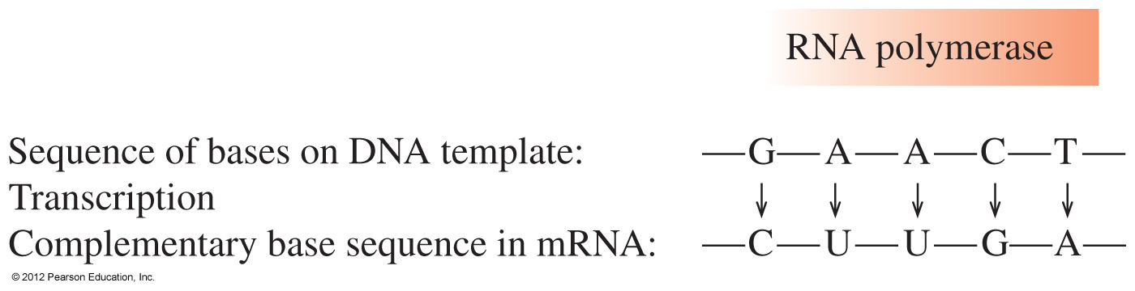
Protein Synthesis: Transcription
Transcription begins when a section of DNA containing the gene unwinds.
Within the unwound DNA, RNA polymerase enzyme uses one of the strands as a template to synthesize mRNA.
mRNA is synthesized using complementary base pairing, with uracil (U) replacing thymine (T).
The newly formed mRNA moves out of the nucleus to ribosomes in the cytoplasm.

Slide 24
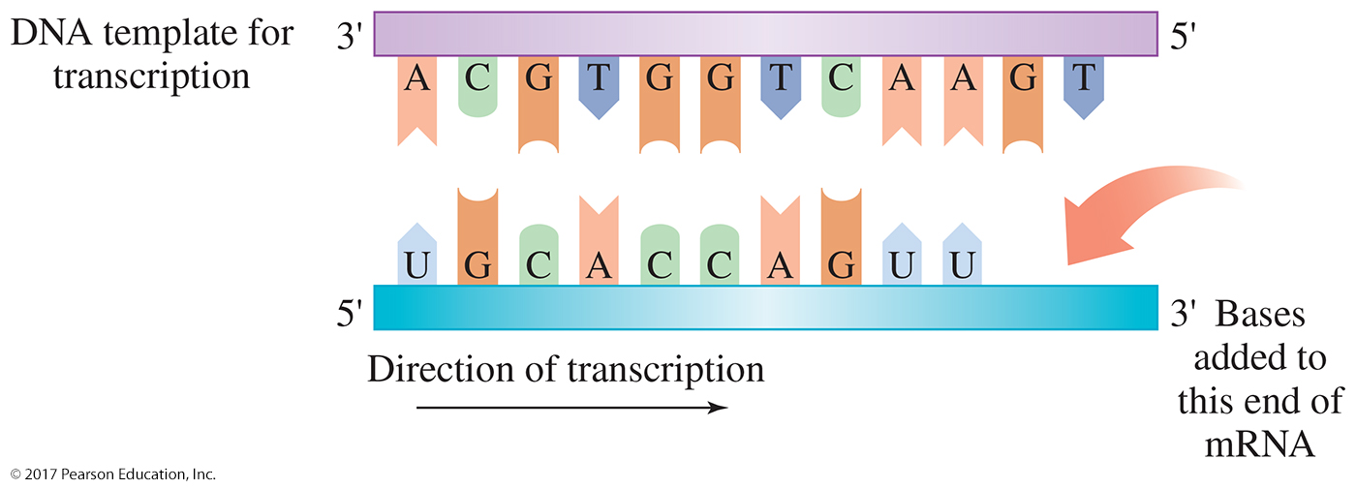
Transcription
Gene copying is catalyzed by RNA polymerase.

Slide 25
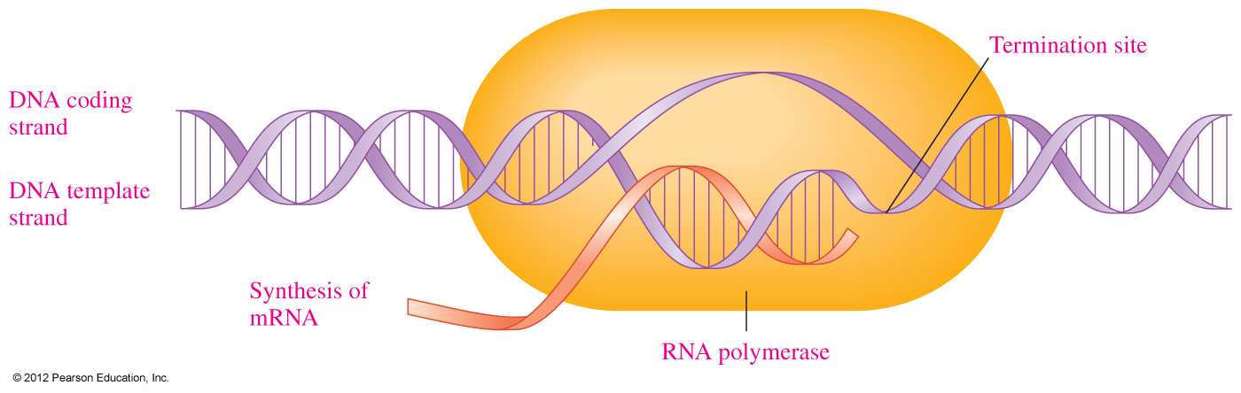
RNA Polymerase
During transcription,
RNA polymerase moves along the DNA template to synthesize the corresponding mRNA
the mRNA is released at the termination point

Slide 26
Practice
What is the sequence of bases in mRNA produced from a section of the template strand of DNA that has the sequence of bases
–C–T–A–A–G–G–?

Slide 27
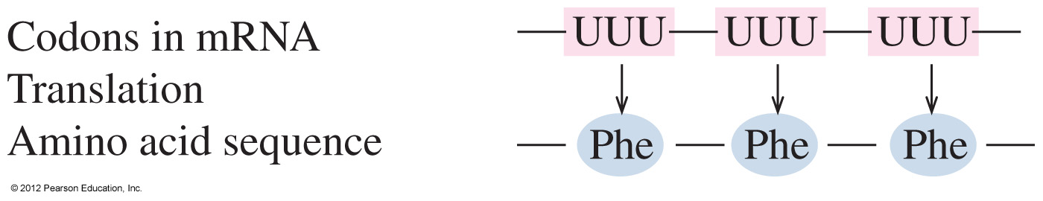
Genetic Code
The genetic code
is a series of three nucleotides in mRNA called codons that determine the amino acid order for the protein
has a different codon for all 20 amino acids needed to build a protein
contains certain codons that signal the “start” and “end” of a polypeptide chain
For example, a sequence of −UUU−UUU−UUU− codes for three
phenylalanine amino acids.

Slide 28
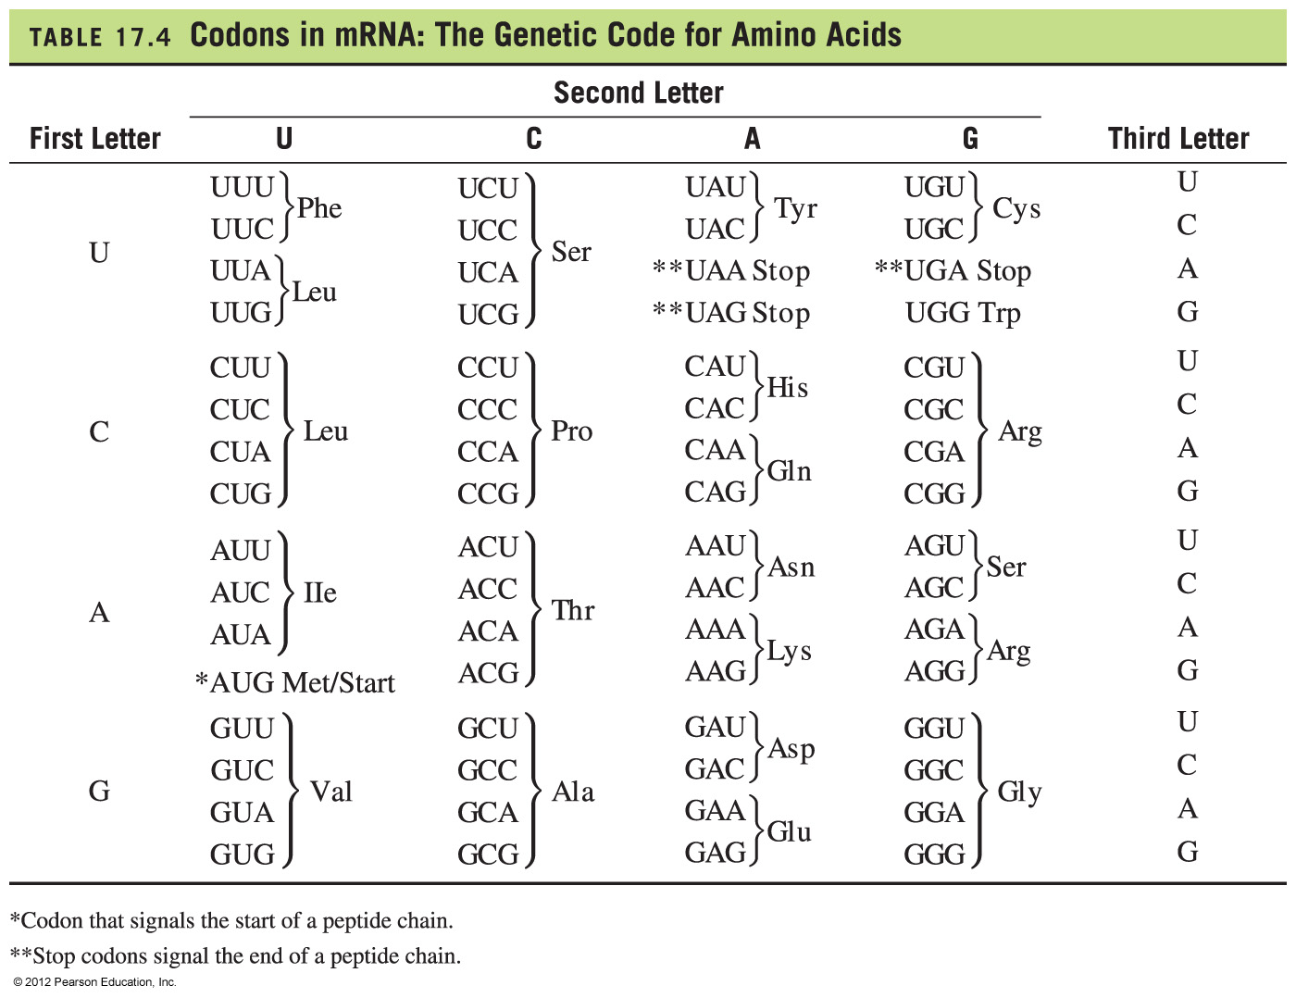
The Genetic Code: mRNA Codons

Slide 29
Codons and Amino Acids
Determine the amino acids from the following
codons in a section of mRNA.
—CCU—AGC—GGA—CUU—
According to the genetic code, the amino acids for these
codons are
CCU = proline AGC = serine
GGA = glycine CUU = leucine
This mRNA section codes for an amino acid sequence of
—CCU—AGC—GGA—CUU—
— Pro — Ser — Gly — Leu —

Slide 30
Practice
Write the order of amino acids coded for by a section of mRNA with the base sequence
—GCC—GUA—GAC—

Slide 31
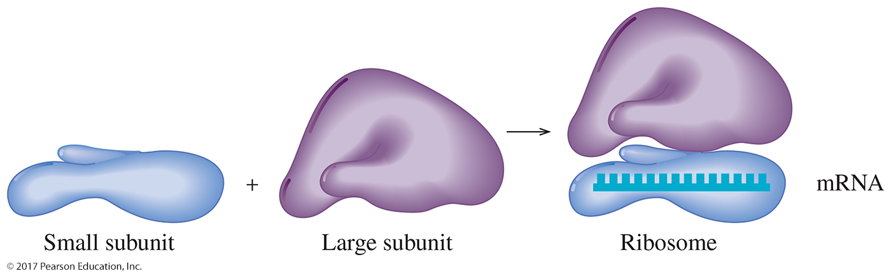
RNA and Protein Synthesis
Ribosomal RNA and the Ribosome
The ribosome is an organelle composed of ribosomal RNA (rRNA) and protein.
It is the place where the nucleotide sequence of mRNA is interpreted into an amino acid sequence.
The ribosome has two rRNA/protein subunits called the small subunit and the large subunit.
The mRNA strand fits into a groove on the small subunit with the bases pointing toward the large subunit.
© 2017 Pearson Education, Inc.

Slide 32
Initiation of Protein Synthesis
For the initiation of protein synthesis,
an mRNA attaches to a ribosome
the start codon (AUG) in mRNA forms hydrogen bonds to methionine on tRNA
the second codon attaches to a tRNA with the next
amino acid
a peptide bond forms between the adjacent amino acids at the first and second codons
During chain elongation, the ribosome moves along the mRNA
from codon to codon, attaching new amino acids to the growing
polypeptide chain.

Slide 33
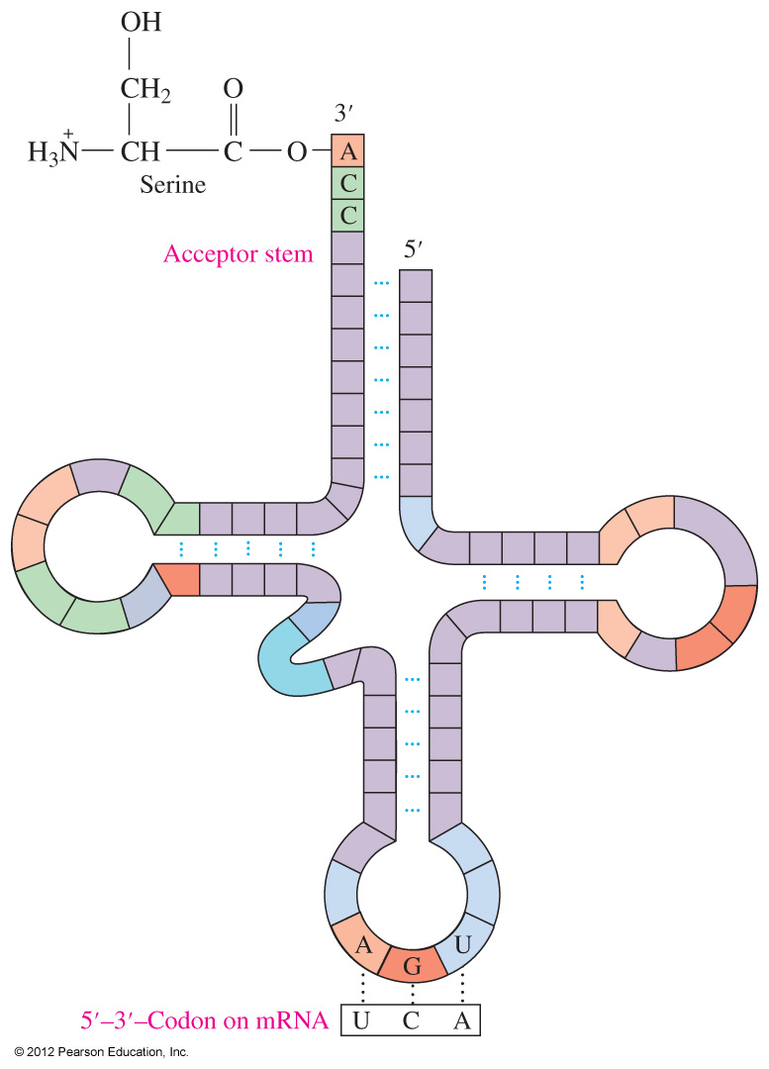
Initiation of Protein Synthesis
An activated tRNA with anticodon AGU bonds to serine at the acceptor stem.

Slide 34
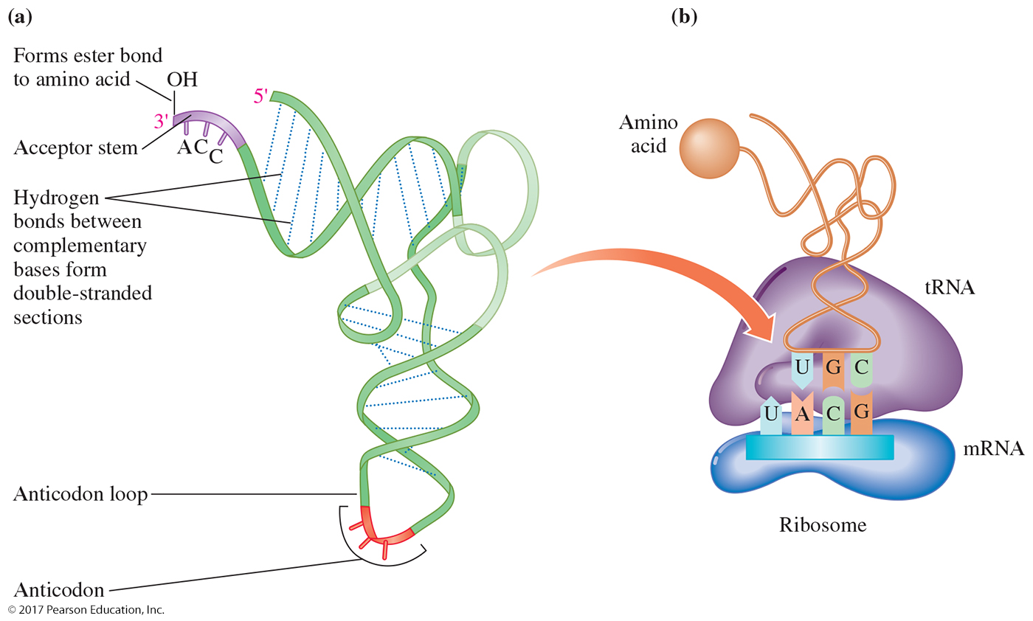

Slide 35
Translocation
Once the peptide bond is formed, the initial tRNA detaches from
the ribosome, which shifts to the next available codon, a process
called translocation.
During translocation,
the first tRNA detaches from the ribosome
the ribosome shifts to the adjacent codon on the mRNA
a new tRNA/amino acid attaches to the open binding site
a peptide bond forms and that tRNA detaches
the ribosome shifts down the mRNA to read the next codon

Slide 36
Peptide Formation
Peptide chain starts to form
Anticodons UAC AGA AGA GAG
• • • • • • • • • • • •
AUG UCU CUC UCU CUC UUU
Met
Met
Ser
Ser
Leu
tRNA
Ribosome Ribosome shifts

Slide 37
Termination
In the termination step,
all the amino acids are linked
the ribosome reaches a “stop” codon: UGA, UAA, or UAG
there is no tRNA with an anticodon for the “stop” codons
the polypeptide detaches from the ribosome

Slide 38
Termination
Once the polypeptide is released,
the R groups of the amino acids in the new polypeptide can form hydrogen bonds to give the secondary structures of α helices, β-pleated sheets, or triple helices
chains form cross-links such as salt bridges and disulfide bonds to produce tertiary and quaternary structures, which makes it a biologically active protein

Slide 39
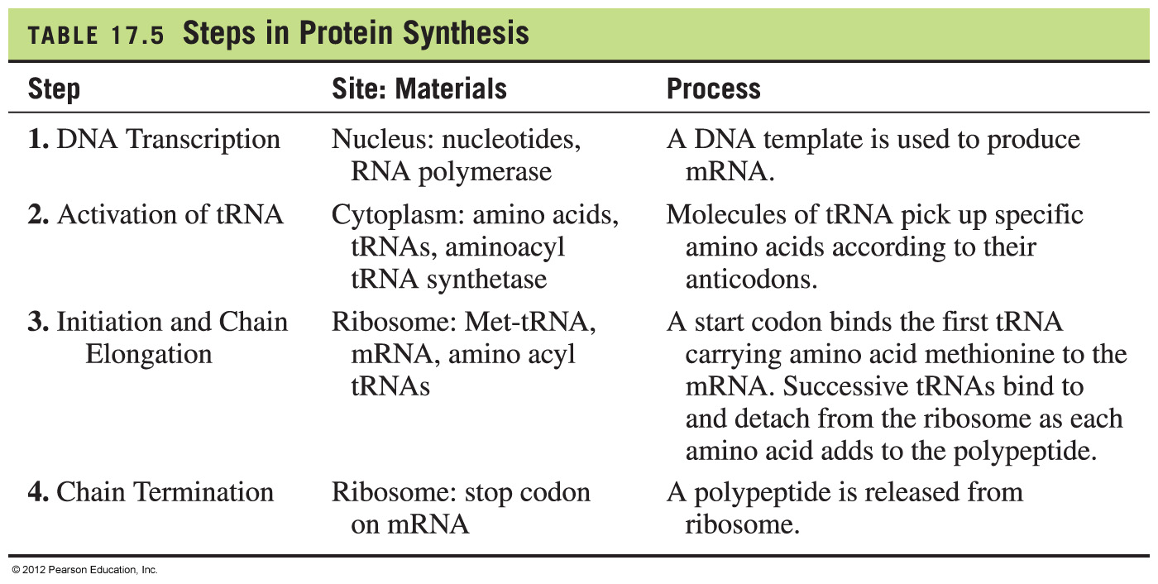
Summary of Protein Synthesis

Slide 40
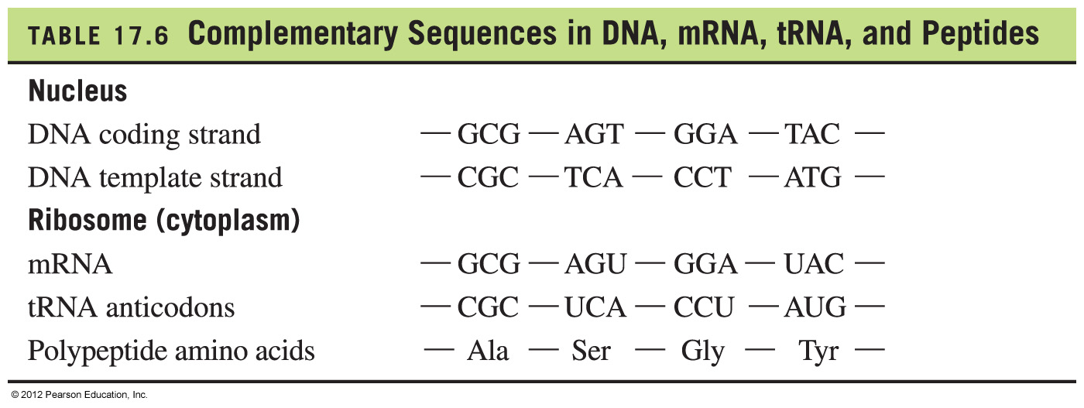
Complementary Sequences in DNA, mRNA, tRNA, and Peptides

Slide 41
Practice
Assign each of the following terms to a definition or concept.
activation initiation
translocation termination
A. Ribosomes move along mRNA, adding amino acids to a growing peptide chain.
B. A completed peptide chain is released.
C. A tRNA attaches to its specific amino acid.
D. A tRNA binds to the AUG codon of the mRNA on the ribosome.

Slide 42
Practice
The following section of DNA is used to build mRNA for a protein.
—GAA—CCC—TTT—
A. What is the corresponding mRNA sequence?
B. What are the anticodons on the tRNAs?
C. What is the amino acid order in the peptide?

Slide 43
Mutations
A mutation, or change in the nucleotide sequence of
DNA, can
result from mutagens such as radiation and chemicals
produce one or more incorrect codons in mRNA
produce a protein containing one or more incorrect amino acids
produce defective proteins and enzymes
cause genetic diseases

Slide 44
Types of Mutations
A substitution or point mutation is the replacement of one base in the template strand of DNA with another.
If a substitution or point mutation changes the nucleotide, a different amino acid may be inserted into the polypeptide.
If this produces no change in the amino acid sequence, it is called a silent mutation.
A frameshift mutation is the insertion of a single nucleotide into the sequence resulting in a change to all subsequent codons, leading to a new amino acid sequence.

Slide 45
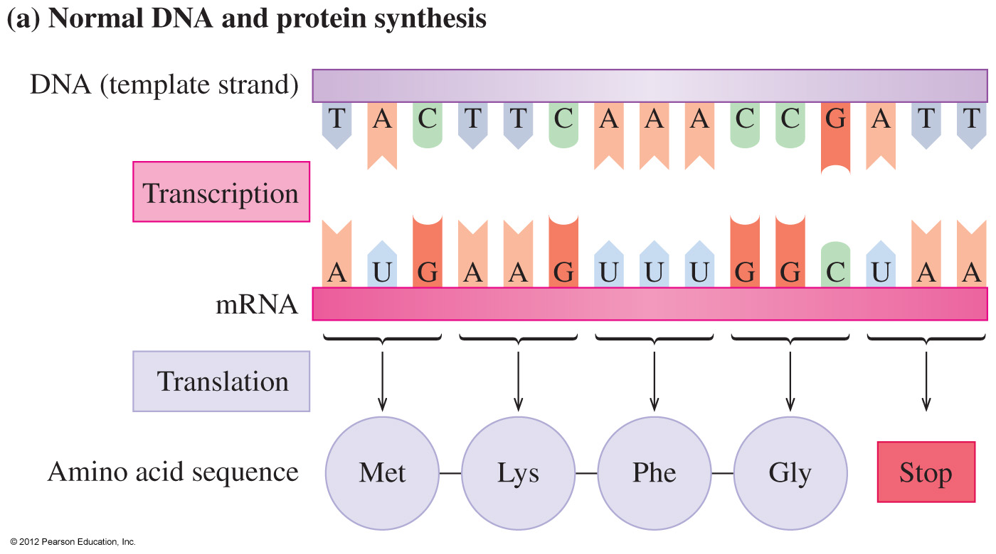
Normal DNA and Protein Synthesis
The normal DNA sequence produces a mRNA that provides instructions for the correct series of amino acids in a protein.

Slide 46
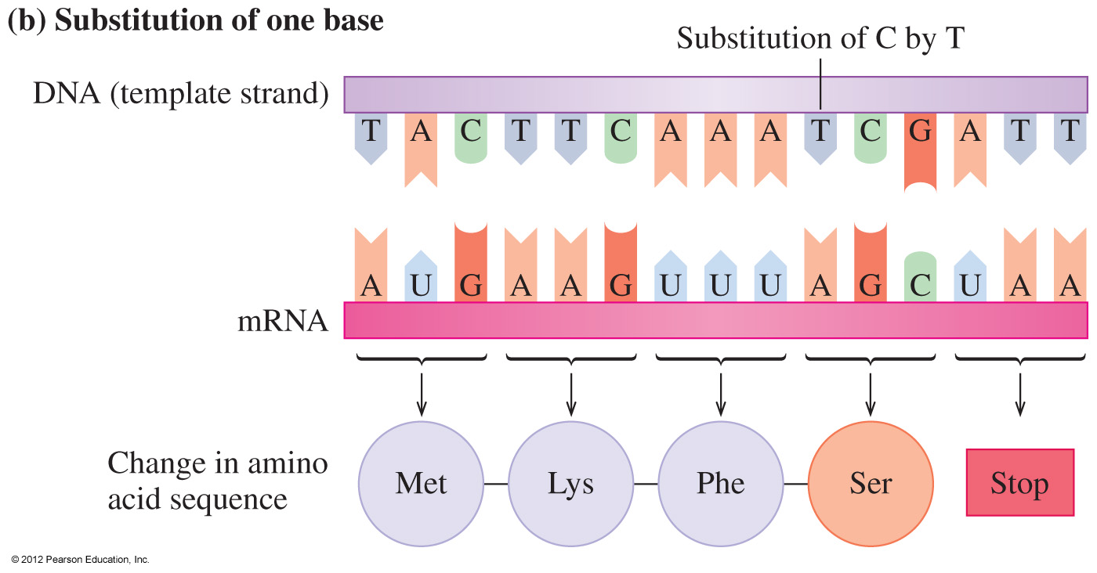
Mutation: Substitution
Substitution
of a base in DNA changes a codon in the mRNA
of a different codon leads to the placement of an incorrect amino acid in the polypeptide

Slide 47
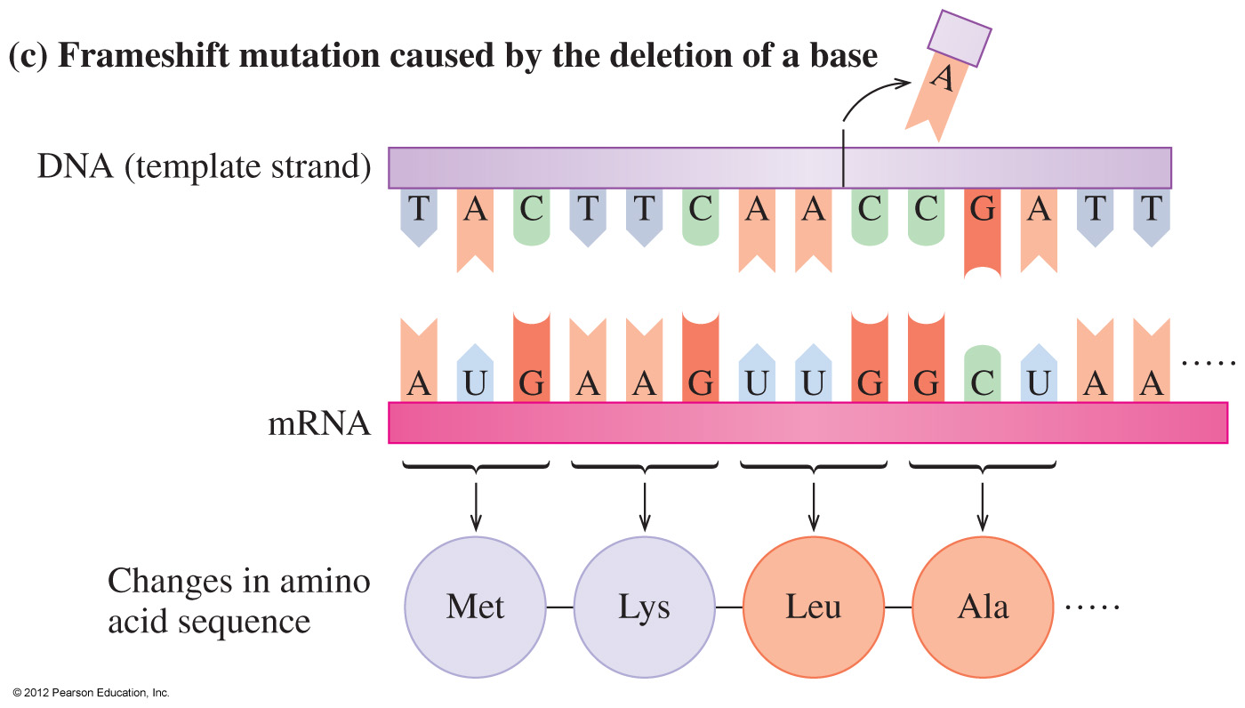
Frameshift Mutation
In a frameshift mutation,
an extra base adds to or is deleted from the normal DNA sequence
all the codons in mRNA and amino acids are incorrect from the base change

Slide 48
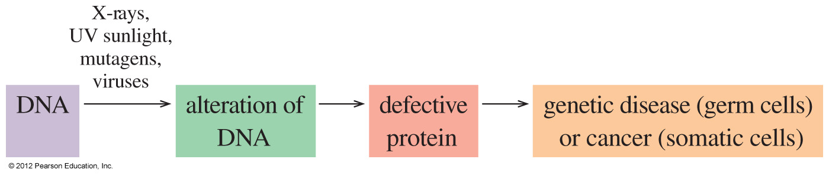
Effect of Mutations
When a mutation causes a change in the amino acid sequence the structure of the resulting protein may be severely altered, causing loss of its biological activity.
Altered enzymes cannot catalyze reactions, and possible toxins may accumulate in the body and may be lethal.
When this condition is hereditary, it is called a genetic disease.

Slide 49
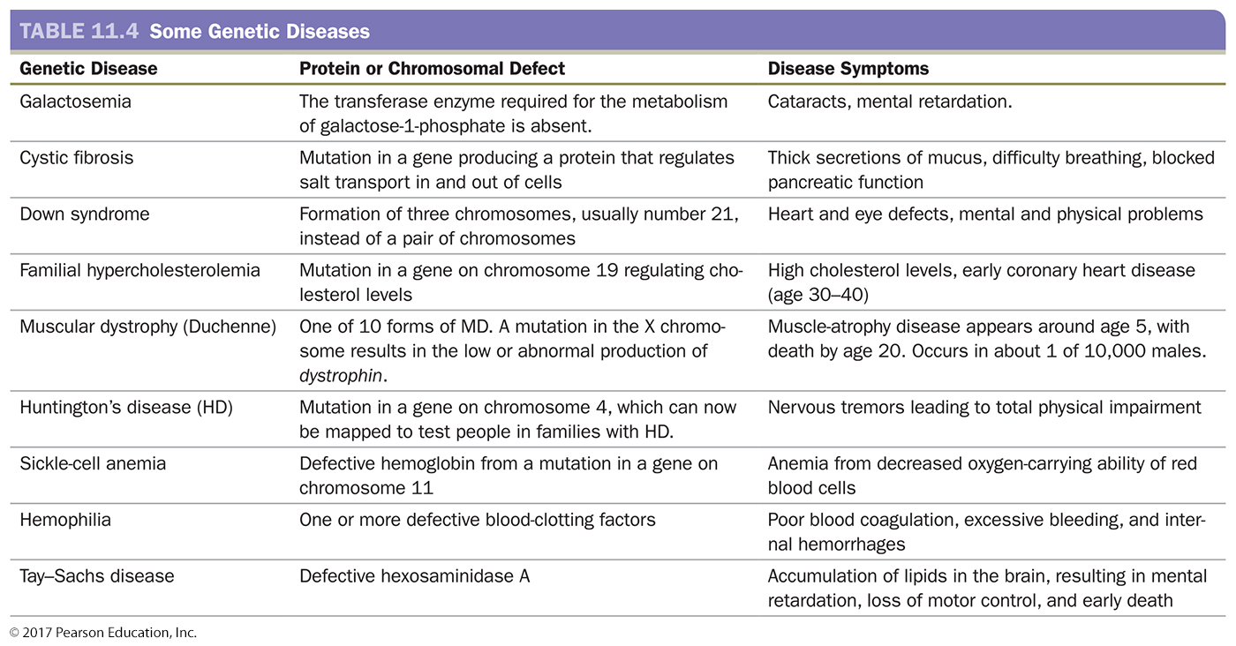
Examples of Genetic Diseases

Slide 50
Practice
Identify each type of mutation as a substitution or frameshift.
A. Cytosine (C) enters the DNA sequence.
B. One adenosine is removed from the DNA sequence.
C. A base sequence of TGA in DNA changes to TAA.

Slide 51
Viruses
Viruses
are small particles of DNA or RNA that require a host cell to replicate
cause a viral infection when the DNA or RNA enters a host cell
are synthesized in the host cell from the viral RNA produced by viral DNA

Slide 52
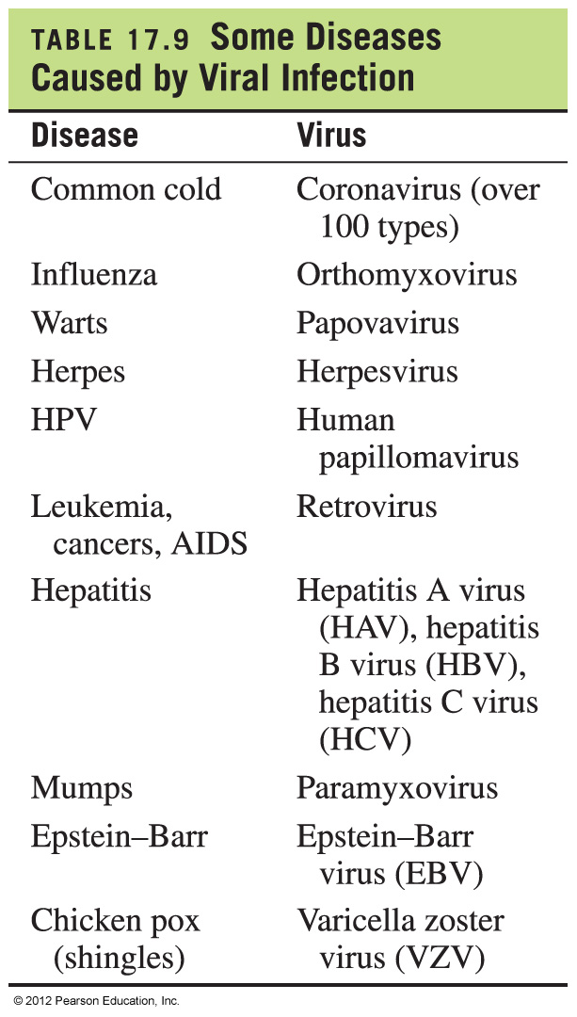
Some Diseases Caused by Viruses

Slide 53
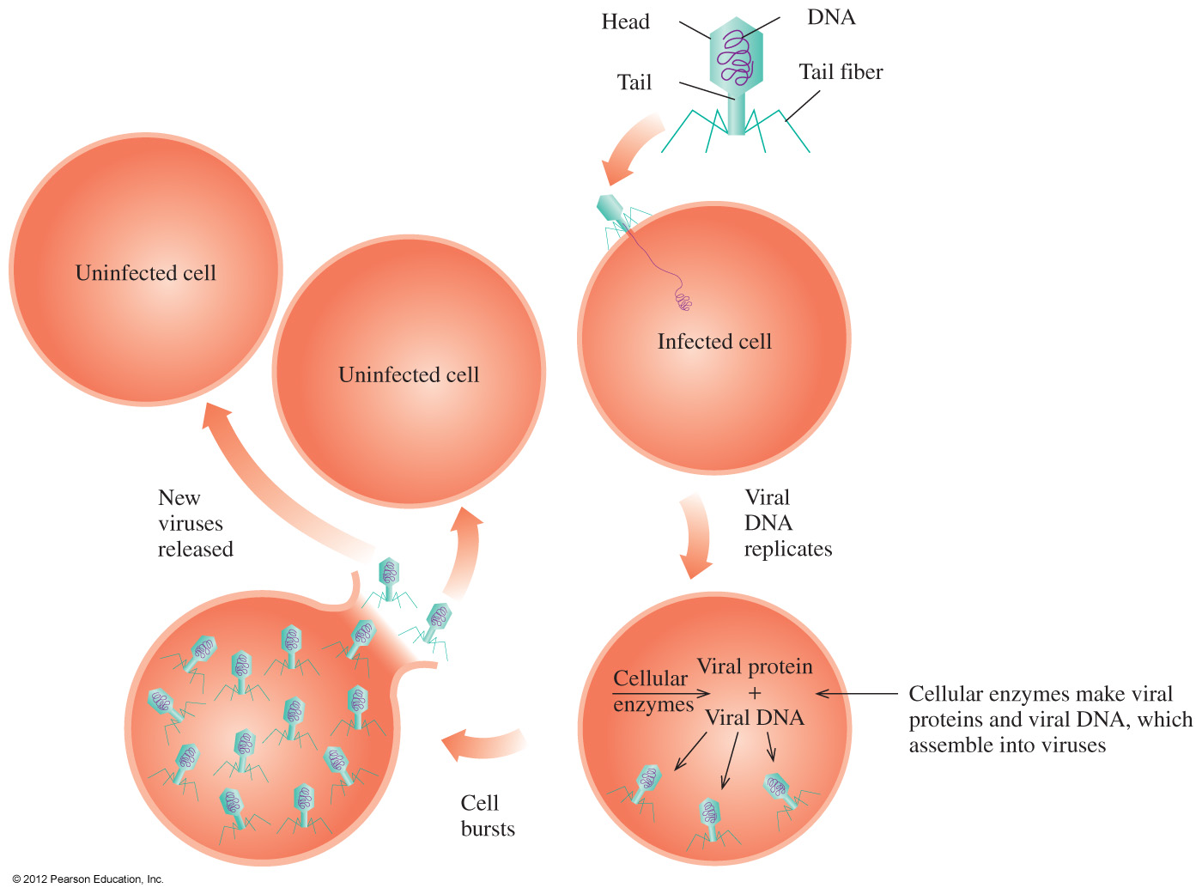
Viruses
After a virus attaches to the host cell, it injects its viral DNA and uses the host cell’s amino acids to synthesize viral protein. It uses the host cell’s nucleic acids,
enzymes, and ribosomes to make viral RNA. When the cell bursts, the new viruses are released to infect other cells.

Slide 54
Reverse Transcription
In reverse transcription,
a retrovirus, which contains viral RNA but no viral DNA, enters a cell
the viral RNA uses reverse transcriptase to produce a viral DNA strand
the viral DNA strand forms a complementary DNA strand
the new DNA uses the nucleotides and enzymes in the host cell to synthesize new virus particles

Slide 55
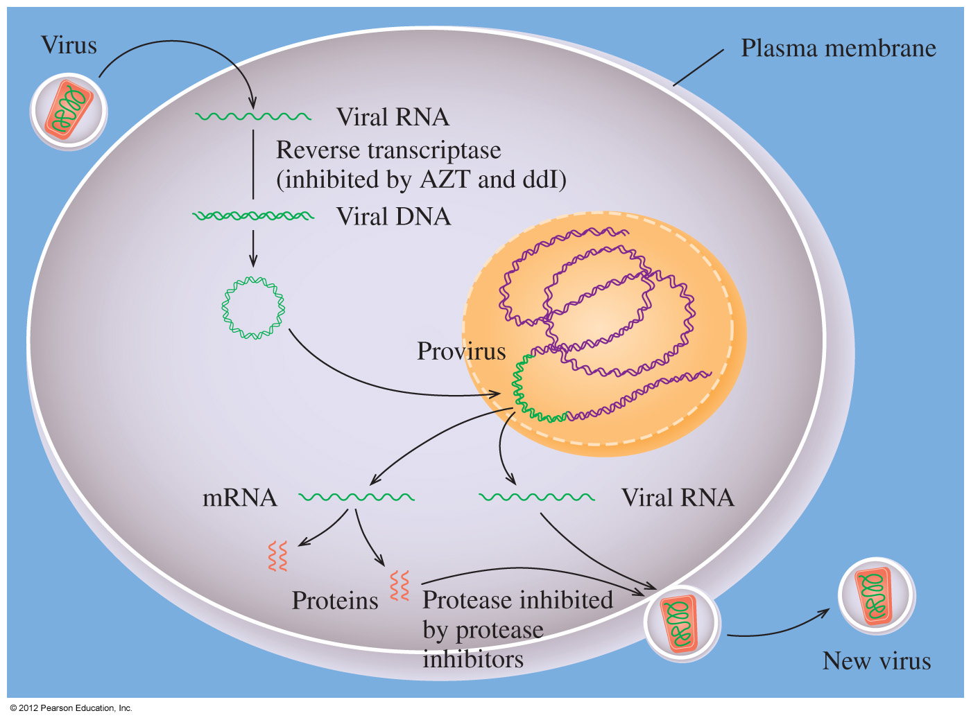
Reverse Transcription
After a retrovirus injects its viral RNA into a cell, it forms a DNA strand by reverse transcription. The DNA forms a double-stranded DNA called a provirus, which joins the host cell DNA. When the cell replicates, the provirus produces the viral RNA
needed to produce more virus particles.

Slide 56
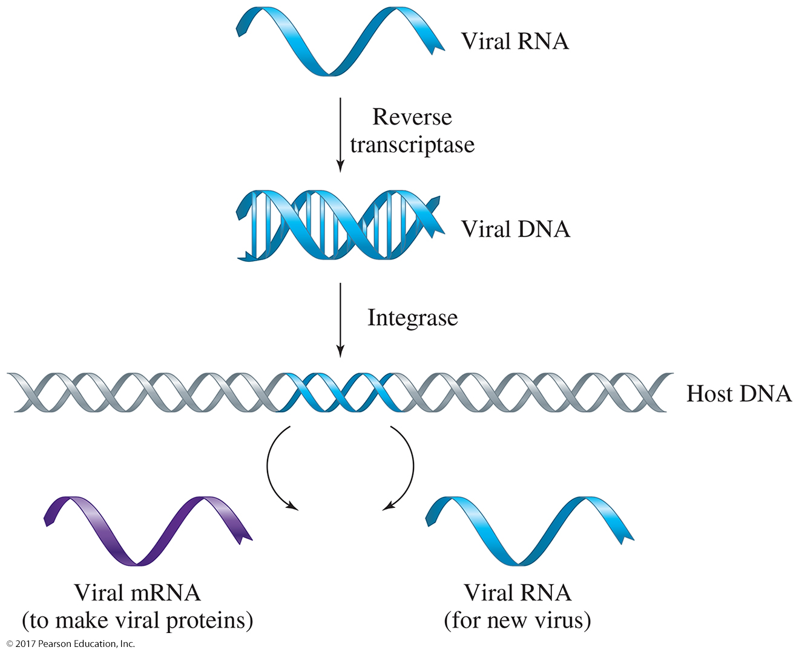

Slide 57
Recombinant DNA
Recombinant DNA involves recombining DNA from two different sources.
In the process, often called genetic engineering or gene cloning, the genome of one organism is altered by splicing in a section of DNA containing a gene from a second organism.
Inserting a higher organism’s gene into an organism with a shorter life cycle produces the desired protein more quickly.
Humans have been crossbreeding plants and animals for centuries, exchanging DNA for desired traits.
The recombinant DNA techniques developed in the mid-1970s work more quickly, expand the usefulness of crossbreeding, and are more predictable.
© 2017 Pearson Education, Inc.

