Slide 1
Chapter 10 Proteins—Workers of the Cell
Amino Acids
Protein Formation
The Three-Dimensional Structure of Proteins
Denaturation of Proteins
Protein Functions
Enzymes
Factors That Affect Enzyme Activity

Slide 2
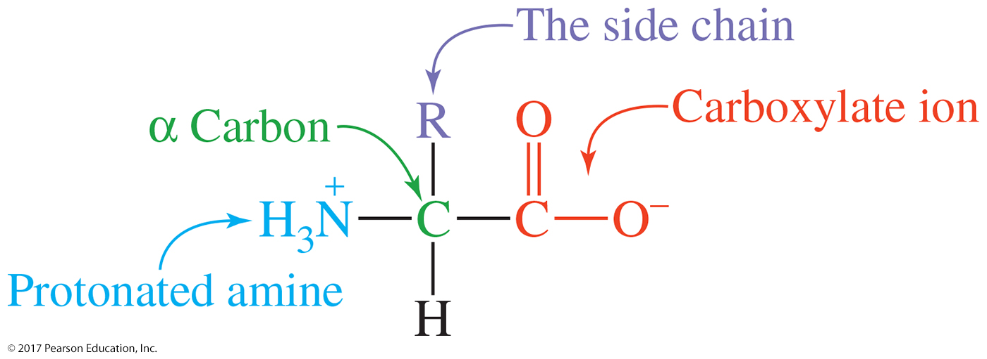
Amino Acids
Amino acids
are the building blocks of proteins.
contain a carboxylic acid group and an amino group on the alpha (α) carbon.
are ionized in solution.

Slide 3
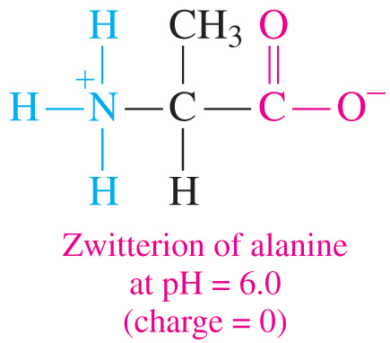
Ionization of Amino Acids
In most body fluids the carboxylic group (−COOH) and the amino group (−NH₂) are ionized.
An ionized amino acid that has a positive and negative charge is a dipolar ion called a zwitterion.
The isoelectric points (pI)
are the pH at which zwitterions have an overall zero charge.
of nonpolar and polar (neutral) amino acids exist at pH values from 5.1 to 6.3.

Slide 4
pH and Ionization
H⁺ OH–
+ +
H₃N–CH₂–COOH H₃N–CH₂–COO– H₂N–CH₂–COO–
Positive ion Zwitterion Negative ion
low pH pI high pH

Slide 5
Practice
CH₃ CH₃
₊ | |
H₃N—CH—COOH H₂N—CH—COO–
(1) (2)
Which structure represents
alanine at a pH above its pI?
alanine at a pH below its pI?

Slide 6
D- and L-Amino Acids
All amino acids besides glycine are chiral
Amino acids in nature are almost exclusively L-amino acids
When a Fischer projection is written with the acid at the top, and the R group at the bottom:
- if the amine group is on the right, it’s a D-amino acid
- if the amine group is on the left, it’s an L-amino acid

Slide 7
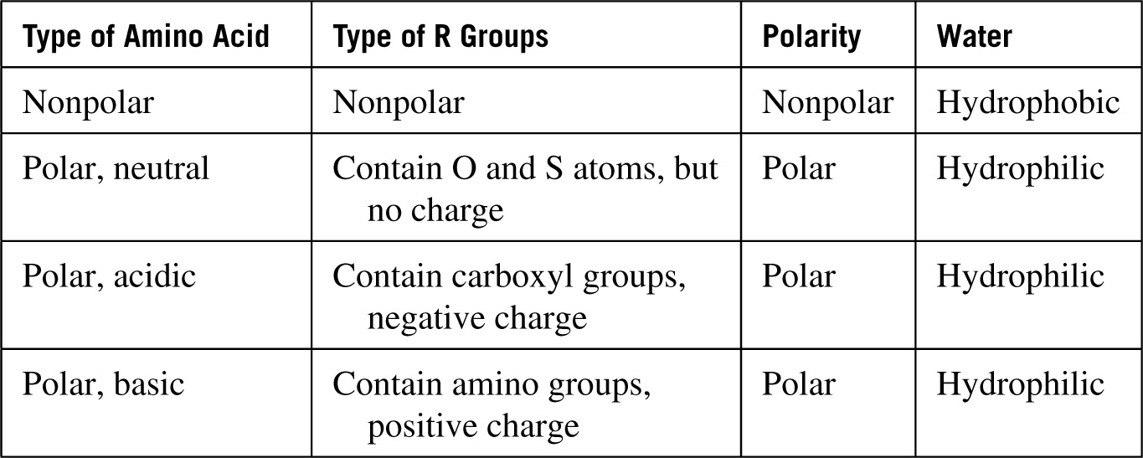
Amino Acids
The R group gives each amino acid its unique identity and characteristics.
Nine families of organic compounds are represented: alkanes (hydrocarbon), aromatics, thioethers, alcohols, phenols, thiols, amides, carboxylic acids, and amines.
The properties of the functional groups allow them to be classified as nonpolar, polar, acidic, and basic.
Twenty amino acids are found in most proteins.

Slide 8
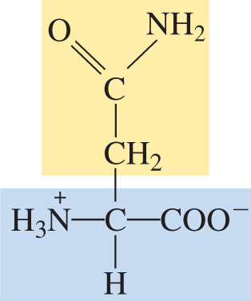
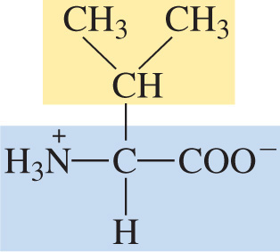
Types of Amino Acids
Amino acids are classified as
nonpolar (hydrophobic) with hydrocarbon side chains
polar (hydrophilic) with polar or ionic side chains
Nonpolar Polar
Valine Asparagine

Slide 9
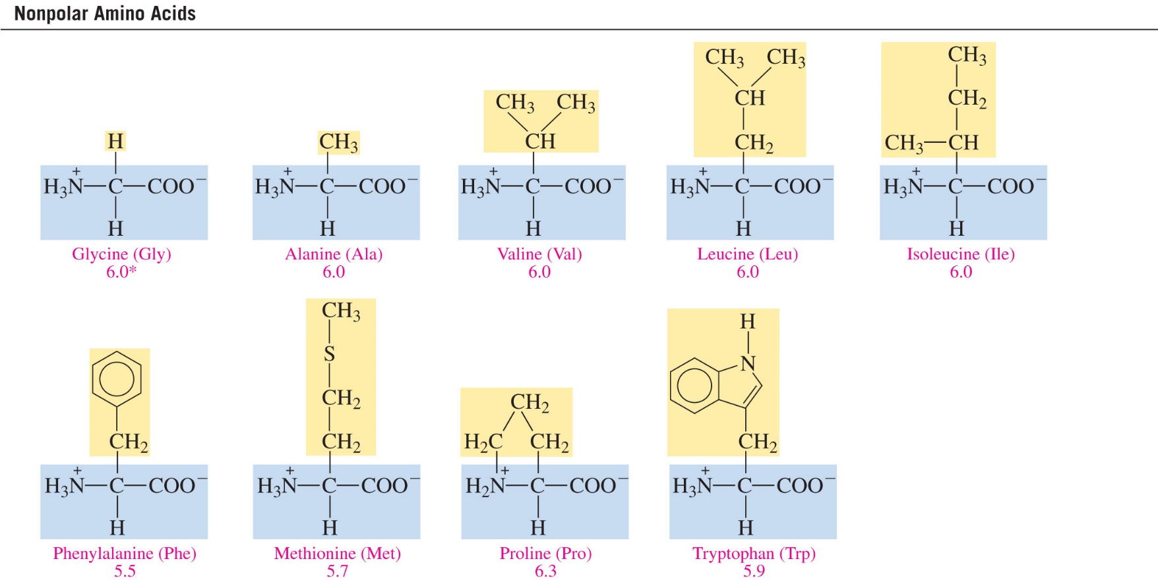
Nonpolar Amino Acids
An amino acid is nonpolar when the R group is H, alkyl,
or aromatic.

Slide 10
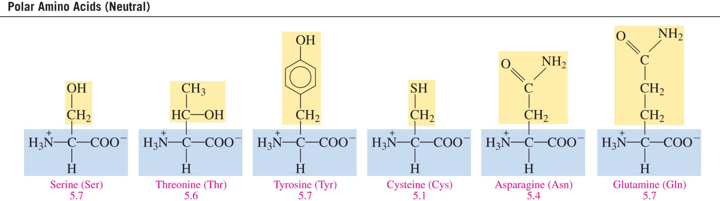
Polar Amino Acids
An amino acid is polar when the R group is an alcohol, thiol,
or amide.

Slide 11
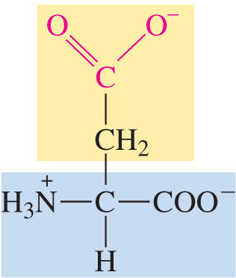
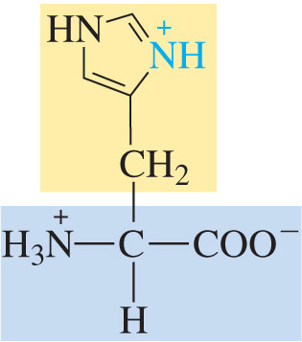
Types of Amino Acids
Amino acids are classified as
acidic (hydrophilic) with acidic side chains
basic (hydrophilic) with −NH₂ side chains
Acidic
Aspartic Acid
Basic
Histidine

Slide 12
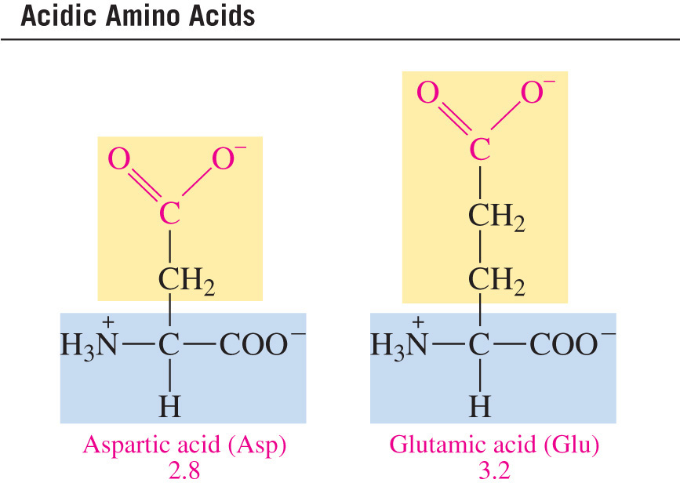
Acidic Amino Acids
An amino acid is acidic when the R group is a carboxylic acid.

Slide 13
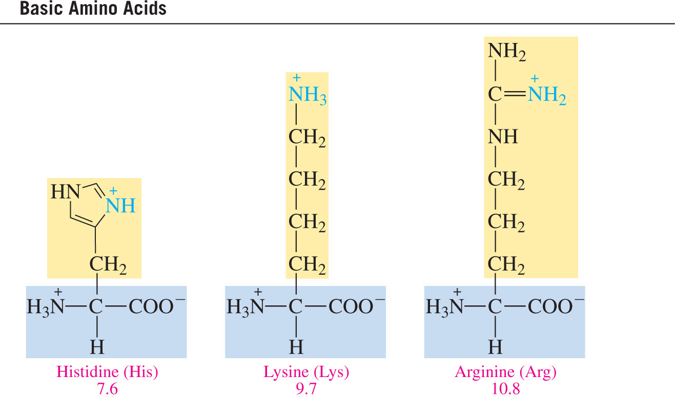
Basic Amino Acids
An amino acid is basic when the R group is an amine.

Slide 14
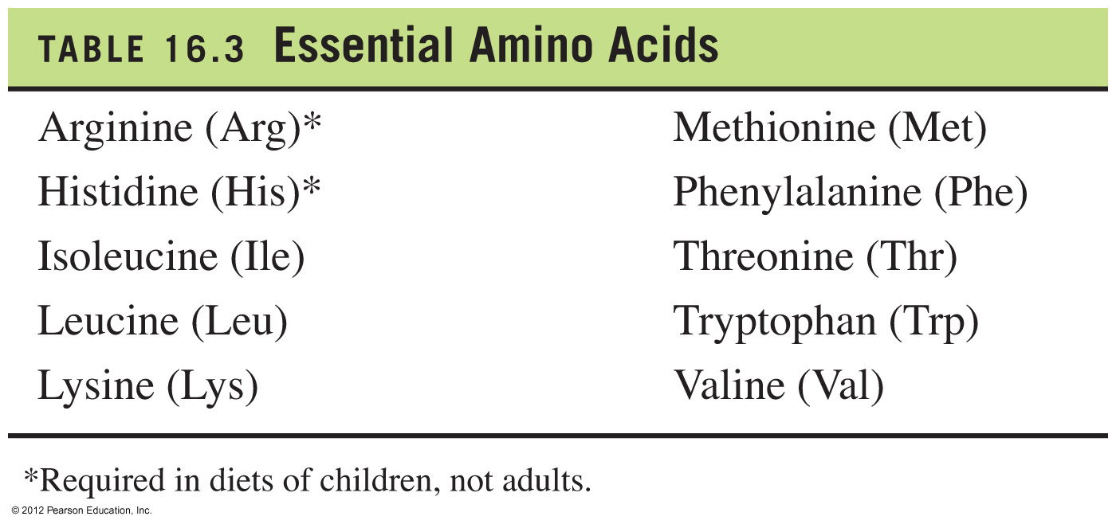
Essential Amino Acids
Essential amino acids
are 10 amino acids not synthesized by the body
must be consumed from proteins in the diet

Slide 15
Practice
Identify each of the following amino acids as polar or nonpolar.
+
A. H₃N–CH₂–COO⁻ Glycine
CH₃
|
CH–OH
+ │
B. H₃N–CH–COO⁻ Threonine

Slide 16
Abbreviations for Amino Acids
Each amino acid has standard 3-letter and 1-letter abbreviations (shown in the table below)
Name | 3-Let | 1-Let | Name | 3-Let | 1-Let
Glycine | Gly | G | Serine | Ser | S
Alanine | Ala | A | Threonine | Thr | T
Valine | Val | V | Asparagine | Asn | N
Leucine | Leu | L | Glutamine | Gln | Q
Isoleucine | Ile | I | Tyrosine | Tyr | Y
Phenylalanine | Phe | F | Aspartic Acid | Asp | D
Methionine | Met | M | Glutamic Acid | Glu | E
Proline | Pro | P | Lysine | Lys | K
Tryptophan | Trp | W | Arginine | Arg | R
Cysteine | Cys | C | Histidine | His | H

Slide 17
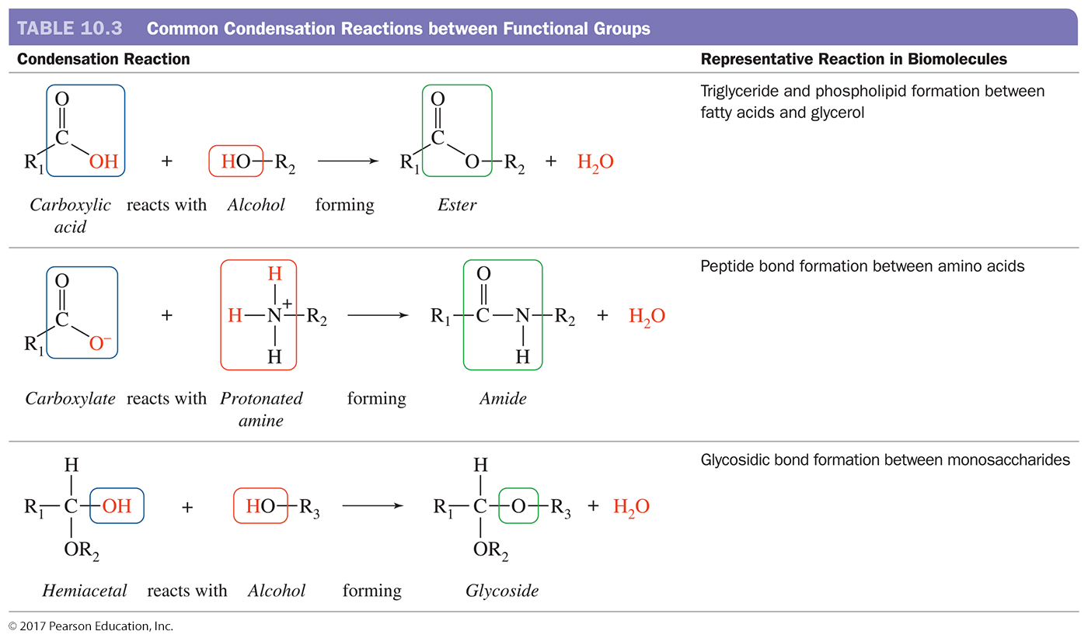
Condensation Reaction

Slide 18
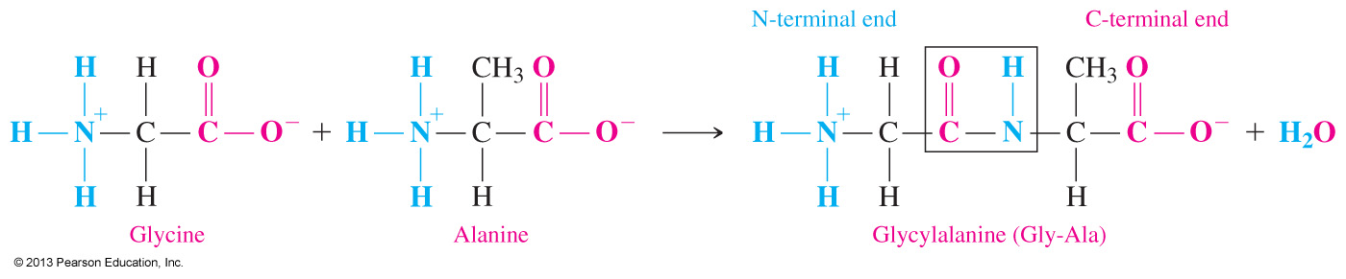
The Peptide Bond
A peptide bond
is an amide bond.
forms between the carboxyl group of one amino acid and the amino group of the next amino acid.
contains an N (free H₃N⁺) terminal written on the left.
contains a C (free COO–) terminal written on the right.
By convention, peptides are always written from the N-terminus to the C-terminus.

Slide 19
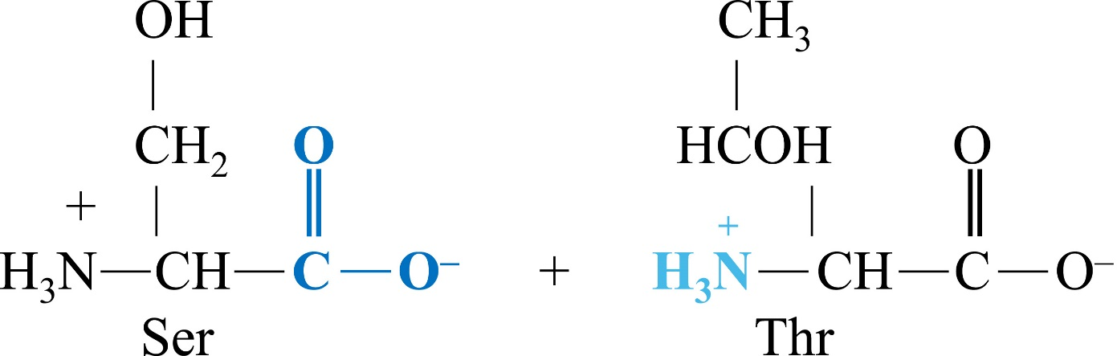
Practice
Write the dipeptide Ser-Thr.

Slide 20
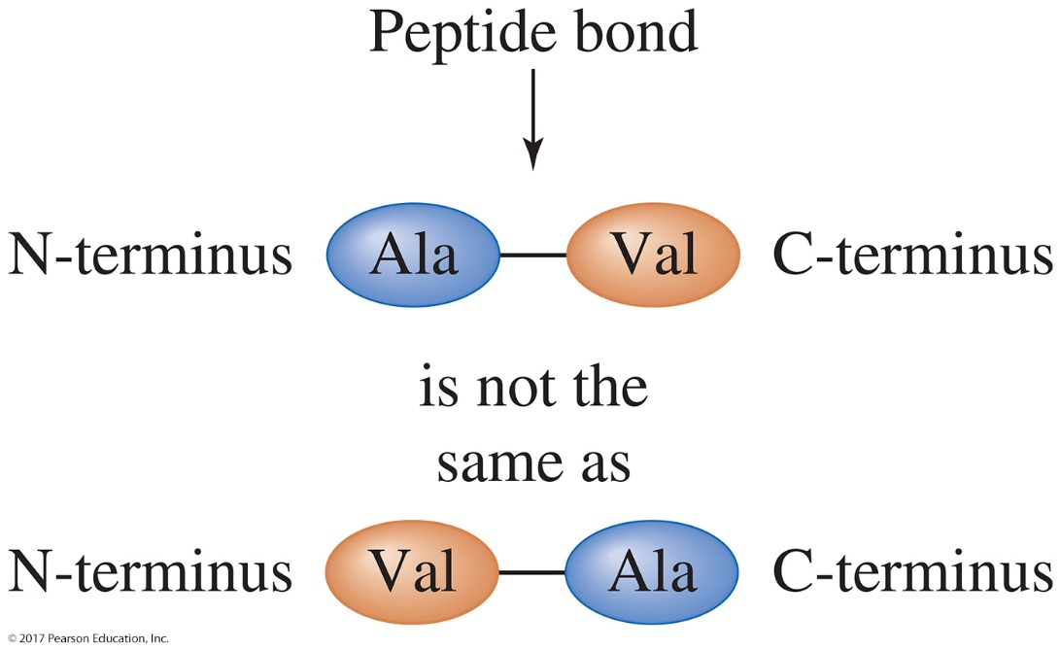
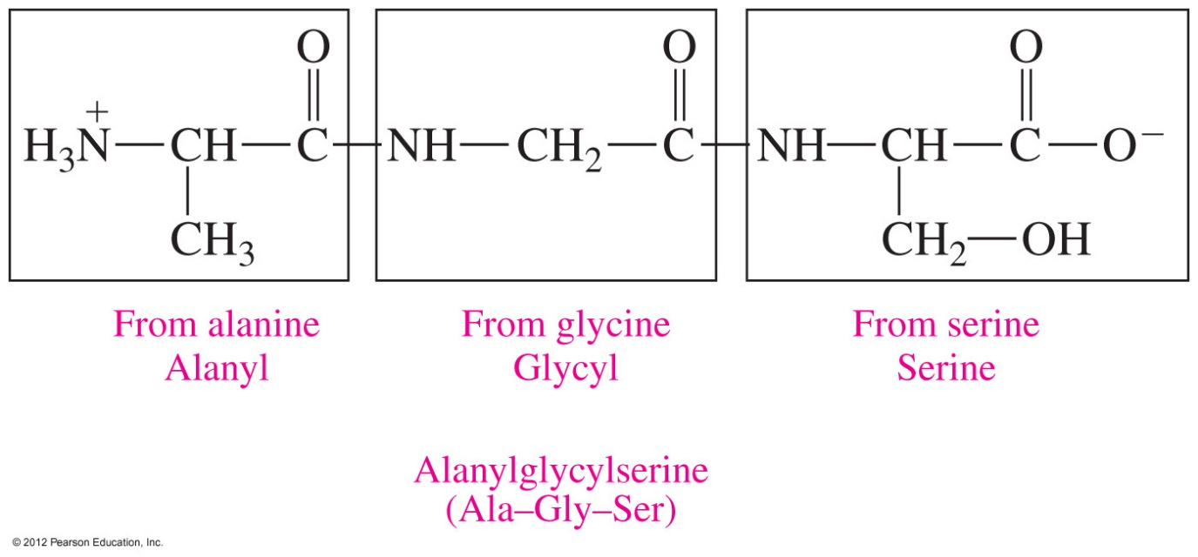
Protein Formation
Dipeptides can combine to form two different dipeptides.
The order of the amino acids is critical to the structure and function of the compound.
N Terminal C Terminal
© 2017 Pearson Education, Inc.

Slide 21
Practice
Write the names and three-letter abbreviations of the tripeptides that could form from two glycines and one alanine.

Slide 22
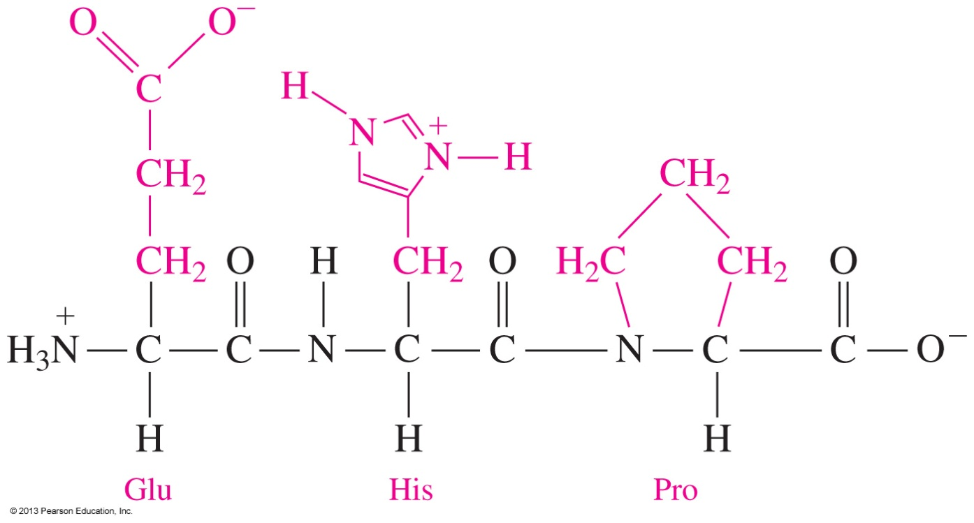
Primary Structure of Proteins
The primary structure of a protein is
the particular sequence of amino acids.
the backbone of a peptide chain or protein.

Slide 23
Secondary Structure: Alpha Helix
The secondary structures of proteins describes the type of structure that forms when amino acids form hydrogen bonds within a single polypeptide chain or between polypeptide chains
An alpha helix (α-helix) has
a coiled shape held in place by hydrogen bonds between the amide groups and the carbonyl groups of the amino acids along the chain.
hydrogen bonds between the H of an —NH group and the O of C═O of the fourth amino acid down the chain.

Slide 24
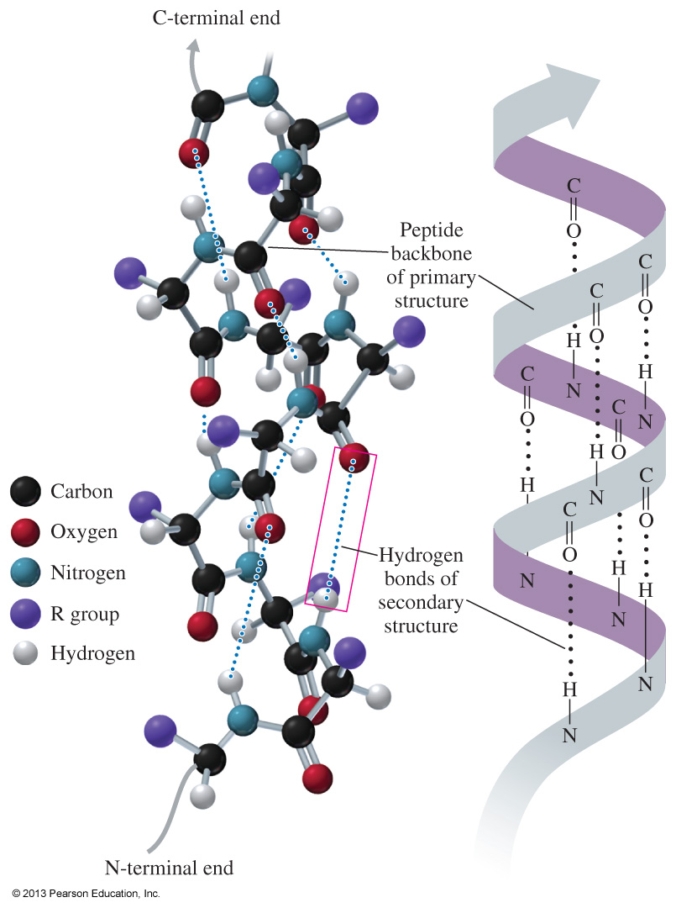
Secondary Structure: Alpha Helix (continued)

Slide 25
Secondary Structure: Beta-Pleated Sheet
A beta-pleated sheet (β-pleated sheet) is a secondary structure that
can form between adjacent polypeptide chains or within the same polypeptide chain when the rigid structure of the amino acid proline causes a bend in the polypeptide chain.
has hydrogen bonds between chains.
has R groups above and below the sheet.
is typical of fibrous proteins, such as silk.

Slide 26
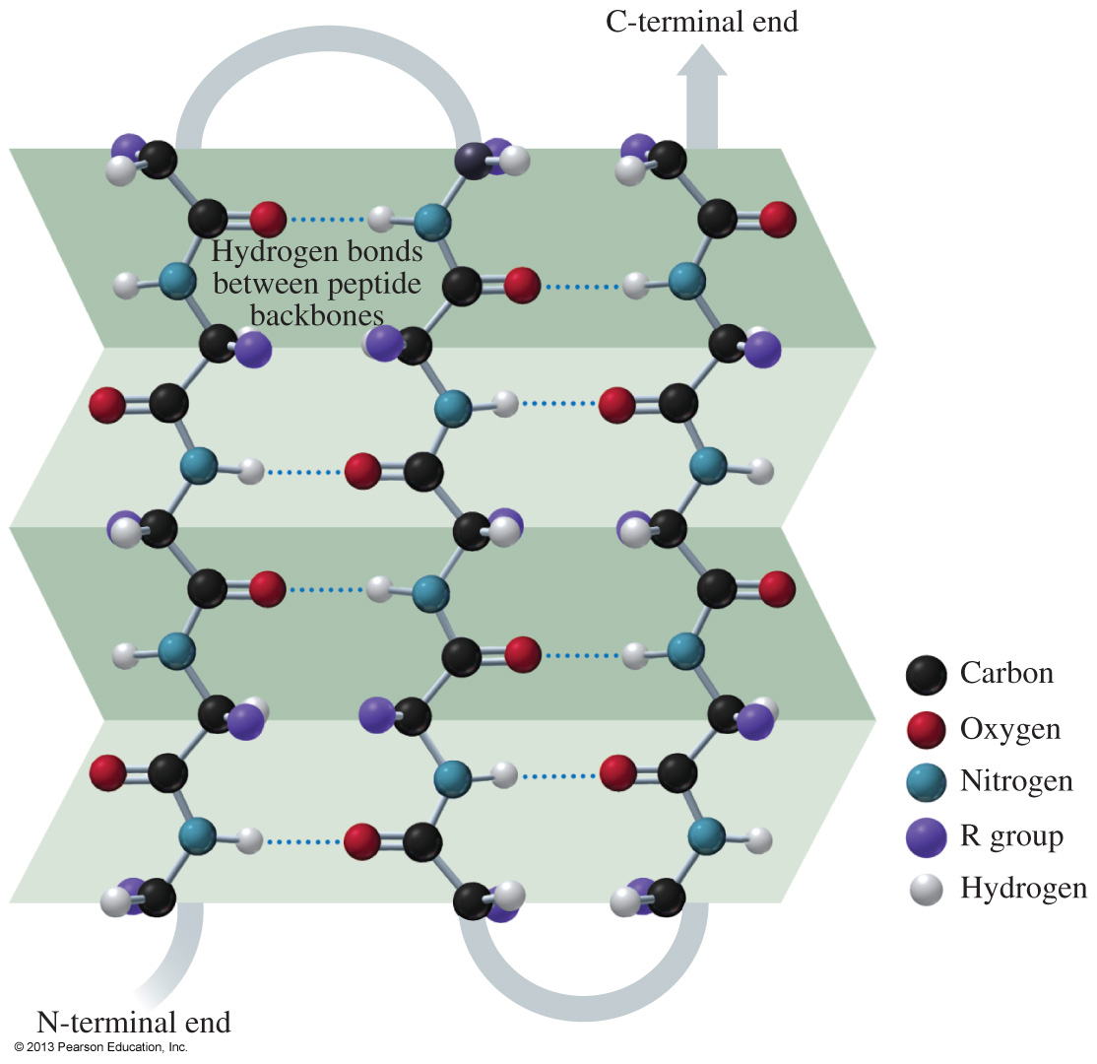
Secondary Structure: Beta-Pleated Sheet (continued)

Slide 27
Practice
Indicate the type of protein structure.
primary alpha helix beta-pleated sheet
A. polypeptide chains held side by side by H bonds
B. sequence of amino acids in a polypeptide chain
C. corkscrew shape with H bonds between amino acids

Slide 28
Tertiary Structure
The tertiary structure of a protein
gives a specific three-dimensional shape to the polypeptide chain.
involves the attractions and repulsions of the R groups of the amino acids of the peptide chain.
is stabilized by:
hydrophobic and hydrophilic interactions,
salt bridges,
hydrogen bonds, and
disulfide bonds.

Slide 29
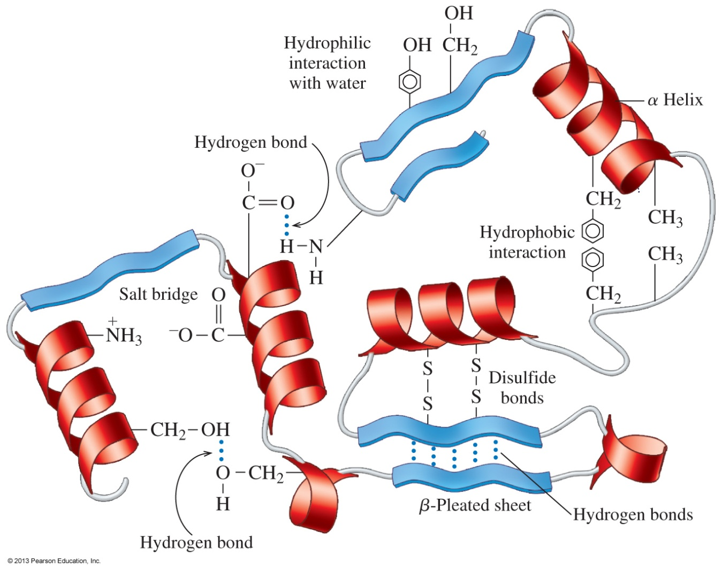
Tertiary Structure (continued)
The interactions of the R groups give a protein its specific three-dimensional tertiary structure.

Slide 30
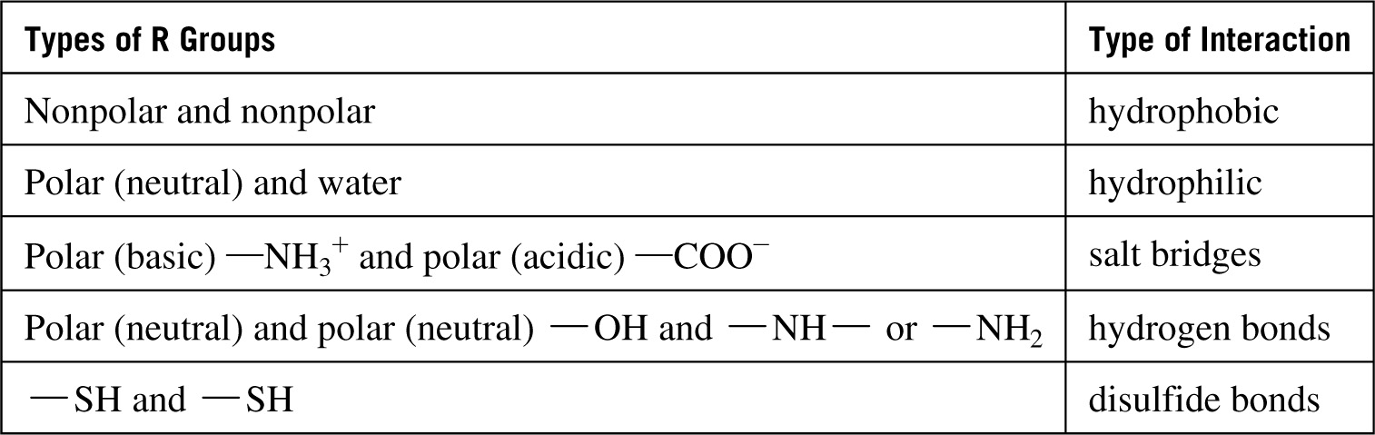
R Group Interactions in Tertiary Structures

Slide 31
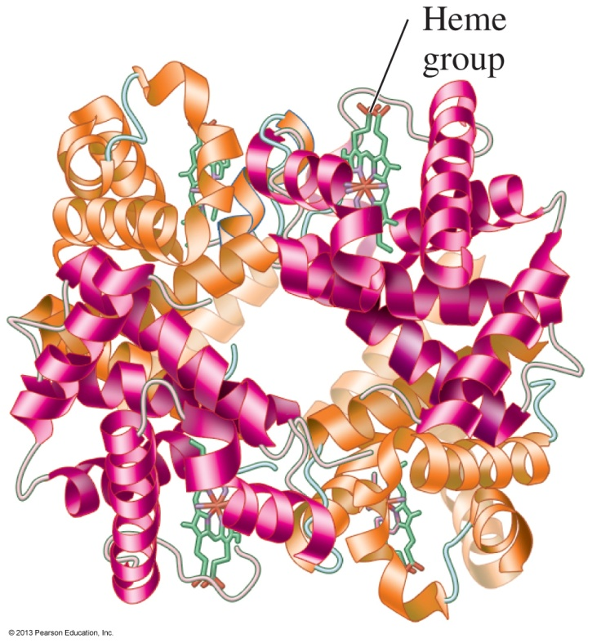
Quaternary Structure
The quaternary structure
is the combination of two or more polypeptide chains.
is stabilized by the same interactions found in tertiary structures.
of hemoglobin consists of two alpha chains and two beta chains with heme groups in each subunit that pick up oxygen for transport in the blood to the tissues.
Hemoglobin

Slide 32
Practice
Select the type of tertiary interaction.
disulfide ionic
H bonds hydrophobic
A. leucine and valine
B. two cysteines
C. aspartic acid and lysine
D. serine and threonine

Slide 33
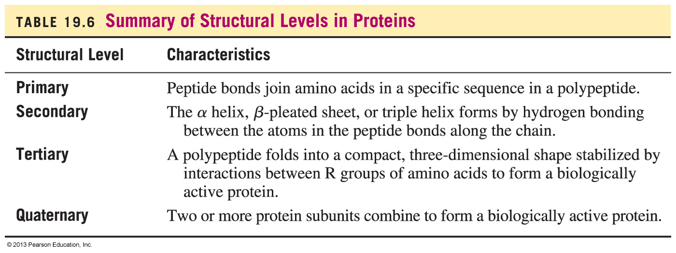
Summary of Protein Structures

Slide 34
Denaturation
Denaturation involves
the disruption of bonds in the secondary, tertiary, and quaternary protein structures.
heat and organic compounds that break apart H bonds and disrupt hydrophobic interactions.
acids and bases that break H bonds between polar R groups and disrupt ionic bonds.
heavy metal ions that react with S—S bonds to form solids.
agitation, such as whipping, that stretches peptide chains until bonds break.

Slide 35
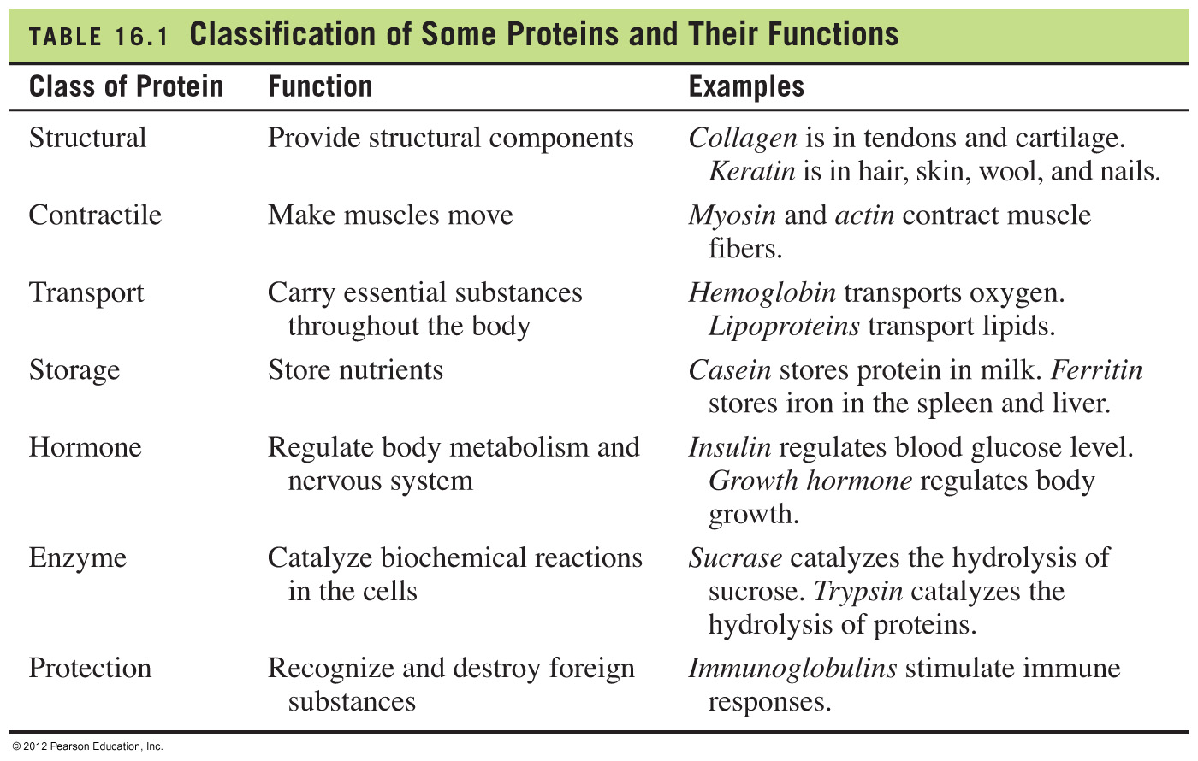
Functions of Proteins

Slide 36
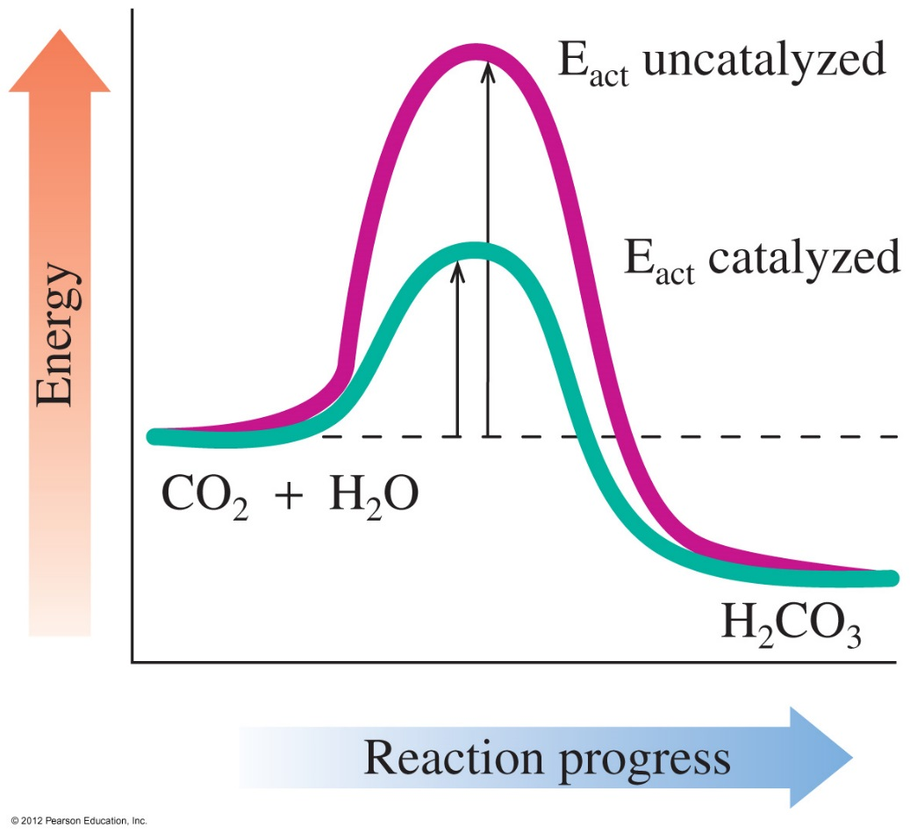
Enzymes Are Biological Catalysts
Enzymes are proteins that
catalyze nearly all the chemical reactions taking place in the cells of the body
increase the rate of reaction by lowering the energy of activation
The enzyme carbonic anhydrase lowers the activation energy needed for the reaction of CO₂ and H₂O.

Slide 37
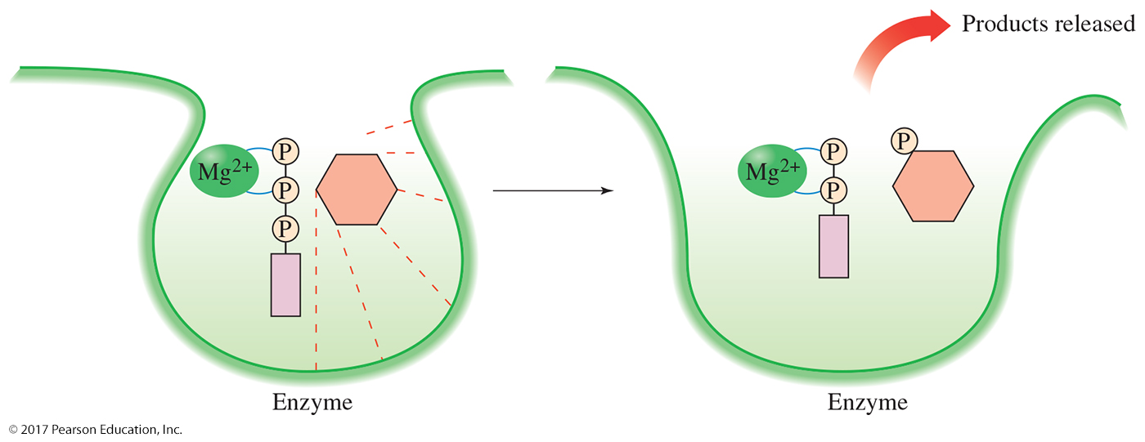
Rates of Reaction
Orientation. when an enzyme interacts with its substrate to form ES, the bonds of the substrate molecule(s) are weakened (strained).
Bond energy. The weakening of the bonds means that they will more readily react: Weaker bonds break more easily and the activation energy is lowered by this effect.
Proximity. When the ES forms, the substrates are in close proximity. They don’t have to find each other as they would in solution.

Slide 38
Names of Enzymes
The name of an enzyme
usually ends in –ase
identifies the reacting substance; for example, sucrase catalyzes the reaction of sucrose
describes the function of the enzyme; for example, oxidases catalyze oxidation
could be a common name, particularly for the digestion enzymes, such as pepsin and trypsin

Slide 39
Classification of Enzymes
Enzymes are classified by the reaction they catalyze.
Class Type of Reactions Catalyzed
Oxidoreductases Oxidation-reduction
Transferases Transfer groups of atoms
Hydrolases Hydrolysis
Lyases Add atoms/remove atoms to or
from a double bond
Isomerases Rearrange atoms
Ligases Use ATP to combine small molecules

Slide 40
Practice
Match the type of reaction with an enzyme.
aminase dehydrogenase
isomerase synthetase
A. converts a cis-fatty acid to a trans-fatty acid
B. removes 2 H atoms to form double bond
C. combines two molecules to make a new compound
D. adds NH₃

Slide 41
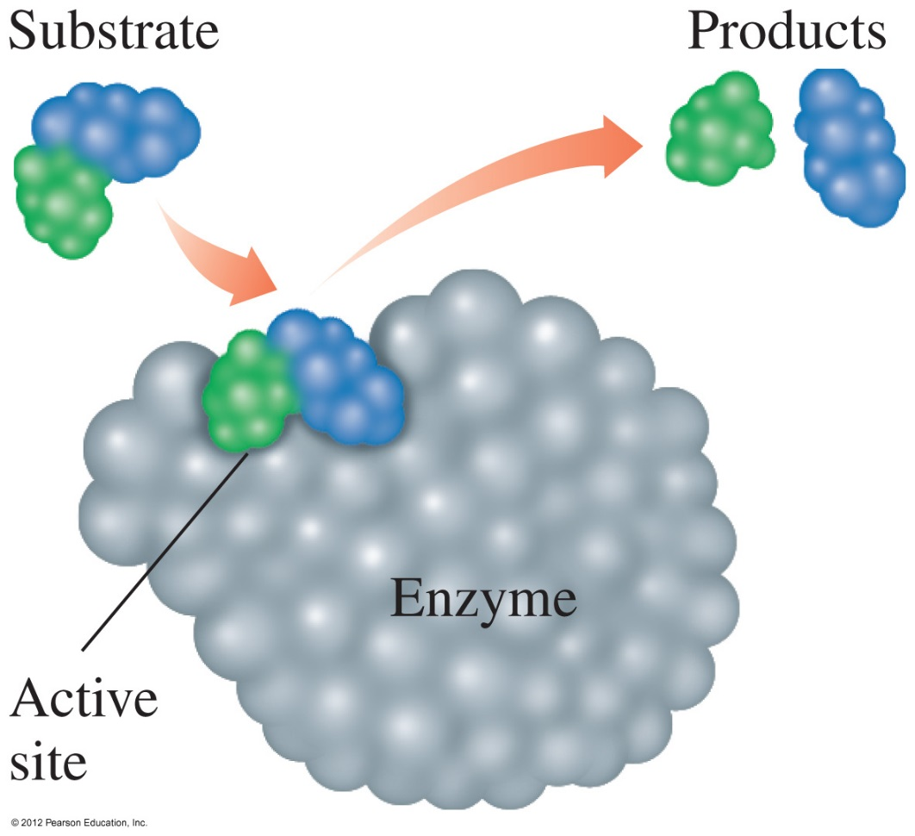
Active Site
The active site
is a region within an enzyme that fits the shape of the reacting molecule called a substrate
contains amino acid R groups that bind the substrate
releases products when the reaction is complete
On the surface of an enzyme, a small region called an active site binds a substrate and catalyzes a reaction of that substrate.

Slide 42
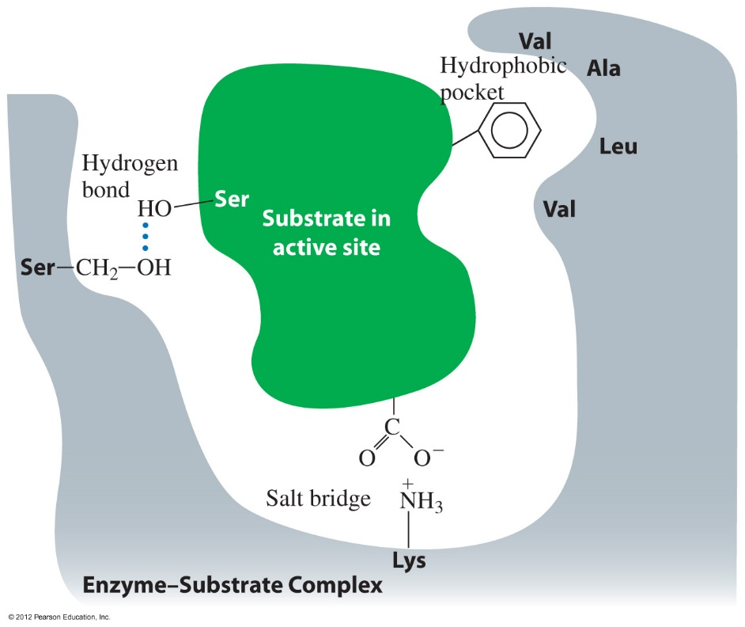
Enzyme-Catalyzed Reaction
In an enzyme-catalyzed reaction,
a substrate attaches to the active site
an enzyme–substrate (ES) complex forms
reaction occurs and products are released
an enzyme is used over and over
E + S ES E + P
Binding of a substrate occurs when it interacts with the amino acids within the active site.

Slide 43
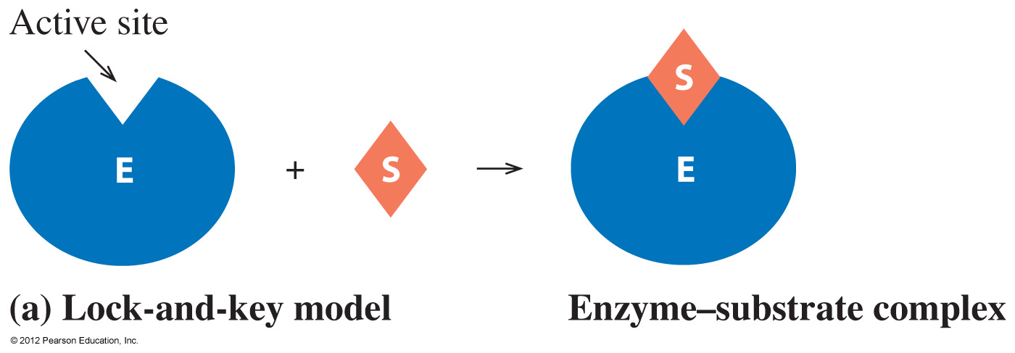
Lock-and-Key Model
In the lock-and-key model, the
active site has a rigid shape
enzyme only binds substrates that exactly fit the active site
enzyme is analogous to a lock
substrate is the key that fits that lock
In the lock-and-key model, a substrate fits the shape of the active site and forms an enzyme–substrate complex.

Slide 44
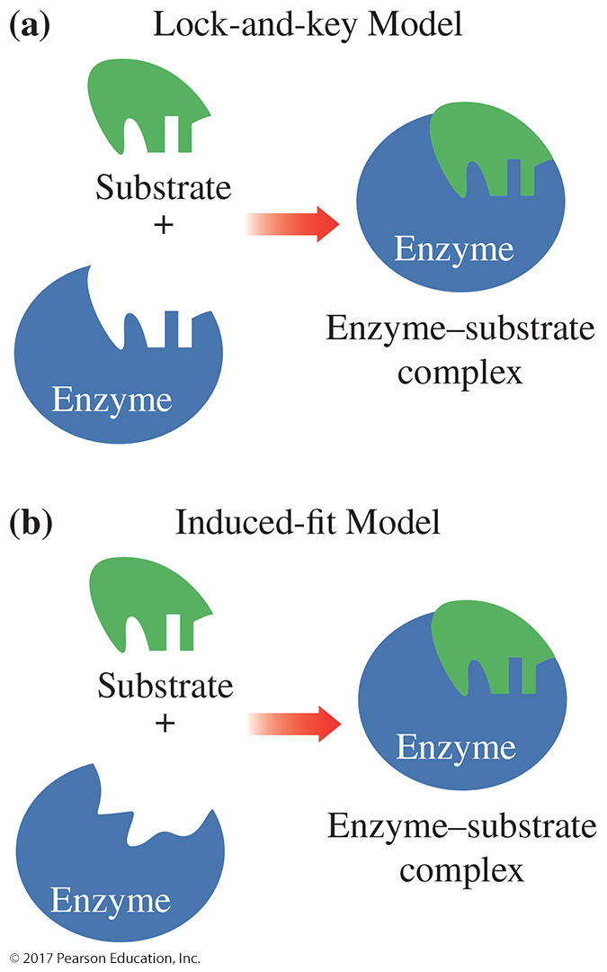
Induced-Fit Model
In the induced-fit model,
enzyme structure is flexible, not rigid
enzyme and substrate adjust the shape of the active site to bind substrate
the range of substrate specificity increases
shape changes improve catalysis during reaction
In the induced-fit model, a flexible active site and substrate adjust shape to provide the best fit for the reaction.

Slide 45
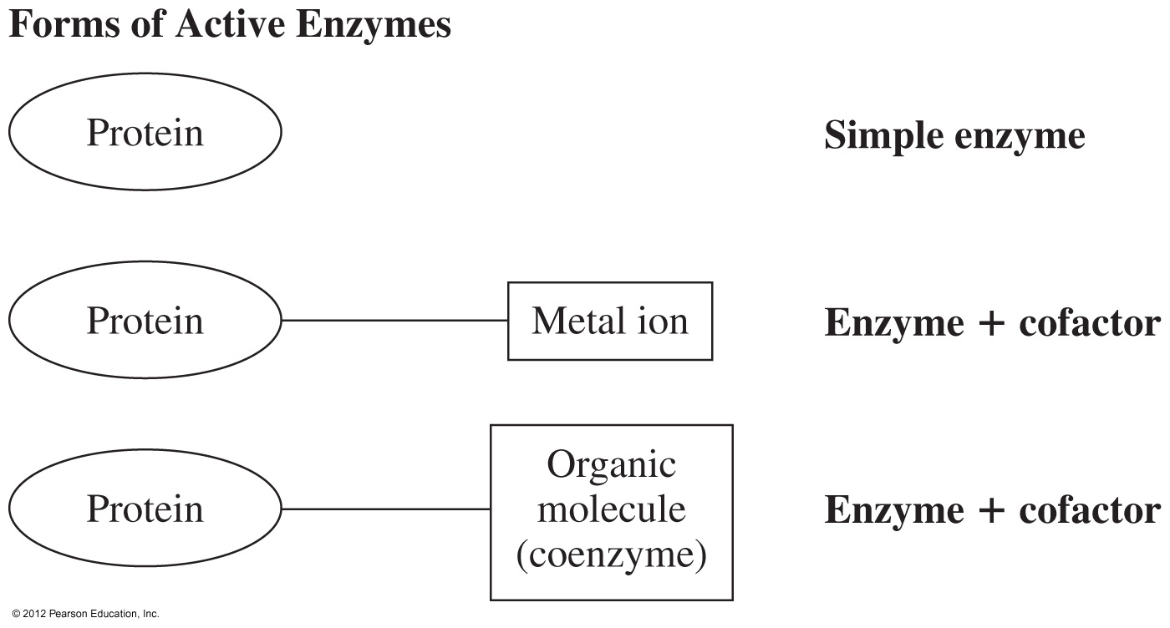
Function of Coenzymes
Cofactors
assist enzymes in catalytic activity
may be metal ions that are bonded to one of the amino acid side chains or small organic molecules known as coenzymes

Slide 46
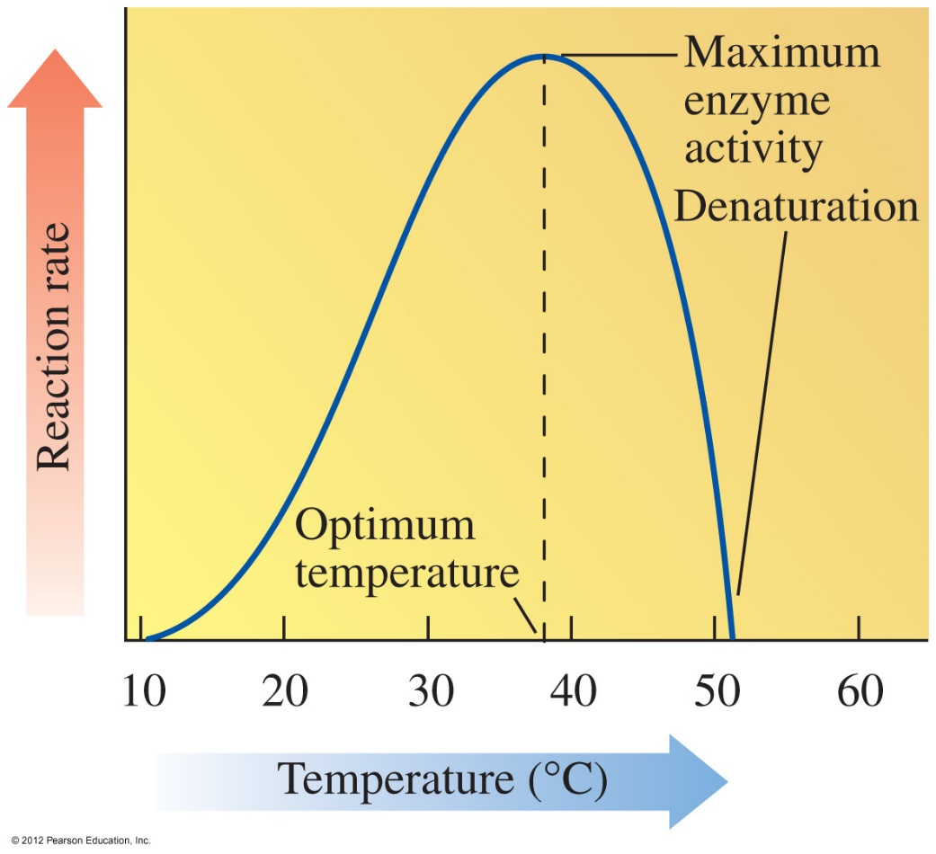
Temperature and Enzyme Action
Enzymes
are most active at an optimum temperature (usually 37 C in humans)
show little activity at low temperatures.
lose activity at high temperatures as denaturation occurs with loss of catalytic activity

Slide 47
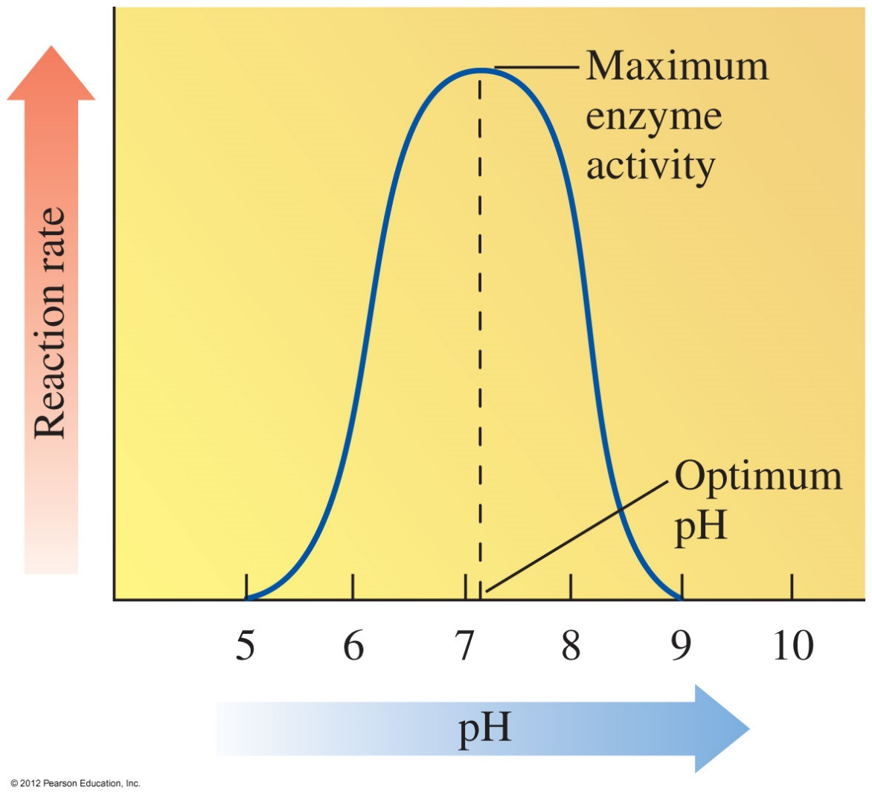
pH and Enzyme Action
Enzymes
are most active at optimum pH
contain R groups of amino acids with proper charges at optimum pH
lose activity in low or high pH as tertiary structure is disrupted
- If an enzyme requires a carboxylate ion (—COO–), lowering the pH could convert the carboxylate ion to carboxylic acid (—COOH). This change would cause enzyme activity to decrease.

Slide 48
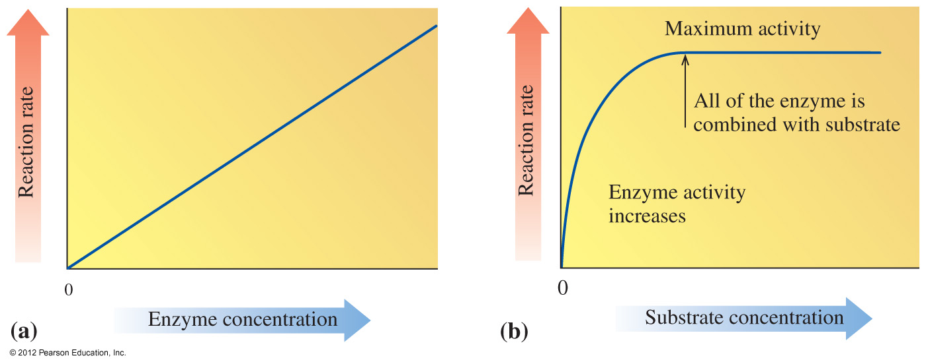
Substrate Concentration
As substrate concentration increases,
the rate of reaction increases (at constant enzyme concentration)
the enzyme eventually becomes saturated, giving maximum activity
At maximum activity, the conditions under which the enzyme is operating are considered to be in a steady state.
Under steady-state conditions, substrate is being converted to product as efficiently as possible.

Slide 49
Practice
Sucrase has an optimum temperature of 37 °C and an optimum pH of 6.2. Determine the effect of the following on its rate of reaction.
no change increase decrease
A. Increasing the concentration of sucrase
B. Changing the pH to 4
C. Running the reaction at 70 °C

Slide 50
Enzyme Inhibition
Inhibitors
are molecules that cause a loss of catalytic activity
prevent substrates from fitting into the active sites
E + S ES E + P
E + I EI no P

Slide 51
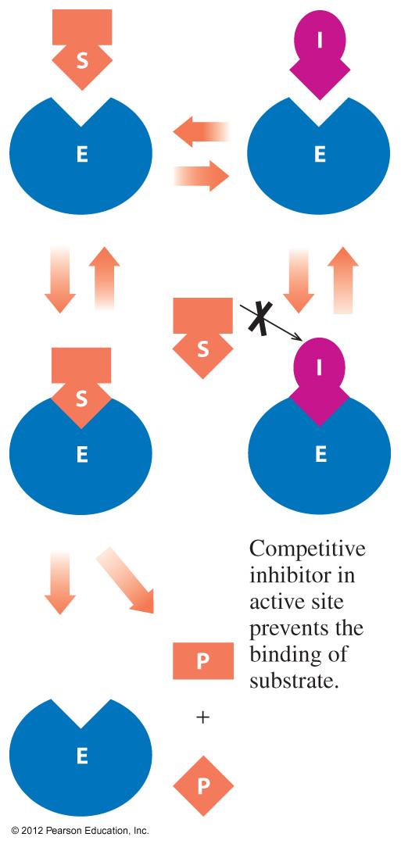
Competitive Inhibition
A competitive inhibitor
has a structure that is similar to that of the substrate
competes with the substrate for the active site
has its effect reversed by increasing substrate concentration

Slide 52
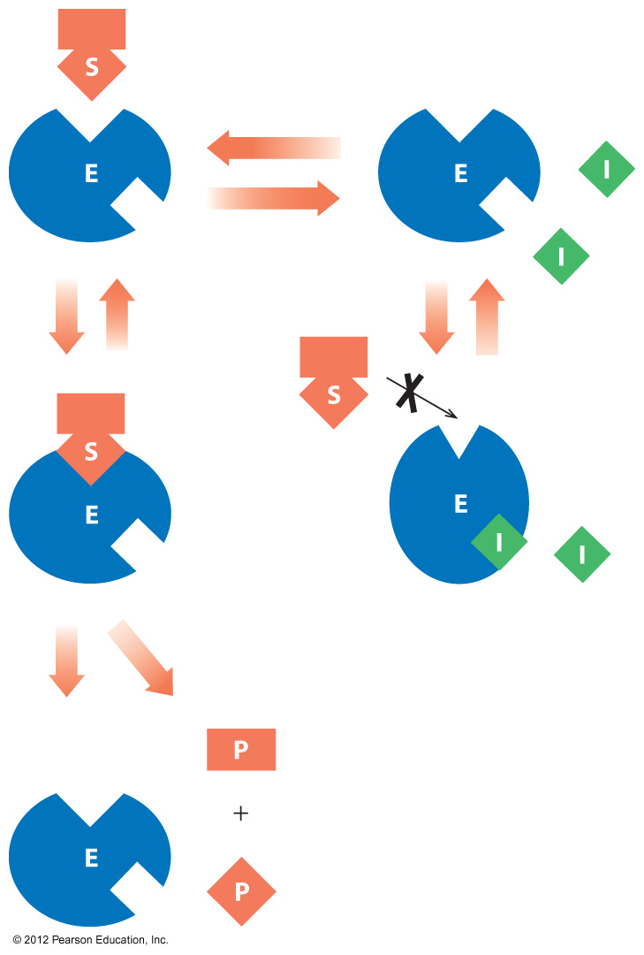
Noncompetitive Inhibition
A noncompetitive inhibitor
has a structure that is much different than the substrate
distorts the shape of the enzyme, which alters the shape of the active site
prevents the binding of the substrate
cannot have its effect reversed by adding more substrate

Slide 53
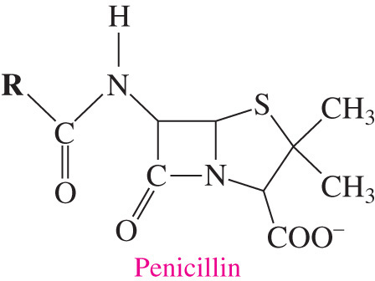
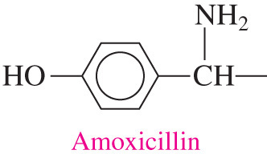
Irreversible Inhibition
An irreversible inhibitor
has a molecule that causes the enzyme to lose all activity
is often a toxic substance that destroys enzymes
usually forms a covalent bond with an amino acid side chain preventing catalytic activity
may be nerve gases or insecticides or antibiotics

Slide 54
Practice
Identify each description as an inhibitor that is competitive
or noncompetitive.
A. Increasing substrate reverses inhibition.
B. Binds to enzyme surface, but not to the active site.
C. Structure is similar to substrate.
D. Inhibition is not reversed by adding more substrate.

