Slide 1
Chapter 1 Chemistry: It’s All About “Stuff”
Matter
Classification
Properties
Changes
Measurements and Significant Figures
Scientific Notation
Units of Measurement
Dimensional Analysis
Density

Slide 2
Matter
Matter
Anything that occupies space and has mass.
Accuracy and Precision
Accurate measurements are close to the actual or true value.
Precise measurements are similar in value, but may not be close to the actual value.
Weight
The effect of gravity on matter

Slide 3
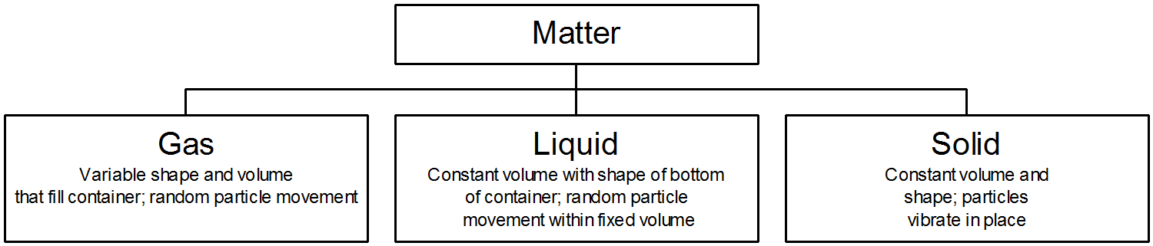
States of Matter

Slide 4
Classification of Matter

Slide 5
Physical properties
Characteristics that can be evaluated without changing the composition of the material.
Examples
color - density
odor - melting point
taste - boiling point
feel - compressibility

Slide 6
Chemical Properties
Result in a change in the composition of a material.
Chemical Reaction - how the change occurs.
Example A chemical property of wood is it’s ability to burn - combustion.
(Reactants and Products are very different)

Slide 7
Changes
Physical Changes - can be carried out without changing the composition of a substances.
Chemical Changes – are changes that change the composition of a substance.

Slide 8
Measurement
Measurement The Importance of Units
Every measurement is composed of a number and a unit.
A number is meaningless without the unit.
aspirin dosage = 325 (milligrams or pounds?)
100-meter dash = 10.00 (seconds or days?)

Slide 9
Measurement The Metric System of Units
Each type of measurement has a base unit.

Slide 10
Rules for determining significant figures
All nonzero digits are significant.
i.e. 111 1286
Zeros between significant figures are significant.
i.e. 1001 20,006
Zeros preceding the first nonzero digit are not significant.
i.e. 0.0002 0.00206
Zeros to the right of the decimal after a nonzero digit are significant.
i.e. 0.00300 9.00 9.10 90.0
Zeros at the end of a non-decimal number may or may not be significant. (Use scientific notation.)
i.e. 900 900.

Slide 11
Mathematical Operations and Significant figures
When multiplying and dividing measured quantities, give as many significant figures as the least found in the measurements used.
2.1 x 3.52 = 7.392 = 7.4
Which gets us to rounding: left most digit to be dropped – 5 or greater add 1 to last digit to be retained, less than five leave alone – 1.2143 -- 1.21
Multiple step calculation - Guard digit: 1.214
When adding or subtracting measured quantities, give the same number of decimals as the least found in the measurements used.
84.2 (3 sign)
+22.321 (5 sign)
106.521 ≈ 106.5 (4 sign)
arithmetic rules if combined ( ), x / , + -

Slide 12
Practice
3.38 – 3.012 = 0.0024 + 0.356 =
0.0024 2.568 x 5.8 =
+0.356 4.186
4.18 – 58.16 x (3.38 – 3.01) = 6.3 + 7.2 =
0.5256

Slide 13
Scientific Notation
coefficient: a.bcd
usually 1 ≤ coefficient < 10
exponent: e
a positive or negative whole number
e
a.bcd x 10

Slide 14
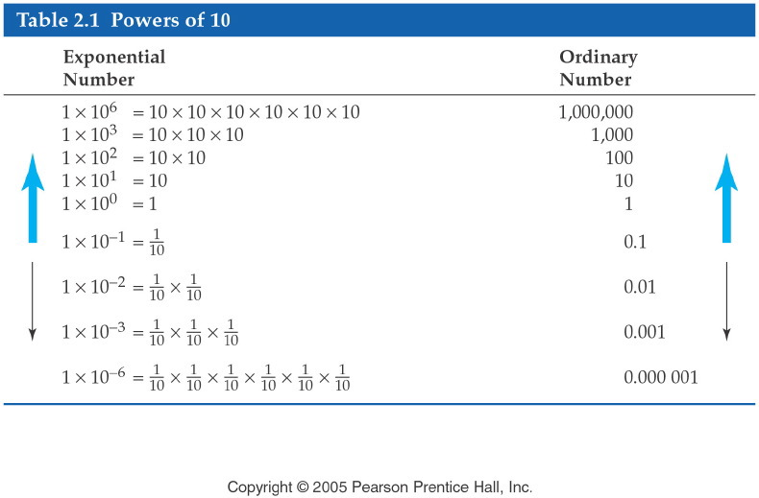

Slide 15
Scientific Notation Practice
900 300,000,000 (write with 3 SF)
0.0000301 843.4
0.00421 6.39 x 10⁻⁴
3.275 x 10²
Note: exp or EE represents “x 10”

Slide 16
The Metric System of Units
Other units are related to the base unit by a power of 10

Slide 17
Converting Between English Units and Metric Units
One for mass 1 lb. = 454 g (0.454kg)
One for length 1 in. = 2.54 cm or 55 mi = 88 km
One for volume 1 qt. = 946 mL or 1 L = 1.06 qt.

Slide 18
Dimensional Analysis
A quantitative problem-solving technique featuring algebraic cancellation of units and the use of PER expressions.
PER Expression: A mathematical statement of two quantities that are directly proportional to one another

Slide 19
How to Solve a Problem by Dimensional Analysis
Step 1: Identify and write down the given quantity. Include units
Step 2:Identify and write down the units of the wanted quantity
Step 3: Write down the PATH based on known conversions
Step 4: Write down the calculation setup.
Step 5: Calculate the answer.
Step 6:Check the answer to be sure both the number and the units make sense.

Slide 20
Practice
The recommended daily allowance of phosphorus for an adult male is 800 mg. How many grams of phosphorus are recommended?
The daily dose of ampicillin for the treatment of an ear infection is 115 mg/kg body weight. What is the daily dose for a 34-lb toddler?
A person on a diet has been losing weight at the rate of 3.5 lb. per week. If the person has been on the diet for 6.0 weeks, how many kilograms were lost?

Slide 21
Practice
A low dose of aspirin is often recommended for
patients who are at risk for coronary artery disease. Low-dose aspirin contains 77 mg of acetylsalicylic acid per tablet.

Slide 22
Temperature Scales Comparing the Three Temperature Scales

Slide 23
Converting Temperatures
Three temperature scales are used:
degrees Fahrenheit (ºF)
degrees Celsius (ºC)
Kelvin (K) notice there is no degree sign for Kelvin
To convert from ºC to ºF: To convert from ºF to ºC:
ºF = 1.8(ºC) + 32 ºC= ºF − 32 1.8
To convert from ºC to K To convert from K to ºC:
K = ºC+ 273 ºC= K − 273

Slide 24
Practice
1. A young woman recovered from extreme hypothermia, during which her temperature had dropped to 20.6ºC.
What was her temperature on the Fahrenheit scale and the Kelvin scale
2. A 4-year-old child has a temperature of 38.7ºC. Since high fevers cause convulsions in children, it is recommended that Phenobarbital be given if the temperature exceeds 101.0ºF. Should Phenobarbital be given now?

Slide 25
Percentage

Slide 26
Practice
A sample of sugar weighing 2.47 g contains 0.988g of carbon. What is the mass % carbon in sugar?
Water is composed of 11.2% H and 88.8% O. What is the mass of water contains 15.0 g of O?

Slide 27
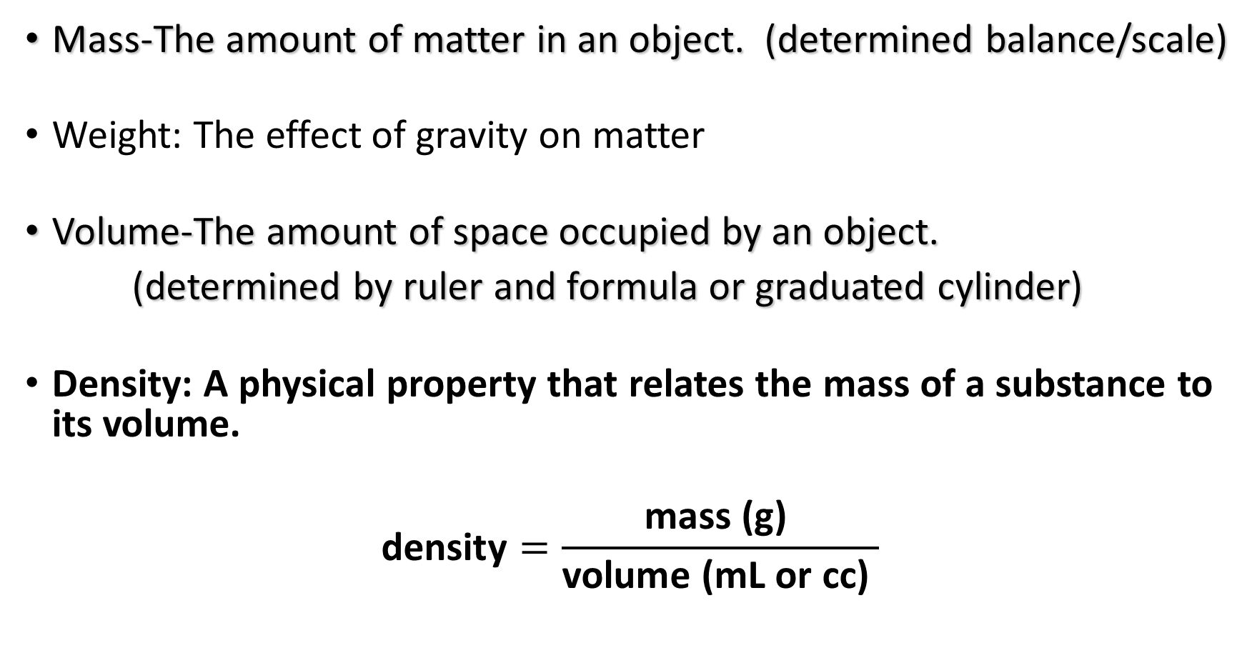
Understanding density
Mass-The amount of matter in an object. (determined balance/scale)
Weight: The effect of gravity on matter
Volume-The amount of space occupied by an object.
(determined by ruler and formula or graduated cylinder)
Density: A physical property that relates the mass of a substance to its volume.
$$\text{density}=\frac{\text{mass}\text{ (}\text{g}\text{)} }{\text{volume}\text{ (}\text{mL} \text{or} \text{cc}\text{)} }$$

Slide 28

Density at a conversion
To convert volume (mL) to mass (g):
$$mL×\frac{g}{mL}=g$$
To convert mass (g) to volume (mL):
$$g×\frac{mL}{g}=mL$$

Slide 29
Practice
Mercury has a density of 13.6 g per mL. What is the density of mercury in lbs. per gallon?
Ebony is a dark hard wood. A rectangular piece of ebony has a mass of 522 g and a volume of 435 cm³. Find the density of ebony
Gasoline has a density of 0.68 g/mL. What is the mass of 90.5 mL of gasoline?

Slide 30
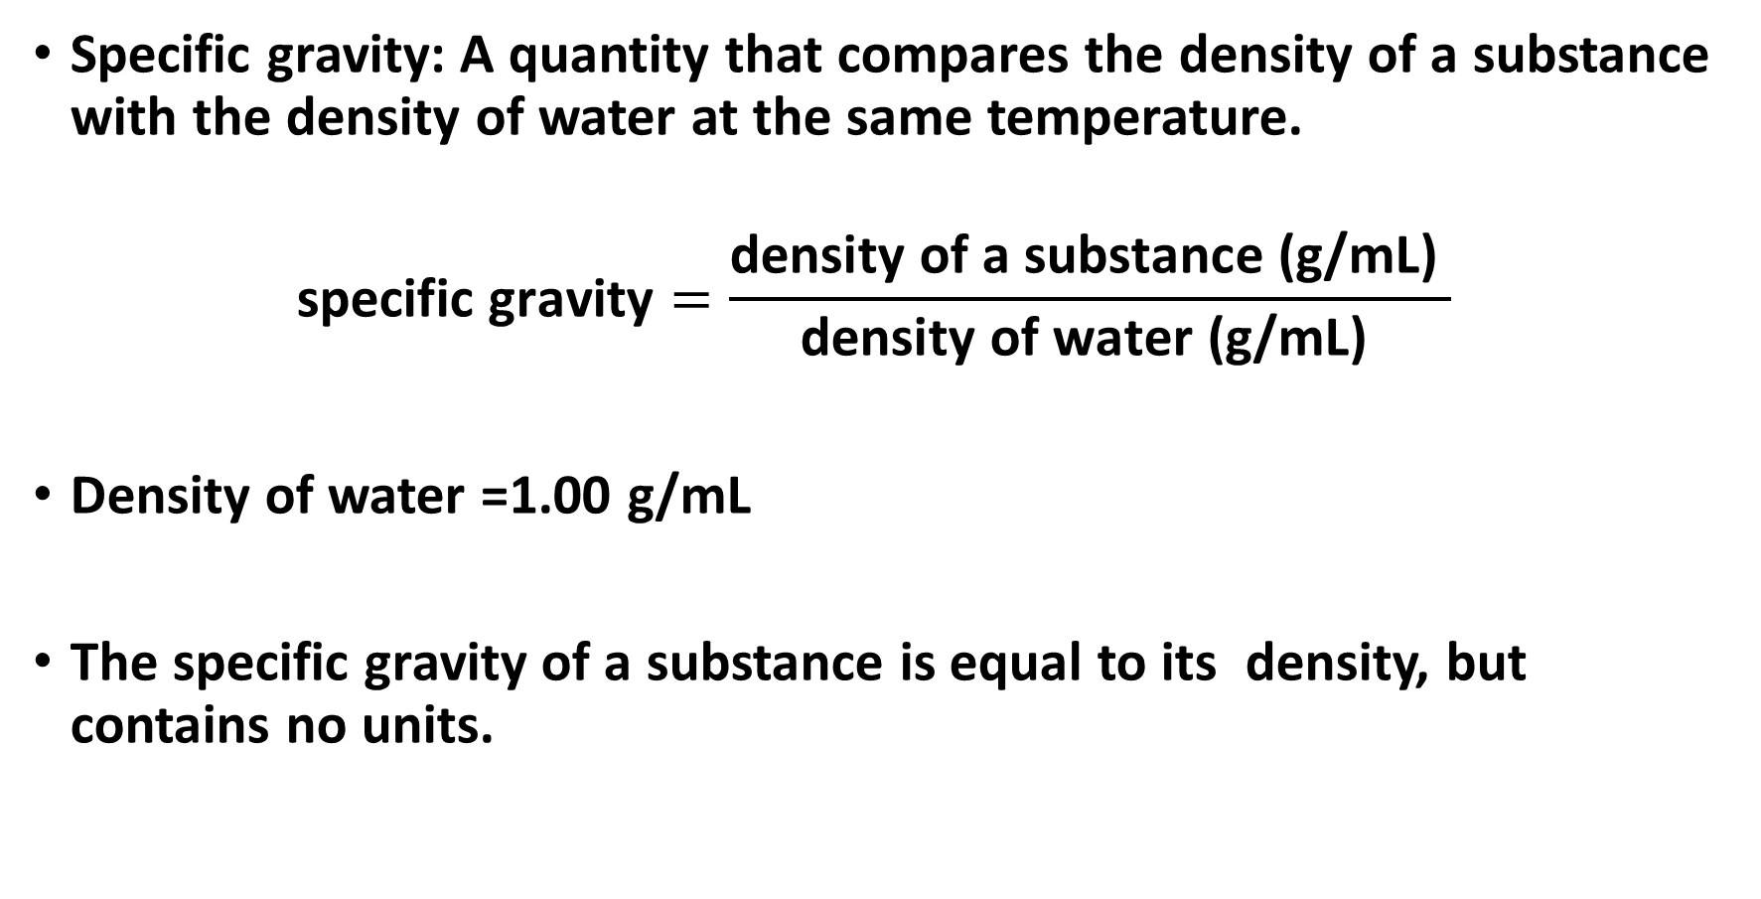
Specific Gravity
Specific gravity: A quantity that compares the density of a substance with the density of water at the same temperature.
$$\text{specific} \text{gravity}=\frac{\text{density} \text{of} \text{a} \text{substance}\text{ (}\text{g}\text{/}\text{mL}\text{)} }{\text{density} \text{of} \text{water}\text{ (}\text{g}\text{/}\text{mL}\text{)} }$$
Density of water =1.00 $\text{g}\text{/}\text{mL}$
The specific gravity of a substance is equal to its density, but contains no units.

Slide 31
Energy
Energy – ability to work
potential energy: stored energy
kinetic energy: energy to produce motion
conservation of energy: Energy takes various forms, but it is never created or destroyed
Units of energy
joules, J
calories, cal
Conversion:
1cal = 4.184 J
I Cal (nutritional calorie) = 1000 cal

