Slide 1
Chemistry 120
Introduction to the Periodic Table of Elements

Slide 2
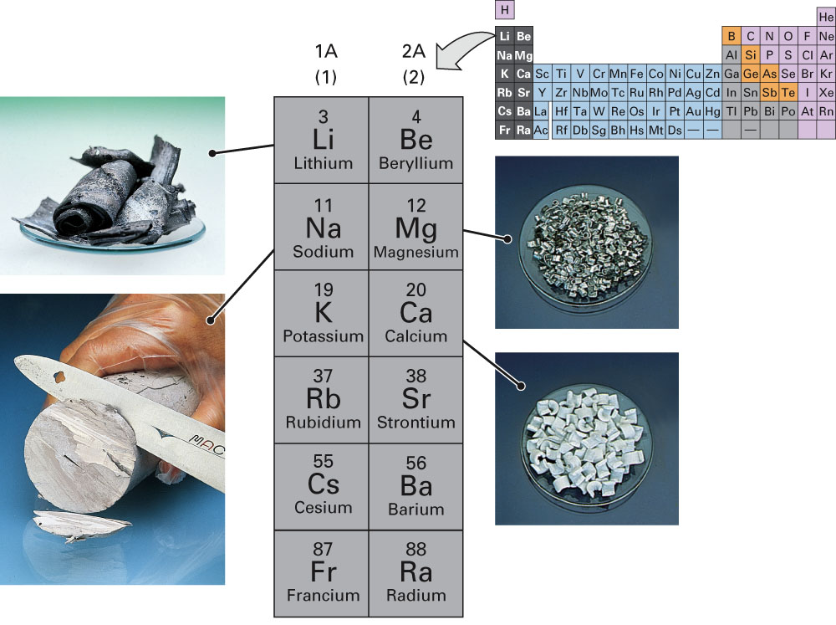
Fig. 11-21, p. 333

Slide 3
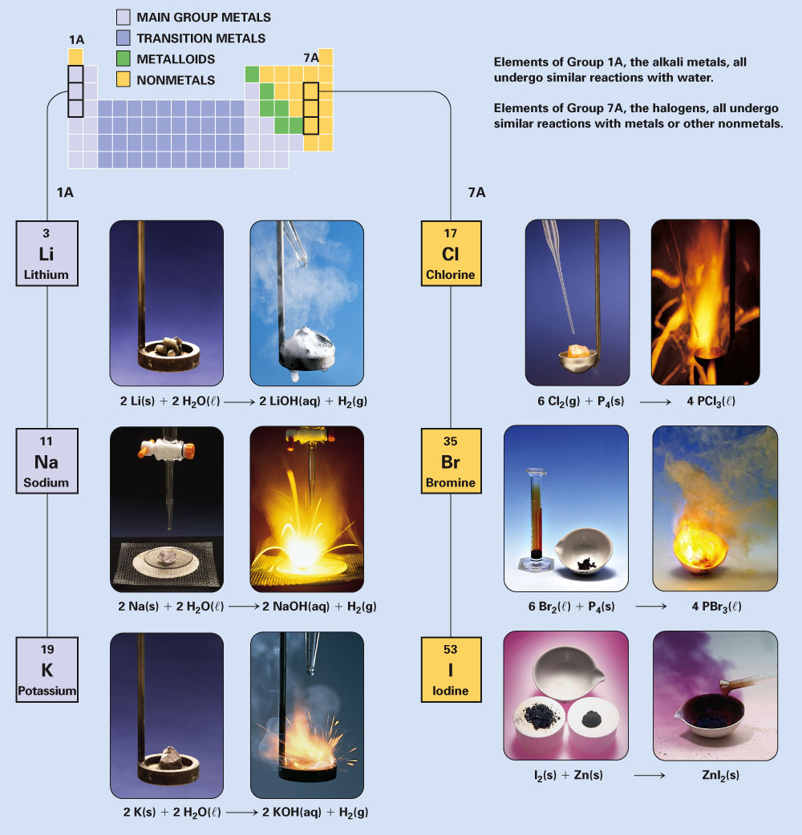
Fig. 11-19, p. 332

Slide 4
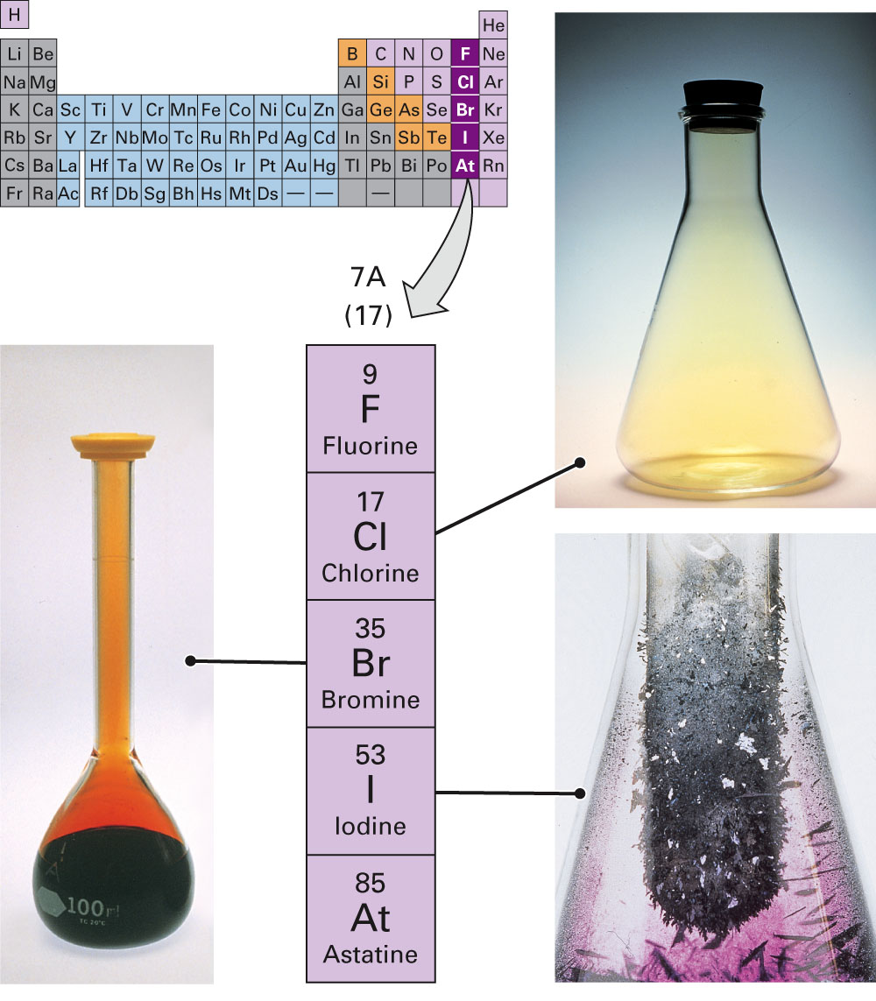
Fig. 11-22, p. 334

Slide 5
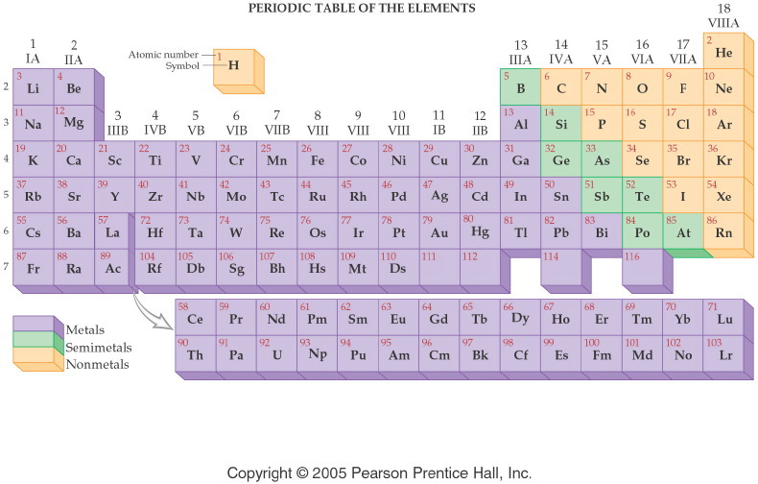
Notes:
Figure: 04-05
Title:
Metals, Nonmetals, Semimetals
Caption:
This periodic table shows metals on the left side, nonmetals on the right side, and semimetals in the middle.
Notes:
The elements are classified by metallic character. Each class of element is shown in a distinct color.

Slide 6
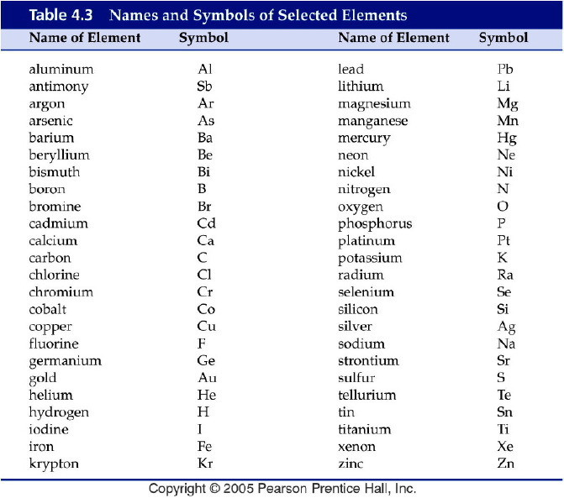
Notes:
Figure: 04-T03
Title:
Table 4.3
Caption:
Names and Symbols of Selected Elements
Notes:
Many of the most common and important elements are listed in this table.

Slide 7
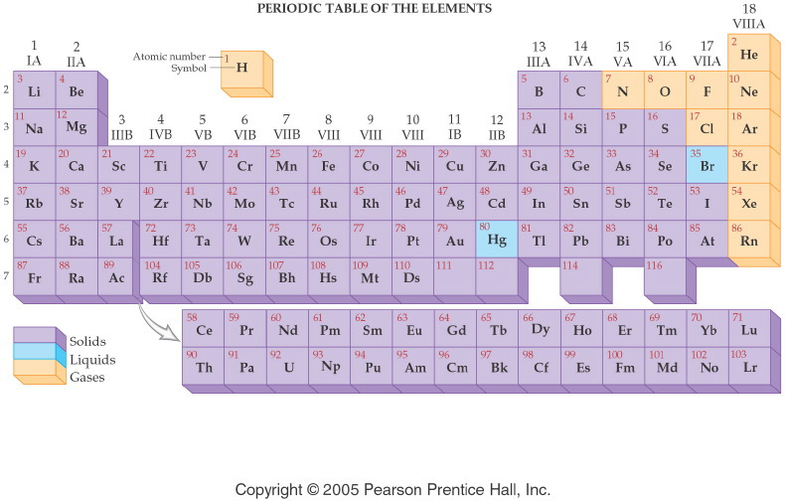
Notes:
Figure: 04-06
Title:
Physical States of Elements
Caption:
At 25° C and normal pressure, all metals (except Hg) are solid. Most nonmetals are gases, but some are solid. The only two liquid elements are Hg (a metal) and Br (a nonmetal).
Notes:
The elements are classified by physical state at room temperature and atmospheric pressure. Each class of element is shown in a distinct color.

Slide 8
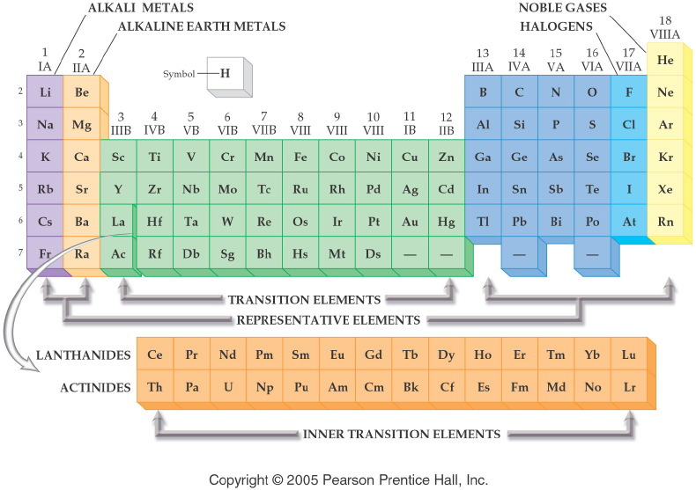
Notes:
Figure: 06-03
Title:
Names of Groups and Periods
Caption:
The common names of groups and periods are shown for selected families and series.
Notes:
These names are still commonly used, and it's important to remember them.

Slide 9
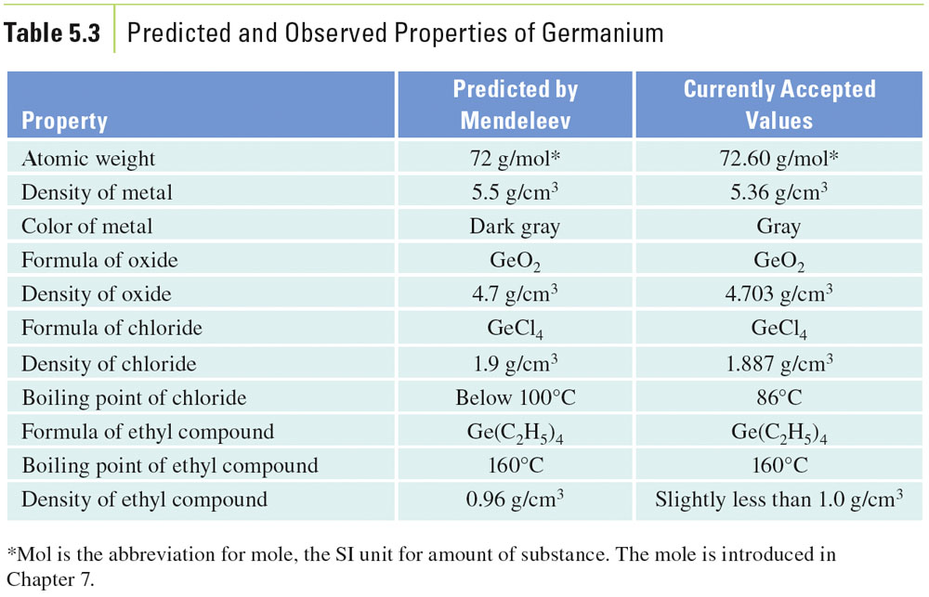
Table 5-3, p. 134

Slide 10
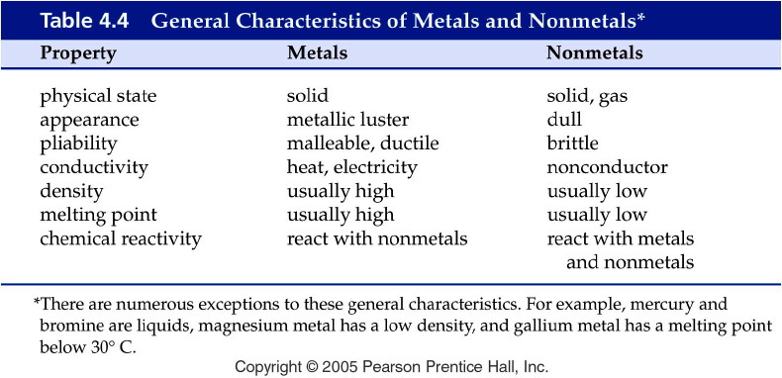
Notes:
Figure: 04-T04
Title:
Table 4.4
Caption:
General Characteristics of Metals and Nonmetals*
Notes:
note that there are exceptions to the general characteristics.

Slide 11
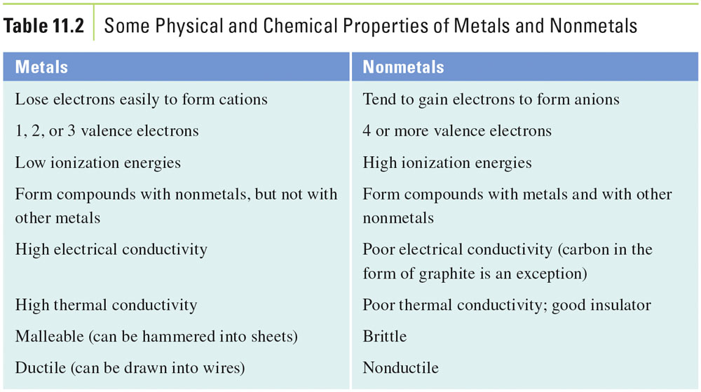
Table 11-2, p. 335

Slide 12
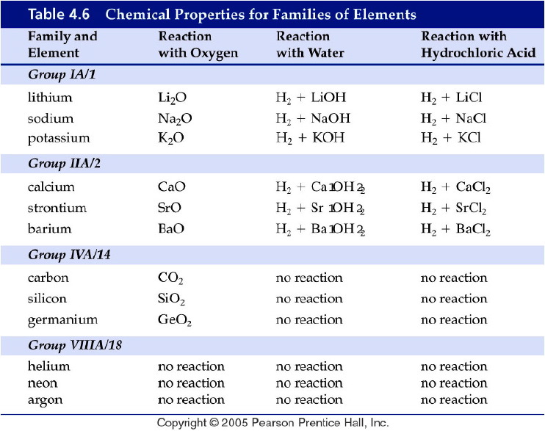
Notes:
Figure: 04-T06
Title:
Table 4.6
Caption:
Chemical Properties for Families of Elements
Notes:
Elements are grouped into families based on similar chemical behavior.

Slide 13
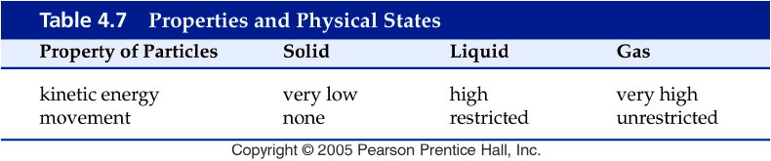
Notes:
Figure: 04-T07
Title:
Table 4.7
Caption:
Properties and Physical States
Notes:
As we go from solid to liquid to gas, the amount of energy and the freedom of movement of particles both increase.

Slide 14
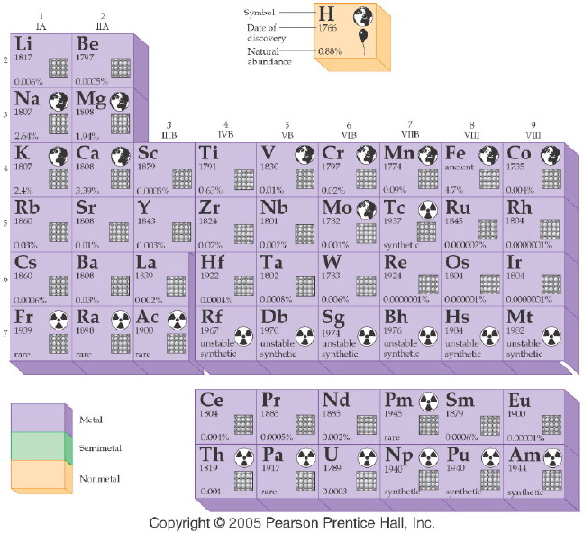
Notes:
Figure: 04-07a
Title:
Periodic Table of the Elements
Caption:
This is a pictorial representation of each element in the periodic table including the year the element was discovered, its natural abundance, its biological importance, and its radioactive properties.
Notes:
This is part 1 of a 2 part diagram. It shows detailed information on each element.

Slide 15
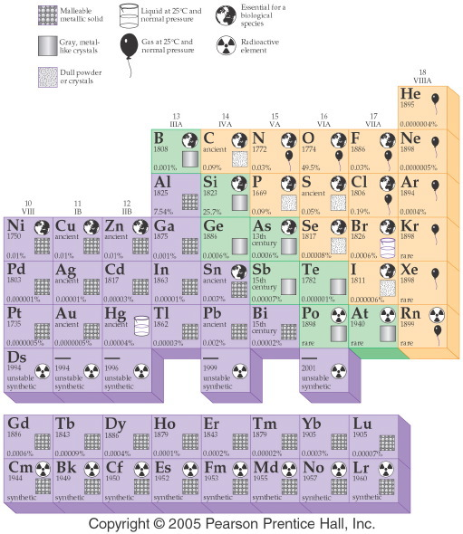
Notes:
Figure: 04-07b
Title:
Periodic Table of the Elements
Caption:
This is a pictorial representation of each element in the periodic table.
Notes:
This is a pictorial representation of each element in the periodic table including the year the element was discovered, its natural abundance, its biological importance, and its radioactive properties.

Slide 16
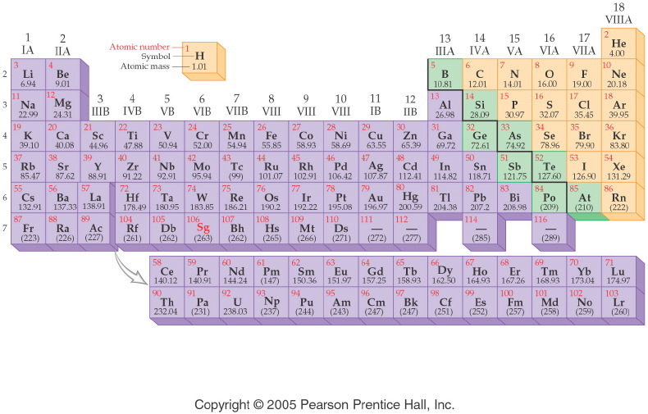
Notes:
Figure: 06-02
Title:
The Modern Periodic Table
Caption:
Atomic numbers increase stepwise throughout the periodic table.
Notes:
Elements are grouped down columns by nuclear charge. This atomic property explains the similarity in reactivity. Color coding shows metallic properties.

Slide 17
Alternative Periodic Tables
Dmitri Mendeleev, the original, periodic table (1869).

Slide 18
Alternative Periodic Tables
The periodic spiral of Professor Thoedor Benfey.

Slide 19
Alternative Periodic Tables
Triangular long form by Emil Zmaczynski

Slide 20
Alternative Periodic Tables
Dr. Timmothy Stowe's physicists periodic table.

Slide 21
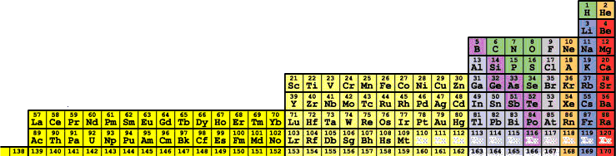
Alternative Periodic Tables
Albert Tarantola's orbital periodic table.

