Slide 1
Chemistry 120
Review

Slide 2
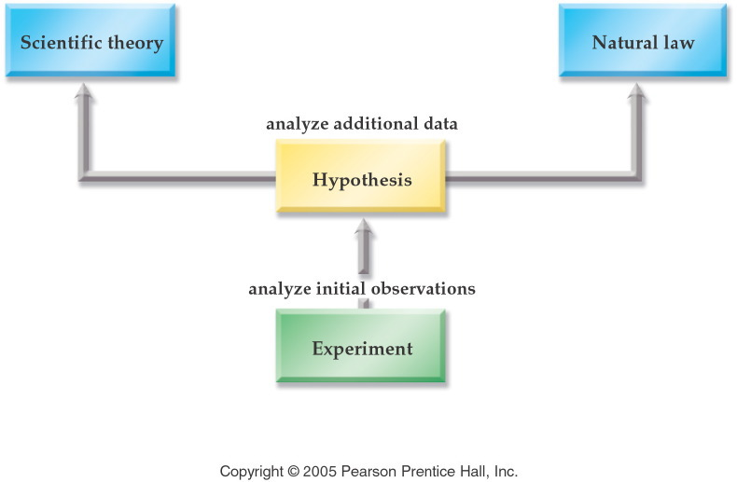
Chapter 1: Introduction to Chemistry
Molecular vs. Particulate view
Scientific Method

Slide 3
Periodic Table
Names and symbols of elements (1st 56 and Hg, Au, and Pb)
Metals, Nonmetals, Semimetals/Metalloids
  Properties
  Position on periodic table
Names of groups
  Representative/Main group elements
    Alkali metals
    Alkaline earth metals
    Boron group
    Carbon group
    Nitrogen group
    Oxygen/chalcogen group
    Halogens
    Noble Gases
  Transition metals
  Inner transition metals
    Lanthanides and Actinides

Slide 4
Chapter 2: Matter and Energy
Matter
  States of Matter
    solid, liquid, and gas
  Types of Matter
    Pure substance: compounds and elements
    Mixture: homogeneous and heterogeneous
  Properties of Matter
    Chemical and physical changes
Law of Conservation of Mass and Energy
Notes:
Figure: 01-04
Title:
The Scientific Method
Caption:
Experiments are performed to form a Hypothesis, which if confirmed may lead to a Scientific Theory.
Notes:
Even a Scientific Theory is not considered to be absolute truth. Scientific Theories can be revised in the light of new, or more reliable research.

Slide 5

Chapter 3:
Measurements and Chemical Calculations
Measurements
  Units of Measurement
    Metric, USGS, SI
    Significant Figures
Dimensional Analysis
Density
Temperature Conversions
  ̊̊̊C, ̊F, K
  ̊C=(5/9) ̊F + 32 and K= ̊C + 273.15

Slide 6
Chapter 5:
Atomic Theory: The Nuclear Model of the Atom
Atomic Theory
  Dalton’s Atomic Theory
  Thomson’s Plum Pudding Model
    Subatomic particles: protons and neutrons
  Rutherford’s Gold Foil Experiment
    Nucleus and electrons
  Nuclear Model of the Atom
  Planetary Model of the Atom aka Bohr Model
  Quantum Mechanical Model of the Atom
Chemical Symbols ^{A}_{Z}Sy ^{c}
  Mass number = A = number of protons and neutrons
  Atomic number = Z = number of protons
  Charge = c
Isotopes
Atomic Mass (amu or g/mol)

Slide 7
Chapter 6: Chemical Nomenclature
Nomenclature
  Monoatomic ions and polyatomic ions
  Ionic
    metal nonmetide
    metal(r.n) nonmetide
    Latin nomenclature using latin roots
      higher metal cation charge –ic ending
      Lower metal cation charge –ous ending
  Molecular
    Prefixnonmetal prefixnonmetide
  Acids
    -ide becomes hydro…ic acid
    -ite becomes –ous acid
    -ate becomes –ic acid
  Hydrates
    Metal nonmetide prefixhydrate

Slide 8
Chapter 7:
Chemical Formula Relationships
Mole
Avogadro’s number (1 mol X= 6.022 x 10²³ X)
Molar Mass (g/mol)
Stoichiometry
  Using chemical formulas
Percent Composition
Empirical and Molecular Formulas

Slide 9
Chapter 8: Chemical Reactions
Chapter 9: Chemical Change
Methods of Writing Chemical Reactions
  Conventional Equation
  Total Ionic Equation
  Net Ionic Equation
Types of Chemical Reactions
  Redox
    Synthesis/Combination
    Decomposition
    Single Replacement
      Activity Series
  Double Replacement (solubility rules)
    Precipitation
    Gas Evolving
    Slightly ionizable substances (water, weak acids and bases)
    Acid-base neutralization

Slide 10

Chapter 10:
Quantity Relationships in Chemical Reactions
Stoichiometry
  Using balanced chemical equations
  Calculate the theoretical yield
  Calculate percent yield
  Limiting Reactant Problems
  Thermochemical equations and calculations

Slide 11
Chapter 11:
Atomic Theory: The Quantum Model of the Atom
Electromagnetic Spectrum
Pauli Exclusion Principle
Hund’s Rule
Electron Configuration
  ns²np⁶(n-1)d¹⁰(n-2)f¹⁴
Periodic Trends
  Atomic size
  First ionization energy
  Metallic character
  Electronegativity

Slide 12
Chapter 12: Chemical Bonding
Chemical Bonds
  Ionic
  Metallic
  Covalent
    Nonpolar
    Polar
    Coordinate
Lewis Structures

Slide 13
Chapter 13: Structure and Shape
Valence Shell Electron Pair Repulsion Theory
(VSEPR)
Molecule Polarity
  Net dipole moments
Exceptions to the octet rule
Organic structures
  Hydrocarbons
  Alcohols
  Ethers
  Carboxylic acids

Slide 14
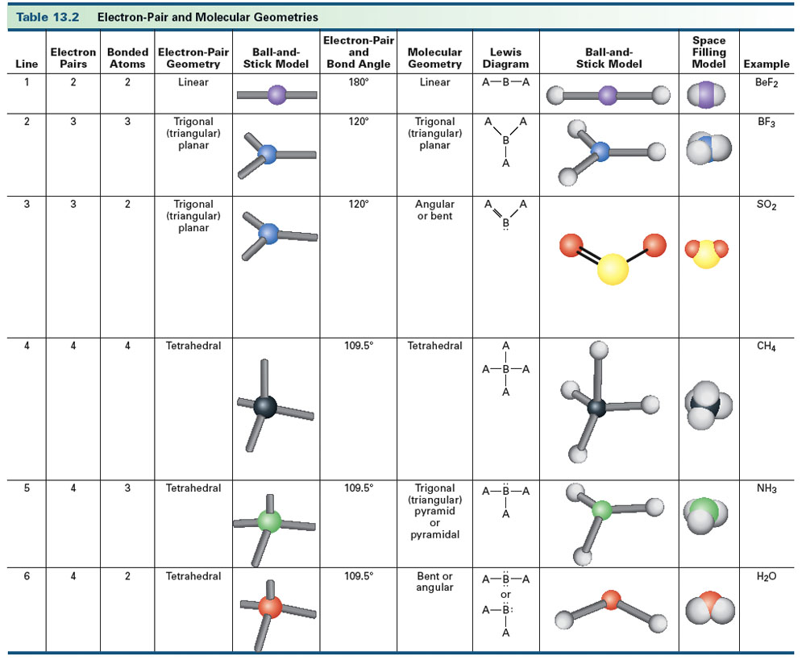
Table 13-2, p. 377

Slide 15
Chapter 4: Introduction to Gases
Chapter 14: The Ideal Gas Law
Properties of Gases
Kinetic Molecular Theory
STP
  0 ̊C and 760 torr
  Molar Volume 22.4 L/mol
Gas Laws
  Charles Law: V α T(K)
  Boyle’s Law: P α 1/V
  Avogadro’s Law: V α n
  Ideal Gas Law: PV=nRT
Applications
  PV(MM)=mRT
  DRT=(MM)P
  Molar Volume M_{v}=V/n or M_{v}=RT/P
Gas Stoichiometry

Slide 16
Chapter 15: Gases, Liquids and Solids
Dalton’s Law of Partial Pressures: P_{total} = P₁ + P₂+…
Properties of Liquids
  Vapor pressure
  Boiling point
  Viscosity
  Surface tension
Intermolecular Forces
  Induced dipole aka London forces or dispersion forces
  Dipole forces
  Hydrogen bonding
Energy and changes of state q=mc∆T and q=m∆H
Properties of Solids
  Amorphous
  Crystalline
    Ionic
    Molecular
    Covalent Network
    Metallic
  Polycrystalline

Slide 17
Chapter 16: Solutions
Types of Solutions
  Gas
  Solid
  Liquid
Units of Concentration
  Mass percent
  Molarity
  Molality
Dilutions M₁V₁= M₂V₂
Solution Stoichiometry

Slide 18

Chapter 17:
Acid-Base (Proton Transfer) Reactions
Properties of Acids and Bases
Definitions of Acids and Bases
  Arrhenius
  Brønsted-Lowry
  Lewis
Acid-Base Reactions
  Arrhenius acid-base reactions
  Brønsted-Lowry acid-base reactions
  Lewis acid-base reactions
  Single replacement reactions
  Metal oxide and acids
K_{w}, pH and pOH

Slide 19
Lab Techniques
Basic glass working
Proper use of standard equipment
  Balances
    Electronic and quad-beam
  Volumetric equipment
    Beakers, graduated cylinders, Erlenmeyer flasks
    Volumetric flasks and pipets, burets
Use equipment to collect, organize and evaluate experimental data
  Observe physical and chemical changes
  Interpret qualitative (non-numerical) and quantitative (numerical) data
Use CRC Handbook to look up information
  Make linear graphs using data

