Slide 1
Chemistry 120
Chapter 8: Chemical Reactions
Chapter 9: Chemical Change

Slide 2
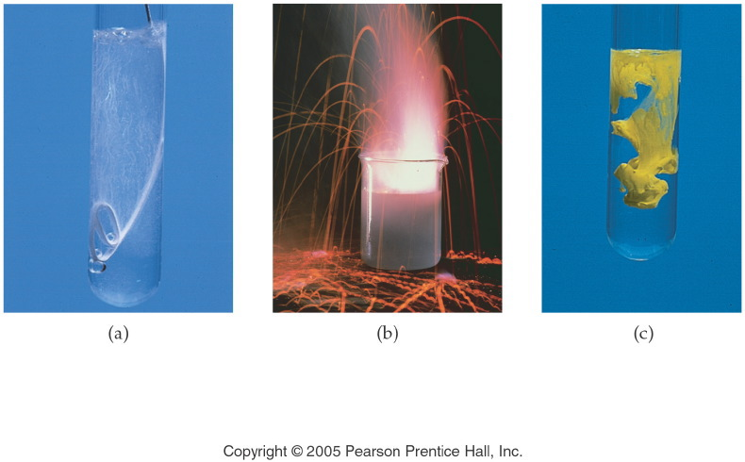
Notes:
Figure: 08-01
Title:
Evidence for a Chemical Reaction
Caption:
Each of the above is evidence for a chemical reaction: (a) the gas bubbles released from magnesium metal in acid; (b) the heat and light released from potassium metal in water; and (c) the color change and the precipitate produced by two aqueous solutions.
Notes:
Each of the changes shows evidence of a chemical reaction. New substances are formed and energy is released or absorbed when a reaction occurs.

Slide 3
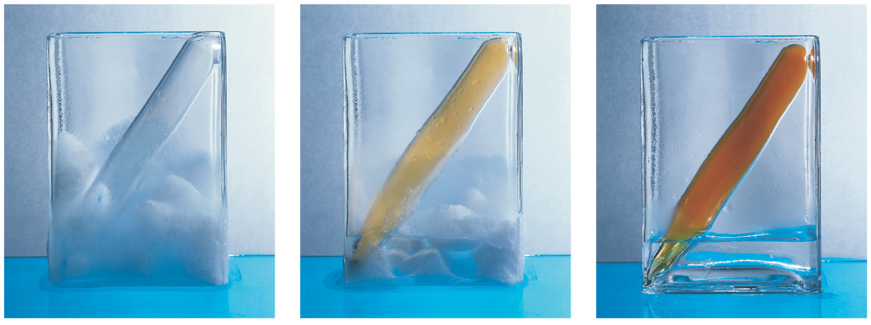
Permanent Color Change

Slide 4
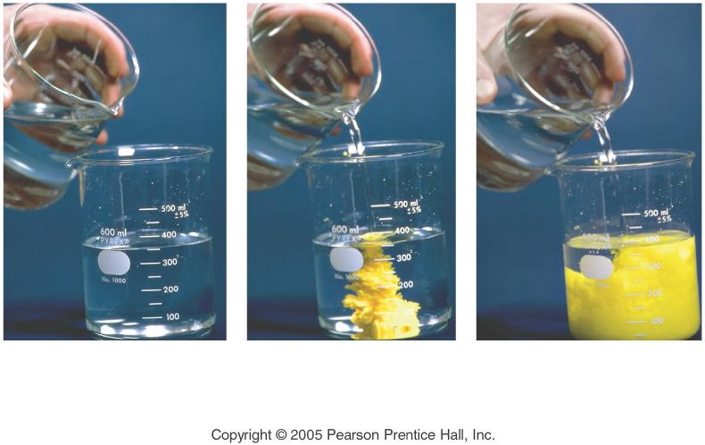
Notes:
Figure: 08-01-21CREx14
Title:
precipitation reaction
Caption:
Composite of 3 photos: 1) 2 clear solutions; 2) yellow precipitate starts; 3) clear solution turns to yellow.
Notes:
This is a double-replacement reaction. One of the products is insoluble in water.

Slide 5
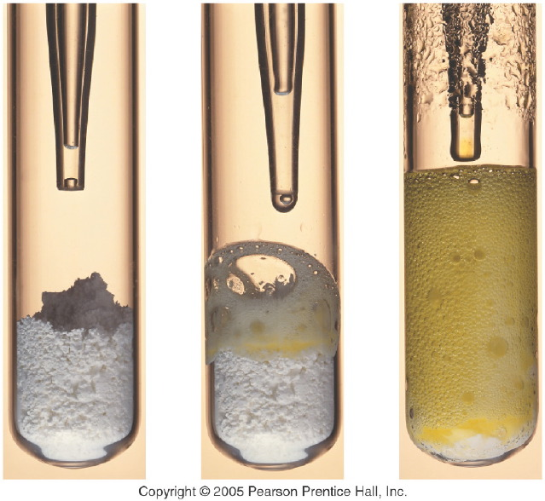
Notes:
Figure: 08-01-20CRKC10
Title:
Hydrochloric acid and baking soda
Caption:
Composite of 3 photos: In test tube 1) dropper over white powder; 2) white powder starting to become yellow foam; 3) yellow foam.
Notes:
This reaction produces a gas as well as an aqueous solution.

Slide 6
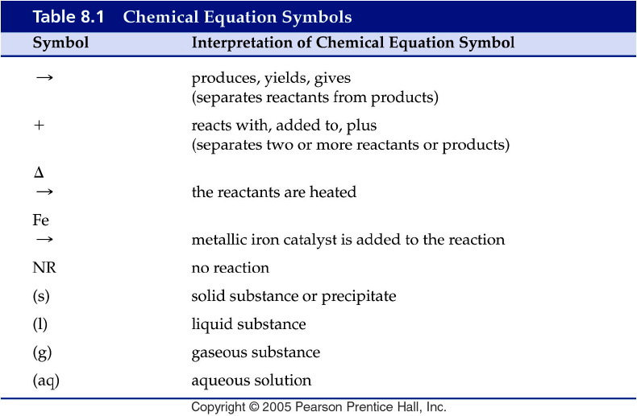
Notes:
Figure: 08-T01
Title:
Table 8.1
Caption:
Chemical Equation Symbols
Notes:
These symbols are used to describe the details of the conditions in a chemical reaction and to describe the products and reactants.

Slide 7
Example – Chemical Reactions
What is the coefficient of oxygen gas, when methane, CH₄, gas undergoes combustion with oxygen gas to produce carbon dioxide gas and water vapor?

Slide 8
Example – Chemical Reactions
Solid lithium chlorate decomposes upon heating to powdered lithium chloride and oxygen gas.
What is the coefficient of the lithium chloride in the balanced chemical equation?

Slide 9
Example – Conventional, Total Ionic and Net Ionic Equations
When cadmium bromide reacts with potassium arsenate the products are:
CdK₂ and AsO₄Br₃
Cd₂(AsO₄)₃ and K₃Br₂
Cd₃(AsO₄)₂ and K₃Br₂
Cd₃(AsO₄)₂ and KBr
KCd and BrAsO₄

Slide 10
Example – Conventional, Total Ionic and Net Ionic Equations
What are the spectator ions in the total ionic equation?
Cd²⁺, Br⁻, K⁺, AsO₄³⁻
Br⁻, K⁺
Cd²⁺, AsO₄³⁻
Cd²⁺, Br⁻, K⁺, As³⁻, O²⁻
No spectator ions

Slide 11
Example – Conventional, Total Ionic and Net Ionic Equations
Zinc metal reacts with aqueous copper(II) chloride to produce copper solid and aqueous zinc chloride.
What is the net ionic equation?
Zn _{(s)} + CuCl_{2 (aq)} → Cu _{(s)} + ZnCl_{2 (aq)}
Zn _{(s)} + Cu²⁺ _{(aq)} + 2 Cl⁻ _{(aq)} → Cu _{(s)} + Zn²⁺ _{(aq)} + 2 Cl⁻ _{(aq)}
Zn _{(s)} + Cu²⁺ _{(aq)} → Cu _{(s)} + Zn²⁺ _{(aq)}
Zn _{(s)} + Cu²⁺ _{(aq)} + 2 Cl⁻ _{(aq)} → Cu _{(s)} + ZnCl₂ _{(aq)}
All spectator ions

Slide 12
Example – Conventional, Total Ionic and Net Ionic Equations
Aqueous ammonium nitrate reacts with aqueous sodium hydroxide to produce aqueous sodium nitrate and ammonia gas and water.
What is the total ionic equation?
NH₄NO_{3 (aq)} + NaOH _{(aq)} → NaNO_{3 (aq)} + NH_{3 (g)} + H₂O _{(l)}
NH₄ ⁺ _{(aq)} + NO₃⁻ _{(aq)} + Na⁺ _{(aq)} + OH- _{(aq)} → Na⁺ _{(aq)} + NO₃⁻ _{(aq)} + NH_{3 (g)} + H₂O _{(l)}
NH₄ ⁺ _{(aq)} + OH- _{(aq)} → NH_{3 (g)} + H₂O _{(l)}
All spectator ions

Slide 13
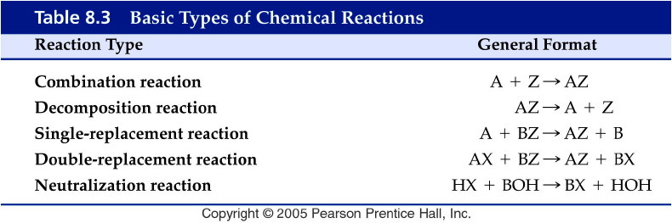
Notes:
Figure: 08-T03
Title:
Table 8.3
Caption:
Basic Types of Chemical Reactions
Notes:
These are the basic types of chemical reactions.

Slide 14
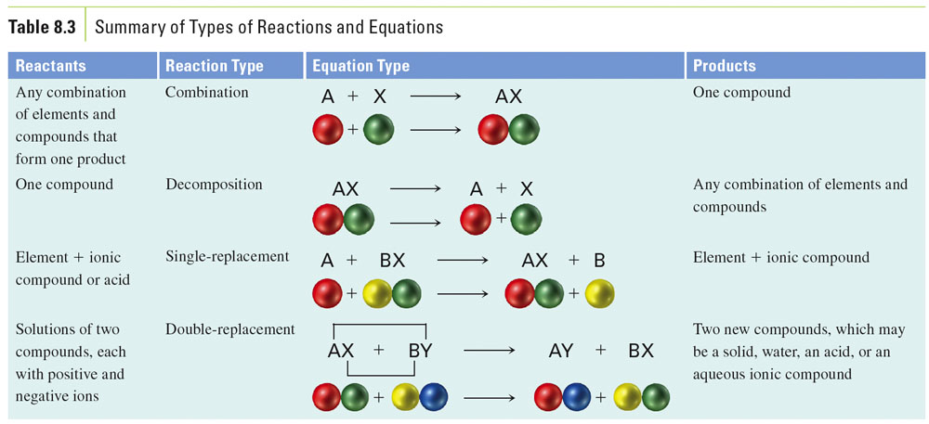

Slide 15
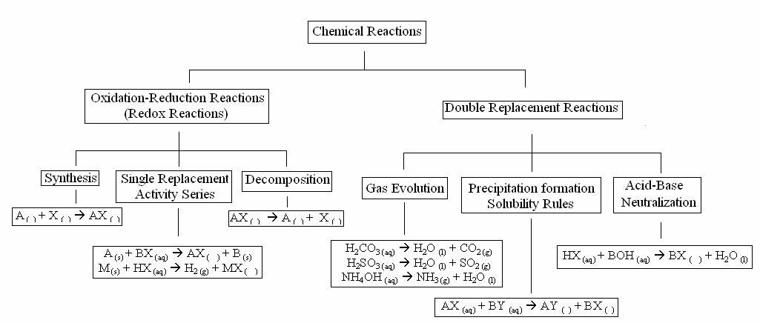

Slide 16
Common Strong Acids and Bases
Common Strong Bases
Lithium hydroxide LiOH _{(aq)}
Sodium hydroxide NaOH _{(aq)}
Potassium hydroxide KOH _{(aq)}
Strontium hydroxide Sr(OH)₂ _{(aq)}
Barium hydroxide Ba(OH)₂ _{(aq)}
Calcium hydroxide Ca(OH)_{2 (aq)}
Common Strong Acids
Hydrochloric acid HCl _{(aq)}
Hydrobromic acid HBr _{(aq)}
Hydroiodic acid HI _{(aq)}
Perchloric acid HClO_{4 (aq)}
Chloric acid HClO_{3 (aq)}
Nitric acid HNO_{3 (aq)}
Sulfuric acid H₂SO_{4 (aq)}

Slide 17
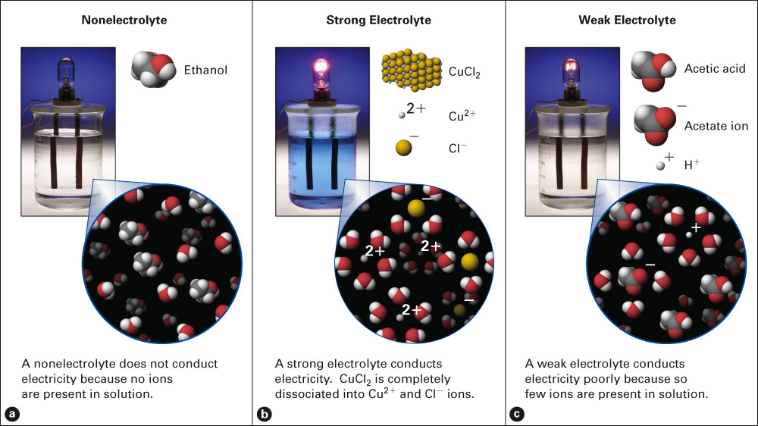
Fig. 9-2, p. 237

Slide 18
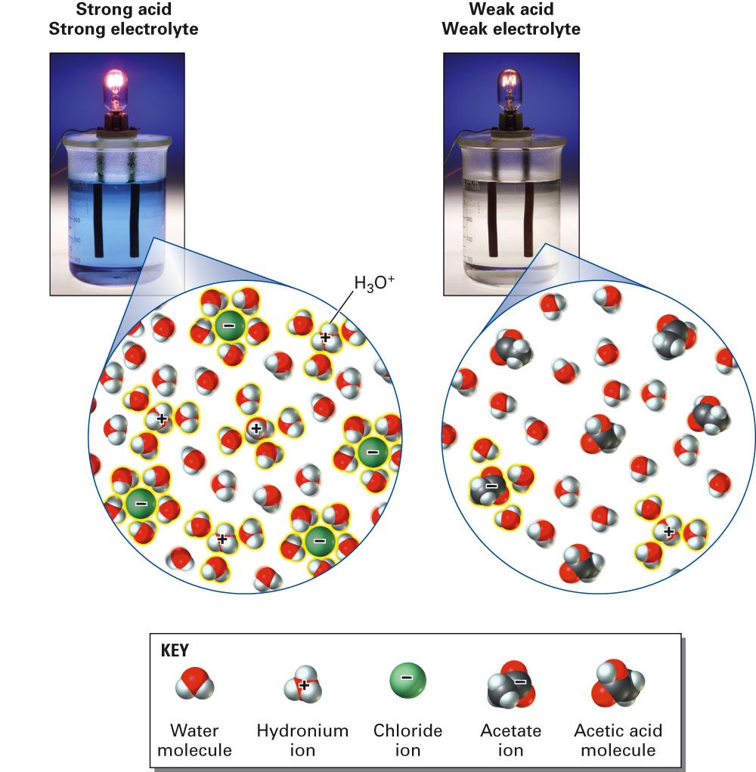
Fig. 9-6, p. 241

Slide 19
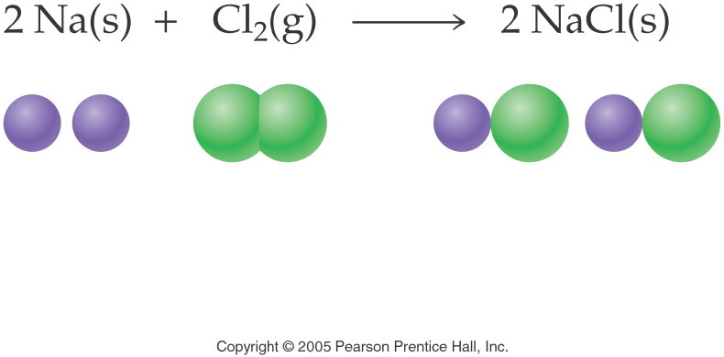
Notes:
Figure: 08-01-04EQ10-UN
Title:
sodium chloride
Caption:
Chemical equation of two sodium chloride and its molecular models
Notes:
This is a combination reaction. One product is produced from the two reactants. Note that the equation is balanced.

Slide 20
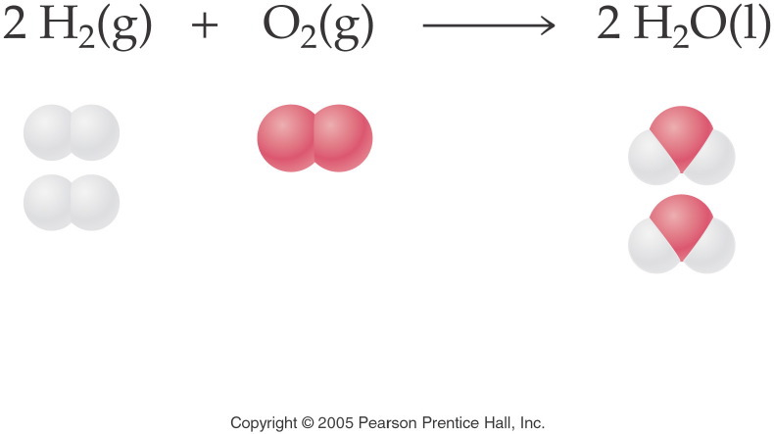
Notes:
Figure: 08-01-01EQ7-UN
Title:
Water
Caption:
Chemical equation of two water and its molecular atoms
Notes:
We should clear fractions by multiplying all coefficients by a number that will make all the coefficients whole numbers. Here we multiplied all the coefficients by 2 to make whole-number coefficients.

Slide 21
Example – Redox Reactions
Synthesis/Combination Reactions
Chromium metal is heated with nitrogen gas to give solid chromium(III) nitride. What is the coefficient of the chromium metal?

Slide 22
Example – Redox Reactions
Synthesis/Combination Reactions
Solid magnesium oxide combines with carbon dioxide to produce magnesium carbonate powder. What is the coefficient of the product?

Slide 23
Example – Redox Reactions
Combustion Reactions
Silver metal oxides. What is the formula of the product?

Slide 24
Example – Redox Reactions
Combustion Reactions
Titanium metal undergoes combustion to yield titanium(IV) oxide. What is the balanced chemical equation?
Ti _{(s)} + O _{(g)} → TiO _{(s)}
2 Ti _{(s)} + 2 O_{2 (g)} → Ti₂O_{4 (s)}
Ti _{(s)} + O_{2 (g)} → TiO_{2 (s)}
Ti _{(s)} + O_{2 (g)} → Ti₄O_{2 (s)}
No reaction

Slide 25
Example – Redox Reactions
Combustion Reactions
Chlorine gas and oxygen gas react to produce dichlorine trioxide gas. What is the coefficient in front of oxygen gas?

Slide 26
Example – Redox Reactions
Decomposition Reactions
Silver bicarbonate decomposes by heating to silver carbonate powder, water, and carbon dioxide gas. What is the sum of the coefficients?

Slide 27
Example – Redox Reactions
Decomposition Reactions
Silver carbonate further decomposes upon heating to silver oxide and carbon dioxide. What is the sum of the coefficients now?

Slide 28
Example – Redox Reactions
Decomposition Reactions
Stannous chlorate decomposes upon heating to yield stannous chloride and oxygen gas. What is the balanced chemical equation?
Sn(ClO₃)_{2 (s)} → SnCl_{2 (s)} + 3 O_{2 (g)}
Sn(ClO₂)_{2 (s)} → SnCl_{2 (s)} + 4 O_{2 (g)}
Sn(ClO₂)_{2 (s)} → no rxn
SnCl_{2 (s)} + 3 O_{2 (g)} → Sn(ClO₃)_{2 (s)}

Slide 29
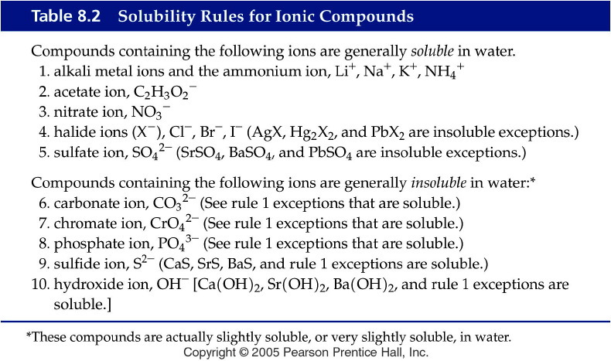
Notes:
Figure: 08-T02
Title:
Table 8.2
Caption:
Solubility Rules for Ionic Compounds
Notes:
Note that Rule 1 "trumps" other rules, i.e., compounds of Group IA (1) metals and ammonium ion are always soluble.

Slide 30
Solubility Rules
All common compounds of Group 1 and ammonium ions (NH₄⁺) are soluble.
All nitrates (NO₃⁻), acetates (C₂H₃O₂⁻), and chlorates (ClO₃⁻ ) are soluble. Except acetates of aluminum (Al³⁺), and silver (Ag⁺).
All binary compounds of the halogens (other than F) with metals are soluble, except those of silver (Ag⁺), mercury(I) (Hg₂²⁺), and lead(II) (Pb²⁺) (lead halides are soluble in hot water).
4. Compounds containing fluoride ions (F⁻) are soluble except for calcium (Ca²⁺), barium (Ba²⁺), strontium (Sr²⁺), magnesium (Mg²⁺), and lead(II) (Pb²⁺).
5. All sulfates (SO₄²⁻) are soluble, except those of barium (Ba²⁺), strontium (Sr²⁺), calcium (Ca²⁺), lead(II) (Pb²⁺), silver (Ag⁺), and mercury (I) (Hg₂²⁺), which are insoluble. The latter three are slightly soluble.
6. Except for rule 1, carbonates (CO₃²⁻), hydroxides (OH⁻), oxides (O²⁻), silicates (SiO₄²⁻), and phosphates (PO₄³⁻) are insoluble.
7. Sulfides (S²⁻) are insoluble except when paired with calcium (Ca²⁺), barium (Ba²⁺), strontium (Sr²⁺), magnesium (Mg²⁺), sodium (Na⁺), potassium (K⁺), and ammonium (NH₄⁺) .

Slide 31
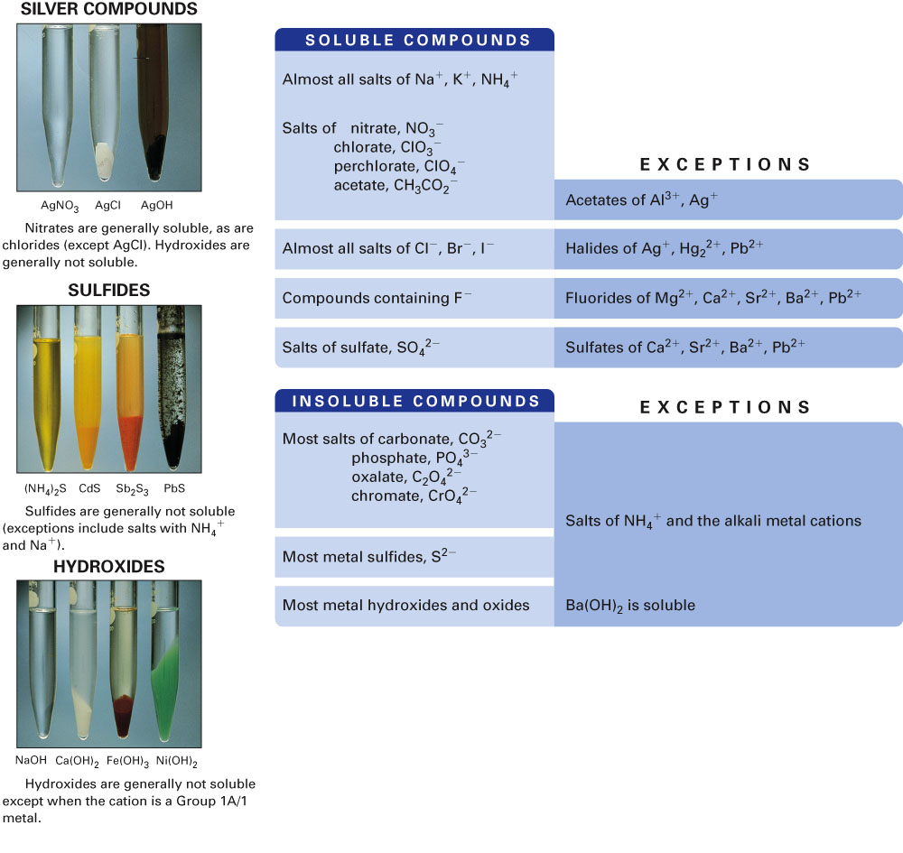
Fig. 9-13, p. 256

Slide 32
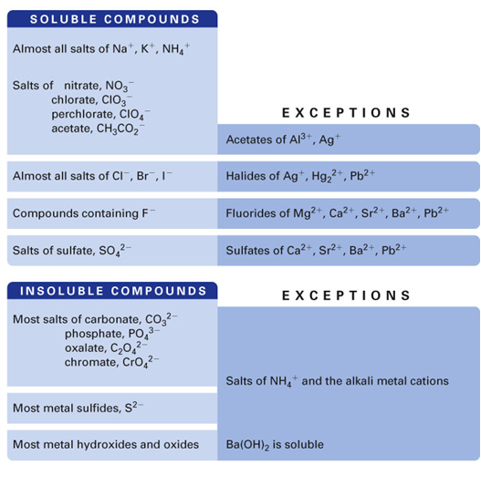
Example – Ion Exchange Reactions
What is the precipitate when lead(II) nitrate reacts with lithium chloride?

Slide 33
Example – Ion Exchange Reactions
Ferric chloride reacts with ammonium phosphate what is the coefficient in front of the precipitate?

Slide 34
Example – Ion Exchange Reactions
What gas is formed when sodium sulfite reacts with hydrobromic acid?

Slide 35
Example – Ion Exchange Reactions
When aqueous solutions of sodium sulfite and potassium bromide are mixed the products are:
NaBr and K₂SO₃
K₂SO₃ and Na₂Br
NaK and SO₃Br
No reaction

Slide 36
Example – Ion Exchange Reactions
Aqueous sodium acetate is mixed with hydrobromic acid. What is formed?
Precipitate
Gas
Slightly ionizable substance
No reaction

Slide 37
Example – Ion Exchange Reactions
When sulfuric acid and aqueous lithium hydroxide are mixed one of the products is
Water
Lithium hydride
Sulfur trioxide
Lithium sulfide
No reaction

Slide 38
Activity Series
Metals
Li ← most reactive
K
active Ba Will replace H₂ from
metals Sr liquid water, steam or
Ca acid
Na
Mg
Al
Mn Will replace H₂ from
Zn steam or acid
Cr
Fe
Cd
Co
Ni Will replace H₂ from
Sn acid
Pb
(H)
Sb
Cu
Ag Will not replace H₂
Pd from liquid water,
Pt steam or acid
Hg
Au ← least reactive
Nonmetals: Halogens
F ← most reactive
Cl
Br
I ← least reactive

Slide 39
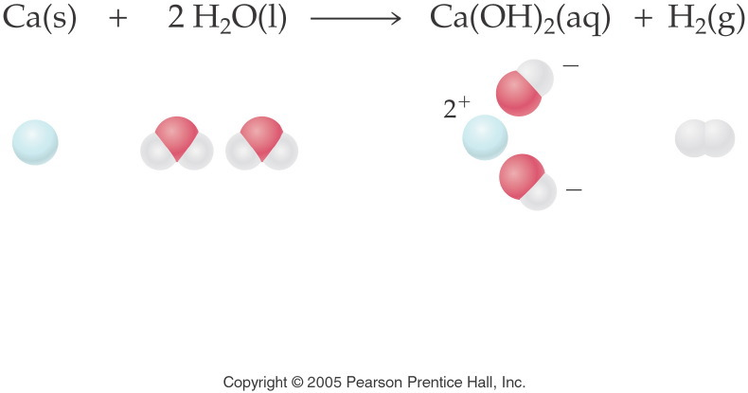
Notes:
Figure: 08-01-10EQ13-UN
Title:
Calcium and water
Caption:
Chemical equation of calcium hydroxide and its molecular models
Notes:
This is a single-replacement reaction. Two products are produced from the two reactants. One element replaces another. Note that the equation is balanced.

Slide 40
Example – Redox Reactions
Single Replacement Reactions
Activity
Series of
Metals
Li
K
Ba
Sr
Ca
Na
Mg
Al
Mn
Zn
Cr
Fe
Cd
Co
Ni
Sn
Pb
(H)
Sb
Cu
Ag
Pd
Pt
Hg
Au
Aluminum wire is placed in a cupric nitrate solution. What is the sum of the coefficients?

Slide 41
Example – Redox Reactions
Single Replacement Reactions
Metals
Li
K
Ba
Sr
Ca
Na
Mg
Al
Mn
Zn
Cr
Fe
Cd
Co
Ni
Sn
Pb
(H)
Sb
Cu
Ag
Pd
Pt
Hg
Au
Copper wire is placed in a solution of magnesium nitrate. What is the net ionic equation?
Cu _{(s)} + Mg(NO₃)_{2 (aq)} → Mg _{(s)} + Cu(NO₃)_{2 (aq)}
Cu _{(s)} + Mg(NO₃)_{2 (aq)} → MgCu _{(s)} + NO_{2 (g)}
Cu _{(s)} + Mg²⁺ _{(aq)} + 2 NO₃⁻ _{(aq)} → Mg _{(s)} + Cu²⁺ _{(aq)} + 2 NO₃⁻ _{(aq)}
Cu _{(s)} + Mg²⁺ _{(aq)} → Mg _{(s)} + Cu²⁺ _{(aq)}
No reaction

Slide 42
Example – Redox Reactions
Single Replacement Reactions
Metals
Li
K
Ba
Sr
Ca
Na
Mg
Al
Mn
Zn
Cr
Fe
Cd
Co
Ni
Sn
Pb
(H)
Sb
Cu
Ag
Pd
Pt
Hg
Au
Magnesium ribbon is placed in a hydrochloric acid solution. What is the balanced chemical equation?
Mg _{(s)} + 2 HCl _{(aq)} → MgCl_{2 (aq)} + H_{2 (g)}
Mg _{(s)} + 2 HCl _{(aq)} → MgCl_{2 (aq)} + 2 H _{(g)}
Mg _{(s)} + 2 H⁺ _{(aq)} + 2 Cl- _{(aq)} → Mg²⁺ _{(aq)} + 2 Cl⁻ _{(aq)} + H_{2 (g)}
Mg _{(s)} + 2 H⁺ _{(aq)} → Mg²⁺ _{(aq)} + H_{2 (g)}
No reaction

Slide 43
Example – Redox Reactions
Single Replacement Reactions
Metals
Li
K
Ba
Sr
Ca
Na
Mg
Al
Mn
Zn
Cr
Fe
Cd
Co
Ni
Sn
Pb
(H)
Sb
Cu
Ag
Pd
Pt
Hg
Au
Manganese chips are added to nitric acid. What gas is formed?

Slide 44
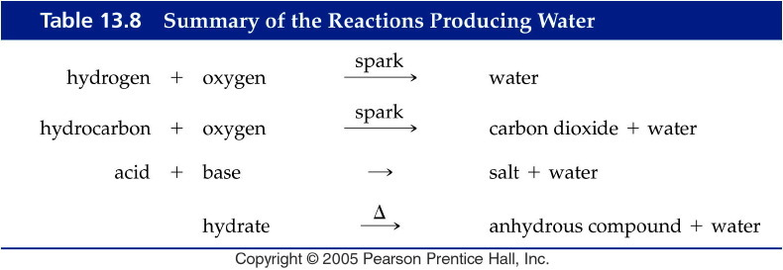
Notes:
Figure: 13-T08
Title:
Table 13.8
Caption:
Summary of the Reactions Producing Water
Notes:
Four major types of reactions that produce water.

Slide 45
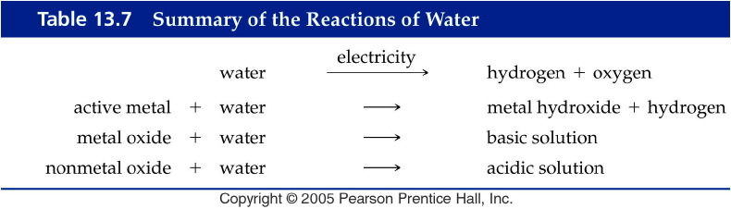
Notes:
Figure: 13-T07
Title:
Table 13.7
Caption:
Summary of the Reactions of Water
Notes:
Reactions of three types of compounds with water. Nonmetal oxides form acidic solutions. Active metals produce hydrogen gas and a basic solution. Metal oxides form basic solutions.

