Slide 1
Chemistry 120
Chapter 7: Chemical Formula Relationships

Slide 2
Example – Chemical Formula
How many oxygen atoms are in a formula unit of lead(II) nitrate?

Slide 3
Example – Chemical Formula
How many atoms are in a molecular unit of diphosphorus trisulfide?

Slide 4
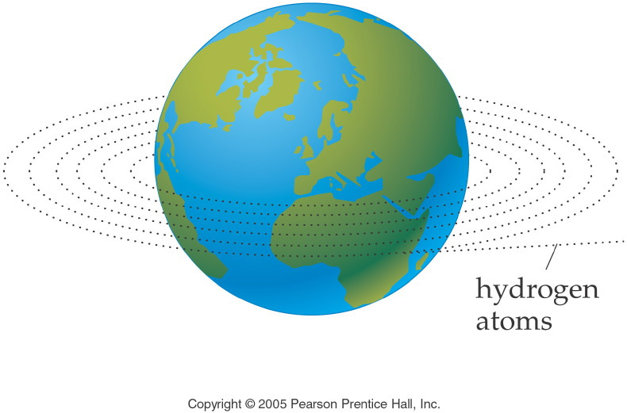
Notes:
Figure: 09-01-01UN
Title:
Length Analogy
Caption:
6.02 x 10²³ hydrogen atoms laid side by side would circle the earth 1,000,000 times.
Notes:
This diagram relates the circumference of the earth to a mole of hydrogen atoms.

Slide 5
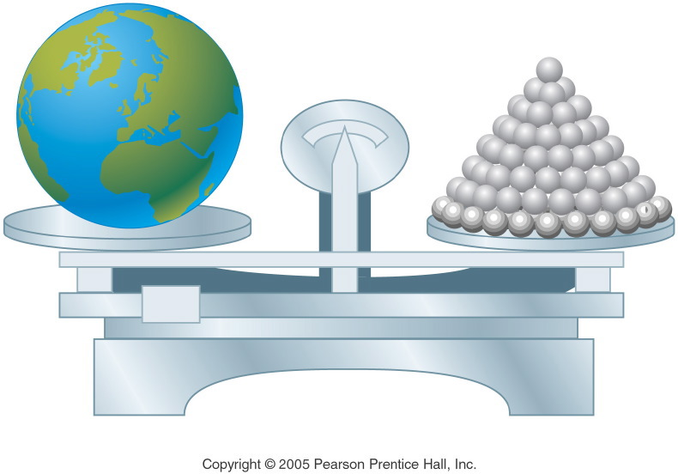
Notes:
Figure: 09-01-02UN
Title:
Mass Analogy
Caption:
6.02 x 10²³ shotput balls have a total mass equal to the mass of the earth.
Notes:
This diagram relates the mass of the earth to a mole of shotput balls.

Slide 6
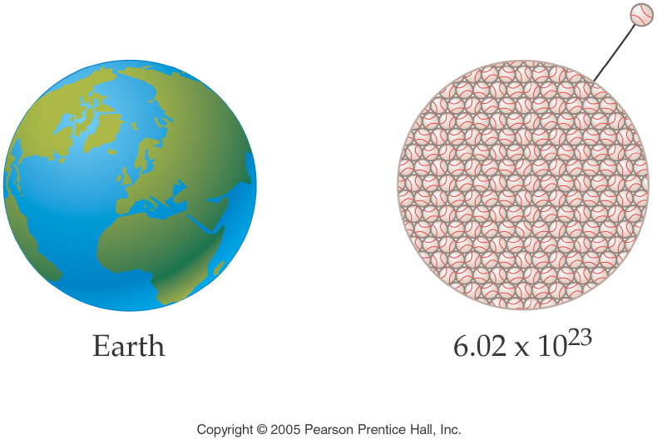
Notes:
Figure: 09-01-03UN
Title:
Volume Analogy
Caption:
6.02 x 10²³ softballs have a total volume equal to the volume of the earth.
Notes:
This diagram relates the volume of the earth to a mole of softballs.

Slide 7
Example – Avogadro’s Number
How many moles of fluorine gas are in 1.2044 x 10²⁴ molecules of fluorine gas?

Slide 8
Example – Avogadro’s Number
How many fluorine atoms are in 1.25 moles of fluorine gas?

Slide 9
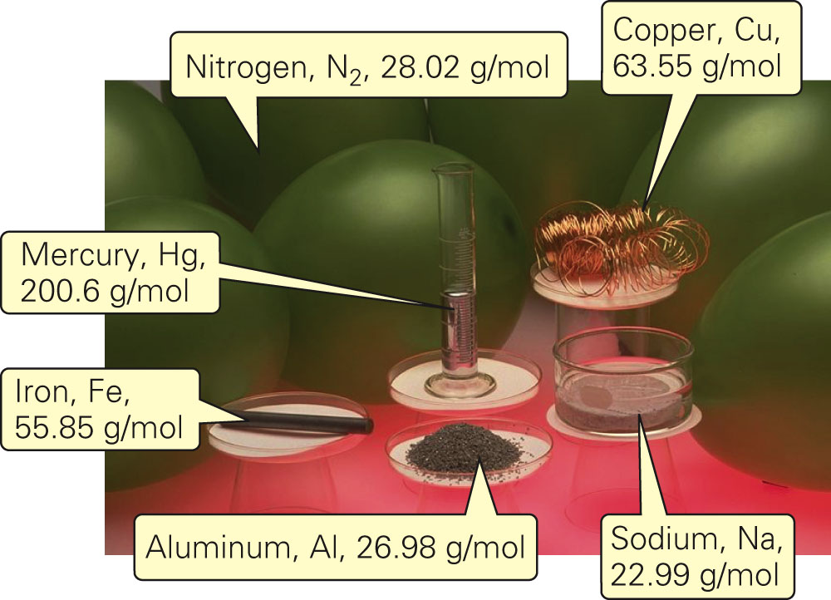
Fig. 7-2a, p. 185

Slide 10
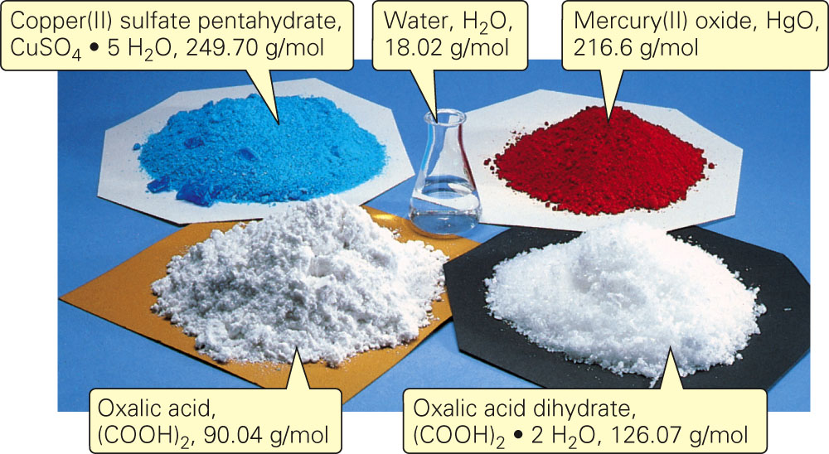
Fig. 7-2b, p. 185

Slide 11
Example – Molar Mass
Calculate the molar mass of lead(IV) oxide.

Slide 12
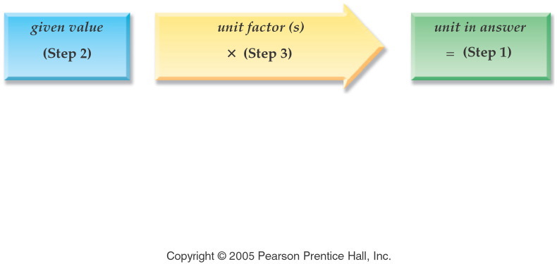
Notes:
Figure: 09-01-03UNa
Title:
unit analysis method
Caption:
Example exercise arrows
Notes:
We want to convert from the given unit to the requested unit by using a unit factor that will cancel the given unit.

Slide 13
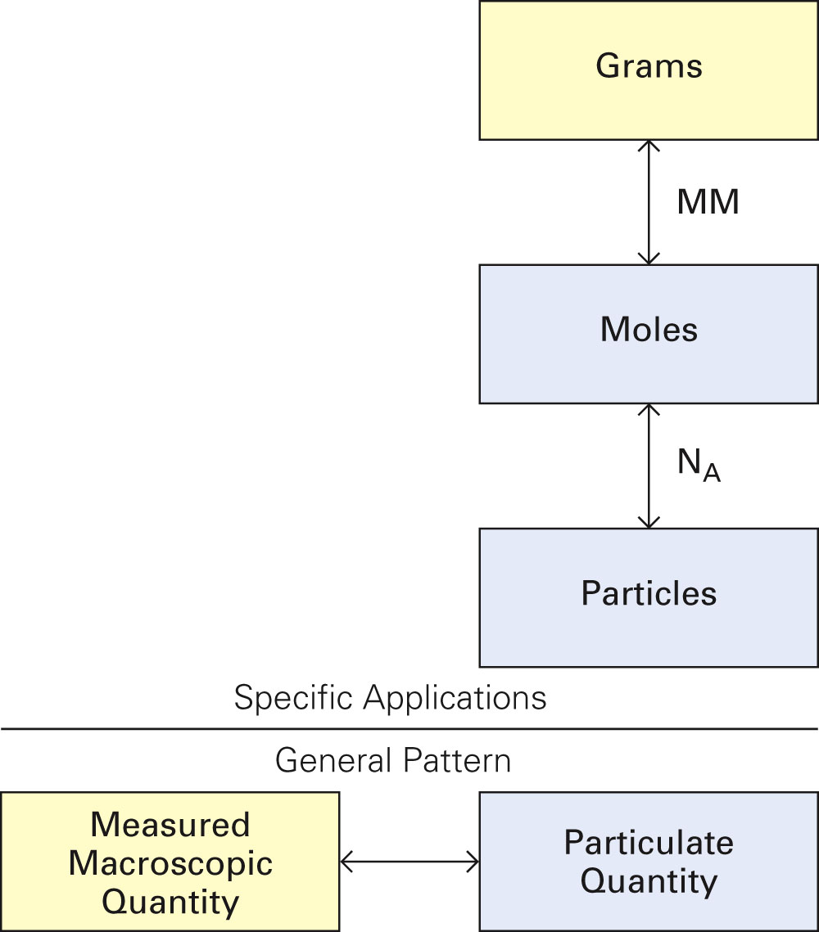
Fig. 7-3, p. 187

Slide 14
Example – Stoichiometry
How many moles of sodium are in 17.2 g of sodium?

Slide 15
Example – Stoichiometry
How many grams of mercury are there in 2.95 x 10²³ atoms of mercury?

Slide 16
Example – Stoichiometry
How many grams of chlorine atoms are in 15.0 g of sodium chloride?

Slide 17
Example – Stoichiometry
How many grams of carbon atoms are in 5.72 g of glucose, C₆H₁₂O₆?

Slide 18
Example – Percentage Composition
Calculate the percentage hydrogen in water.

Slide 19
Example – Empirical/Molecular Formulas
A compound is found to contain 25.0% hydrogen, and 75.0% carbon. What is the empirical formula?

Slide 20
Example – Empirical/Molecular Formulas
A sample of vitamin C has 40.91% carbon, 4.59% hydrogen and 54.50% oxygen. What is the empirical formula?

Slide 21
Example – Empirical/Molecular Formulas
If 1.550 g of mercury oxide decomposes to give 1.435 g of liquid mercury and oxygen gas, what is the empirical formula of the mercury oxide?

Slide 22
Example – Empirical/Molecular Formulas
Nicotine has an empirical formula of C₅H₇N and a molar mass of about 160 g/mol. What is the molecular formula?

Slide 23
Example – Empirical/Molecular Formulas
If the molar mass of adipic acid is 147 g/mol, what is the molecular formula? Given that a 2.018 g sample of adipic acid was combusted with oxygen gas and 3.646 g of carbon dioxide gas and 1.244 g of water vapor were produced. Adipic acid contains C, H and O atoms.

Slide 24
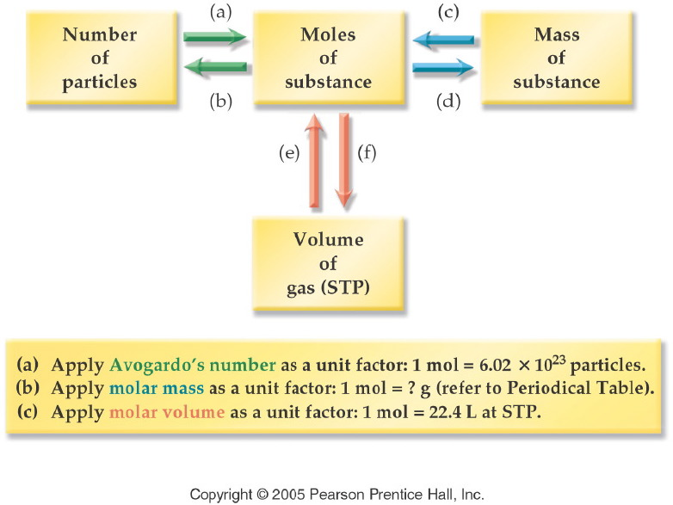
Notes:
Figure: 09-02-08UN
Title:
Concept Map: Summary of Mole Calculations
Caption:
We use a strategy map to show the application of unit factors to solve problems by unit analysis. In this chapter, we have related the mole concept to the number of particles, the mass of a substance, and the volume of a gas. Now, let's summarize mole calculations using a concept map that relates these concepts.
Notes:
Each of these concepts can be related to the others through the use of appropriate unit conversion factors.

Slide 25
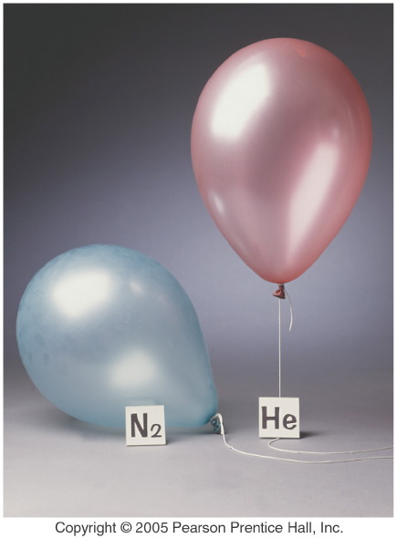
Notes:
Figure: 09-02-09UN
Title:
Gas Density
Caption:
Gas Balloons
Notes:
Both balloons have the same volume and therefore the same number of moles of gas. The He balloon floats because a volume of He has less mass than the same volume of air. The nitrogen balloon sinks because a volume of nitrogen has more mass than the same volume of air.

Slide 26
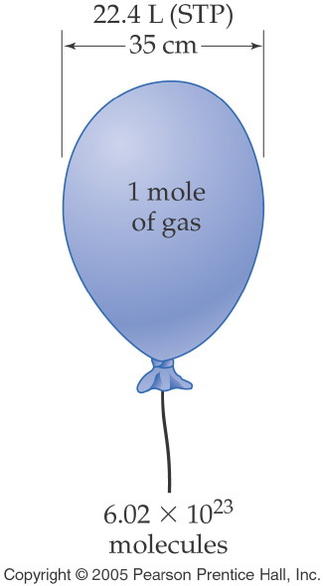
Notes:
Figure: 09-02
Title:
Molar Volume of a Gas
Caption:
A balloon containing 1 mol of gas has a diameter of 35 cm. The volume of the gas is 22.4 L.
Notes:
This concept will be covered in detail in Chapter 11. In this chapter, all calculation must be done at STP. (1 atm, 273K)

Slide 27
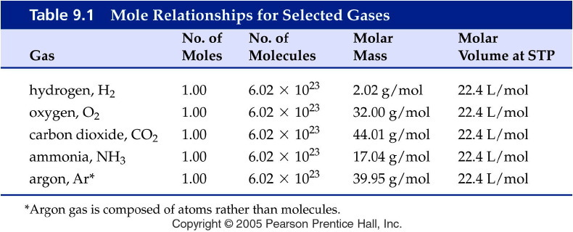
Notes:
Figure: 09-T01
Title:
Table 9.1
Caption:
Mole Relationships for Selected Gases
Notes:
Note that every one of these gases at STP has the same volume per one mole.

