Slide 1
Chemistry 120
Chapter 6: Chemical Nomenclature

Slide 2
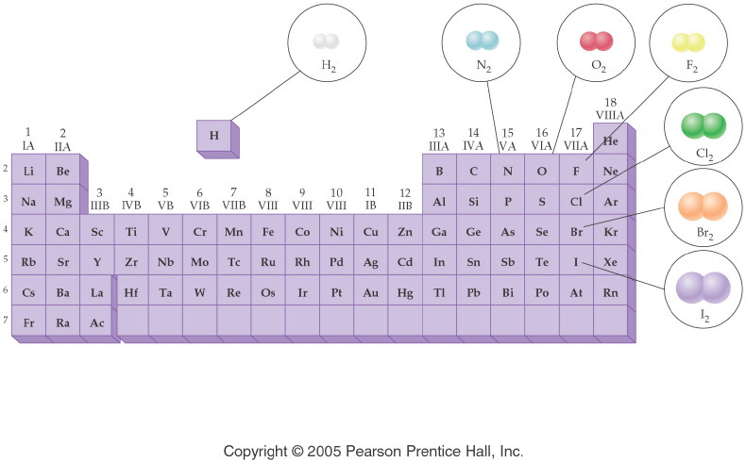
Notes:
Figure: 08-01-16UN
Title:
Diatomic Molecules
Caption:
Seven elements occur naturally as diatomic molecules: H₂, N₂, O₂, F₂, Cl₂, Br₂, and I₂.
Notes:
This is a periodic table showing the location of each naturally occurring diatomic molecule. Part 1 of a 2-part diagram.

Slide 3
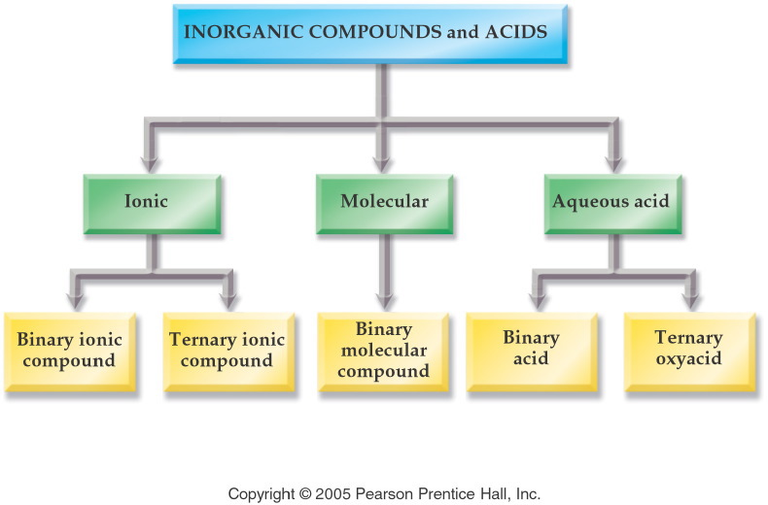
Notes:
Figure: 07-01
Title:
Inorganic Compounds
Caption:
Inorganic compounds are divided into three categories: Ionic, Molecular, and Aqueous Acid.
Notes:
Ionic compounds are divided into binary and ternary. Aqueous acids are divided into binary and ternary, for a total of five categories.

Slide 4
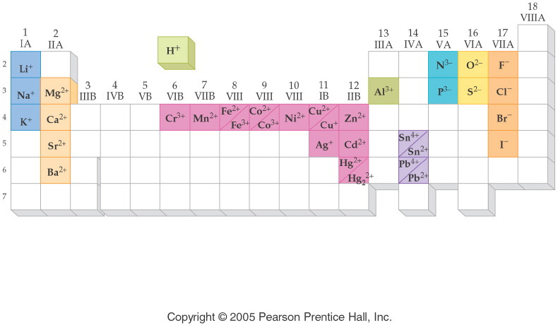
Notes:
Figure: 07-03
Title:
Periodic Table of Ions
Caption:
Note the correlation of ionic charge and group number. Transition metals exhibit more than one charge.
Notes:
The ions listed are common and will be used throughout the remainder of this book.

Slide 5
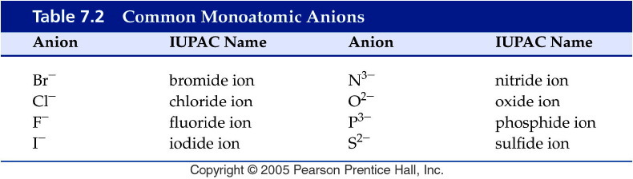
Notes:
Figure: 07-T02
Title:
Table 7.2
Caption:
Common Monoatomic Anions
Notes:
All of these names are derived from the name of the element plus the suffix -ide.

Slide 6
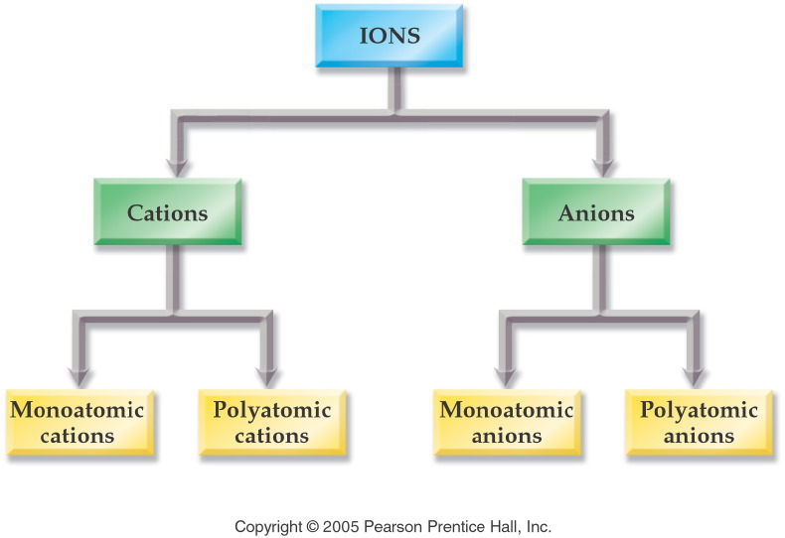
Notes:
Figure: 07-02
Title:
Classification of Ions
Caption:
Ions are divided into four categories: Mono- and polyatomic cations, and mono- and polyatomic anions.
Notes:
Monoatomic ions are named according to their element. Polyatomic ions are named systematically from a set of rules.

Slide 7
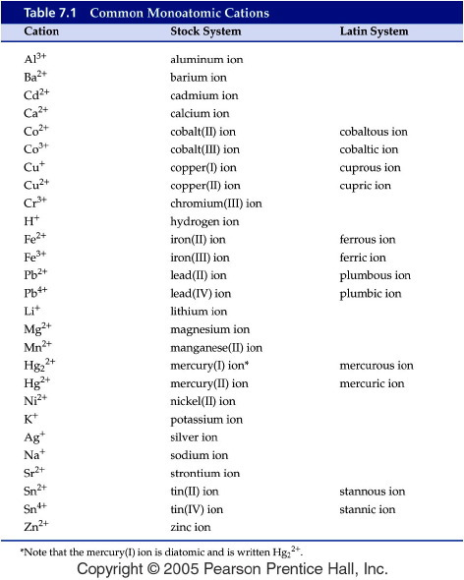
Notes:
Figure: 07-T01
Title:
Table 7.1
Caption:
Common Monoatomic Cations
Notes:
The lower charged ion of a metal ends in -ous; the higher charged in -ic.

Slide 8
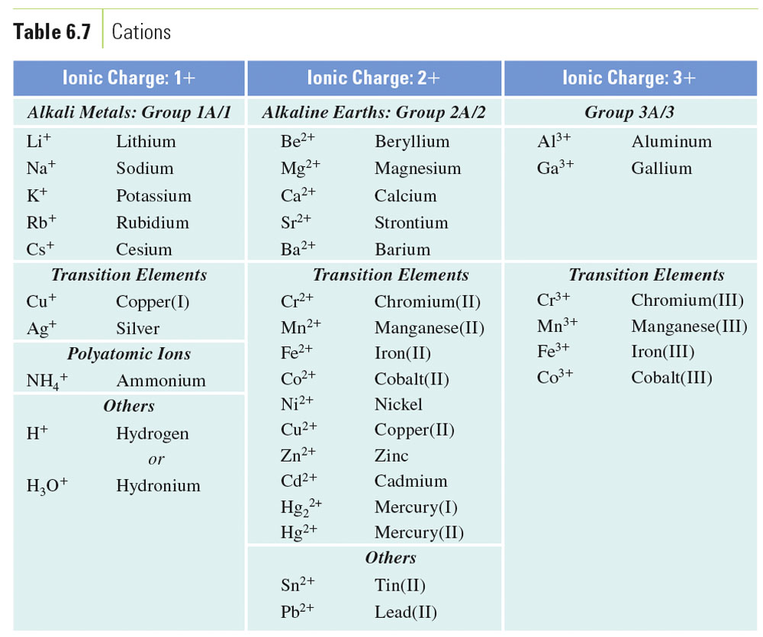
Table 6-7, p. 162

Slide 9
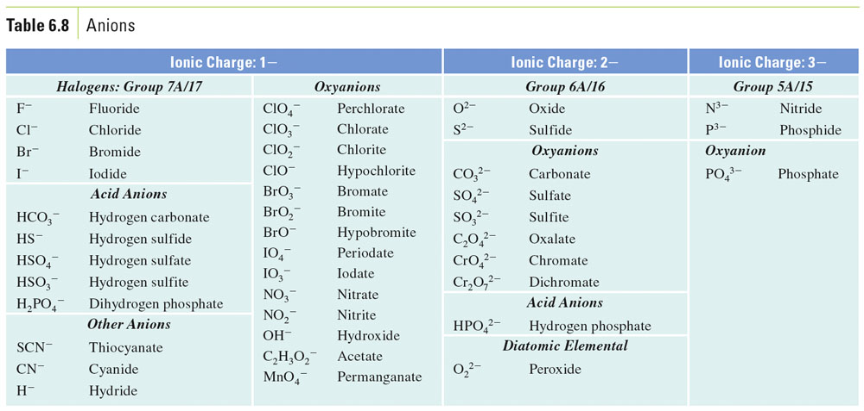
Table 6-8, p. 162

Slide 10
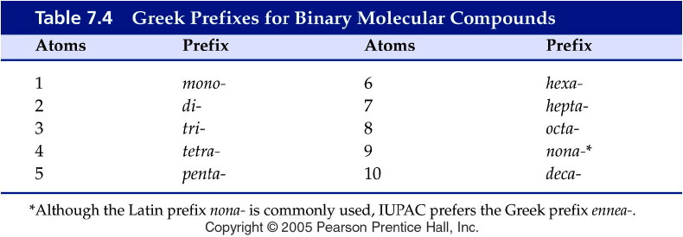
Notes:
Figure: 07-T04
Title:
Table 7.4
Caption:
Greek Prefixes for Binary Molecular Compounds
Notes:
These prefixes indicate how many of each kind of atom in a molecular compound. You probably know many of these already from words like monotone, tricycle, pentagon, hexagon, octagon, and decade.

Slide 11

Notes:
Figure: 07-03-01UN
Title:
Salt, NaCl
Caption:
Sodium chloride is so essential to health that, historically, laborers were paid in salt. In fact, the term salary translates as "salt money."
Notes:
Sodium chloride contains monoatomic sodium ions and chloride ions.

Slide 12
Example – Binary Nomenclature
What is the name for Ca₃N₂?
Tricalcium dinitride
Calcium nitride
Calcium nitrogen
Calcium nitrate
Calcium nitrite

Slide 13
Example – Binary Nomenclature
What is the formula for potassium phosphide?
KP
PP
K₃P
KP₃
K₃PO₄

Slide 14
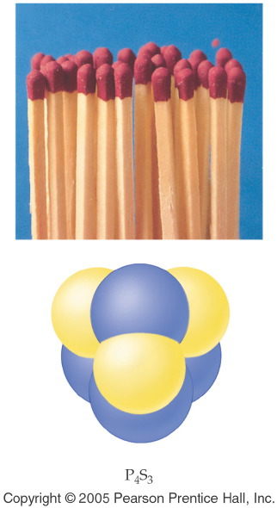
Notes:
Figure: 07-04
Title:
Matches
Caption:
P₄S₃ and KClO₃ are present in the tip of a match. Gaseous SO₂ is one of the products of the reaction when the match is lit; this compound gives the characteristic smell of a burning match.
Notes:
P₄S₃ is a binary molecular compound.

Slide 15
Example – Binary Nomenclature
What is the formula for dinitrogen monoxide?
2NO
N₂O
NO₂
N₂O₂
NO

Slide 16
Example – Binary Nomenclature
What is the name for P₄O₁₀
Phosphorus oxide
Phosphorus decaoxide
Tetraphosphorus decaoxide
Phosphorus oxygen
Decaphosphorus tetraoxide

Slide 17
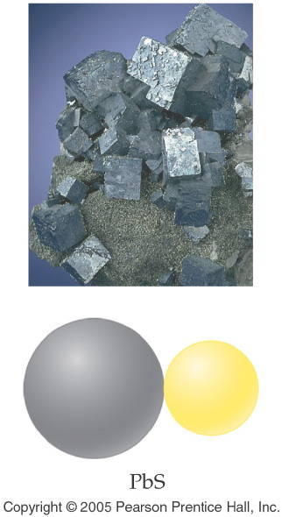
Notes:
Figure: 07-03-08UN
Title:
Galena, PbS
Caption:
Galena is a natural mineral that contains lead.
Notes:
Galena contains monoatomic lead (II) ions and sulfide ions.

Slide 18
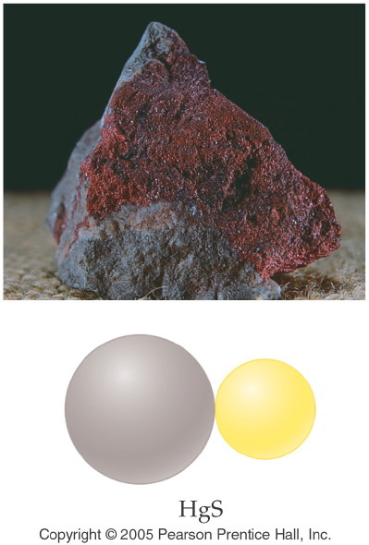
Notes:
Figure: 07-03-07UN
Title:
Cinnabar, HgS
Caption:
Cinnabar is a natural mineral that contains mercury.
Notes:
Cinnabar contains monoatomic mercury (II) cations and sulfide anions.

Slide 19
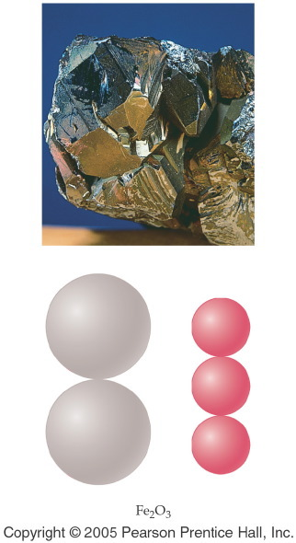
Notes:
Figure: 07-03-06UN
Title:
Hematite, Fe₂O₃
Caption:
Hematite is a natural mineral that contains iron.
Notes:
Hematite contains monoatomic iron (III) cations and oxide anions.

Slide 20
Example – Binary Nomenclature
What is the name for Fe₂O₃
Iron oxide
Iron(III) oxide
Ferric oxide
Iron(II) oxide
B and C

Slide 21
Example – Binary Nomenclature
What is the formula for lead(IV) oxide?
Pb₂O₄
PbO₂
PbO
LbO₂
Plumbic oxide

Slide 22
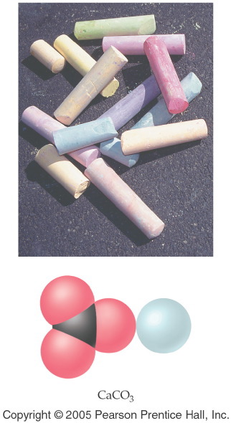
Notes:
Figure: 07-03-03EE07
Title:
Chalk, CaCO₃
Caption:
Ordinary classroom chalk is composed of calcium carbonate, whose chemical formula is CaCO₃.
Notes:
Calcium carbonate contains monoatomic calcium cations and polyatomic carbonate ions.

Slide 23
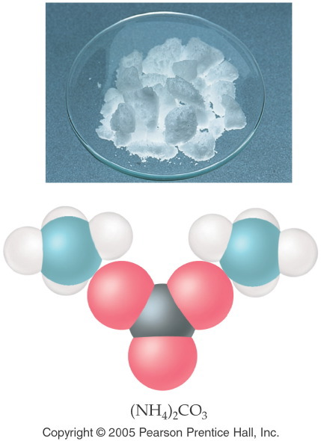
Notes:
Figure: 07-02-01UN
Title:
Ammonium Carbonate, (NH₄)₂CO₃
Caption:
Ammonium carbonate decomposes in air to give ammonia, NH₃, and carbon dioxide, CO₂; it is used in smelling salts and is found in baking powders.
Notes:
the odor of ammonia may be familiar from the ammonia solution you can buy in the grocery store. Ammonium and carbonate ions are both polyatomic ions.

Slide 24

Notes:
Figure: 07-03-09UN
Title:
Marble, CaCO₃
Caption:
Marble, CaCO₃, is a natural mineral that was used to construct the Taj Mahal in India.
Notes:
Marble contains monoatomic calcium cations and polyatomic carbonate anions.

Slide 25
Example – Ternary and Quaternary Nomenclature
What is the name of NaNO₃?
Sodium nitrite
Sodium nitride
Sodium nitrogen trioxide
Sodium nitrate
Sodium nitrogen oxide

Slide 26
Example – Ternary and Quaternary Nomenclature
What is the name of Cr₂(CO₃)₃?
Chromium carbonate
Chromium(II) carbonate
Chromium(II) carbonate(III)
Chromium(III) carbon trioxide
Chromium(III) carbonate

Slide 27
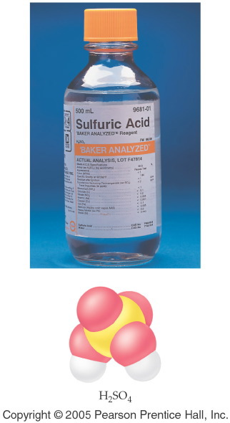
Notes:
Figure: 07-04-02UN
Title:
Sulfuric Acid, H₂SO₄(aq)
Caption:
Aqueous sulfuric acid, H₂SO₄, is found in automobile batteries; hence, it is commonly termed "battery acid."
Notes:
Sulfuric acid is one of the world's most commonly produced chemicals. Its name comes from the sulfate ion.

Slide 28

Notes:
Figure: 07-04-01UN
Title:
Hydrofluoric Acid, HF(aq)
Caption:
Aqueous hydrofluoric acid, HF, is used to etch silicon in the manufacture of computer chips.
Notes:
Hydrofluoric acid can not be stored in glass containers because HF reacts with glass as well as silicon.

Slide 29
Example – Acid Nomenclature
What is the name of HCl _{(aq)}?
Chloric acid
Hydrochloric acid
Hydrogen chloride
Hydrochlorous acid
B and C

Slide 30
Example – Acid Nomenclature
What is the name of HClO_{3 (aq)}?
Chloric acid
Hydrochloric acid
Hydrogen chlorate
chlorous acid
Perchloric acid

Slide 31
Example – Acid Nomenclature
What is the formula for phosphorous acid?
H₃PO_{3 (aq)}
H₃P _{(aq)}
H₃PO_{4 (aq)}
PO_{3 (aq)}
H₂PO_{3 (aq)}

Slide 32
Example – Hydrate Nomenclature
What is the formula of cupric chloride dihydrate?
CuCl • H₂O
CuCl₂ • 2 H₂O
H₂CuCl₂O
CuCl₂
B and C

Slide 33
Example – Hydrate Nomenclature
What is the name of MgSO₄ • 6 H₂O?
Magnesium sulfate hexahydrate
Manganese(II) sulfate hexahydrate
Magnesium sulfate hydrate
Magnesium(II) sulfate hexahydrate
Magnesium(II) sulfite hexahydrate

