Slide 1
Chemistry 120
Chapter 5: Atomic Theory: The Nuclear Model of the Atom
Outline
Models of the Atom
  Dalton’s Atomic Theory
  Thomson’s Plum-Pudding Model
  Rutherford’s Gold Foil Experiment
  Nuclear Model of the Atom
Subatomic particles
  Electrons
  Protons
  Neutrons
Atomic Notation
Isotopes
Atomic Mass

Slide 2
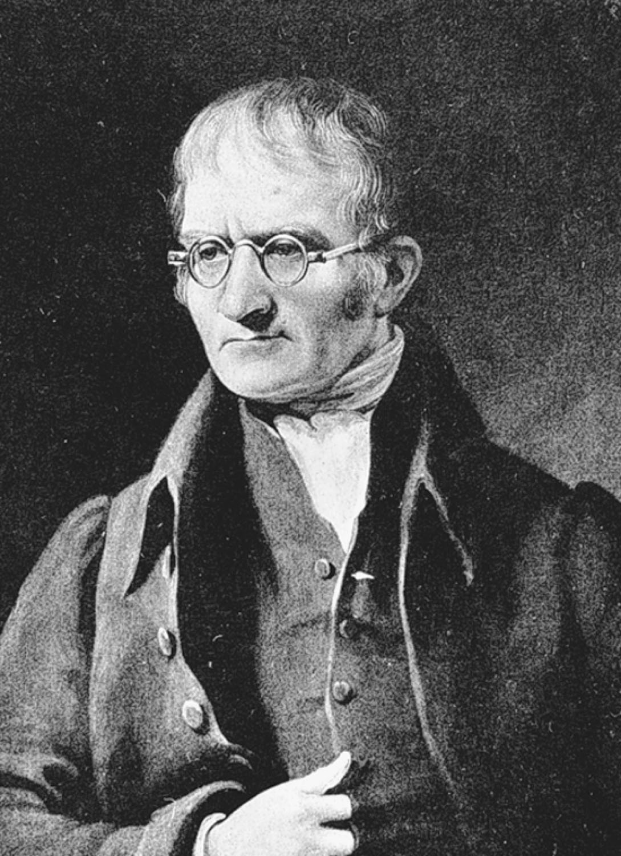
John Dalton
p124
Notes:
John Dalton (1766–1844) devised the atomic theory while trying to formulate a hypothesis to explain the Law of Multiple Proportions

Slide 3
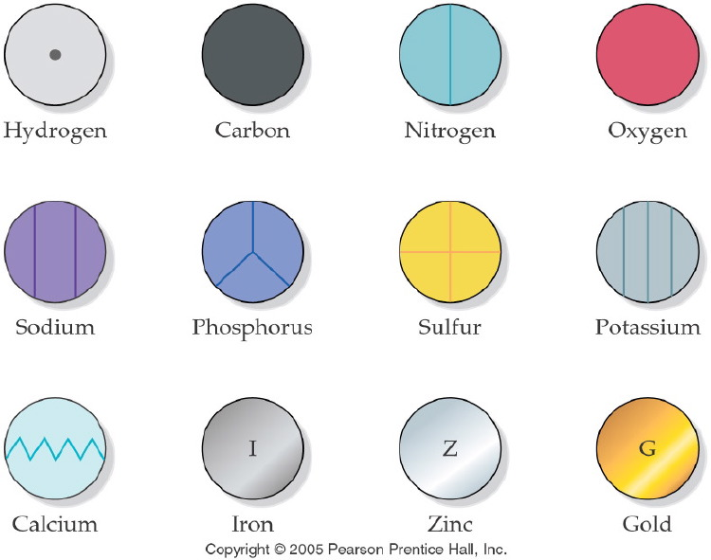
Notes:
Figure: 04-04
Title:
Dalton's Symbols for Elements
Caption:
Dalton symbolized each element using a circle with an inscribed marking.
Notes:
Dalton saw elements as solid spheres of matter called "atoms," so he used different circles to represent each element.

Slide 4
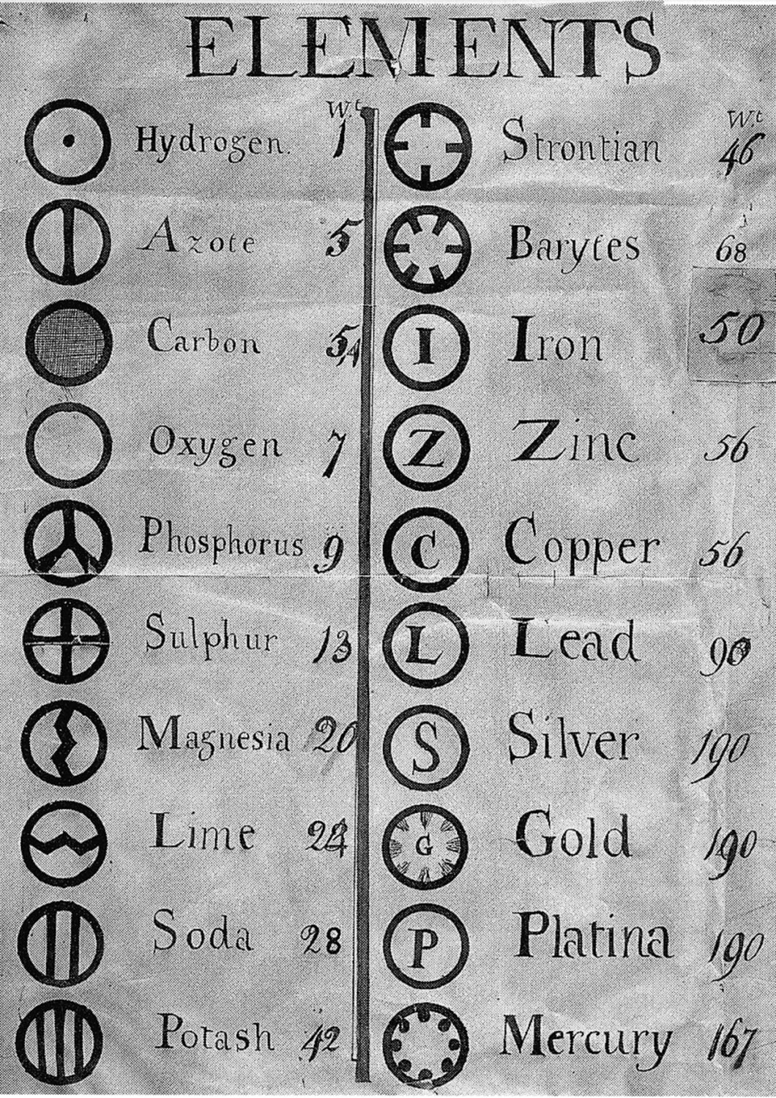
p123
Notes:
John Dalton’s 1808 book A New System of Chemical Phi-losophy set the stage for the modern science of chemistry by reviving the ancient Greek concept that matter was made of elementary particles called atoms. Dalton added to the Greek idea by proposing that atoms of any one element are different from atoms of other elements. This illustration from Dalton’s book shows his pro-posed system of “arbitrary marks or signs,” as he wrote, to represent the elements. In this chapter, you will learn about Dalton’s atomic theory and the modern system of “arbitrary marks or signs” used by today’s scientists to repre-sent the elements.

Slide 5
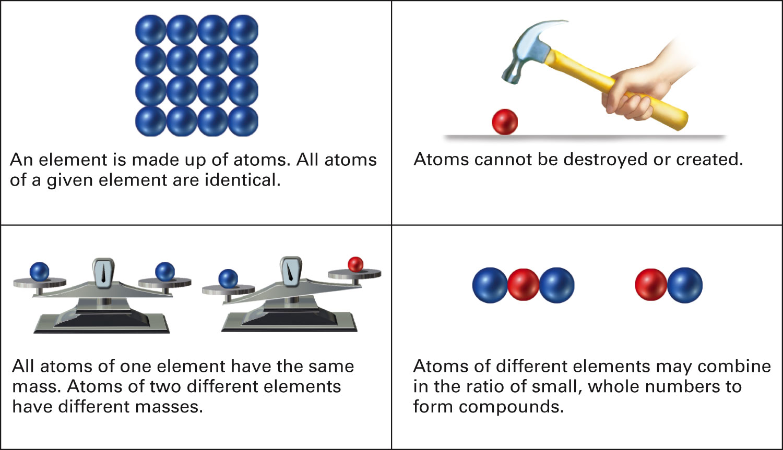
Figure 5-1 p124
Notes:
Figure 5.1 Atoms according to Dalton’s atomic theory.

Slide 6
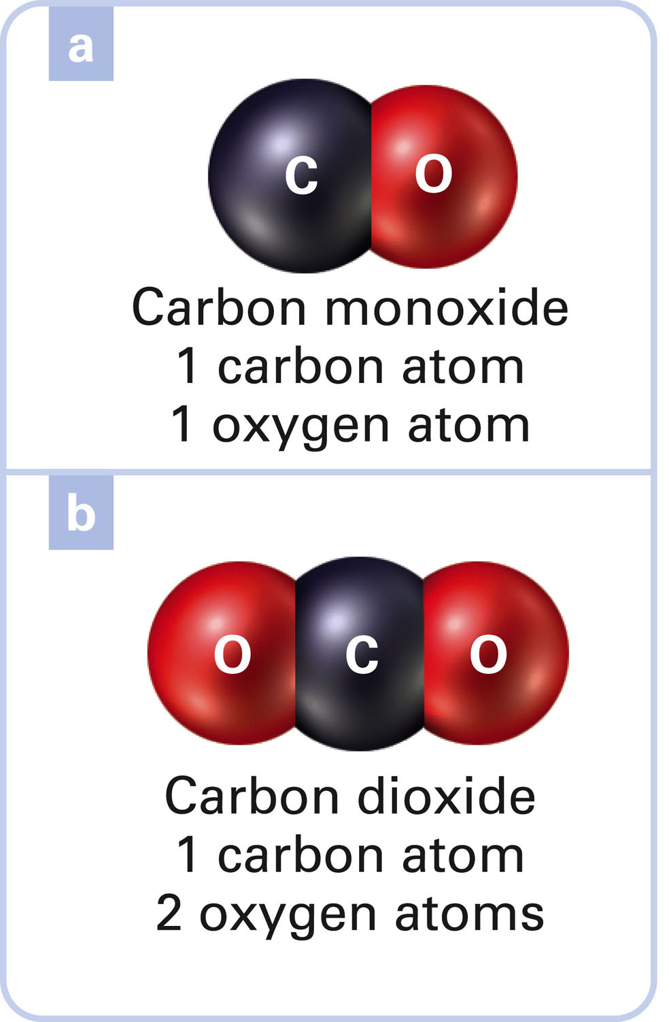
What is the Law of Multiple Proportions?
Figure 5-2 p125
Notes:
Figure 5.2 Explanation of the Law of Multiple Proportions. Carbon and oxygen combine to form more than one compound. Assume, according to the atomic theory, that carbon and oxygen atoms combine in a 1:1 ratio to form one compound and in a 1-carbon-to-2-oxygen-atom ratio to form another compound. If this assumption at the particulate level is true, the mass of the two oxygen atoms in the 1:2 compound is twice the mass of the one oxygen atom in the 1:1 com-pound. The oxygen mass ratio is 2:1 in the two compounds with the fixed mass of one carbon atom. This analysis at the particulate level predicts a similar result at the macroscopic level, at which masses of combining elements can be measured. Going to the laboratory, we find that (a) 1.0 gram of carbon combines with 1.3 grams of oxygen to form carbon monoxide, CO, and (b) 1.0 gram of carbon combines with 2.6 grams of oxygen to form carbon dioxide, CO2. The macroscopic mass ratio of oxygen that combines with 1.0 gram of carbon in the two compounds is 2.6/1.3, which reduces to 2/1, exactly as predicted by the atomic theory at the particulate level.

Slide 7
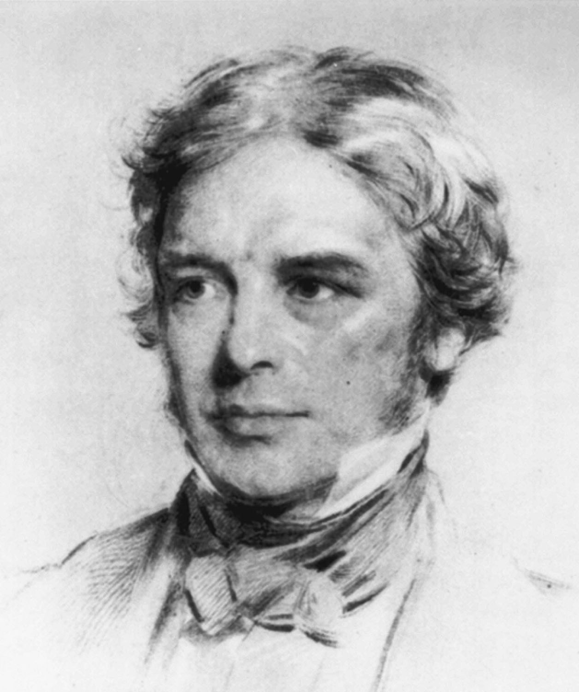
Michael Faraday
p125
Notes:
A portrait of Michael Faraday (1791–1867) was one of three portraits that Albert Einstein kept in his study. The other two portraits were of Isaac Newton and James Clerk Maxwell.

Slide 8
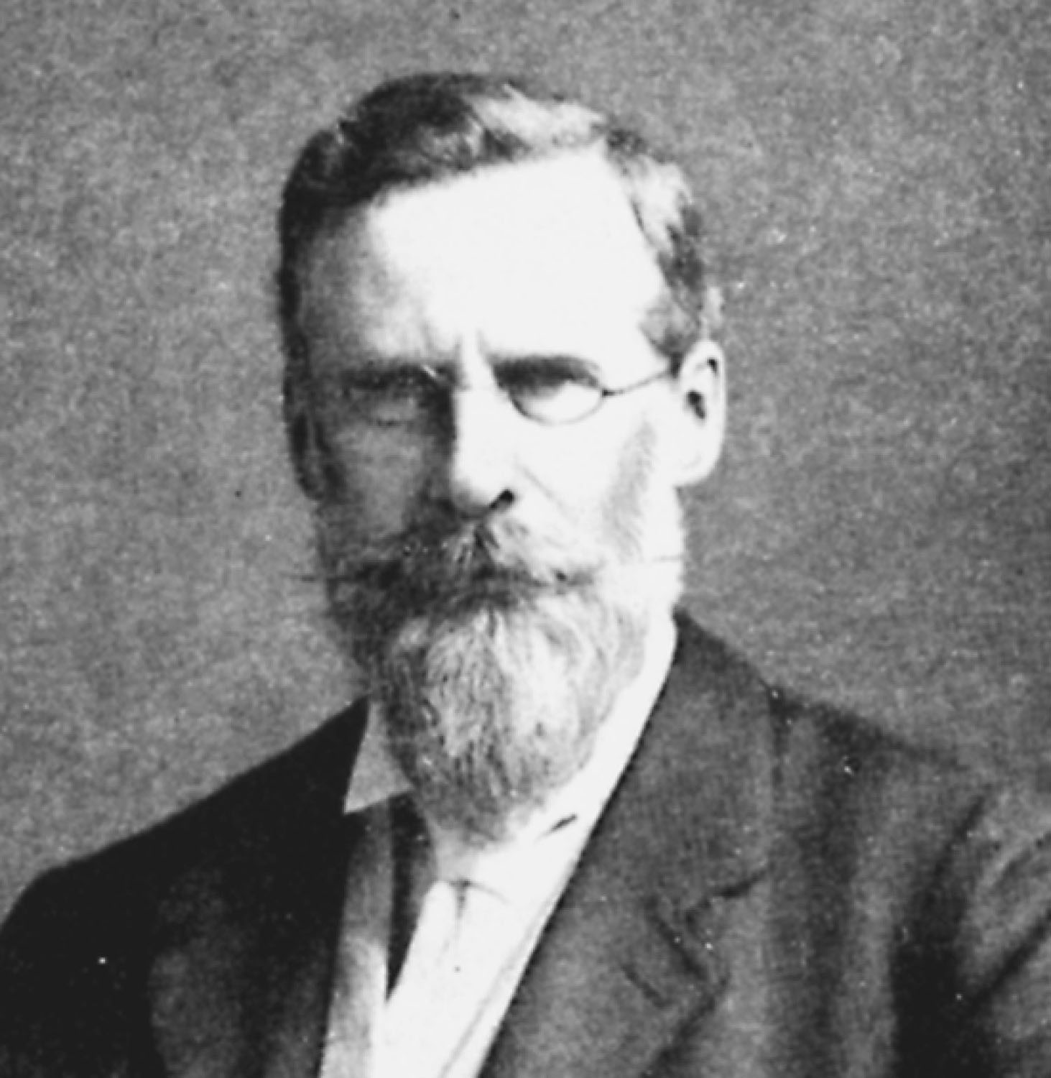
Sir William Crookes
p125
Notes:
William Crookes’s (1832–1919) dis-covery of what is now called the Crookes tube was a critical early step that led to the discovery of the electron and X-rays.

Slide 9
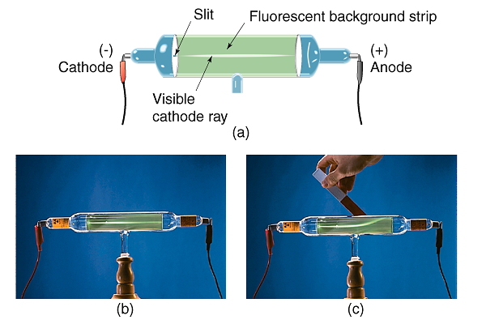
What does Crookes’ tube tell us about cathode rays?

Slide 10
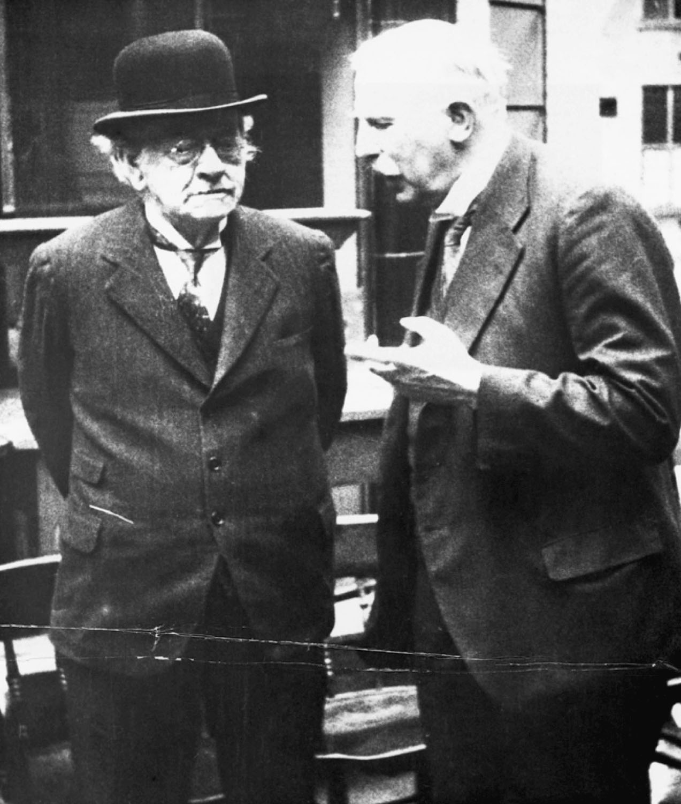
J. J. Thomson and Ernest Rutherford
p126
Notes:
J. J. Thomson (1856–1940) (left) dis-covered the electron, and Ernest Rutherford (1871–1937) (right) dis-covered the proton

Slide 11
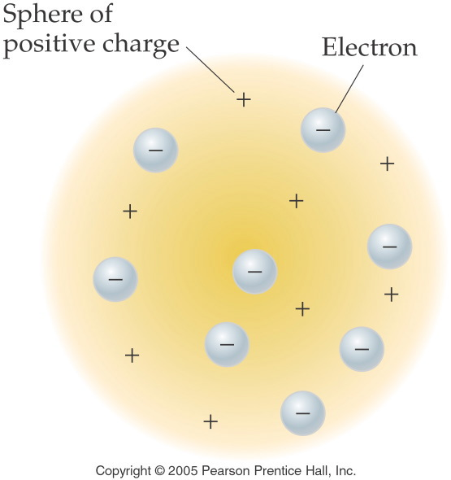
What did Thomson’s Plum Pudding Model look like?
Notes:
Figure: 05-01
Title:
Thomson Model of the Atom
Caption:
Atoms are pictured as spheres of positive charge. The small negative particles represent electrons.
Notes:
Thomson's subatomic model was flawed, but he did determine the relative charge to mass ratio of electrons and protons.

Slide 12
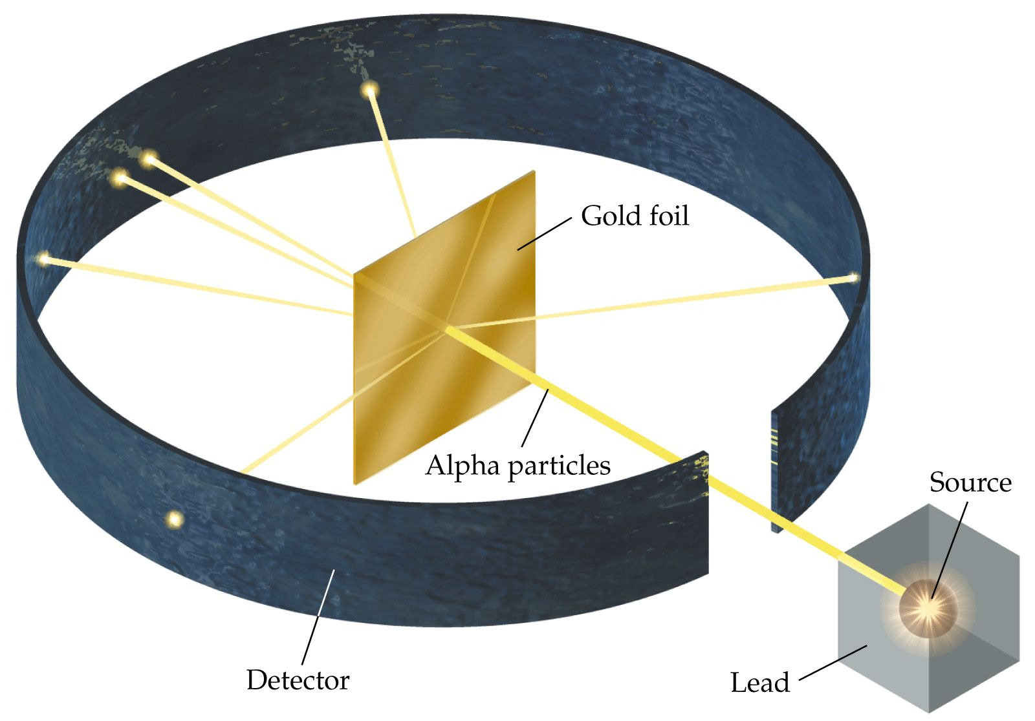
What does the gold foil experiment show us about the structure of the atom?

Slide 13
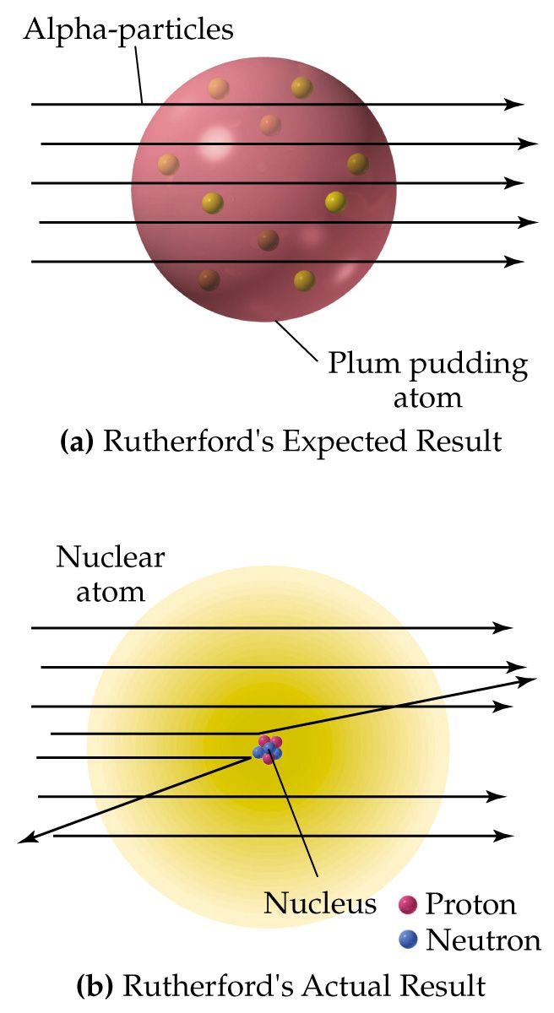
How does the Plum Pudding Model differ from the Nuclear Model of the atom?

Slide 14
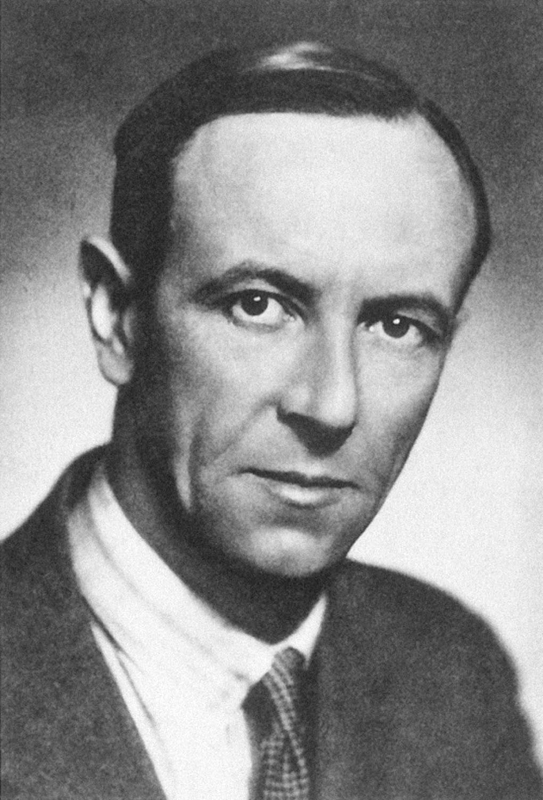
James Chadwick
p126
Notes:
James Chadwick (1891–1974) dis-covered the neutron in 1932.

Slide 15
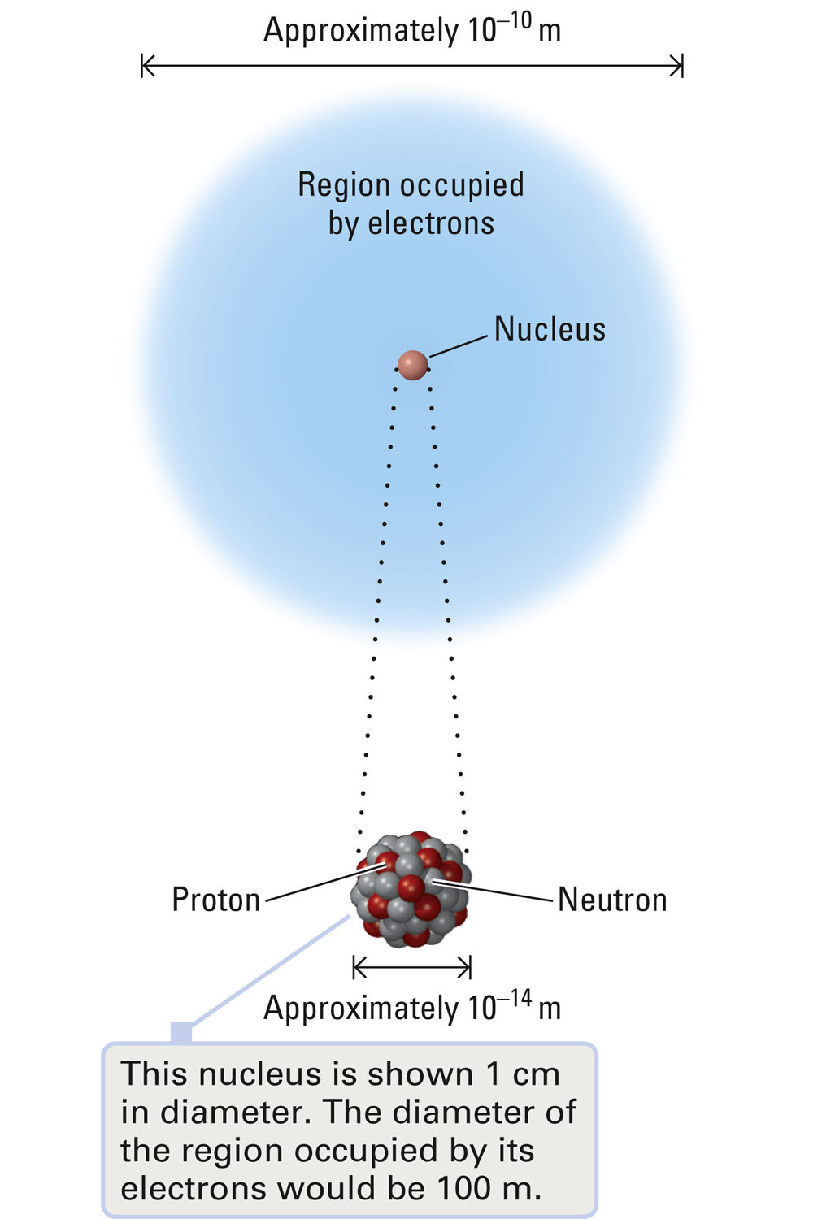
Figure 5-4 p127
Notes:
Figure 5.4 Relative sizes of an atom and its nucleus. The diameter of an atom is approximately 10,000 times the diameter of its nucleus.

Slide 16
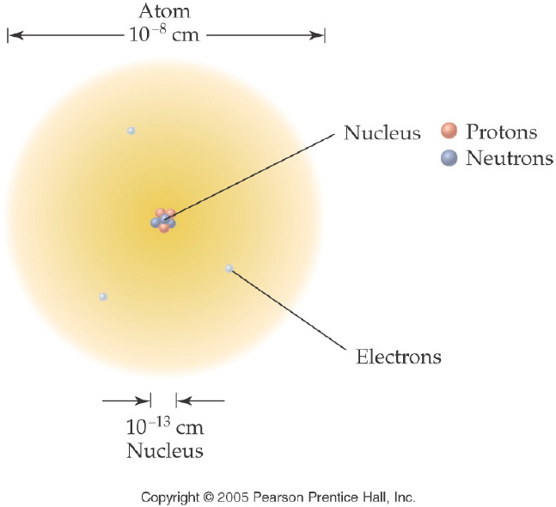
How are the subatomic particles distributed in the atom?
Notes:
Figure: 05-04
Title:
Rutherford Model of the Atom
Caption:
Most of the mass of the atom is found in the nucleus. Note that the atoms and nuclei are not to scale, as the size of an atom is about 100,000 times larger than the size of the nucleus.
Notes:
The vast majority of the atom is empty space.

Slide 17
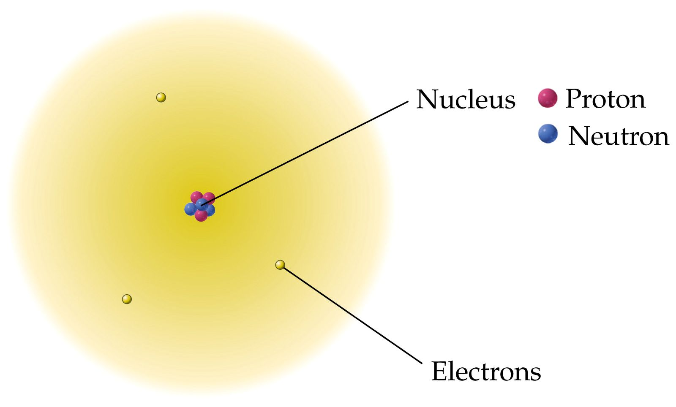
How are the subatomic particles distributed in the atom?

Slide 18
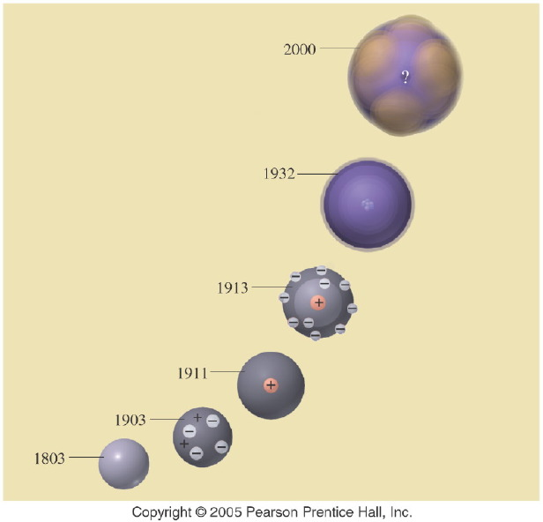
Notes:
Figure: 05-20-02UN
Title:
Atomic Models
Caption:
In the evolving model of the atom, what does the question mark (?) represent in the 2000 model?
Notes:
Atomic theory is one scientific theory that has been adjusted over the years as new evidence has come to light. It is still changing today.

Slide 19
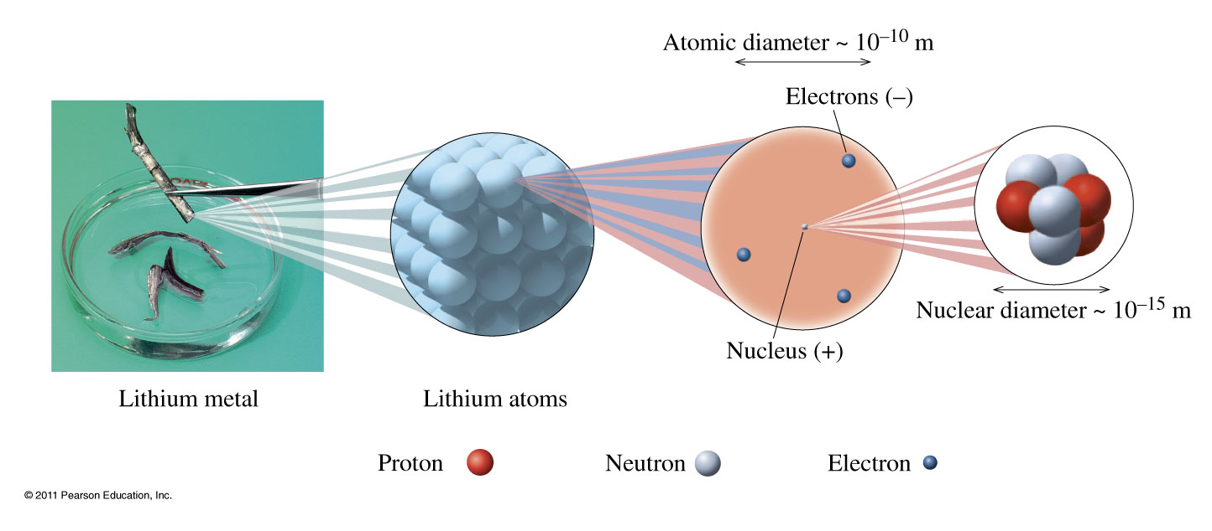
Notes:
Chapter 4, Figure 4.10
In an atom, the protons (positive charge) and neutrons (neutral) that make up almost all the mass of the atom are packed into the tiny volume of the nucleus. The rapidly moving electrons (negative charge) surround the nucleus and account for the large volume of the atom.

Slide 20
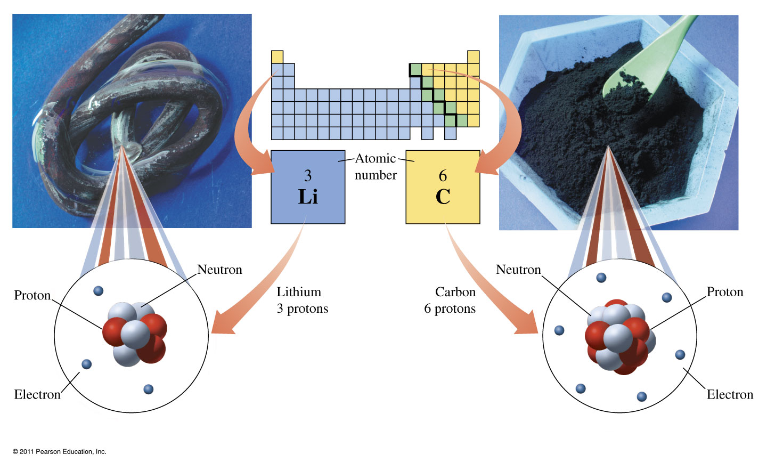
Notes:
Chapter 4, Unnumbered Figure, Page 109
All atoms of lithium (left) contain three protons, and all atoms of carbon (right) contain six protons.

Slide 21
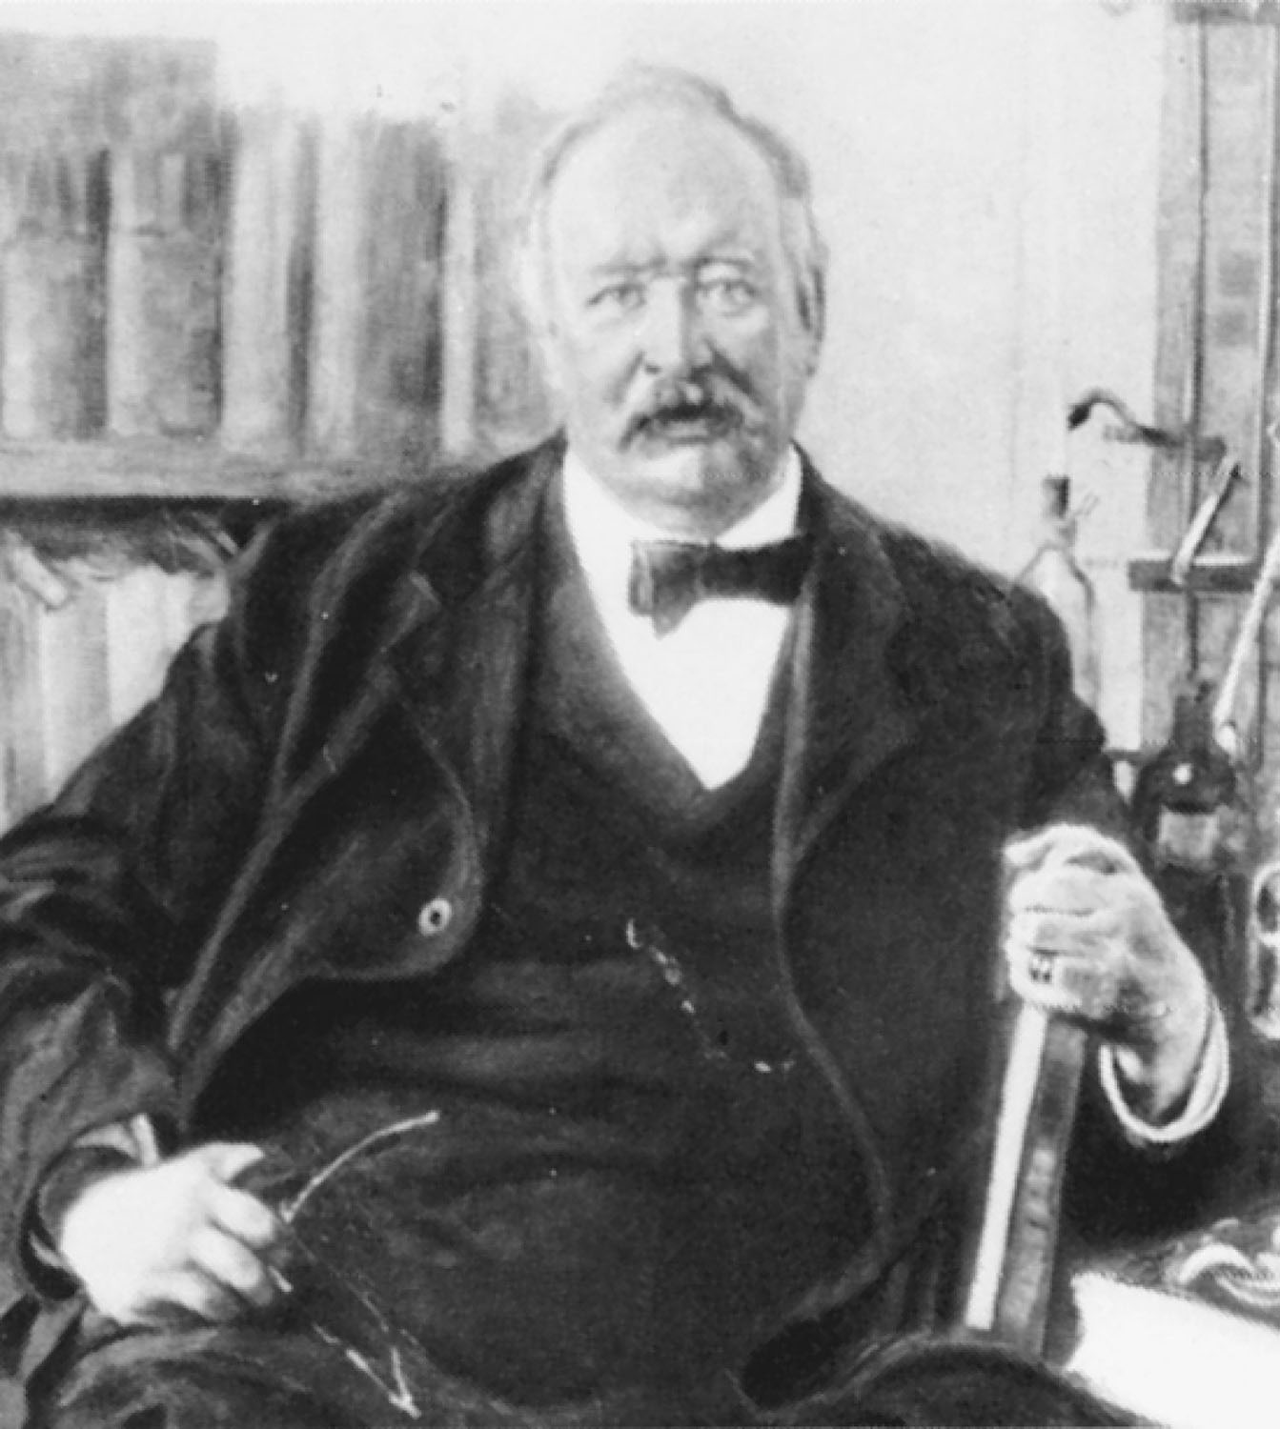
Svante Arrhenius
p526
Notes:
Svante August Arrhenius (1859–1927). Arrhenius was awarded the 1903 Nobel Prize in Chemistry for proposing that ionic compounds can divide into oppositely charged particles in solution.

Slide 22
Example – Atomic Notation
Thallium-201, Tl-201, is used for heart imaging.
What is the mass number?
What is the atomic number?
How many protons are there?
How many neutrons are there?
How many electrons are there?

Slide 23
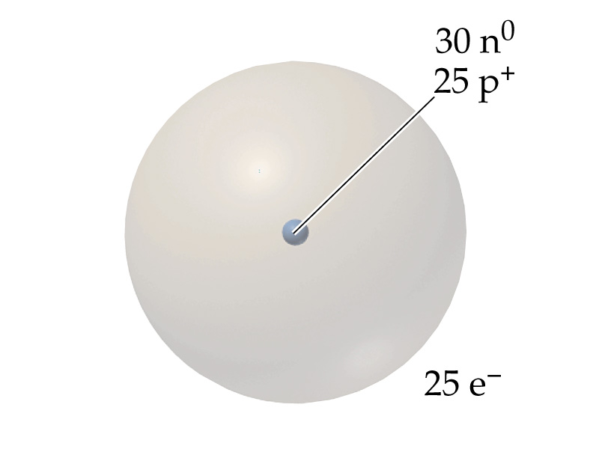
Example – Elements
What element is represented by:
Manganese, Mn
Zinc, Zn
Terbium, Tb
Tin, Sn
Mercury, Hg

Slide 24
Example – Chemical Symbols
What is the atomic notation for a nuclide that has 15 protons, 16 neutrons, and 18 electrons?

Slide 25
Example – Chemical Symbols
What is the atomic notation for an atom that has 17 protons, 20 neutrons, and 17 electrons?

Slide 26
Example – Chemical Symbols
What is the atomic notation for an atom that has 15 protons, 16 neutrons, and 18 electrons?

Slide 27
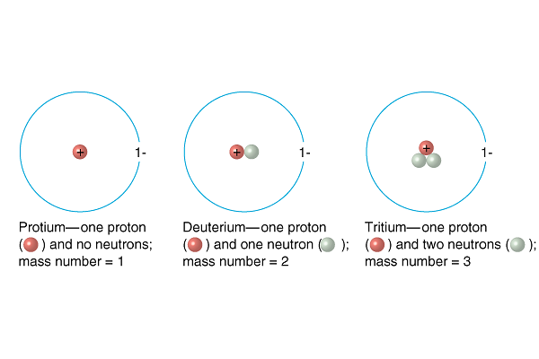
What is an isotope?
¹H | ²H | ³H

Slide 28
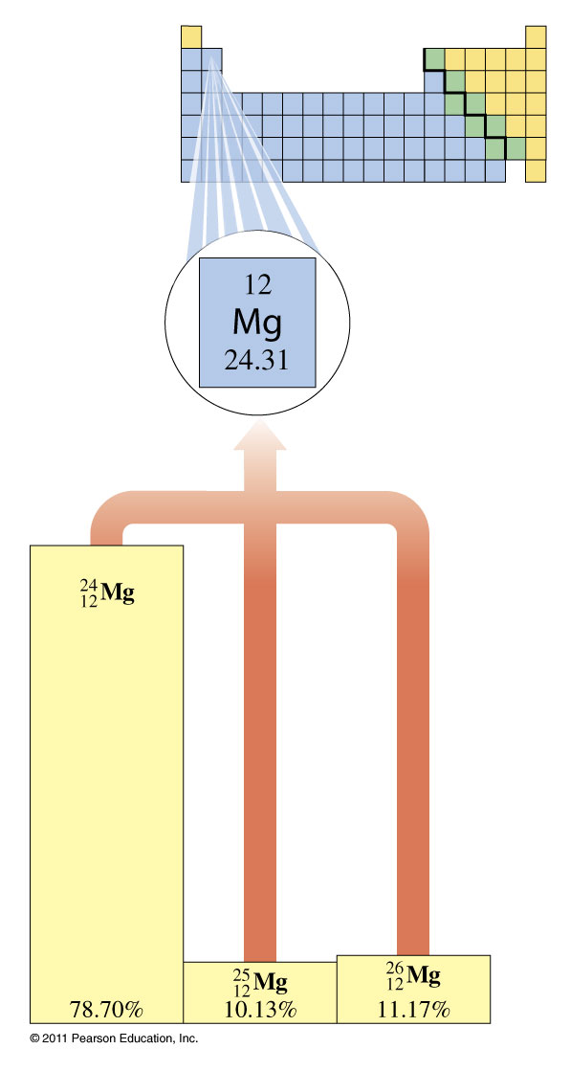
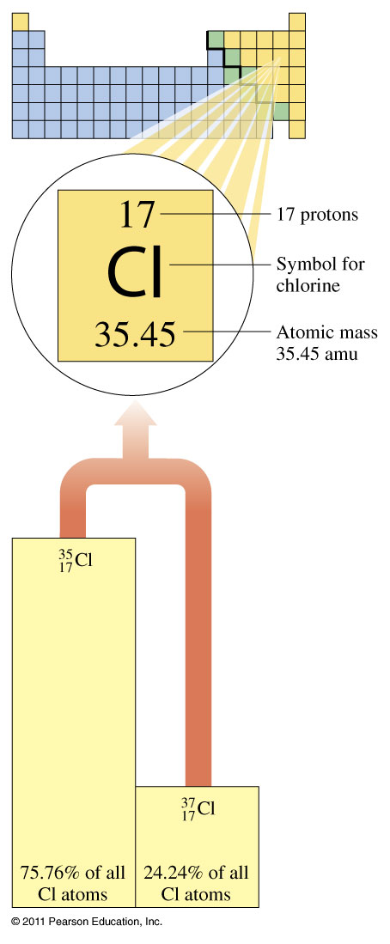

Slide 29
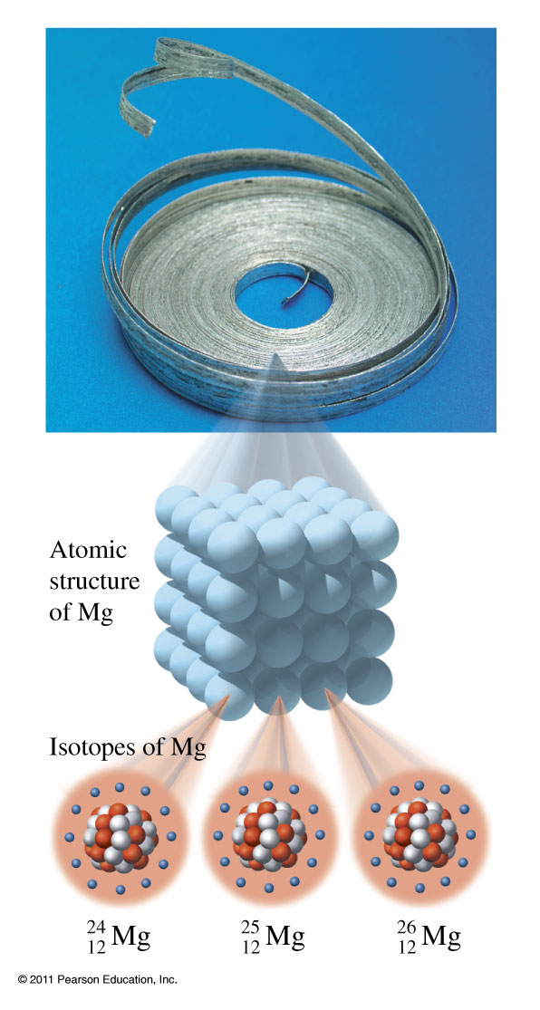
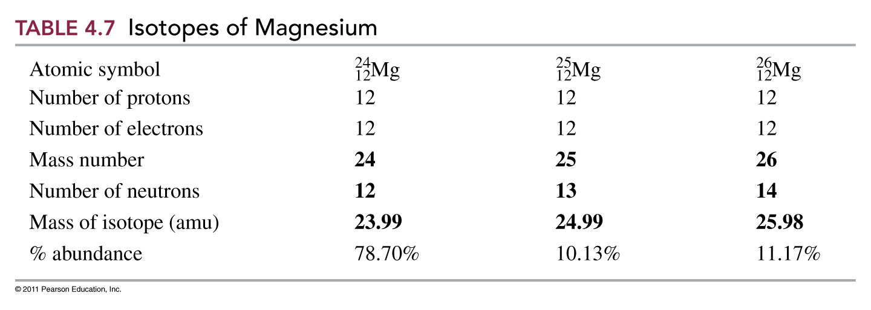
Isotopes of Magnesium
In naturally occurring magnesium, there are three isotopes:
Basic Chemistry Copyright © 2011 Pearson Education, Inc.

Slide 30
Example – Atomic Mass
Calculate the atomic mass of chlorine given
 | Mass (u) | %abundance
Chlorine-35 | 34.969 | 75.78
Chlorine-37 | 36.966 | 24.22

Slide 31
Example – Atomic Mass
Calculate the atomic mass of magnesium given
 | Mass (u) | %abundance
Mg-24 | 23.985 | 78.70
Mg-25 | 24.986 | 10.13
Mg-26 | 25.983 | 11.17

Slide 32
Example – Atomic Mass
Lithium has two isotopes: lithium-6 at 7.420% and lithium-7 at 92.58%. If the atomic mass of lithium is 6.941 u and the mass of lithium-6 is 6.0151 u, what the mass of lithium-7?

Slide 33
Example – Atomic Mass
Bromine has two isotopes. Bromine-79 the most abundant isotope at 50.69% has a mass of 78.9183 u. What is the mass of bromine-81?

Slide 34
Example – Atomic Mass
The atomic mass of chlorine on a five significant figure periodic table is 35.453 u. Chlorine has two natural isotopes with atomic mass 34.96885 u and 36.96590 u. Calculate the percent distribution between the two isotopes.

