Slide 1
Chemistry 120
Chapter 3:
Measurement and Chemical Calculations

Slide 2
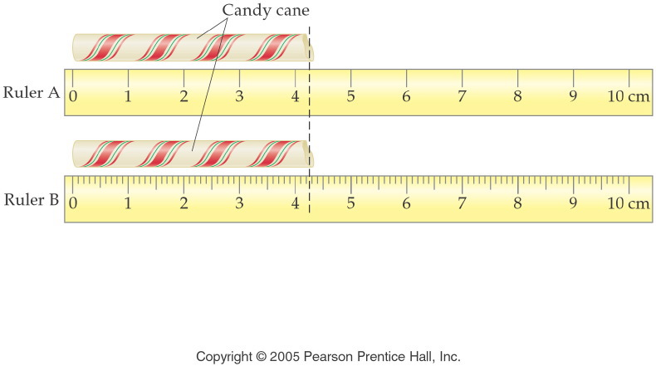
Notes:
Figure: 02-02
Title:
Metric Rulers
Caption:
On ruler A, each division is 1 cm. On ruler B, each division is 1 cm and each subdivision is 0.1 cm.
Notes:
These rulers are not to scale, but they reflect the relationship of measurement precision to instrumentation precision.

Slide 3
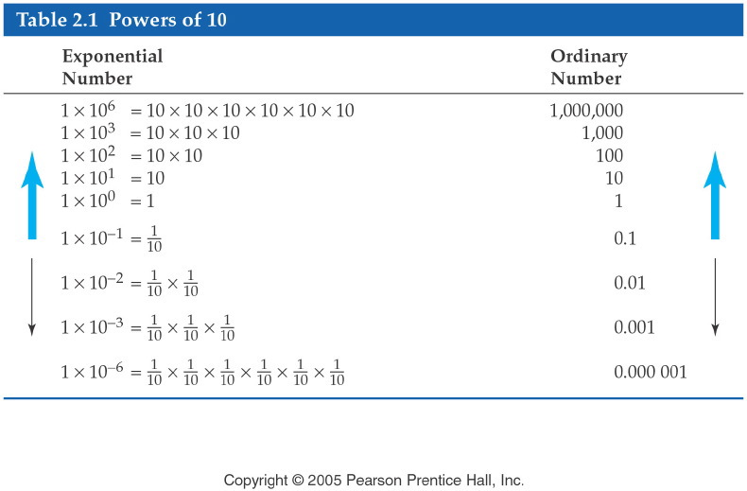
Notes:
Figure: 02-06-03T2.1
Title:
Table 2.1
Caption:
Several relevant examples of 10 being raised to an exponential power.
Notes:
This is the foundation for scientific notation.

Slide 4
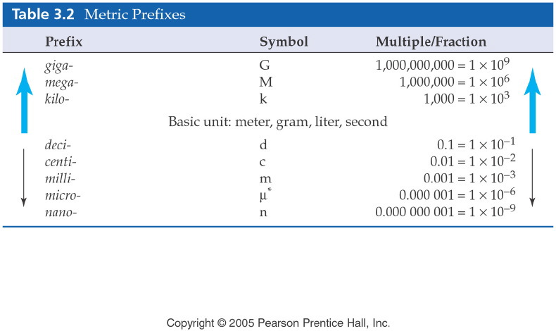
Notes:
Figure: 03-01-01T3.2
Title:
Table 3.2
Caption:
The metric prefixes are used to increase or decrease the value of any metric unit by a factor of 10.
Notes:
Although these prefixes are most commonly used, there are many other metric prefixes not tabulated in the list.

Slide 5
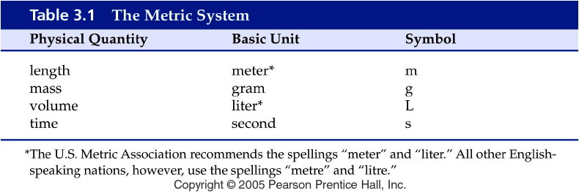
Notes:
Figure: 03-T01
Title:
Table 3.1
Caption:
The Metric System
Notes:
four basic metric (SI) units

Slide 6
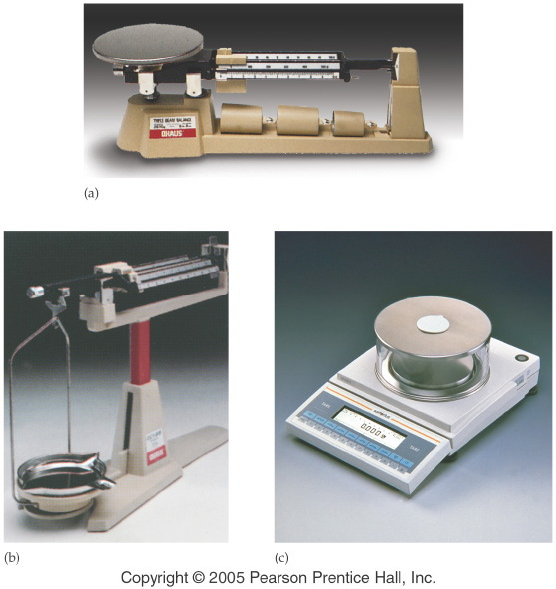
Notes:
Figure: 02-03
Title:
Balances for Measuring Mass
Caption:
(a) A platform balance having an uncertainty of 0.1 g. (b) A beam balance having an uncertainty of 0.01 g. (c) An electronic balance having an uncertainty of 0.001 g.
Notes:
Many labs have all three kinds of balances in use.

Slide 7
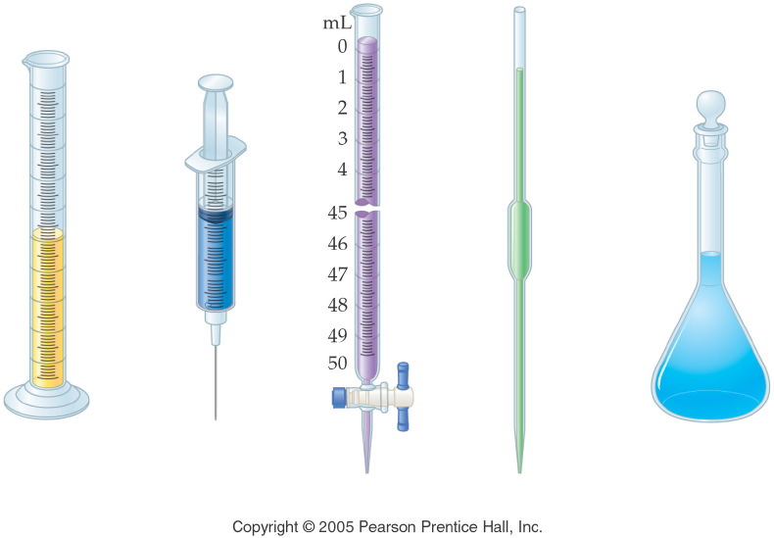
Notes:
Figure: 02-05
Title:
Measuring Volume
Caption:
Graduated cylinders, syringes, burets, pipettes, and flasks are used to measure volume.
Notes:
While graduated cylinders, syringes, and burets are calibrated to measure varying amounts of liquid, they are not as precise as those used to measure a fixed volume.

Slide 8
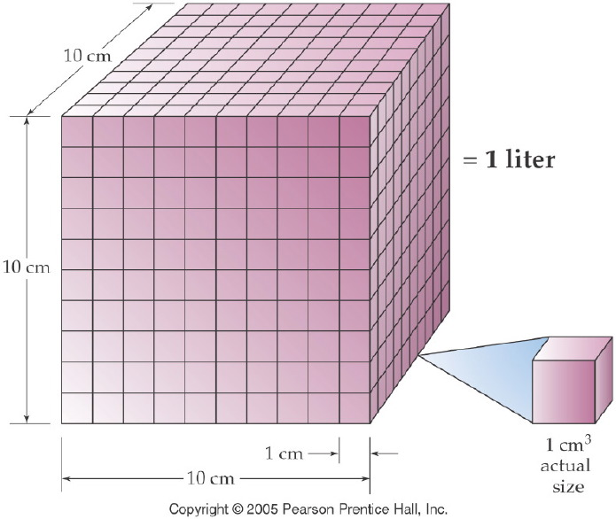
Notes:
Figure: 03-01-09UN
Title:
One Liter
Caption:
A liter equals the volume of a cube 10 cm on a side, that is, 1000 cm³.
Notes:
This diagram is useful in explaining the difference between a length unit conversion (1 in = 2.54 cm) and a volume conversion ( (1 in)³ = (2.54 cm)³.

Slide 9
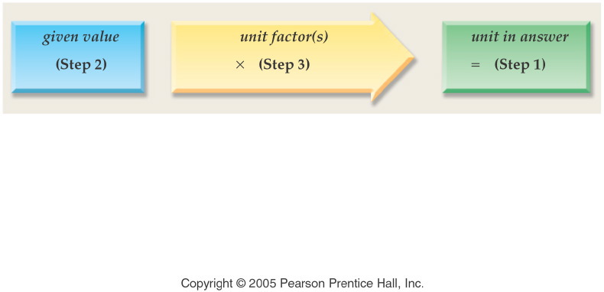
Notes:
Figure: 03-01-01UNa
Title:
unit analysis method
Caption:
Example exercise arrows.
Notes:
As in chapter 2, the path from one unit to another involves a unit factor that will cancel the units of the given quantity and give the units desired in the final answer.

Slide 10
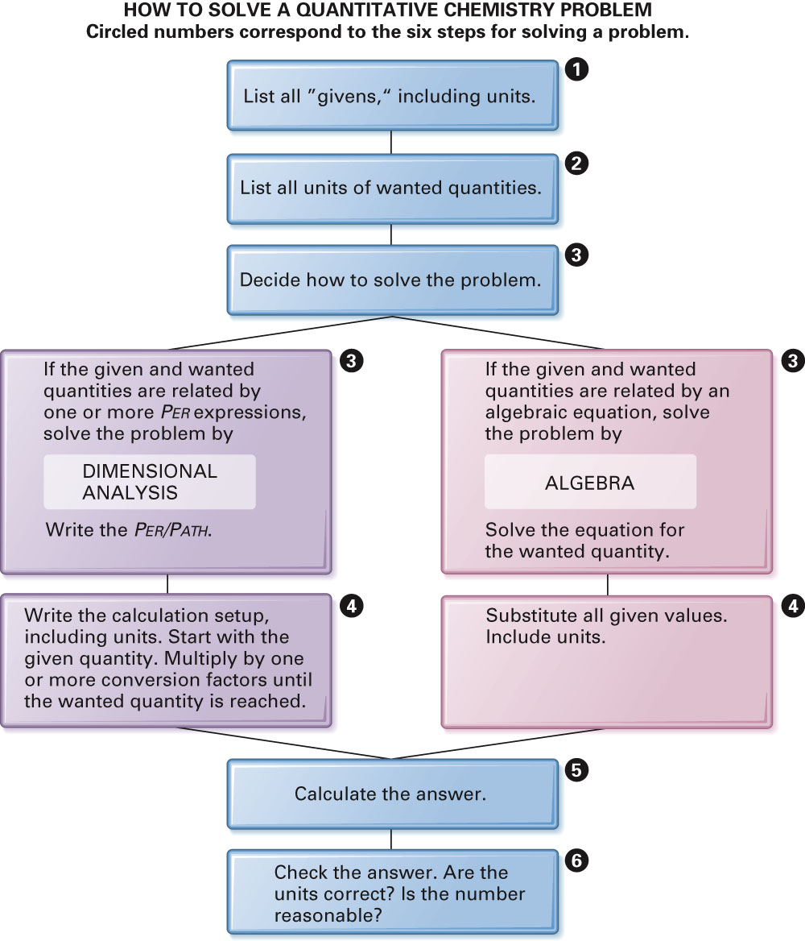
Fig. 3-12, p. 89

Slide 11
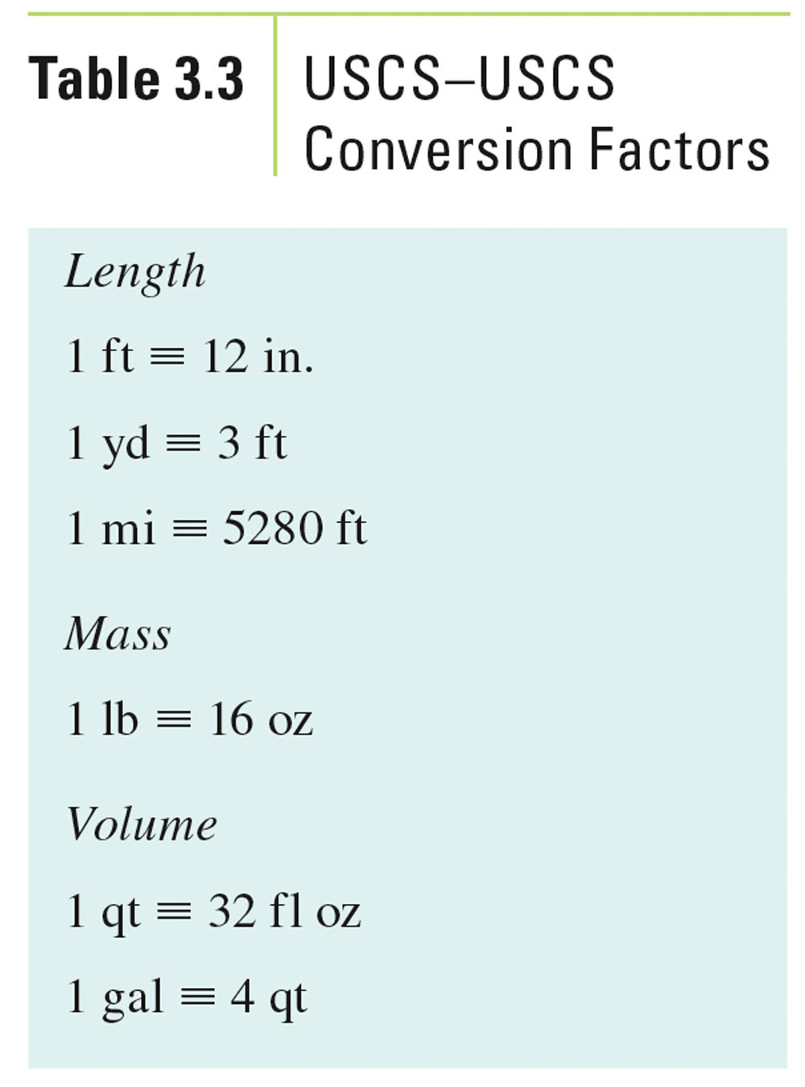
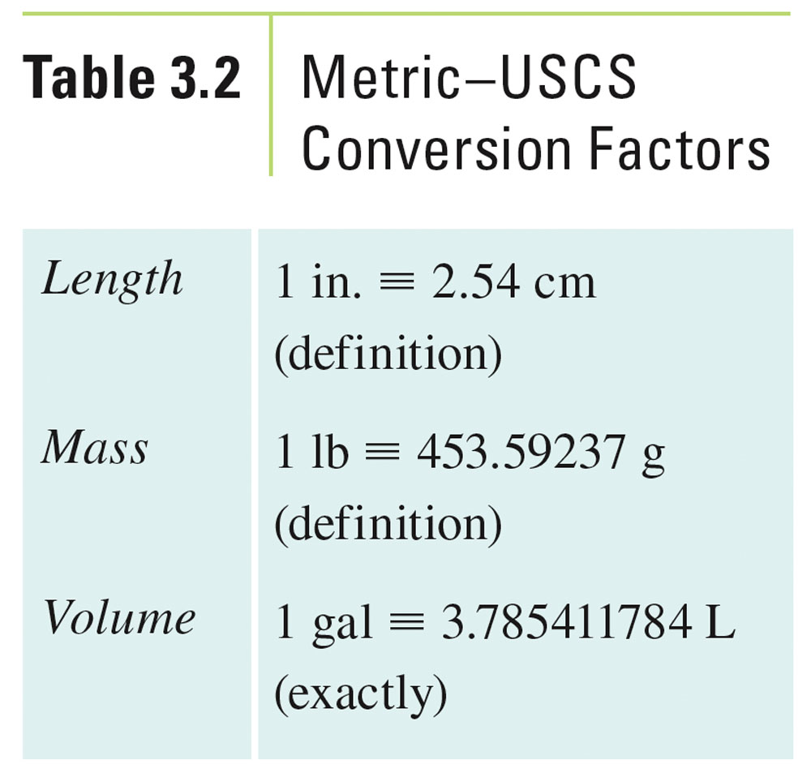
Table 3-3, p. 79

Slide 12
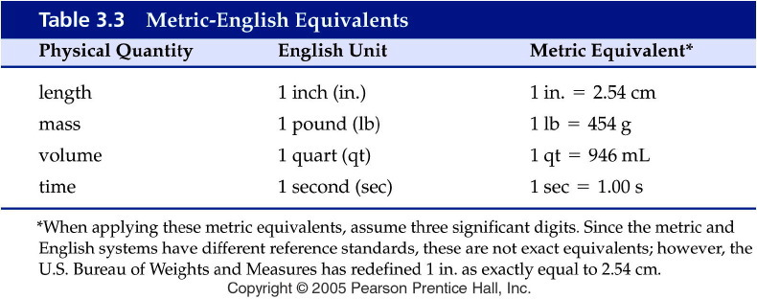
Notes:
Figure: 03-T03
Title:
Table 3.3
Caption:
Metric-English Equivalents
Notes:
metric equivalents to common metric quantities.

Slide 13
Example - Units of Measurement
The recommended amount of sodium in the diet is 2400. mg per day. How many grams per day is that?

Slide 14
Example - Units of Measurement
A paper clip is 4.68 cm long. How many mm is it?

Slide 15
Example - Units of Measurement
How many liters are in 3.0 cups?

Slide 16
Example - Units of Measurement
A football field is exactly 100 yards, how many meters is it?

Slide 17
Example - Units of Measurement
A room is exactly 800 square feet, how many square centimeters is it?

Slide 18
Example - Units of Measurement
During a volcanic eruption on Mauna Loa, Hawaii, the lava flowed at a rate of 33 meters per minute. At this rate, how far in kilometers will it travel in 45 minutes?

Slide 19
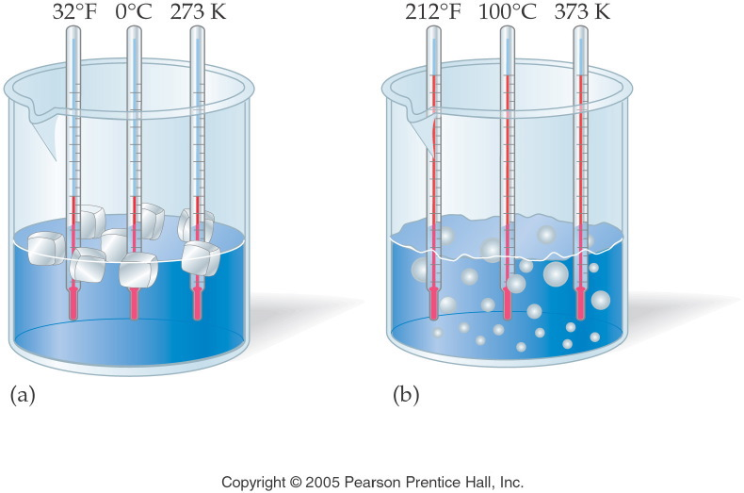
Notes:
Figure: 03-06
Title:
Temperature Scales
Caption:
Fahrenheit, Celsius, and Kelvin thermometers are all placed in boiling and freezing water.
Notes:
Celsius and Kelvin temperature readings change on the same relative scale. Fahrenheit temperature readings change on a different (x 1.8) scale.

Slide 20
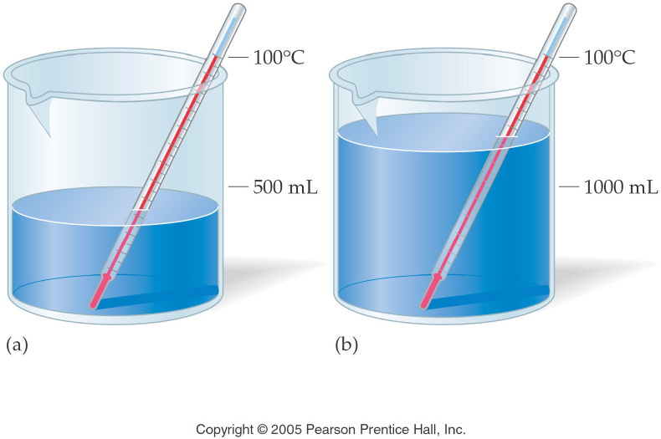
Notes:
Figure: 03-07
Title:
Heat versus Temperature
Caption:
500 mL and 1000 mL are both heated to 100/C. The second beaker holds twice the amount of heat.
Notes:
This diagram represents the relationship between mass and heat energy.

Slide 21
Example - Temperature
What temperature would you set your Fahrenheit oven to cook a pizza at 163.0 °C?

Slide 22
Example - Temperature
What is the Kelvin temperature of the oven? Recall, the pizza cooks at 163.0 °C?

Slide 23
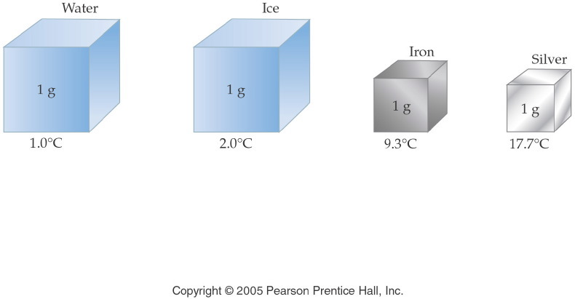
Notes:
Figure: 03-08
Title:
Illustration of Specific Heat
Caption:
Each cube represents 1 g of substance receiving 1 cal of heat. The temperature change varies with the substance.
Notes:
A large specific heat means that a substance can absorb more energy before its temperature changes. Note that water has the highest specific heat on the list.

Slide 24
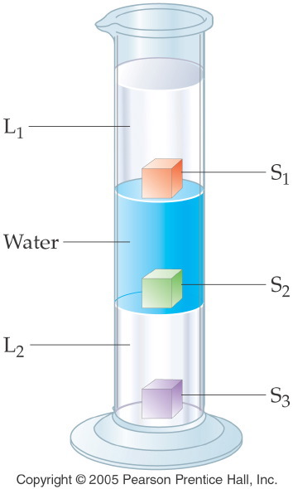
Notes:
Figure: 03-05
Title:
Density of Liquids and Solids
Caption:
L₁ is floating on top of water, floating on top of L₂. S₁ floats on water, S₂ floats on L2, S₃ sinks to the bottom.
Notes:
As the diagram suggests, lower density material floats on top of higher density material.

Slide 25
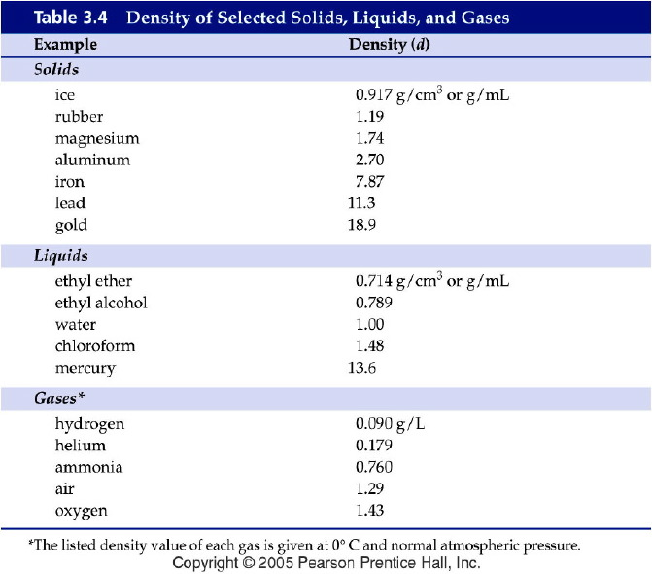
Notes:
Figure: 03-T04
Title:
Table 3.4
Caption:
Density of Selected Solids, Liquids, and Gases
Notes:
Note that the density of a gas is much less than that of a liquid or solid.

Slide 26
Example - Density
If a gold nugget weighs 96.5 g and has a volume of 5.00 cm³, what is it’s density?

Slide 27
Example - Density
If the density of milk is 1.04 g/mL, how many grams of milk are in 0.50 quarts?

Slide 28
Example - Density
The density of gasoline is 0.69 g/mL. If 15.0 gallons of gas is pumped, how many kilograms of gasoline is in your car?

Slide 29
Example - Density
The density of gasoline is 0.69 g/mL. If 15.0 gallons of gas is pumped, how many pounds of gasoline is in your car?

Slide 30
Example – Percent Concept
Bronze is 80.0% by mass copper and 20.0% tin. A sculptor is preparing to cast a 1.75 lb bronze figure. How many kg of copper are needed?

