Slide 1
Chemistry 120
Chapter 2: Matter and Energy

Slide 2
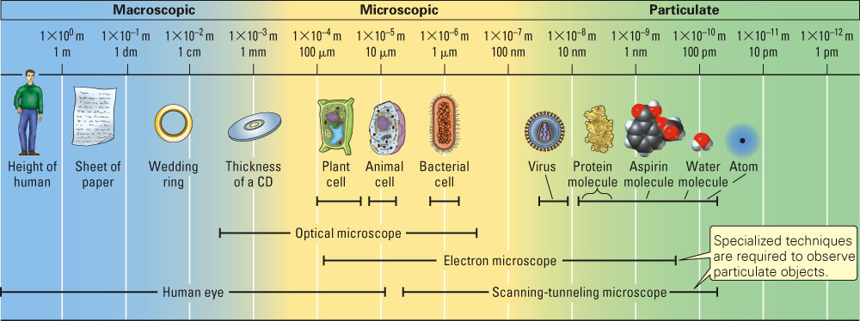
Representations of Matter:
Macroscopic, Microscopic and Particulate

Slide 3
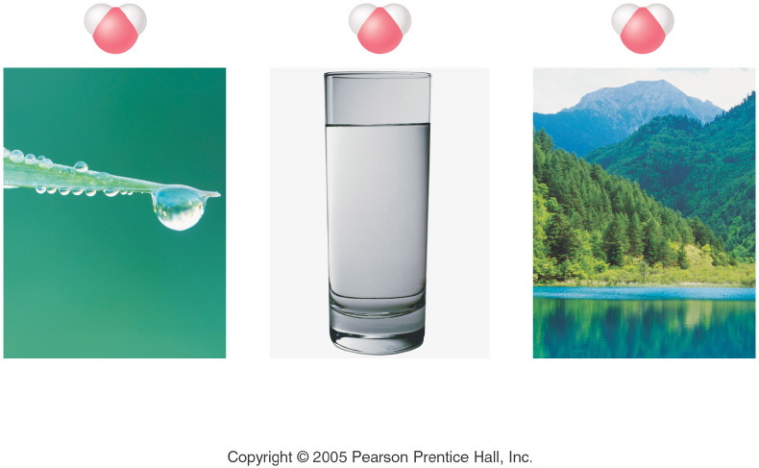
Notes:
Figure: 04-08
Title:
Law of Definite Composition
Caption:
A drop of water, a glass of water, and a lake of water all contain hydrogen and oxygen in the same percent by mass, that is, 11.2% hydrogen and 88.8% oxygen.
Notes:
The Law of Definite Composition states that no matter its source, a compound contains the same elements in the same percents by mass.

Slide 4
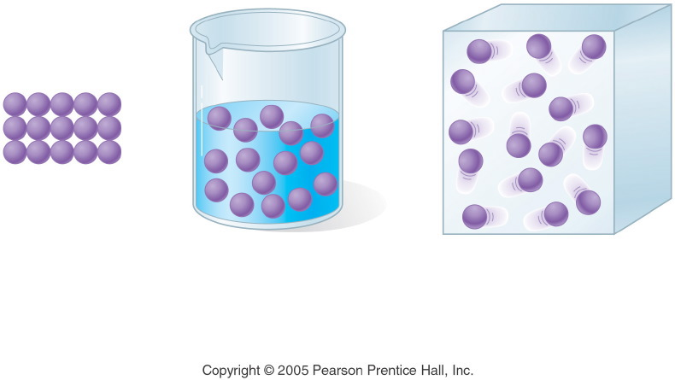
Notes:
Figure: 04-16-04UN
Title:
Physical State
Caption:
Solid, liquid, and gas molecules are shown.
Notes:
This diagram is part of Ch. 4, Key Concept #1.

Slide 5
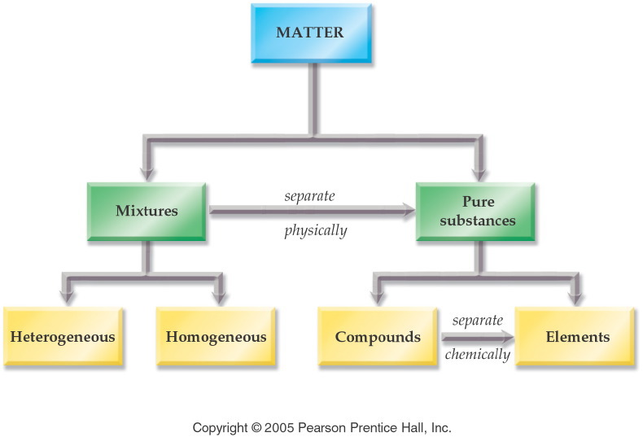
Notes:
Figure: 04-02
Title:
Classification of Matter
Caption:
Matter is classified as a mixture (heterogeneous, homogeneous) or a substance (compound, element).
Notes:
Each type of matter defines a certain complexity. Elements are combined to form compounds. Compounds are combined with elements to form mixtures. Uneven mixtures are heterogeneous.

Slide 6
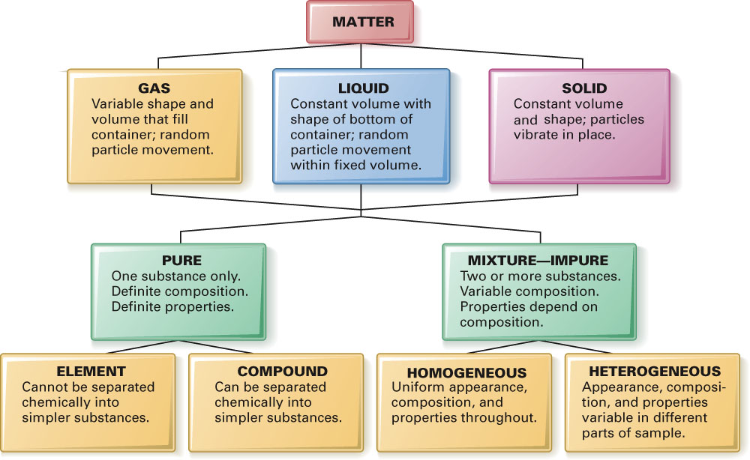
Fig. 2-19, p. 37

Slide 7
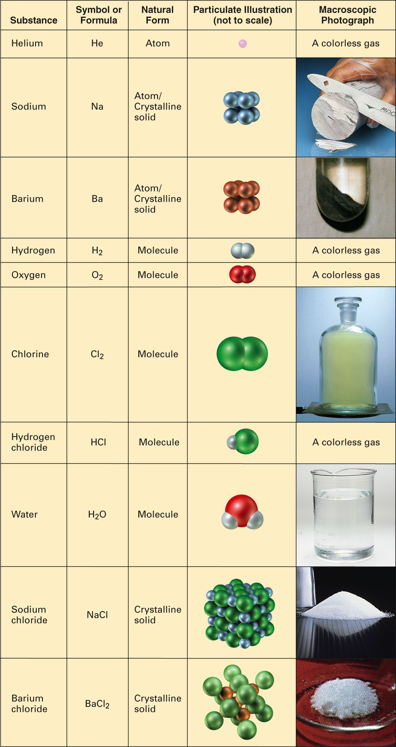
Fig. 2-18, p. 36

Slide 8
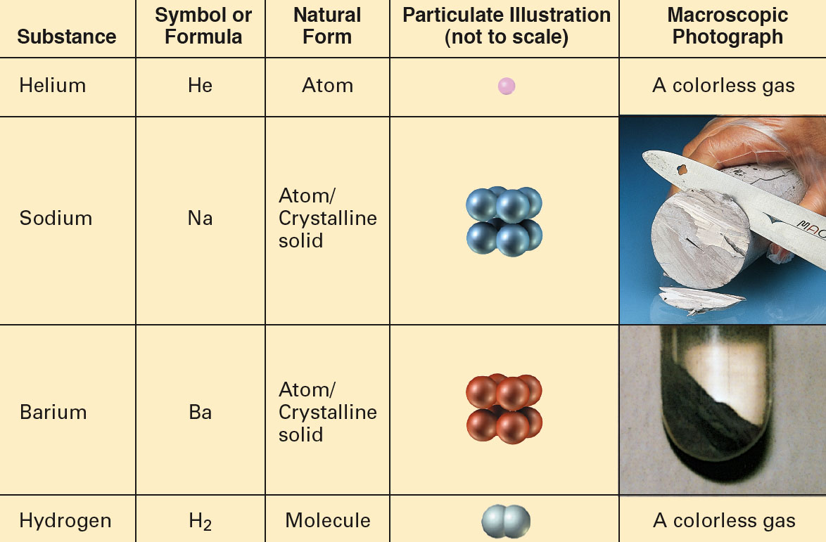
Elements and Compounds
Particulate and Macroscopic Views of Elements and Compounds:

Slide 9
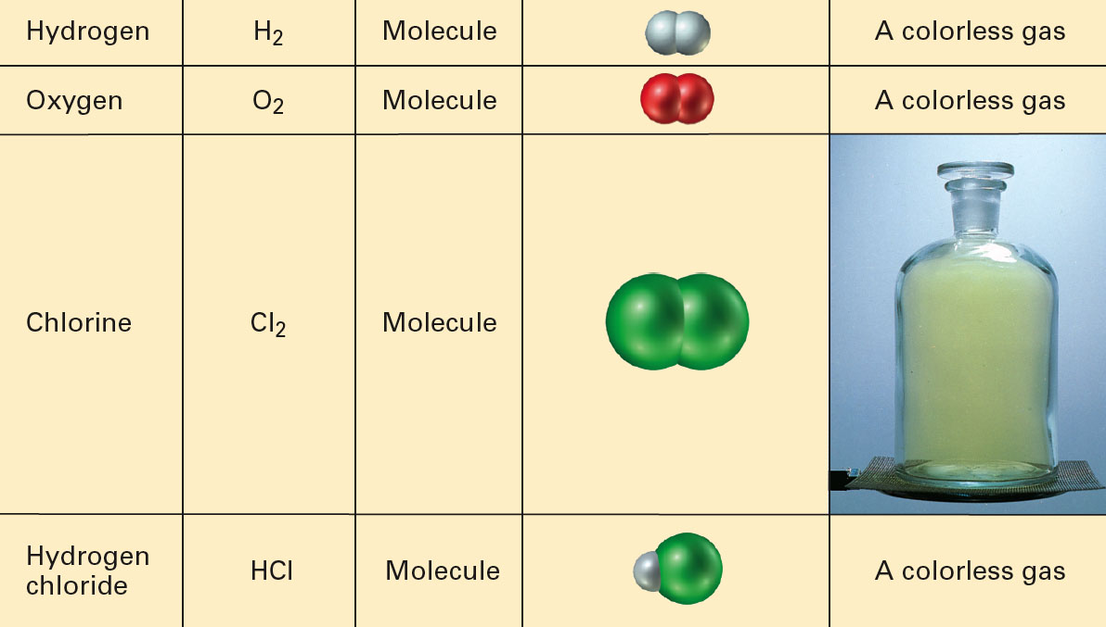
Elements and Compounds
Particulate and Macroscopic Views of Elements and Compounds:

Slide 10
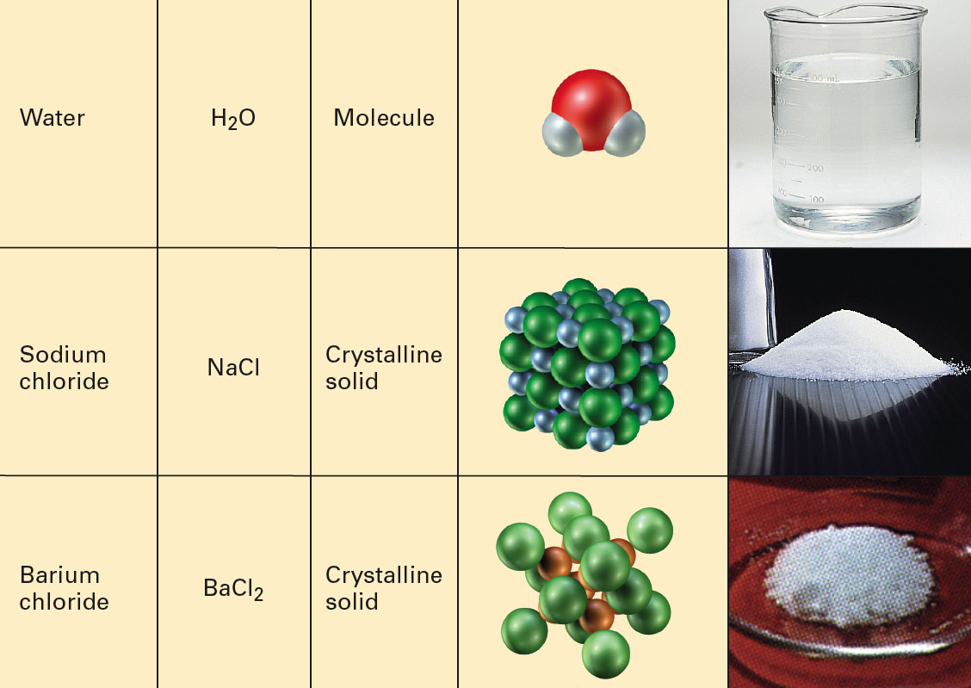
Elements and Compounds
Particulate and Macroscopic Views of Elements and Compounds:

Slide 11
Example - Mixtures
Classify a plastic bottle as a
A. Element
B. Compound
C. Heterogeneous mixture
D. Homogeneous mixture

Slide 12
Example - Mixtures
Classify root beer float as a
A. Element
B. Compound
C. Heterogeneous mixture
D. Homogeneous mixture

Slide 13
Example - Mixtures
Classify water as a
A. Element
B. Compound
C. Heterogeneous mixture
D. Homogeneous mixture

Slide 14
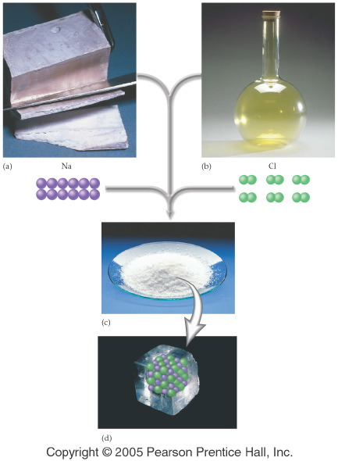
Notes:
Figure: 04-11
Caption:
Sodium is a shiny metal, chlorine is a yellow gas. Sodium chloride is a white crystalline solid (table salt).
Notes:
This is part 1 of a 2 part diagram showing the difference between sodium, chlorine, and sodium chloride.

Slide 15
Physical properties
Characteristics that can be evaluated without changing the composition of the material.
Examples
      color - density
      odor - melting point
      taste - boiling point
      feel - compressibility

Slide 16
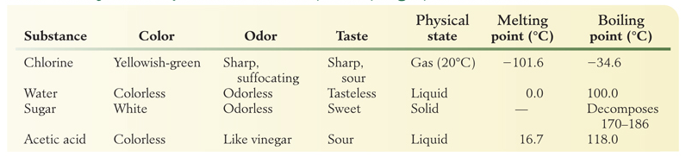
Examples of Physical Properties

Slide 17
Chemical Properties
Result in a change in the composition of a material.
Chemical Reaction - how the change occurs.
Example A chemical property of wood is it’s ability to burn - combustion.
  (Reactants and Products are very different)

Slide 18
Changes
Physical Changes - can be carried out without changing the composition of a substances.
Chemical Changes – are changes that change the composition of a substance.

Slide 19
Example – Physical and Chemical Properties
Salt melts at 800.7 °C. Is that a
A. Physical property?
B. Chemical property?

Slide 20
Example – Physical and Chemical Properties
Mercury is poisonouss. Is that a
A. Physical property?
B. Chemical property?

Slide 21
Example – Physical and Chemical Properties
Salt is granular and white. Is that a
A. Physical property?
B. Chemical property?

Slide 22
Example – Physical and Chemical Properties
Alka-Seltzer tablets form bubbles in water. Is that a
A. Physical property?
B. Chemical property?

Slide 23
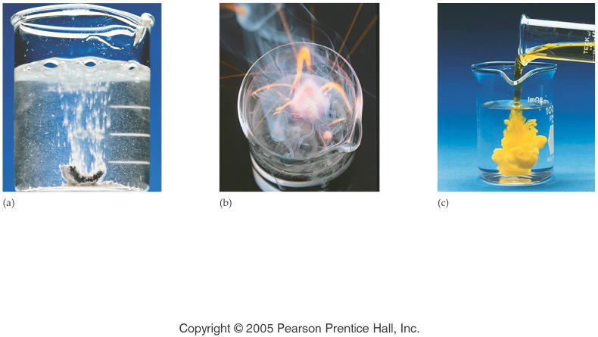
Notes:
Figure: 04-12
Title:
Evidence of Chemical Change
Caption:
The evidence for a chemical change includes (a) gas bubbles from the reaction of calcium metal in water, (b) heat and light energy from the reaction of potassium metal in water, and (c) a colorful, insoluble substance from the reaction of two solutions.
Notes:
We can be sure that there is a chemical change occurring in each of these instances because new substances are being formed with different chemical properties.

Slide 24
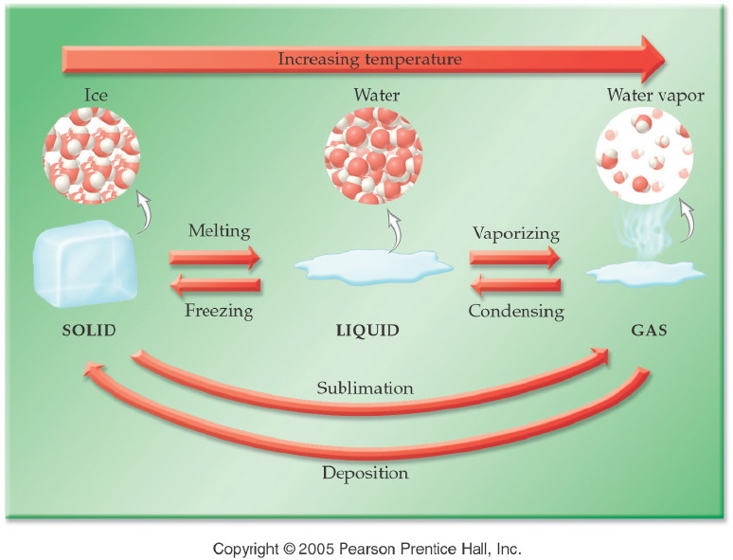
Notes:
Figure: 04-01
Title:
Changes in Physical State
Caption:
As temperature increases, a solid melts to become a liquid and then vaporizes to a gas. As temperature decreases, the process reverses.
Notes:
Understanding the nomenclature (freezing vs. melting, vaporizing vs. condensing) will help the students predict the direction of temperature change.

Slide 25
Law of Conservation of Energy
Energy can be neither created nor destroyed.
In an Exothermic process, heat flows from a system into its surroundings.
In an Endothermic process, heat flows from the surroundings into the system

Slide 26
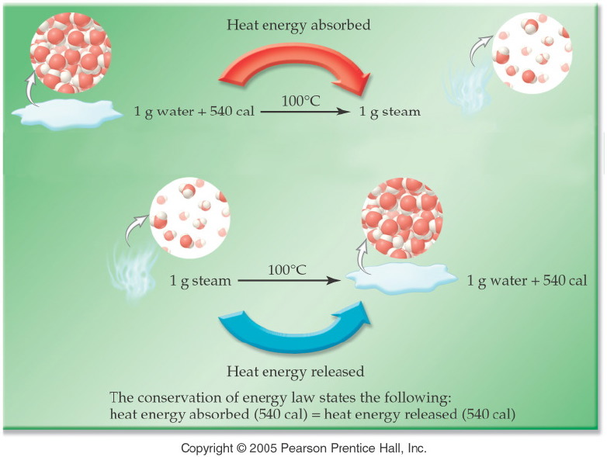

Slide 27
Example – Physical and Chemical Change
Recycling plastic is a
A. physical change.
B. chemical change.

Slide 28
Example – Physical and Chemical Change
Pouring vinegar on baking soda, which produces bubbles is a
A. physical change.
B. chemical change.

Slide 29
Example – Physical and Chemical Change
Grinding aspirin tablets to a fine powder is a
A. physical change.
B. chemical change.

Slide 30
Example – Physical and Chemical Change
Forging of iron is a
A. physical change.
B. chemical change.

Slide 31
Example – Physical and Chemical Change
Fruit ripening is a
A. physical change.
B. chemical change.

Slide 32
Example – Physical and Chemical Change
Burning wood is a
A. physical change.
B. chemical change.

Slide 33
Example – Physical and Chemical Change
Dissolving salt in water is a
A. physical change.
B. chemical change.

Slide 34
Example – Physical and Chemical Change
Alcohol burning is a
A. physical change.
B. chemical change.

Slide 35
Law of Conservation of Matter
Matter can be neither created nor destroyed.

Slide 36
Example – Law of Conservation of Mass
If 10.0 g of calcium carbonate, CaCO₃, is decomposed by heating to 5.6 g of calcium oxide, CaO, and carbon dioxide, CO₂. How many grams of carbon dioxide gas are evolved?
heat
CaCO_{3 (s)} → CaO _{(s)} + CO_{2 (g)}

Slide 37
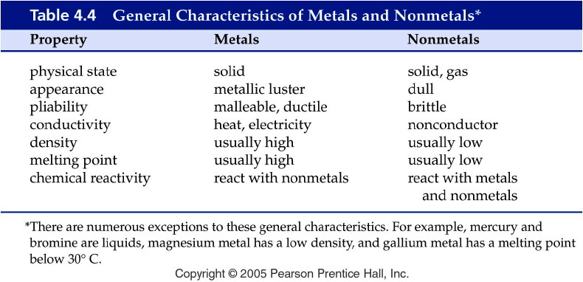
Notes:
Figure: 04-T04
Title:
Table 4.4
Caption:
General Characteristics of Metals and Nonmetals*
Notes:
note that there are exceptions to the general characteristics.

Slide 38
Energy
Energy is the capacity to do work.
Types of energy
  Kinetic energy
  Potential energy
  Thermal energy
Measured in Joules or Calories

Slide 39
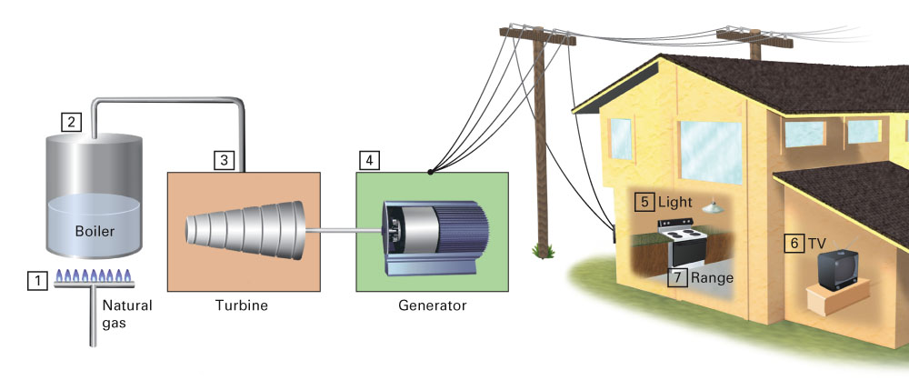
Conservation Laws
Common Events in which Energy Changes
from One Form to Another:

Slide 40
Example – Law of Conservation of Energy
Uranium converts water to steam is _____ energy released to _____ energy absorbed.
A. nuclear, heat
B. heat, mechanical
C. mechanical, mechanical
D. mechanical, electrical

Slide 41
Example – Law of Conservation of Energy
Steam drives a turbine is heat energy _______ to mechanical energy _________.
A. absorbed, absorbed
B. released, absorbed
C. absorbed, released
D. released, released

Slide 42
Law of conservation of Mass and Energy
The sum on mass and energy is conserved.

