Slide 1
Chemistry 120
Chapter 17:
Acid-Bases (Proton Transfer) Reactions

Slide 2
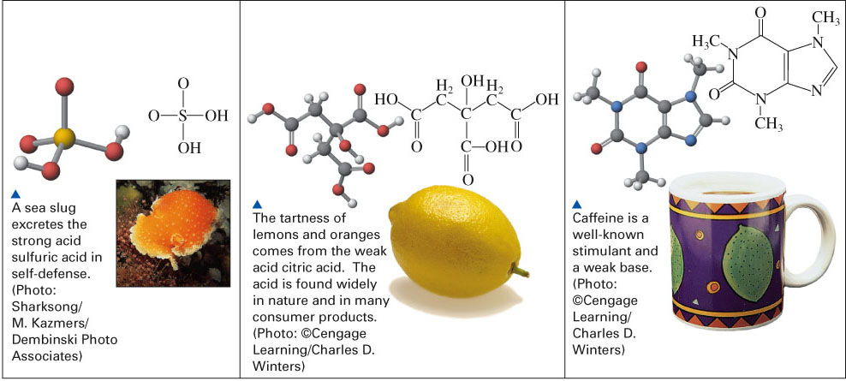
Fig. 17-4, p. 532

Slide 3
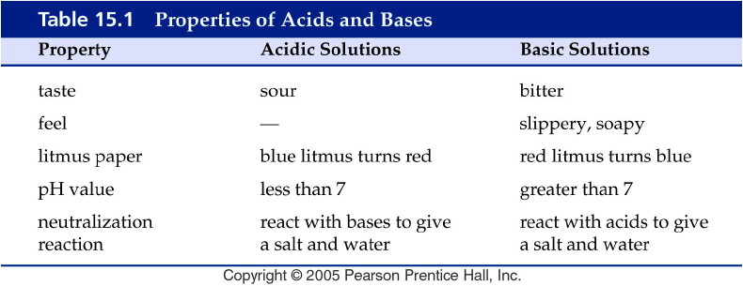
Notes:
Figure: 15-T01
Title:
Table 15.1
Caption:
Properties of Acids and Bases
Notes:
You should NOT taste or feel chemicals--these observed characteristics are historical. (Many early chemists had short lives because they tasted their chemicals!)

Slide 4
Activity Series
Metals
Li ← most reactive
K
active Ba
metals Sr
Ca
Na
Mg
Al
Mn
Zn
Fe
Cd
Co
Ni
Sn
Pb
(H)
Cu
Ag
Hg
Au ← least reactive
Nonmetals: Halogens
F ← most reactive
Cl
Br
I ← least reactive

Slide 5
Common Strong Acids and Bases
Common Strong Bases
Lithium hydroxide LiOH _{(aq)}
Sodium hydroxide NaOH _{(aq)}
Potassium hydroxide KOH _{(aq)}
Strontium hydroxide Sr(OH)₂ _{(aq)}
Barium hydroxide Ba(OH)₂ _{(aq)}
Calcium hydroxide Ca(OH)_{2 (aq)}
Common Strong Acids
Hydrochloric acid HCl _{(aq)}
Hydrobromic acid HBr _{(aq)}
Hydroiodic acid HI _{(aq)}
Perchloric acid HClO_{4 (aq)}
Chloric acid HClO_{3 (aq)}
Nitric acid HNO_{3 (aq)}
Sulfuric acid H₂SO_{4 (aq)}

Slide 6
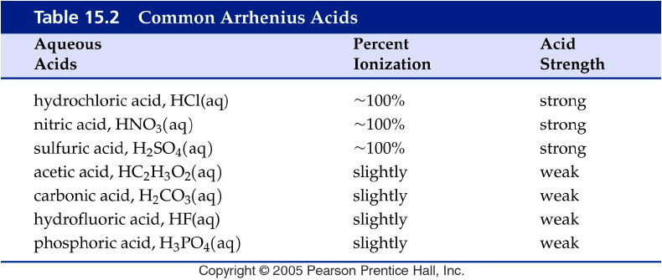
Notes:
Figure: 15-T02
Title:
Table 15.2
Caption:
Common Arrhenius Acids
Notes:
Strong acids ionize completely; weak acids do not.

Slide 7
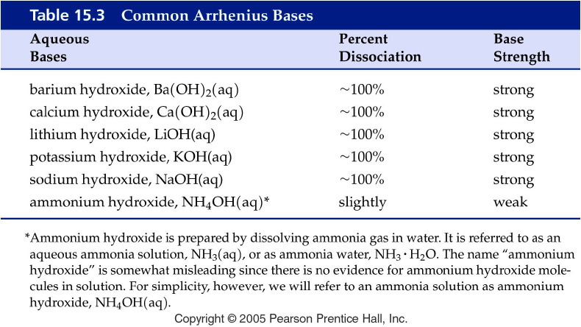
Notes:
Figure: 15-T03
Title:
Table 15.3
Caption:
Common Arrhenius Bases
Notes:
Strong bases ionize completely in water; weak bases do not.

Slide 8
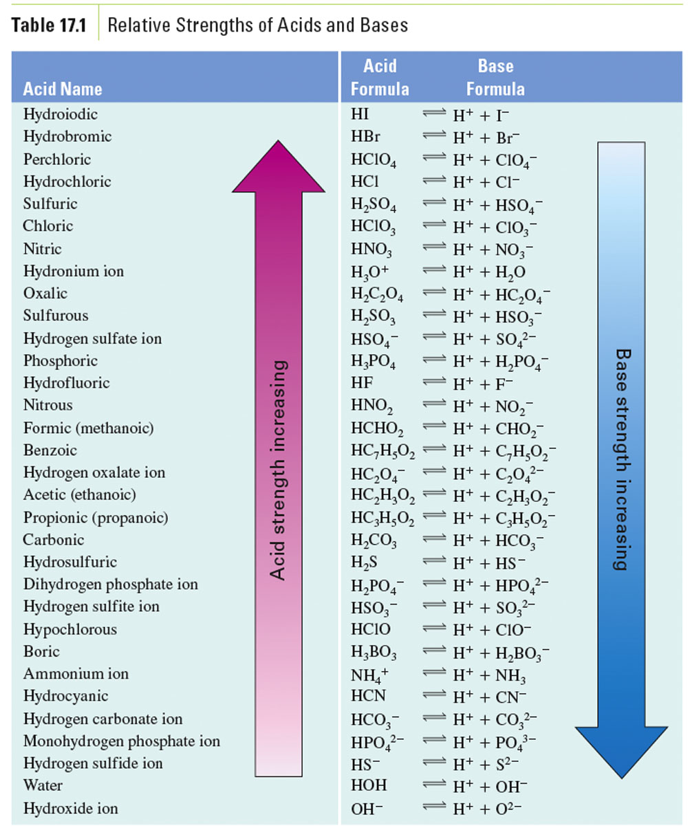

Slide 9
Example – Brønsted-Lowry Acids-Bases
Below is a Brønsted-Lowry acid-base reaction: HCN _{(aq)} + SO₄²⁻ _{(aq)} → CN⁻ _{(aq)} + HSO₄– _{(aq)}
The cyanide ion is
A. Brønsted-Lowry acid
B. Brønsted-Lowry base
C. conjugate acid
D. conjugate base

Slide 10
Examples – Acid Strength
Rank the following acids from weakest to strongest: HSO₃⁻, HBr, HCN, HC₃H₅O₂
A. HSO₃⁻, HBr, HCN, HC₃H₅O₂
B. HBr, HSO₃⁻, HCN, HC₃H₅O₂
C. HCN, HSO₃⁻, HBr, HC₃H₅O₂
D. HCN, HSO₃⁻, HC₃H₅O₂, HBr

Slide 11
Example – Acid Strength
Is the forward or reverse reaction favored?
C₃H₅O₂⁻ _{(aq)} + HPO₄²⁻ _{(aq)}  HC₃H₅O_{2 (aq)} + PO₄³⁻ _{(aq)}

Slide 12
Example – Acid Strength
Is the forward or reverse reaction favored?
HSO₄⁻ _{(aq)} + HS⁻ _{(aq)}  H₂S _{(g)} + SO₄²⁻ _{(aq)}

Slide 13
Example – Acids and Bases
For pure water at 25 °C, the proton concentration and hydroxide ion concentration is 1 x 10⁻⁷ M, what is the equilibrium constant for water?

Slide 14
Example – Acids and Bases
What is the hydronium ion concentration of a solution at 25 °C that is made of a 0.152 M barium hydroxide?

Slide 15
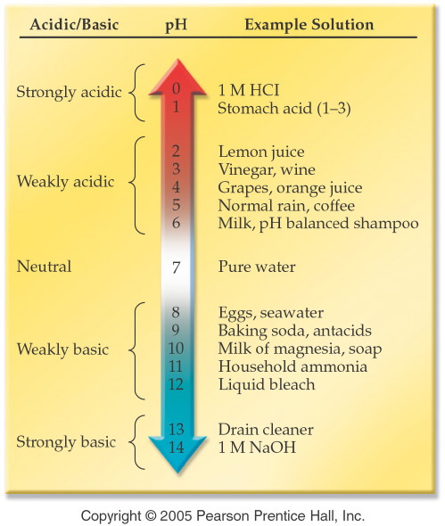
Notes:
Figure: 15-01
Title:
The pH Scale
Caption:
Note that solutions may be strongly acidic, weakly acidic, weakly basic, or strongly basic.
Notes:
The pH scale in aqueous solutions generally ranges from 0 to 14. As pH decreases, acidity increases.

Slide 16
Example - pH
The proton ion concentration of carrots is 7.9 x 10⁻⁶ M, what is the pH?

Slide 17
Example - pH
The hydrogen ion concentration of coffee is 1.00 x 10⁻³ M, what is the pH?

Slide 18
Example - pH
Calculate the proton ion concentration for a solution of baking soda with a pH of 8.250.
5.62 x 10⁻⁹ M
8.250 M
5.623 x 10⁻⁹ M
0.1212 M
0.9165 M

Slide 19
Example - pOH
What is the pOH of an ammonia solution with a hydroxide ion concentration of 3.7 x 10⁻³ M?

Slide 20
Example – pH and pOH
What is the pH of seawater, if the hydroxide ion concentration is 1.0 x 10⁻⁶ M?

Slide 21
Example – pH and pOH
What is the pOH if a sample of wine has a hydrogen ion concentration of 1.5 x 10⁻³ M?

Slide 22
Example – pH
Limiting Reagent
Suppose that 50.00 mL of a 1.72 M hydrochloric acid solution reacts with 32.51 mL of a 1.99 M sodium hydroxide solution. What is the pH of the resulting solution?

Slide 23
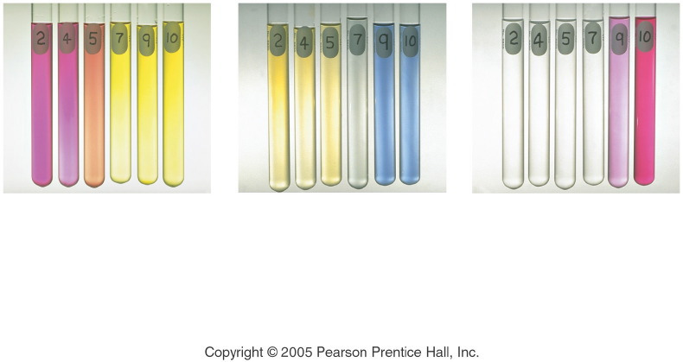
Notes:
Figure: 15-02
Title:
pH and Acid-Base Indicator Color
Caption:
The color of three acid-base indicators at different pH values. Methyl red (left) changes from red to yellow at pH 5. Bromthymol blue (middle) changes from yellow to blue at pH 7. Phenolphthalein (right) changes from colorless to pink at pH 9.
Notes:
Each indicator changes color based on the pH of the solution. THe indicator a scientist uses is chosen based on the approximate pH at which the color change takes place.

Slide 24
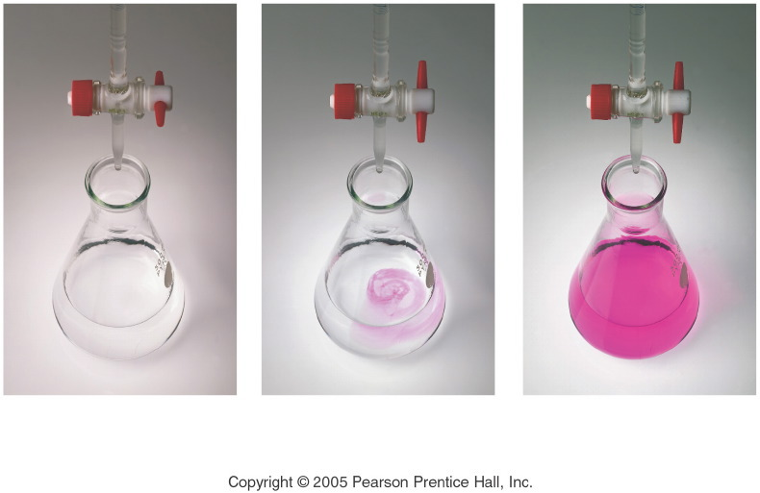
Notes:
Figure: 15-03
Title:
Titration of Acetic Acid with Sodium Hydroxide
Caption:
(a) The flask contains a sample of acetic acid and a drop of phenolphthalein indicator. (b) The buret delivers a measured volume of sodium hydroxide solution into the flask. (c) The titration is complete when the solution attains a permanent pink color.
Notes:
The phenolphthalein is pink in basic solution and colorless in acidic solution. One drop of base from the buret is enough to make the solution change in color.

Slide 25
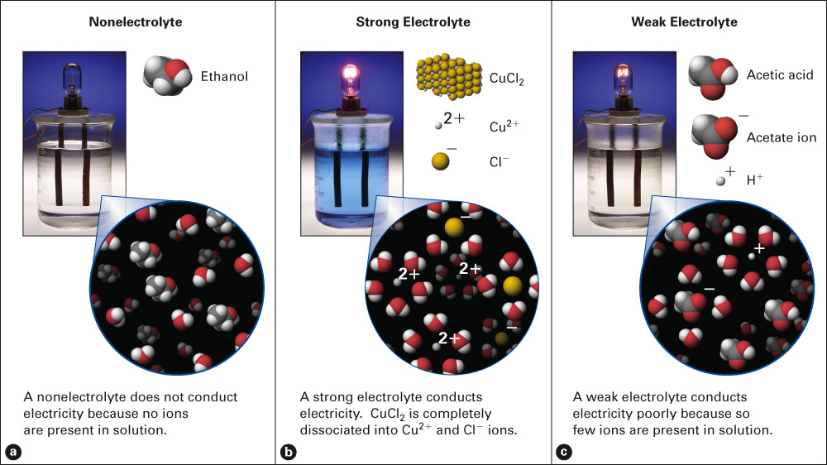
Fig. 9-2, p. 237

Slide 26
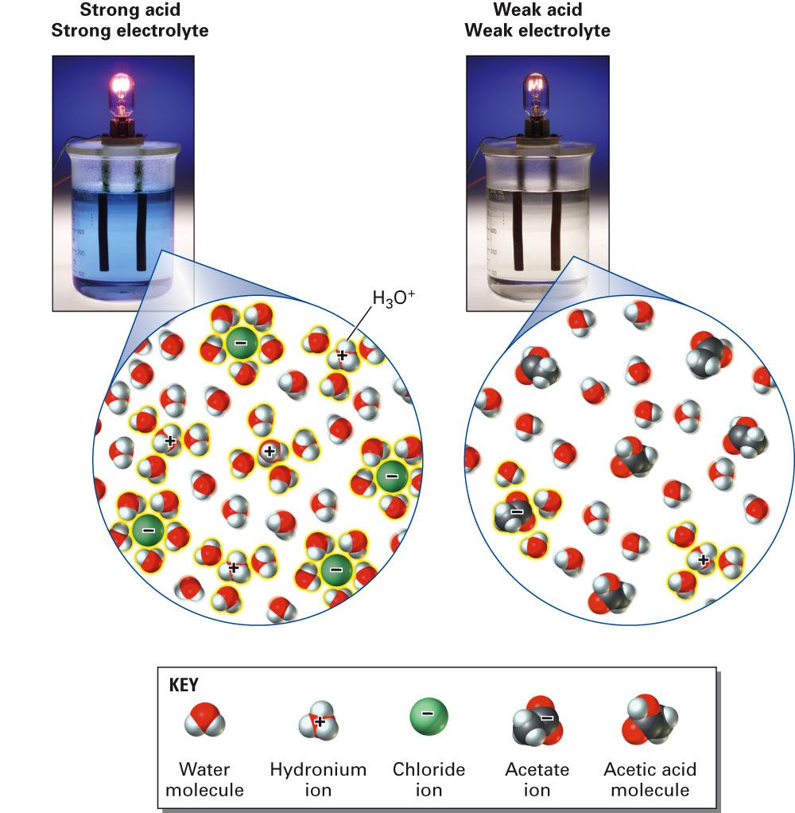
Fig. 9-6, p. 241

Slide 27
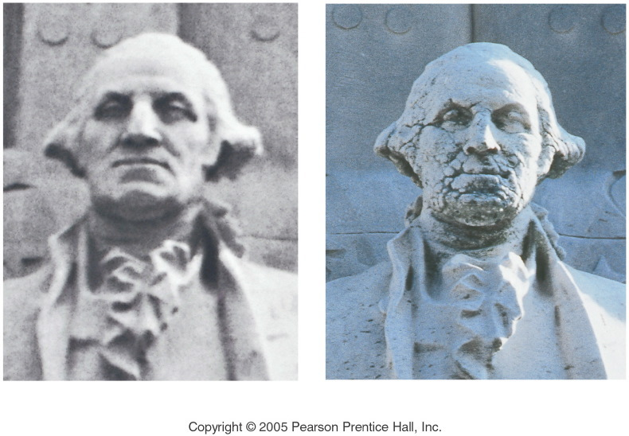
Notes:
Figure: 15-05-02UN
Title:
Acid Rain
Caption:
The photograph on the left shows a marble statue of George Washington in 1935. The recent photograph on the right shows the effect of acid rain, which attacks the statue by dissolving away calcium carbonate in the marble.
Notes:
Carbon dioxide from emissions of fossil fuel burning dissolves in water to produce an acidic solution that dissolves marble.

Slide 28
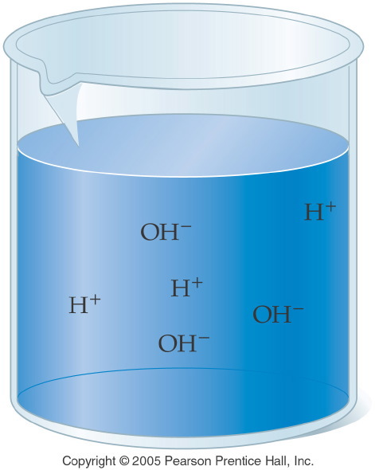
Notes:
Figure: 15-05
Title:
Ionization of Water
Caption:
Pure water ionizes to give a few hydrogen and hydroxide ions. Only 1 molecule in 500 million ionizes.
Notes:
This concept is the basis of the pH scale in aqueous solutions.

Slide 29
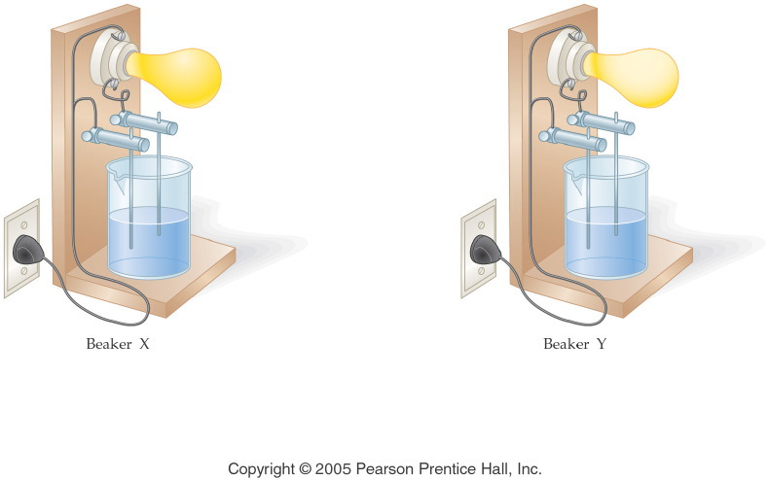
Notes:
Figure: 15-06-01KC09
Title:
Beaker X and Beaker Y
Caption:
Two solutions are tested for conductivity.
Notes:
This diagram is part of Ch. 15, Key Concepts #9.

Slide 30
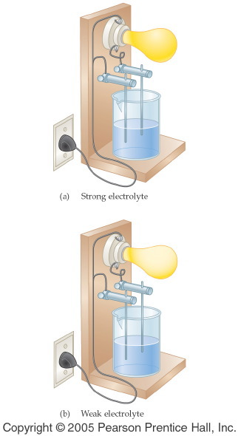
Notes:
Figure: 15-06
Title:
Conductivity of Aqueous Solutions
Caption:
An aqueous solution of hydrochloric acid is a strong electrolyte, while a solution of acetic acid is a weak electrolyte.
Notes:
Strong electrolytes ionize completely, and weak electrolytes only partially ionize. The relative number of ions is shown in the brightness of the lightbulb.

Slide 31
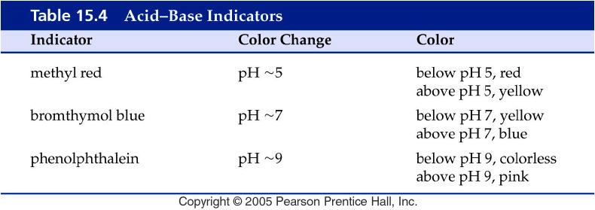
Notes:
Figure: 15-T04
Title:
Table 15.4
Caption:
Acid-Base Indicators
Notes:
Each indicator changes color in a different pH range.

Slide 32
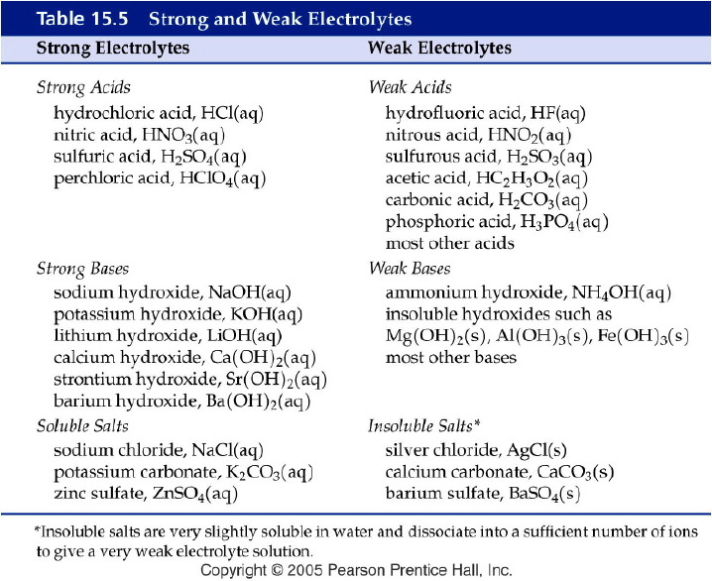
Notes:
Figure: 15-T05
Title:
Table 15.5
Caption:
Strong and Weak Electrolytes
Notes:
Strong Acids and Bases as well as Soluble Salts are strong electrolytes. Weak acids and bases as well as insoluble salts give weak electrolyte solutions.

