Slide 1
Chemistry 120
Chapter 16: Solutions

Slide 2
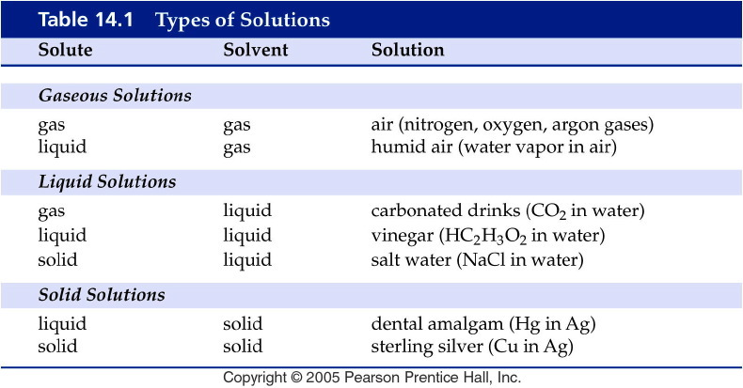
Notes:
Figure: 14-T01
Title:
Table 14.2
Caption:
Types of Solutions
Notes:
Solutions can be prepared that include any combination of the states of matter.

Slide 3
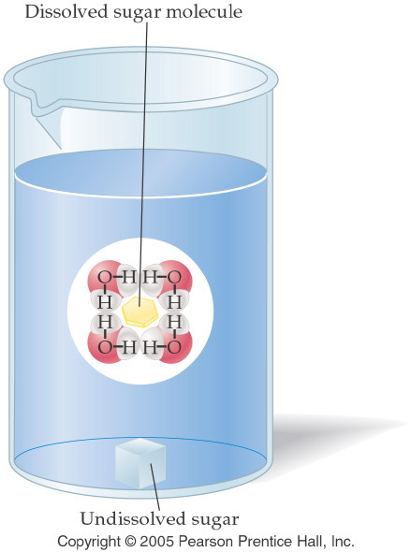
Notes:
Figure: 14-02
Title:
Table Sugar in Water
Caption:
Water molecules attack a sugar cube along the edges and at the corners.
Notes:
Sugar molecules separate and are surrounded by water molecules. These solvent molecules are called a "solvent cage." Each sugar molecule is pulled into solution by several water molecules surrounding it.

Slide 4
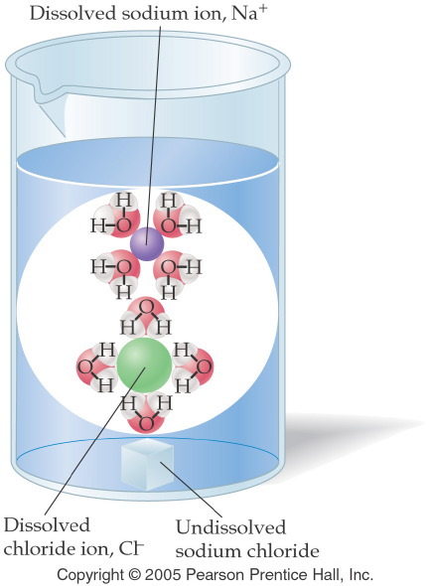
Notes:
Figure: 14-03
Title:
Table Salt in Water
Caption:
The Na+ is attracted to the oxygen atom and the Cl- to the hydrogen atoms in a water molecule.
Notes:
The polar water molecules stabilize the positive sodium ion by surrounding it with partially negative oxygen atoms. The chloride anion is stabilized by the partially positive hydrogen atoms.

Slide 5
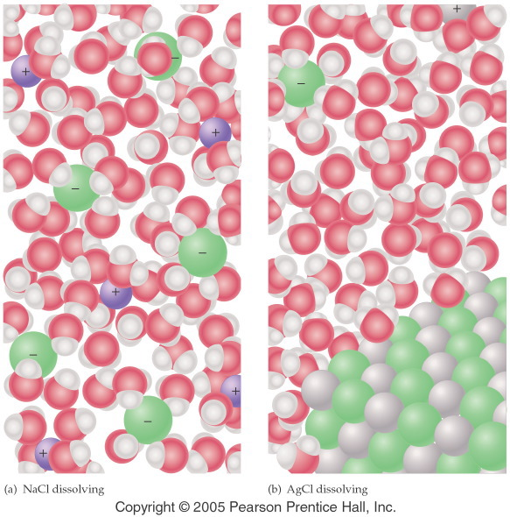
Notes:
Figure: 14-06-12KC07
Title:
NaCl and AgCl
Caption:
In the above molecular art, one panel represents NaCl in solution and the other represents AgCl in solution.
Notes:
NaCl is soluble in water. The ions separate in water. AgCl is insoluble in water. Very few ions separate in water.

Slide 6
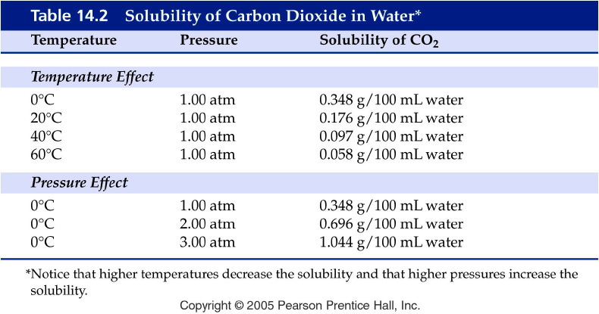
Notes:
Figure: 14-T02
Title:
Table 14.2
Caption:
Solubility of Carbon Dioxide in Water*
Notes:
Gases are most soluble in liquids at low temperature and high pressure.

Slide 7
Example - Solubility
Which of the following pairs are miscible?
Water and ethanol, CH₃CH₂OH
Hexane, CH₃(CH₂)₄CH₃ and xylene,
Ethanol, CH₃CH₂OH, and xylene,
A and B
All of the above

Slide 8
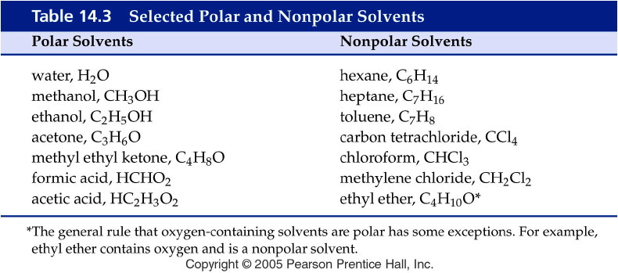
Notes:
Figure: 14-T03
Title:
Table 14.3
Caption:
Selected Polar and Nonpolar Solvents
Notes:
Solvents containing oxygen are generally polar. One exception is diethyl ether.

Slide 9
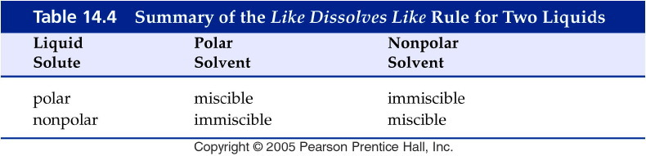
Notes:
Figure: 14-T04
Title:
Table 14.4
Caption:
Summary of the Like Dissolves Like Rule for Two Liquids
Notes:
Polar solutes are miscible in polar solvents but not nonpolar solvents, and vice versa.

Slide 10
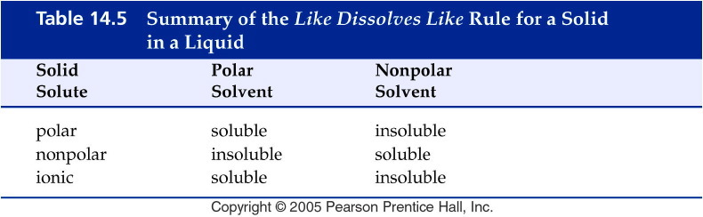
Notes:
Figure: 14-T05
Title:
Table 14.5
Caption:
Summary of the Like Dissolves Like Rule for a Solid in a Liquid
Notes:
Polar solutes are miscible in polar solvents but not nonpolar solvents, and vice versa.

Slide 11
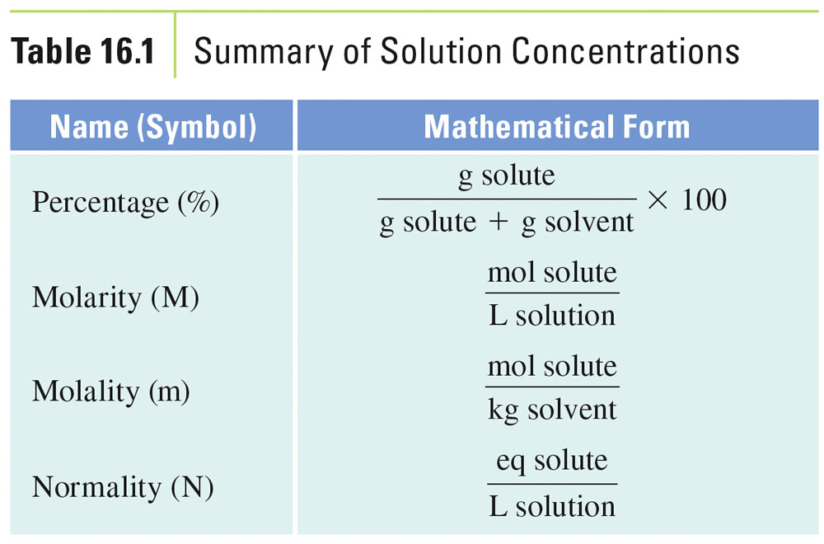

Slide 12
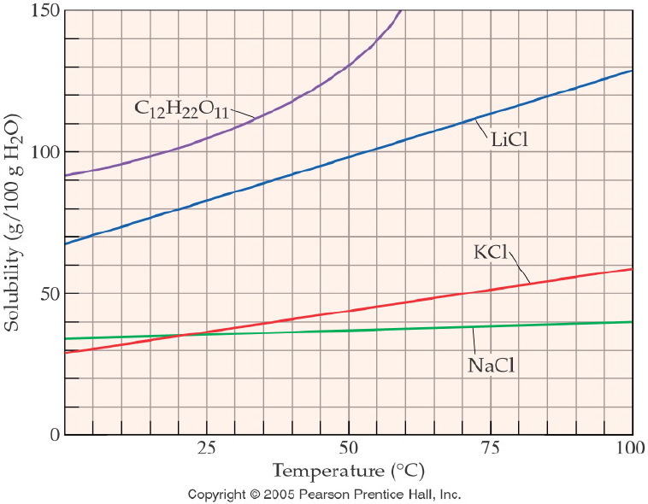
Notes:
Figure: 14-05
Title:
Solubility of Solid Compounds
Caption:
Solid compounds usually become more soluble in water as the temperature increases.
Notes:
This graph is used throughout the chapter as a reference for the solubility of these four compounds in water.

Slide 13
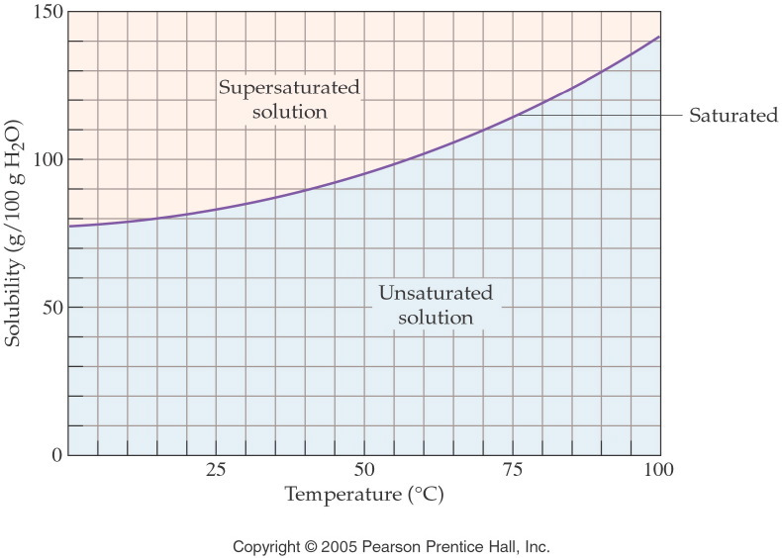
Notes:
Figure: 14-06
Title:
Solubility of Sodium Acetate
Caption:
The curve represents a saturated solution of sodium acetate at various temperatures.
Notes:
Below the curve, a solution is considered unsaturated. On the curve, a solution is considered saturated. Above the curve a solution is considered supersaturated.

Slide 14
Example - Solutions
What type of solution is sodium acetate at 75 °C and 50g/100 g H₂O?
Saturated
Unsaturated
Supersaturated
Not enough information

Slide 15
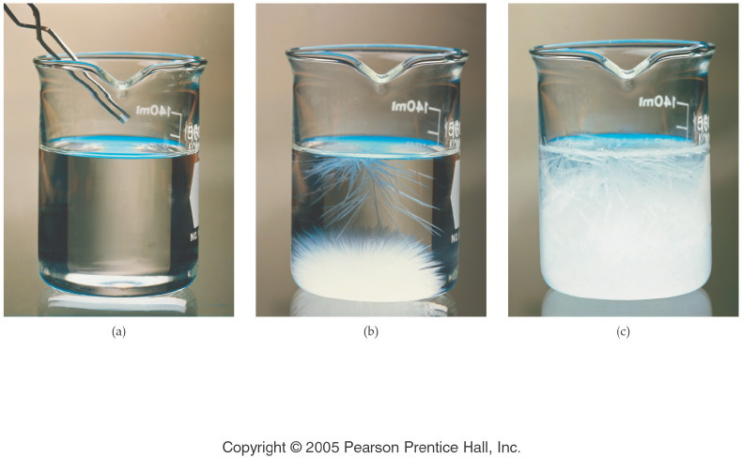
Notes:
Figure: 14-06-01UN
Title:
Illustration of Supersaturation
Caption:
(a) A single crystal of sodium acetate, NaC₂H₃O₂, is dropped into a supersaturated solution, (b) the small crystal causes extensive crystallization, and eventually, (c) the solute forms a solid mass of NaC₂H₃O₂.
Notes:
Any remaining sodium acetate solution in the beaker is saturated.

Slide 16
Example – Units of Concentration
Mass Percent
What is the mass percent of a solution prepared by dissolving 30.0 g of sodium hydroxide in 120.0 g of water?

Slide 17
Example – Units of Concentration
Mass Percent
An antibotic ointment is 3.5% neomycin. How many grams of neomycin are in a tube containing 64 grams of ointment?

Slide 18
Example – Units of Concentration
Molarity
What is the molarity of a solution of 60.0 g of sodium hydroxide in 0.250 L of solution?

Slide 19
Example – Units of Concentration
Molarity
A nitric acid solution is 35.0% nitric acid by mass and has a density of 1.21 g/mL. What is the molarity of the solution?

Slide 20
Example – Units of Concentration
Molarity
Determine the molar concentrations of potassium ions and carbonate ions in a 2.00 M potassium carbonate solution.
2.00 M K⁺ and 2.00 M CO₃²⁻
2.00 M K⁺, 2.00 M C⁴⁻, 2.00 M O²⁻
2.00 M K⁺ and 4.00 M CO₃²⁻
4.00 M K⁺ and 2.00 M CO₃²⁻
none of the above

Slide 21
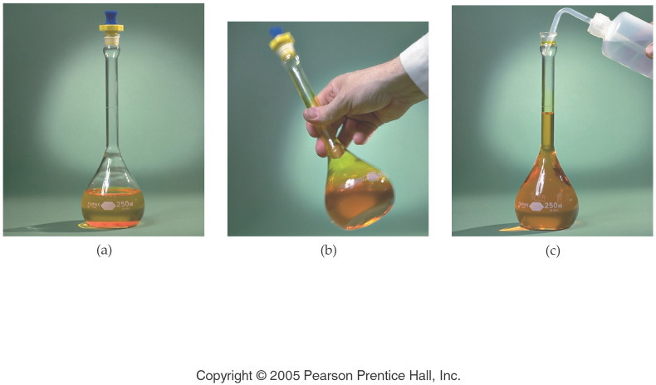
Notes:
Figure: 14-06-05UN
Title:
Preparing 0.100 M Potassium Dichromate
Caption:
(a) A 250-mL volumetric flask contains 7.36 g of potassium dichromate, K₂Cr₂O₇. (b) Distilled water is added into the flask to dissolve the orange compound. (c) The volume of solution is adjusted to the calibration line on the flask, giving a 0.100 M K₂Cr₂O₇ solution.
Notes:
We can NOT prepare the molar solution by simply measuring a volume of solvent and adding the solute. We must prepare an appropriate volume of solution.

Slide 22
Example - Dilutions
What is the molarity of a solution prepared when 75.00 mL of a 4.00 M potassium chloride solution is diluted to 0.500 L?

Slide 23
Example - Dilutions
What volume in mL of a 0.20 M strontium chloride solution can be prepared by diluting 50.0 mL of a 1.0 M strontium chloride solution?

Slide 24
Example – Solution Stoichiometry
How many liters of a 1.50 M hydrochloric acid solution will completely react with 5.32 g of zinc?

Slide 25
Example – Solution Stoichiometry
Acid rain results from the reaction of nitrogen dioxide gas with water to form nitric acid and nitrogen monoxide gas. At STP, how many liters of nitrogen dioxide are required to produce 0.275 L of 0.400 M nitric acid?

Slide 26
Example – Solution Stoichiometry
The antacid Amphogel contains aluminum hydroxide. Aluminum hydroxide reacts with sulfuric acid to produce aluminum sulfate and water. How many mL of 6.00 M sulfuric acid are required to react with an aluminum hydroxide solution of 60.00 mL that has a concentration of 6.00 M hydroxide ions?

Slide 27
Example – Solution Stoichiometry
Nickel(II) chloride reacts with sodium hydroxide to produce nickel(II) hydroxide and sodium chloride.
How many grams of nickel(II) hydroxide are produced when 35.0 mL of 1.75 M sodium hydroxide reacts with 10.00 mL of 5.00 M nickel(II) chloride?

Slide 28
Example – Solution Stoichiometry
Nickel(II) chloride reacts with sodium hydroxide to produce nickel(II) hydroxide and sodium chloride.
How many grams of nickel(II) hydroxide are produced when 35.0 mL of 1.75 M sodium hydroxide reacts with 10.00 mL of 5.00 M nickel(II) chloride?
What is the molarity of the ions that are left?

Slide 29
Example –Solution Stoichiometry
The calcium carbonate in limestone reacts with hydrochloric acid to produce a calcium chloride solution, carbon dioxide, and water. What is the molarity of the hydrochloric acid if 200. mL of hydrochloric acid reacts with excess calcium carbonate to produce 12.0 L of carbon dioxide, which is collected through water, at a pressure of 725 m Hg and 18.0 °C? The vapor pressure of water at 18.0 °C is 15.477 mm Hg.

Slide 30
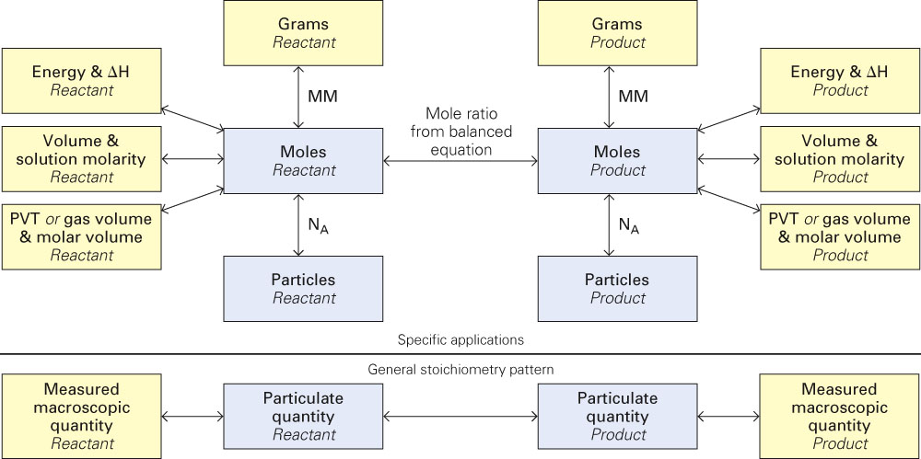
Fig. 16-18, p. 494

