Slide 1
Chemistry 120
Chapter 15: Gases, Liquids and Solids

Slide 2
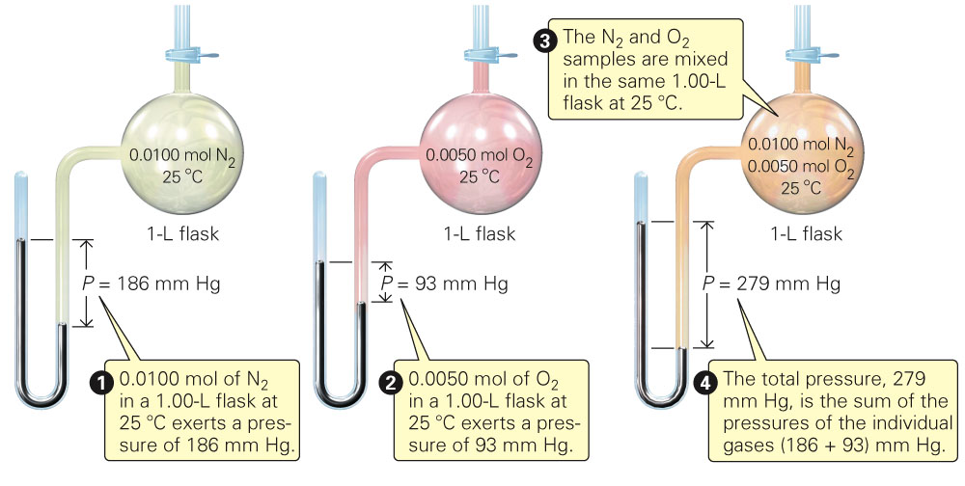
Fig. 15-1, p. 431

Slide 3
Example – Partial Pressure
A mixture of oxygen and helium is prepared for a SCUBA diver, who is going to descend 200 ft below the ocean surface. At this depth, the diver breathes a gas mixture that has a total pressure of 7.0 atm. If the partial pressure of oxygen in the tank is 1.5 atm at that depth, what is the partial pressure of helium?

Slide 4
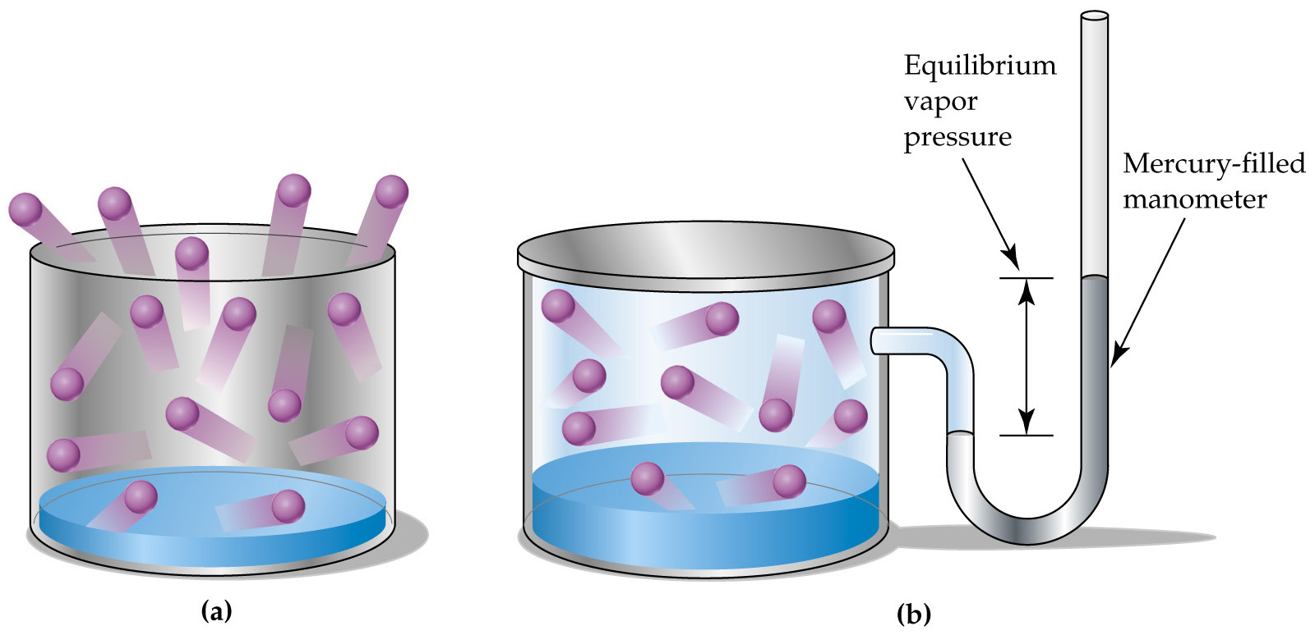
Vapor Pressure
The pressure exerted by a vapor in equilibrium with its liquid phase.

Slide 5
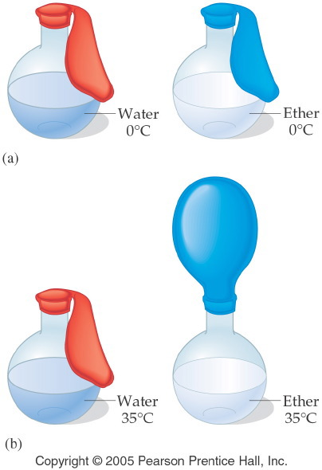
Notes:
Figure: 13-04
Title:
Vapor Pressure of Liquids
Caption:
At 0°C, neither liquid has significant vapor pressure. At 35°C, the vapor pressure of the ether is significant.
Notes:
The vapor pressure of a specific liquid is dependent upon its boiling point, which is dependent upon the intermolecular forces holding the molecules together.

Slide 6
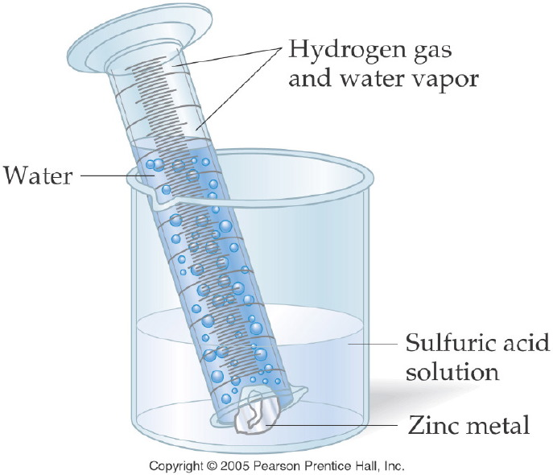
Notes:
Figure: 11-11
Title:
Collecting a Gas over Water
Caption:
A graduated cylinder collects the gas bubbles formed. The volume of the gas is equal to the water displaced.
Notes:
More precisely, a small percentage of the gas volume is from the water vapor, while the remainder is the hydrogen gas. Each exerts a pressure, and the sum of these is the total pressure.

Slide 7
Example – Gas Stoichiometry
105 mL of hydrogen gas was collected at 30 °C. The barometric pressure was 755.0 mm Hg. At a water temperature of 30 °C the partial pressure of the water vapor is 31.8 mm Hg.
What is the partial pressure of hydrogen gas?

Slide 8
Example – Gas Stoichiometry
105 mL of hydrogen gas was collected at 30 °C. The barometric pressure was 755.0 mm Hg. At a water temperature of 30 °C the partial pressure of the water vapor is 31.8 mm Hg.
B. What mass of zinc reacted with excess sulfuric acid?

Slide 9
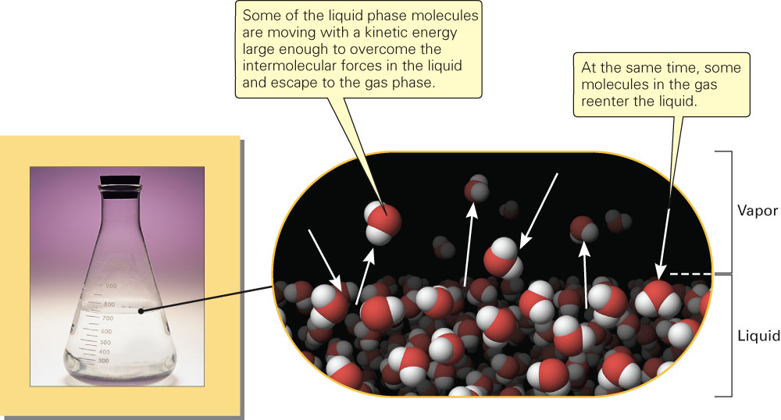
Fig. 15-3, p. 433

Slide 10
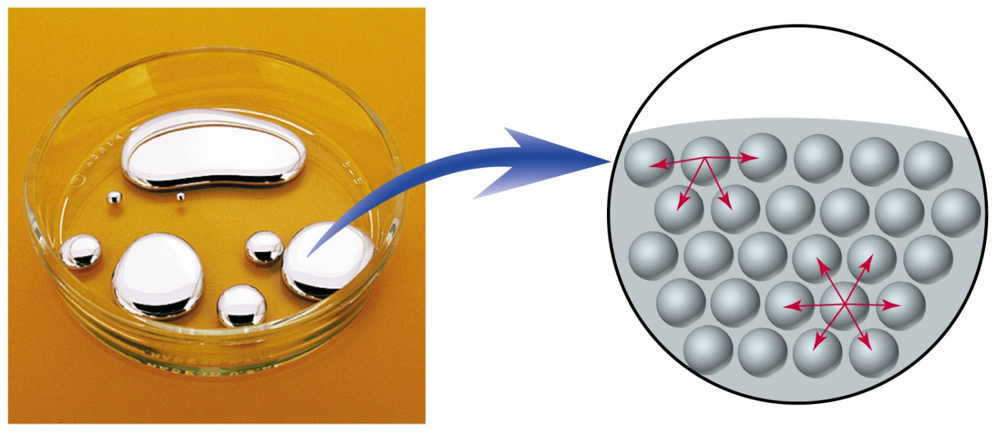
Surface Tension
tendency to minimize surface area
Adhesion – Forces that bind a substance to a surface
Cohesion – Forces that bind a substance to itself

Slide 11
Notes:
Figure: 11-11
Title:
Collecting a Gas over Water
Caption:
A graduated cylinder collects the gas bubbles formed. The volume of the gas is equal to the water displaced.
Notes:
More precisely, a small percentage of the gas volume is from the water vapor, while the remainder is the hydrogen gas. Each exerts a pressure, and the sum of these is the total pressure.

Slide 12
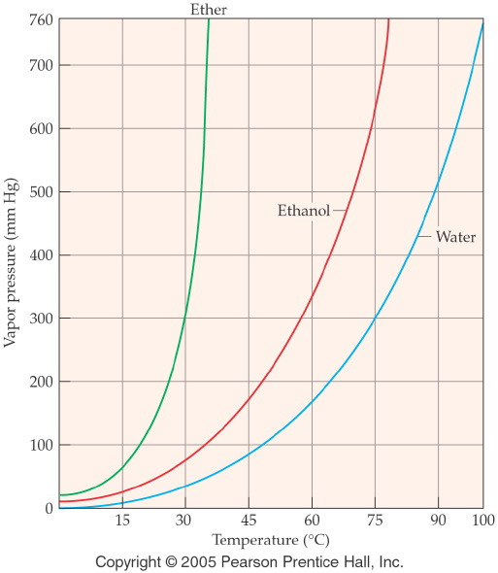
Notes:
Figure: 13-05
Title:
Vapor Pressure vs. Temperature
Caption:
The vapor pressure of a liquid increases as the temperature increases.
Notes:
The boiling point of a liquid is defined as the temperature at which the vapor pressure of the liquid is equal to atmospheric pressure. The vapor pressure of a liquid increases with temperature.

Slide 13
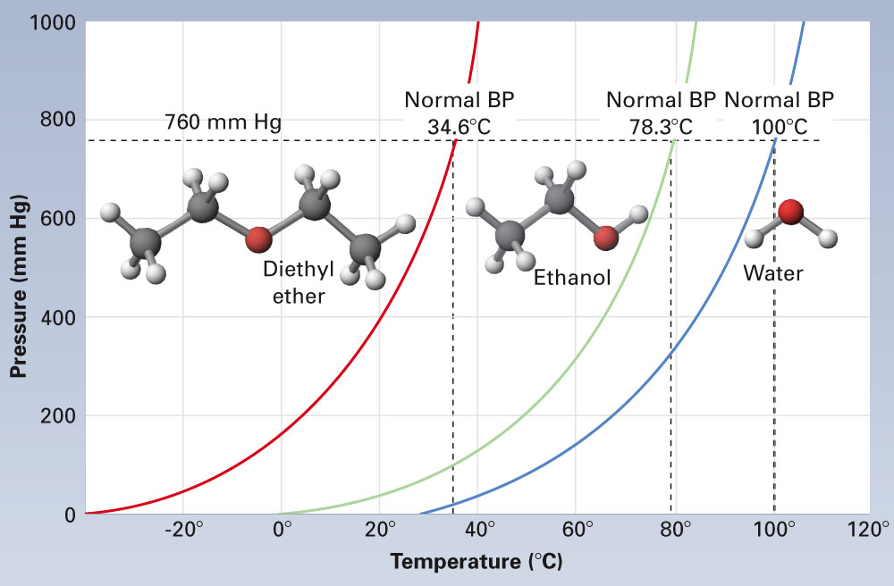
Fig. 15-16, p. 443

Slide 14
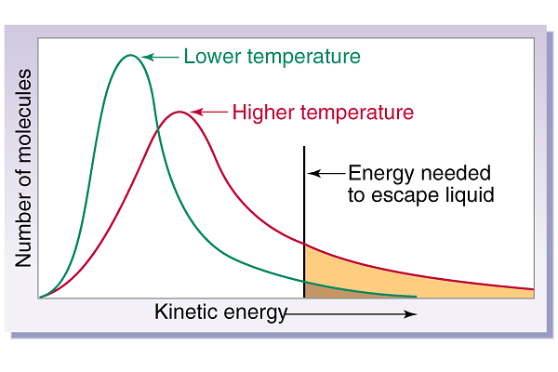

Slide 15
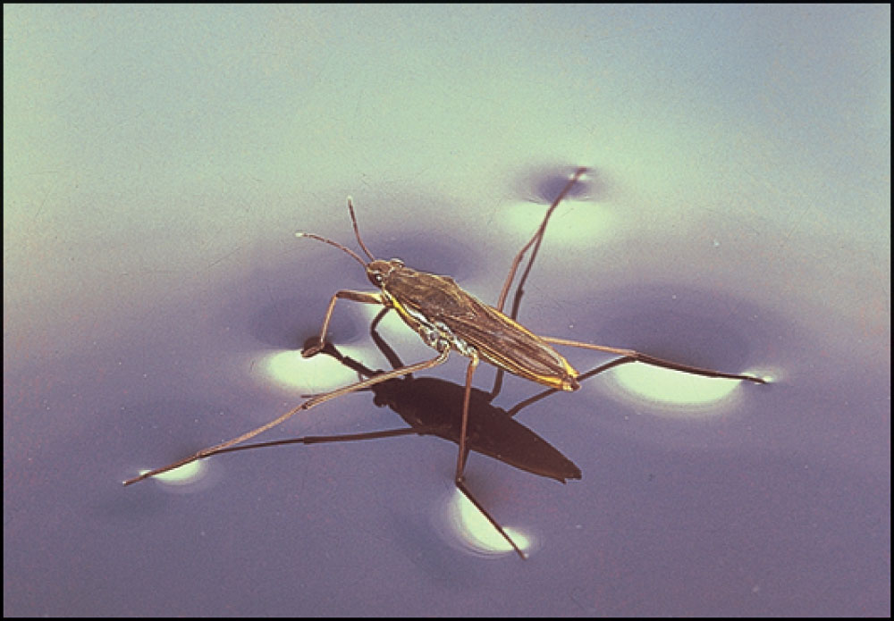
Fig. 15-7, p. 435

Slide 16
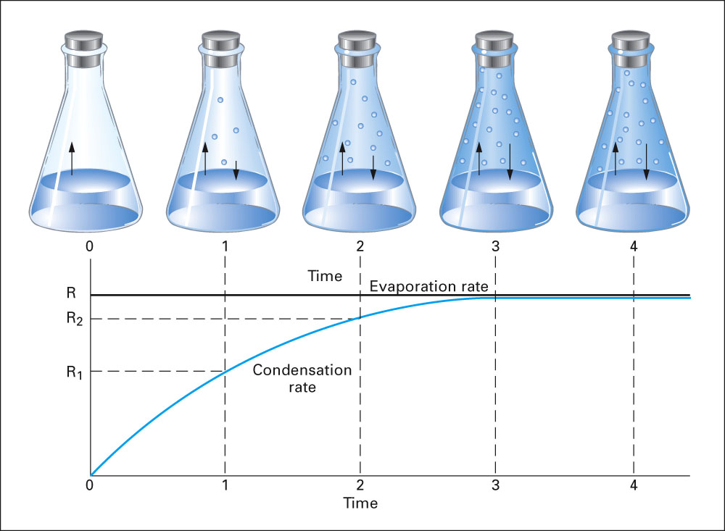
Fig. 15-15, p. 441

Slide 17
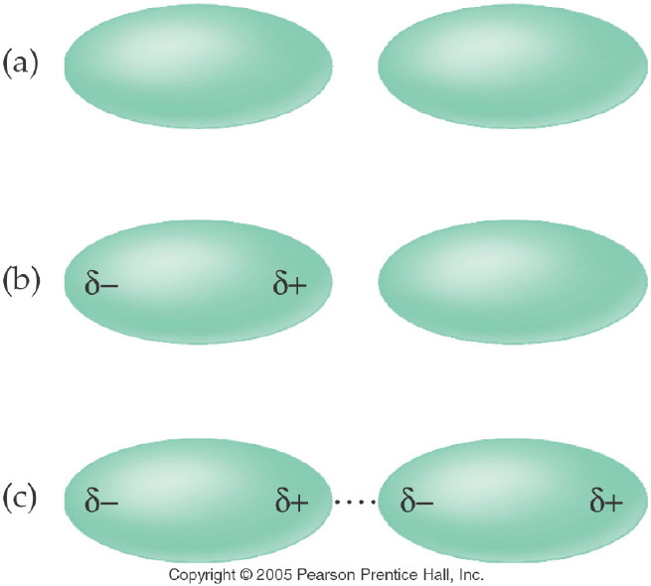
Notes:
Figure: 13-01
Title:
Dispersion Forces
Caption:
Two non-polar molecules are attracted to one another by a temporary dipole, also known as a dispersion force.
Notes:
The larger the molecule, the stronger the temporary dipole. Stronger dispersion forces lead to higher melting and boiling points.

Slide 18
Example – Intermolecular Forces
Order methane, CH₄, pentane, C₅H₁₂, and ethane, C₂H₆, in order of increasing melting point.
CH₄ < C₂H₆ < C₅H₁₂
C₂H₆ < CH₄ < C₅H₁₂
C₅H₁₂ < C₂H₆ < CH₄
CH₄ < C₅H₁₂ < C₂H₆
Not enough information

Slide 19
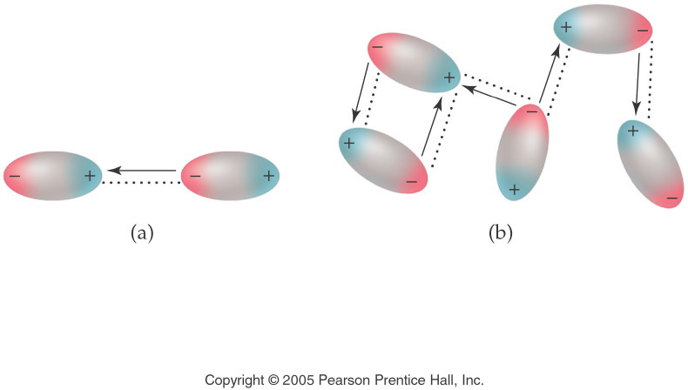
Notes:
Figure: 13-02
Title:
Dipole Forces
Caption:
A dipole force results from a dipole-dipole attraction between two molecules.
Notes:
Dipole forces can only exist between polar molecules. The stronger the polarity, the stronger the intermolecular force. The positive end of one molecule is attracted to the negative end of one or more other molecules, and so on.

Slide 20
Example – Intermolecular Forces
Which molecule has the lower melting point?
Propane, C₃H₈
Methanethiol, CH₃SH

Slide 21
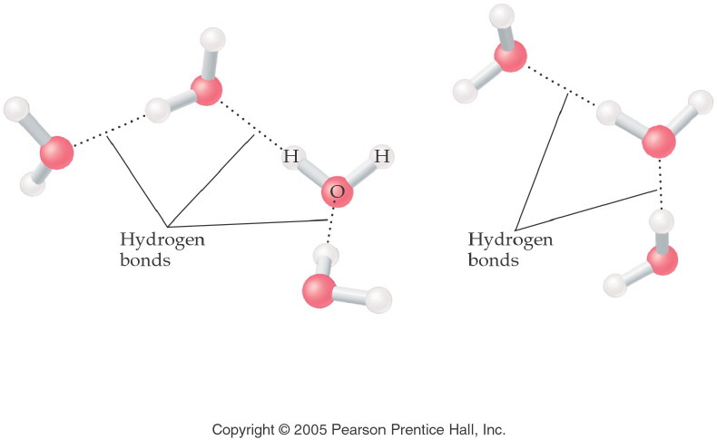
Notes:
Figure: 13-03
Title:
Hydrogen Bonds
Caption:
Polar water molecules form intermolecular hydrogen bonds.
Notes:
Hydrogen bonds are very strong dipole forces that only exist between a strongly partial positive charge (H bonded to F,O,N) and a strongly partial negative charge (F, O, or N). Hydrogen bonds act between molecules.

Slide 22
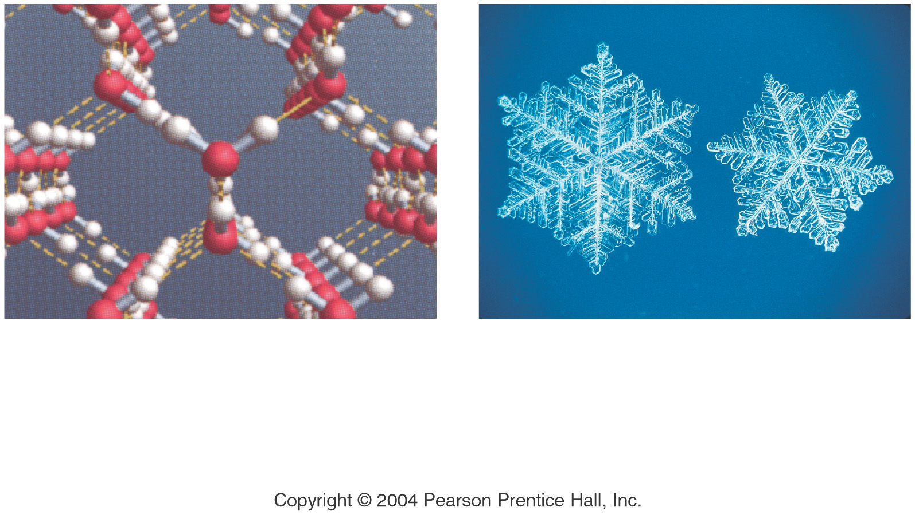

Slide 23
Example – Intermolecular Forces
Order methanol, CH₃OH, fluoromethane, CH₃F, and fluorine, F₂, from highest to lowest melting point.
CH₃OH > F₂ > CH₃F
F₂ > CH₃F > CH₃OH
CH₃OH > CH₃F > F₂
CH₃F > F₂ > CH₃OH
CH₃F > CH₃OH > F₂

Slide 24
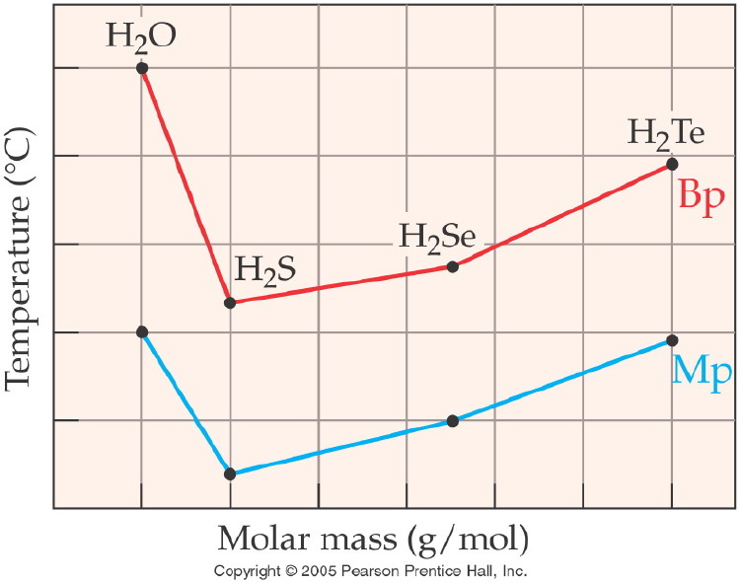
Notes:
Figure: 13-14
Title:
Group VIA Hydrogen Compounds
Caption:
Notice the systematic trend in melting and boiling point as the molar mass increases.
Notes:
Water is an exception, as it can form hydrogen bonds, causing the intermolecular forces to be much stronger. None of the other Group VIA hyrdogen compounds can form hydrogen bonds.

Slide 25
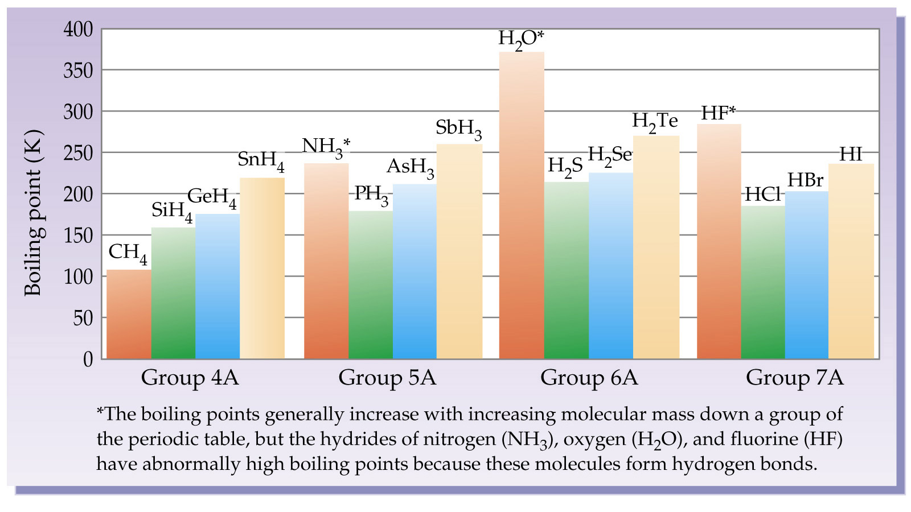

Slide 26
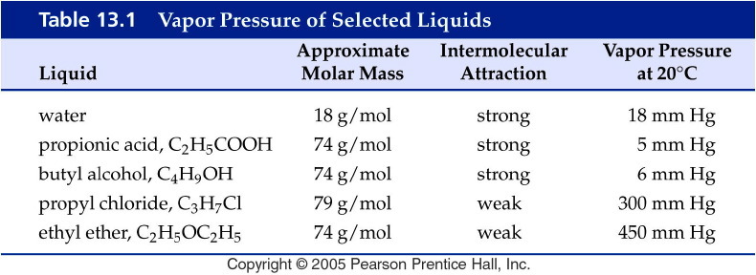
Notes:
Figure: 13-T01
Title:
Table 13.1
Caption:
Vapor Pressure of Selected Liquids
Notes:
Note that four of the compounds have roughly the same molar mass but differ in vapor pressure due to different intermolecular forces. Water, while it has a much lower molar mass, exhibits hydrogen bonding, which makes its vapor pressure much lower than it would be otherwise.

Slide 27
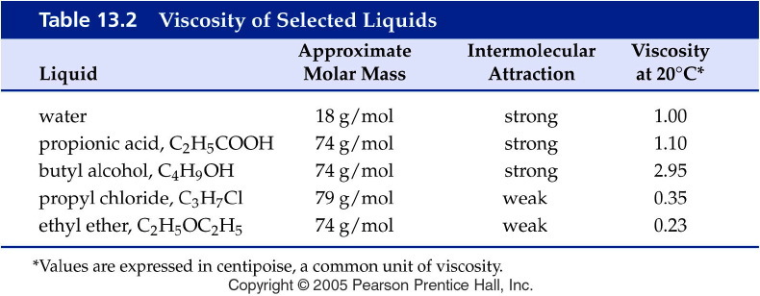
Notes:
Figure: 13-T02
Title:
Table 13.2
Caption:
Viscosity of Selected Liquids
Notes:
Note that four of the compounds have roughly the same molar mass but differ in viscosity due to different intermolecular forces. Water, while it has a much lower molar mass, exhibits hydrogen bonding, which makes its viscosity much higher than it would be otherwise.

Slide 28
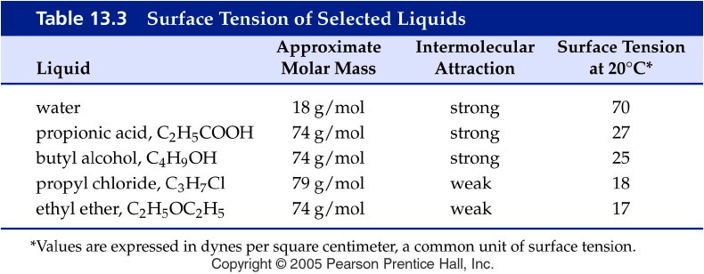
Notes:
Figure: 13-T03
Title:
Table 13.3
Caption:
Surface Tension of Selected Liquids
Notes:
Note that four of the compounds have roughly the same molar mass but differ in surface tension due to different intermolecular forces. Water, while it has a much lower molar mass, exhibits hydrogen bonding, which makes its surface tension much higher than it would be otherwise.

Slide 29
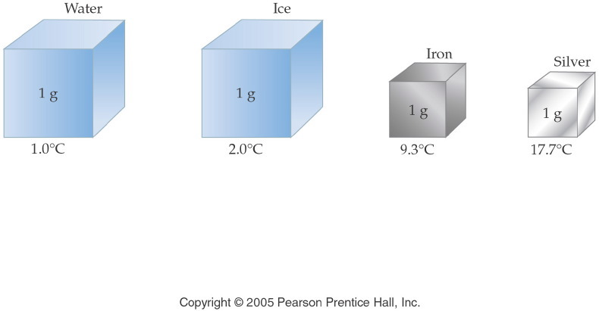
Notes:
Figure: 03-08
Title:
Illustration of Specific Heat
Caption:
Each cube represents 1 g of substance receiving 1 cal of heat. The temperature change varies with the substance.
Notes:
A large specific heat means that a substance can absorb more energy before its temperature changes. Note that water has the highest specific heat on the list.

Slide 30
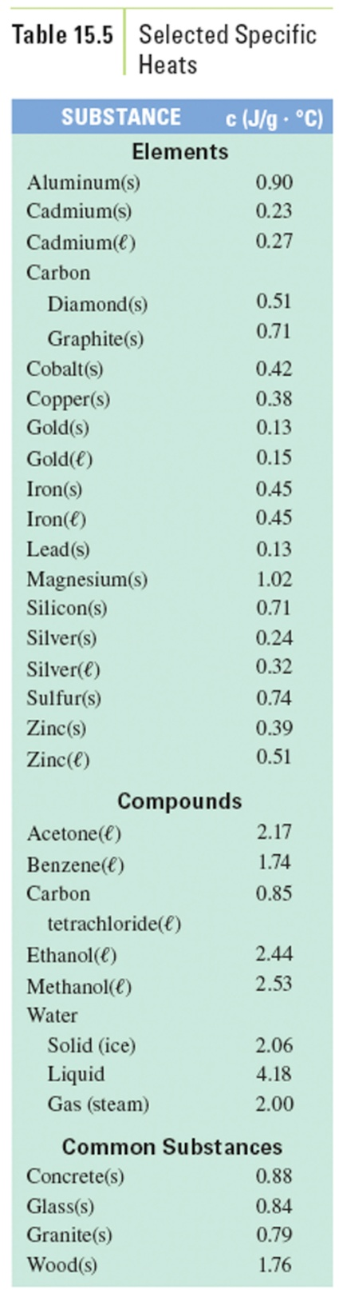
Table 15-5, p. 455

Slide 31
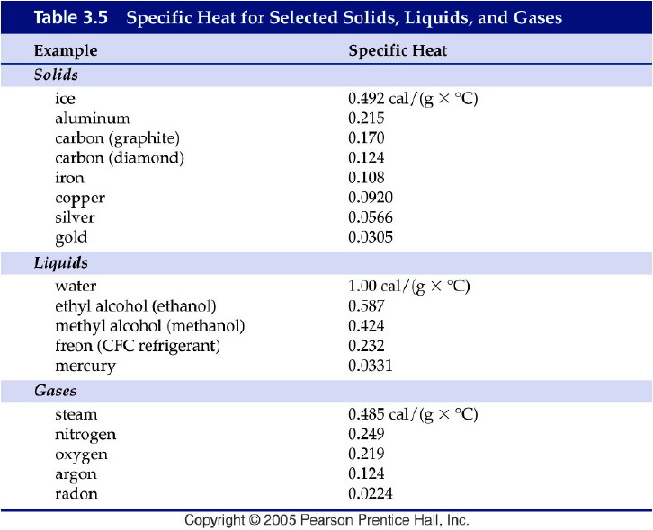
Notes:
Figure: 03-T05
Title:
Table 3.5 Specific Heats
Caption:
Specific Heat for Selected Solids, Liquids, and Gases
Notes:
Each substance has its own specific heat.

Slide 32
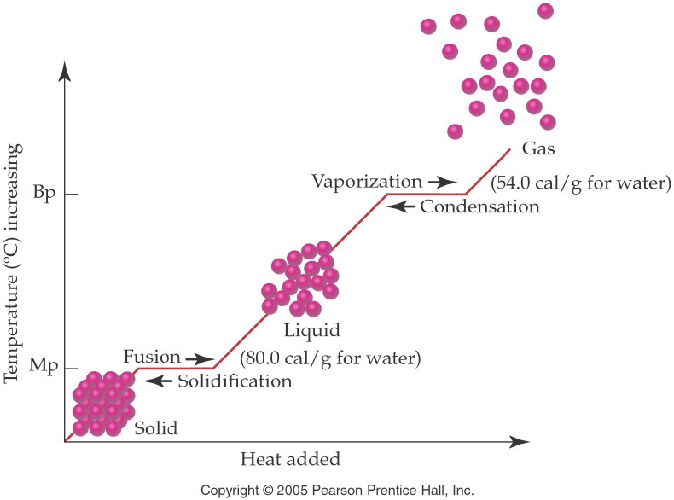
Notes:
Figure: 13-10
Title:
Temperature-Energy Graph
Caption:
As heat is added to a substance, it changes its state. Notice that the temperature remains constant during state change.
Notes:
Energy is required to break the intermolecular forces holding solid or liquid particles together. Temperature stops increasing when a compound melts or boils and then continues to rise after the state change is complete. All of the energy put into the substance during the phase change goes to completing the phase change and not to raising the temperature.

Slide 33
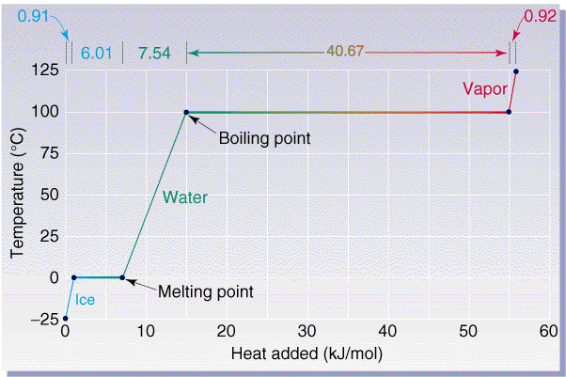

Slide 34
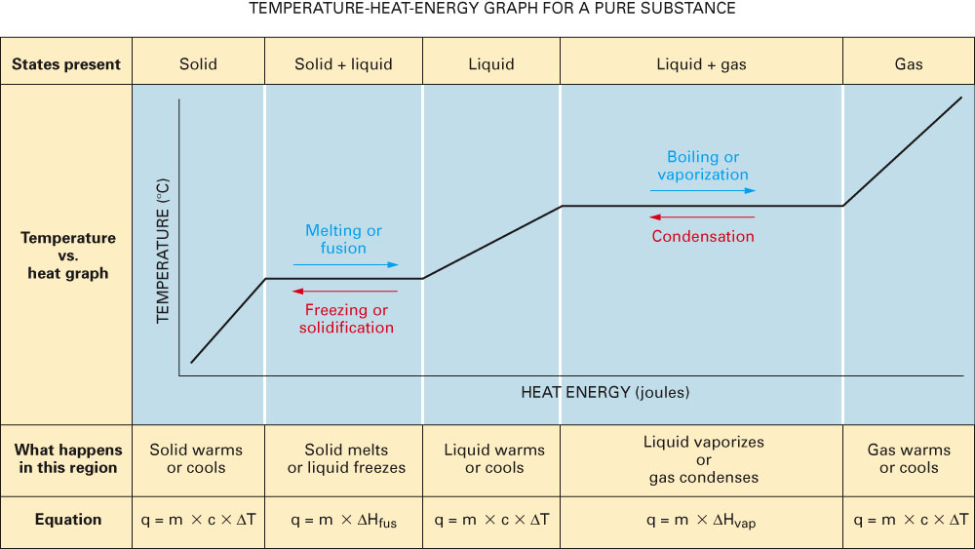
Fig. 15-32, p. 458

Slide 35
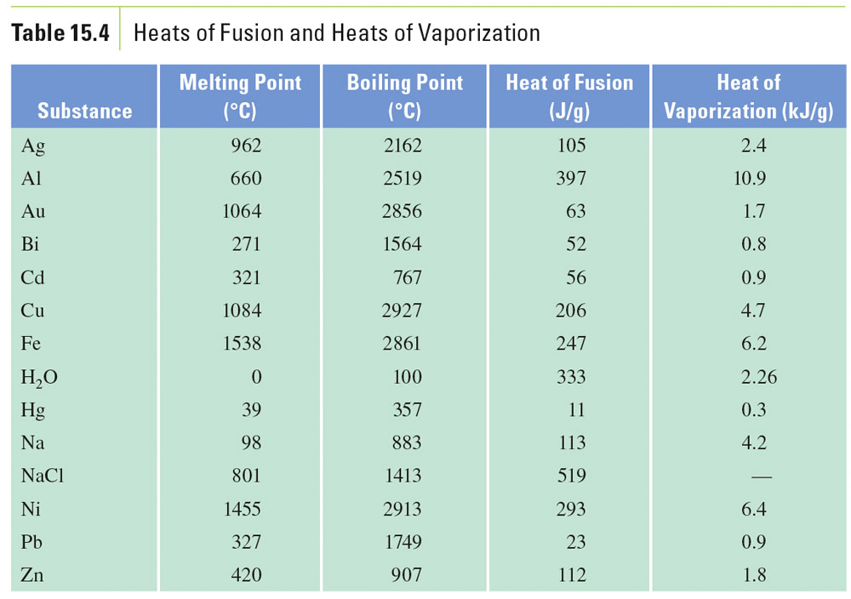
Table 15-4, p. 452

Slide 36
Example – Changes in State
In a sauna, 122 g of water is converted to steam at 100 °C. How many kilojoules of heat are needed? If ΔH_{vap} is 2.26 kJ/g.

Slide 37
Example – Changes in State
Ice cubes at 0 °C with a mass of 26.0 g are added to a soft drink. How much heat is joules will be absorbed to melt all the ice at 0 °C?

Slide 38
Example – Changes in Temperature
The element aluminum has a specific heat of 0.897 J/g °C. How many joules are absorbed by 45.2 g aluminum, if its temperature rises from 12.5 °C to 78.6 °C?

Slide 39
Example – Changes in Temperature and State
Calculate the total heat in joules needed to convert 15.0 g of liquid water at 25.0 °C to steam at 100 °C.

Slide 40
Example – Changes in Temperature and State
How many kJ are released when 75.0 g of steam at 100 °C condenses, cools to 0 °C and freezes?

Slide 41
Example - Calorimetry
A 35.20 g sample of a metal is heated to 100.0 °C is placed in a calorimeter containing 42.5 g of water at 19.2 °C. If the final temperature of the metal and water is 29.5 °C, what is the specific heat of the solid? Assume that no heat is lost to the surroundings.

Slide 42
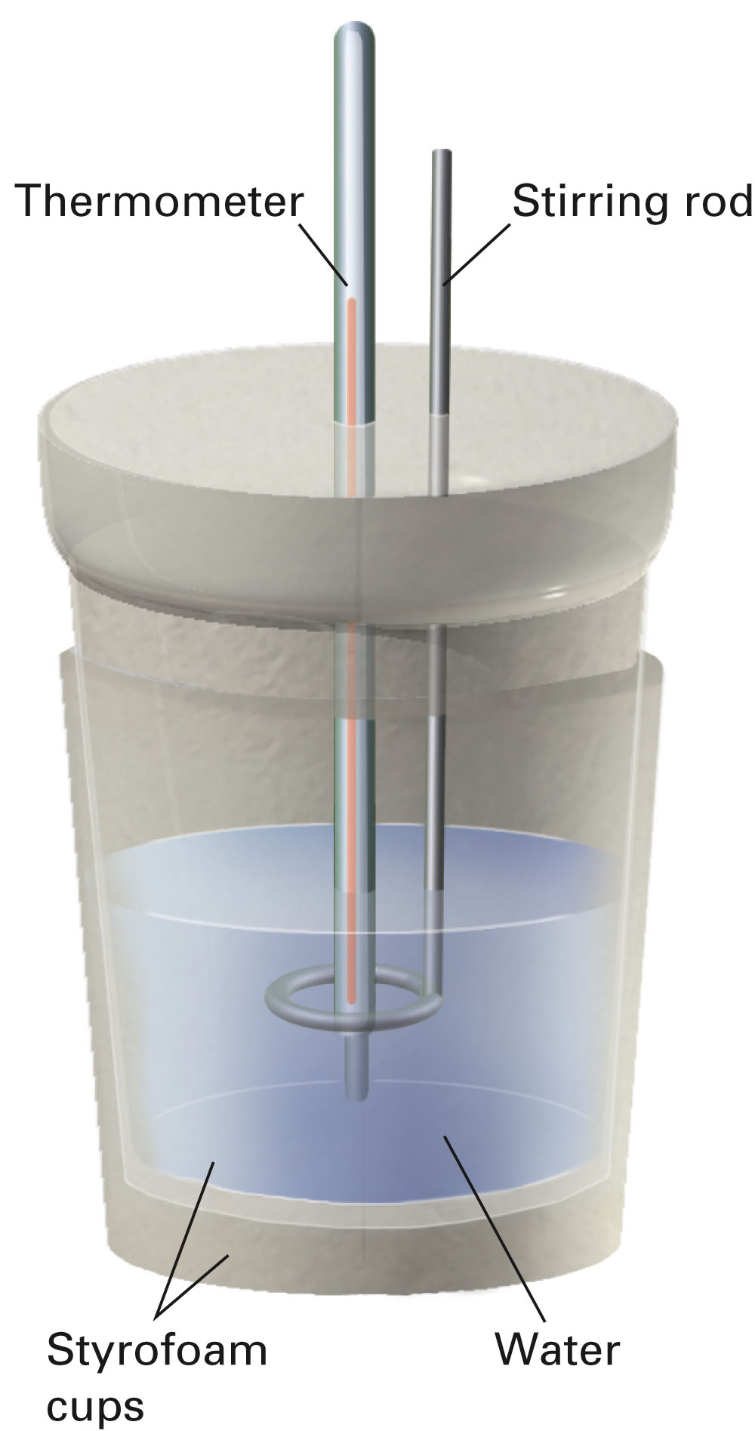
p. 457

Slide 43
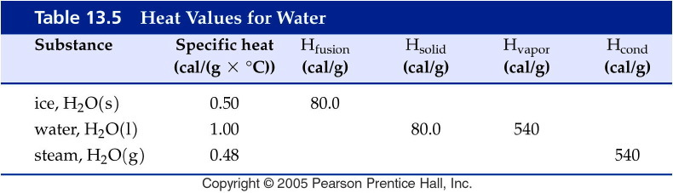
Notes:
Figure: 13-T05
Title:
Table 13.5
Caption:
Heat Values for Water
Notes:
The specific heats of ice, liquid water, and steam are given as well as the heats of fusion, vaporization, solidification, and condensation.

Slide 44
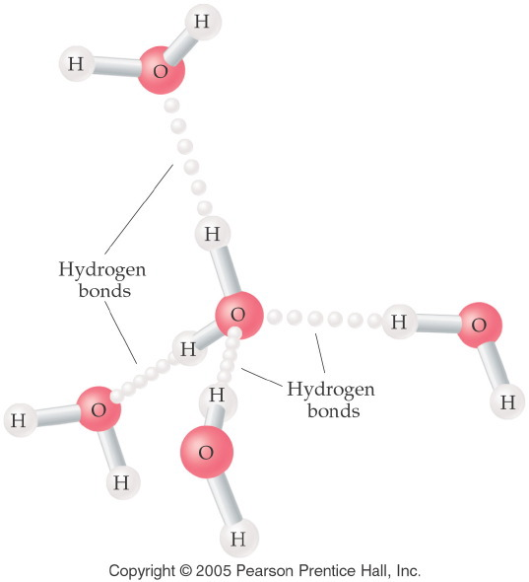
Notes:
Figure: 13-12
Title:
Hydrogen Bonding
Caption:
Each water molecule is attached to four other molecules. The intermolecular bond is 50% longer.
Notes:
The longer a bond, the weaker it is. Although hydrogen bonding is the strongest type of intermolecular force, it is far weaker than the polar covalent intramolecular bonds.

Slide 45
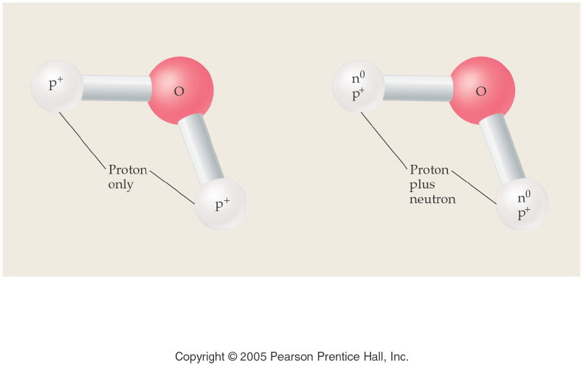
Notes:
Figure: 13-14-01UN
Title:
Water and Heavy Water
Caption:
Heavy water is named deuterium oxide, and its formula is D₂O.
Notes:
The two extra neutrons completely change the physical properties of the water. They are considered to be different compounds. Since the chemical elements that make up heavy water are still hydrogen and oxygen, they are chemically the same.

Slide 46
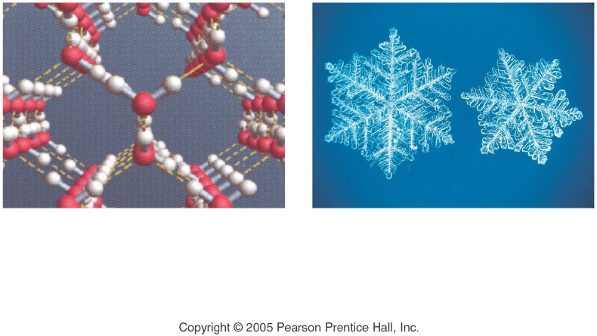
Notes:
Figure: 13-13
Title:
Structure of Ice Crystals
Caption:
Water molecules form hydrogen bonds resulting in six-member rings. The rings in turn form hydrogen bonds to other rings, producing large, three-dimensional crystalline structures.
Notes:
The 6-sided shapes of snowflakes are a result of the 6-membered rings made by hydrogen-bonded water molecules.

Slide 47
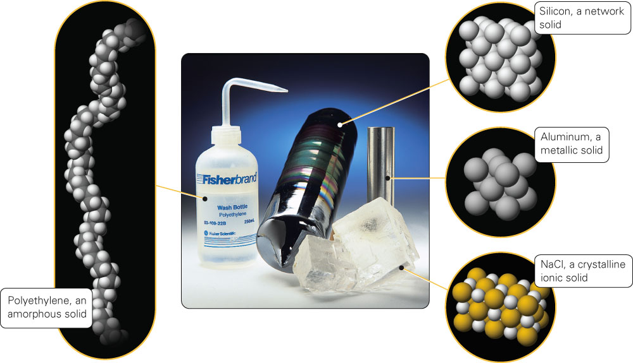
Fig. 15-21, p. 447

Slide 48
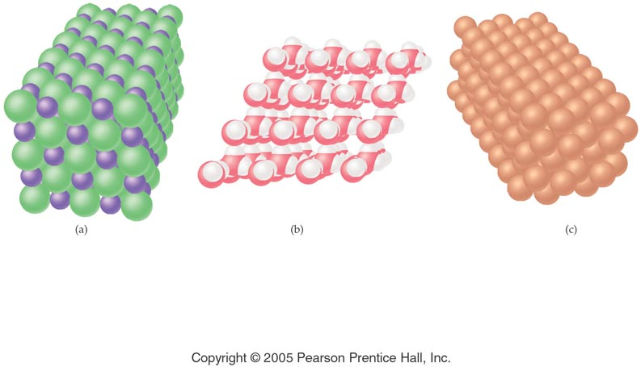
Notes:
Figure: 13-06
Title:
Ionic, Molecular, Metallic
Caption:
Shown here are the arrangements of atoms and ions in ionic, molecular, and metallic solids.
Notes:
All crystals share a repeating lattice-like structure, regardless of their composition. The molecules in a molecular solid remain as individual molecules.

Slide 49
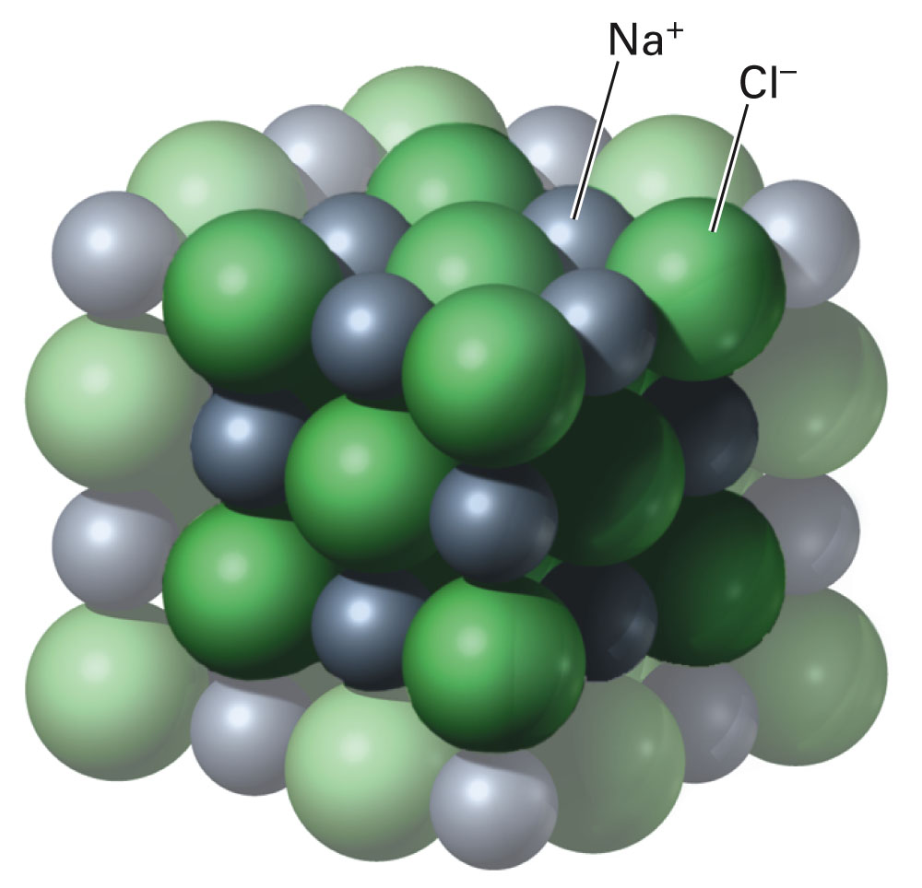
Fig. 15-24, p. 448

Slide 50
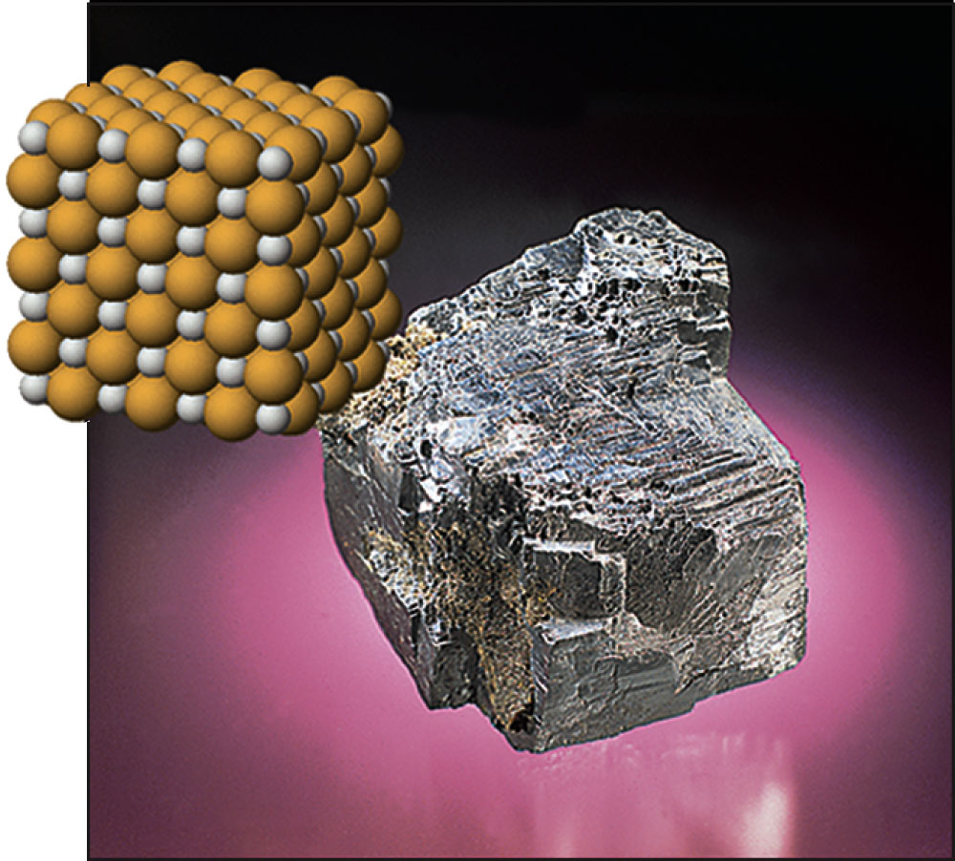
Fig. 15-26, p. 448

Slide 51
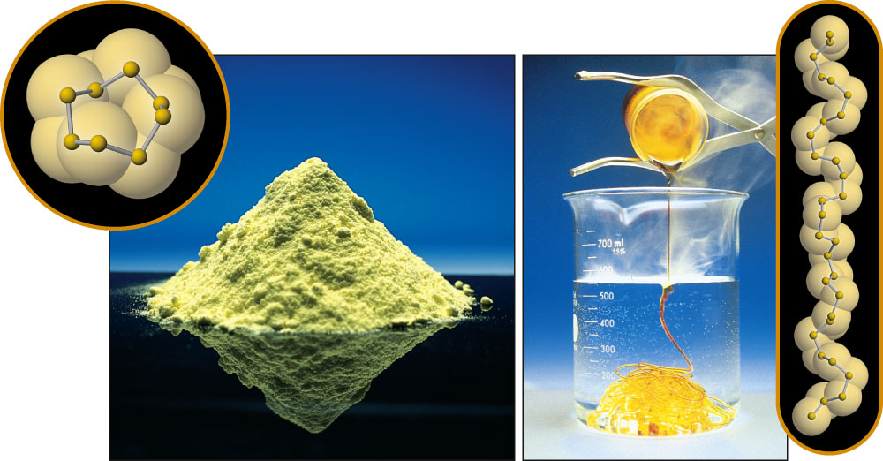
Fig. 15-27, p. 449

Slide 52
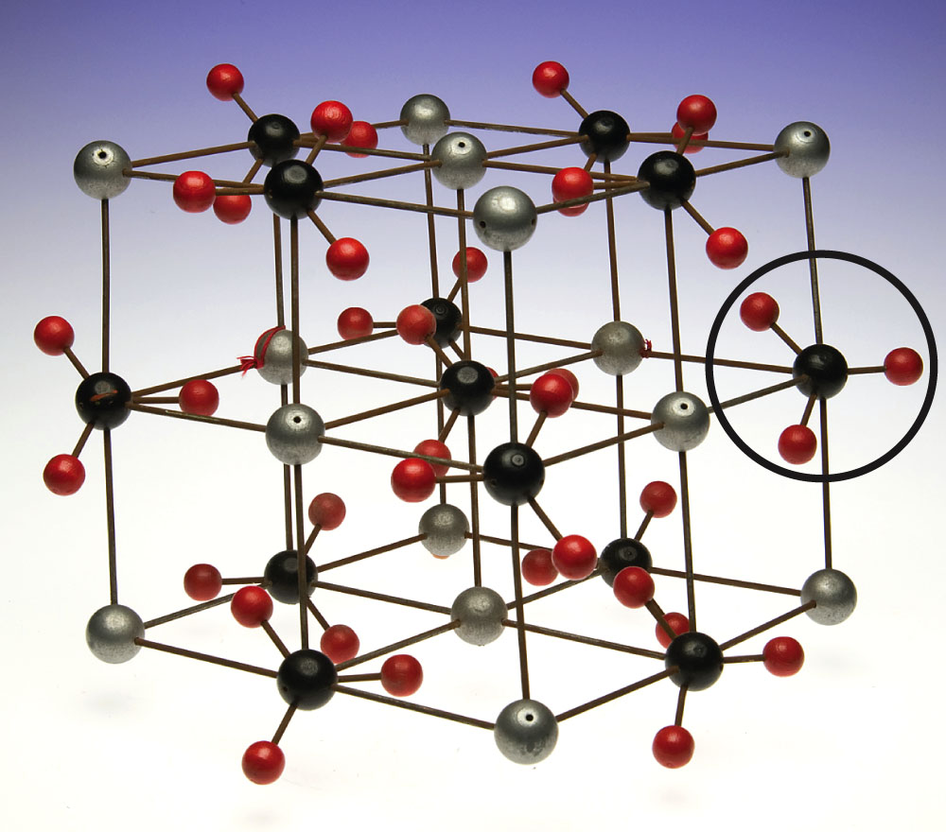
Fig. 15-25, p. 448

Slide 53
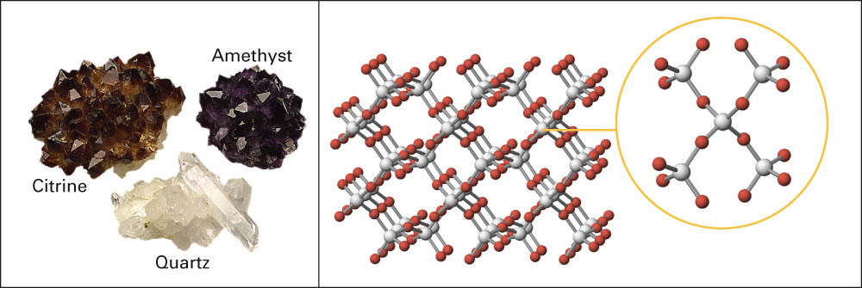
Fig. 15-28, p. 449

Slide 54
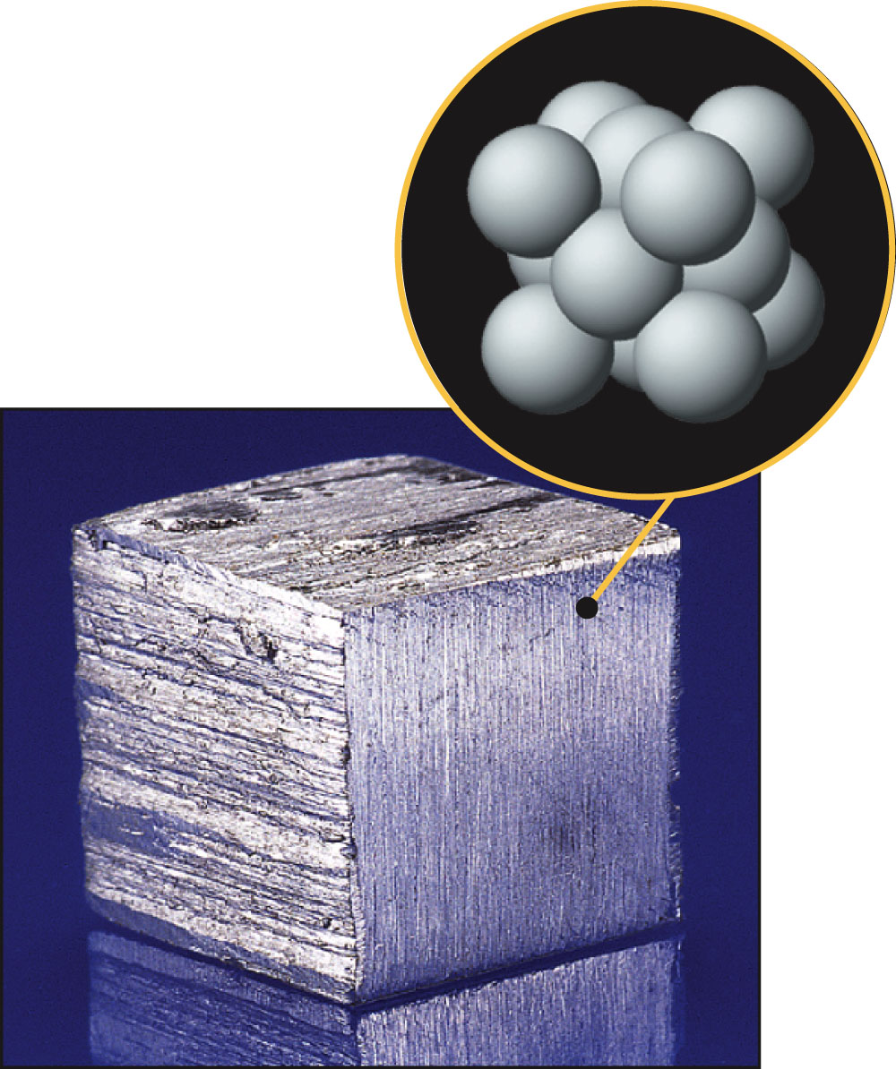
Fig. 15-29, p. 450

Slide 55
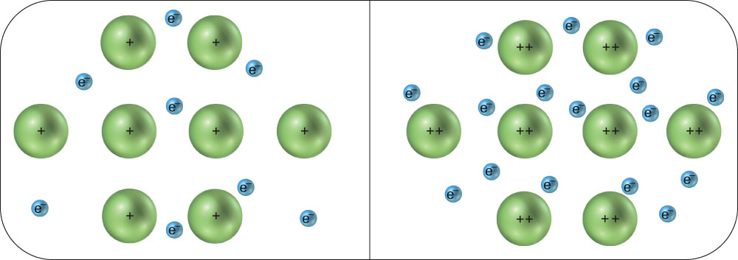
Fig. 12-11, p. 357

Slide 56
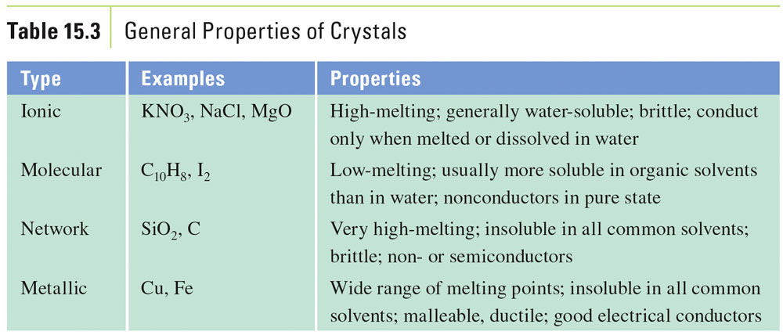
Table 15-3, p. 450

Slide 57
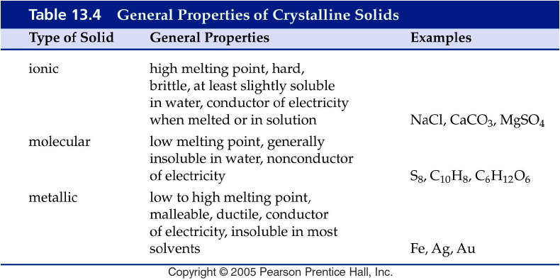
Notes:
Figure: 13-T04
Title:
Table 13.4
Caption:
General Properties of Crystalline Solids
Notes:
Ionic, molecular, and metallic solids differ in properties depending on the elementary particles that make up the solid crystal.

