Slide 1
Chemistry 120
Chapter 13: Structure and Shape

Slide 2
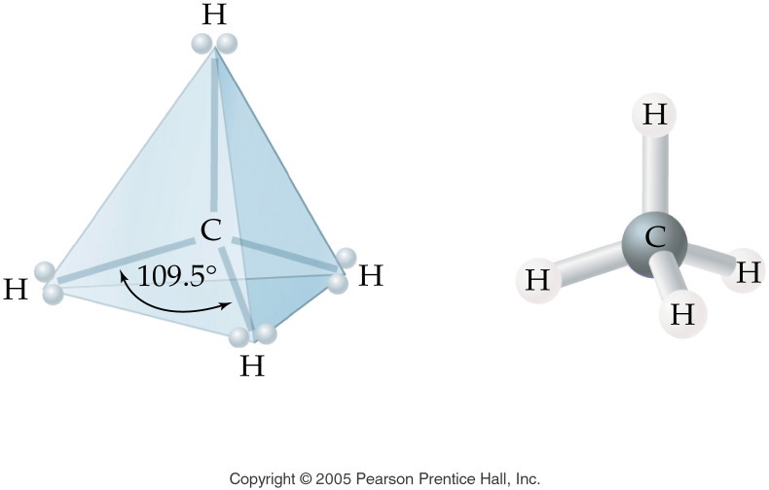
Notes:
Figure: 12-09-07UN
Title:
CH₄ Molecular Shape
Caption:
This is the electron pair geometry and molecular shape of methane.
Notes:
This diagram is part of an in-text example of electron pair geometry and molecular shape. In this example, methane has 4 electron pairs and a tetrahedral molecular shape.

Slide 3
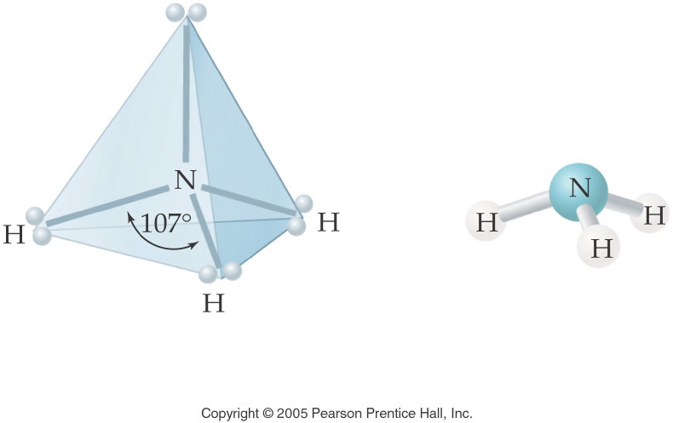
Notes:
Figure: 12-09-08UN
Title:
NH₃ Molecular Shape
Caption:
This is the electron pair geometry and molecular shape of ammonia.
Notes:
This diagram is part of an in-text example of electron pair geometry and molecular shape. In this example, ammonia has 4 electron pairs--3 bonding and 1 nonbonding--and therefore a trigonal planar molecular shape.

Slide 4
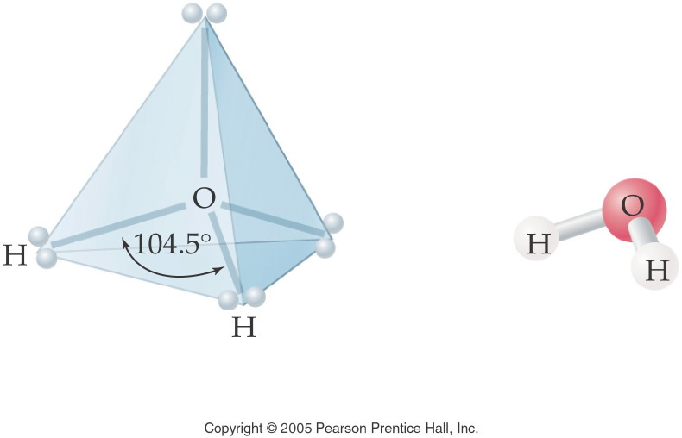
Notes:
Figure: 12-09-09UN
Title:
H₂O Molecular Shape
Caption:
This is the electron pair geometry and molecular shape of water.
Notes:
This diagram is part of an in-text example of electron pair geometry and molecular shape. In this example, water has 4 electron pairs--2 bonding and 2 nonbonding--and therefore a bent molecular shape.

Slide 5
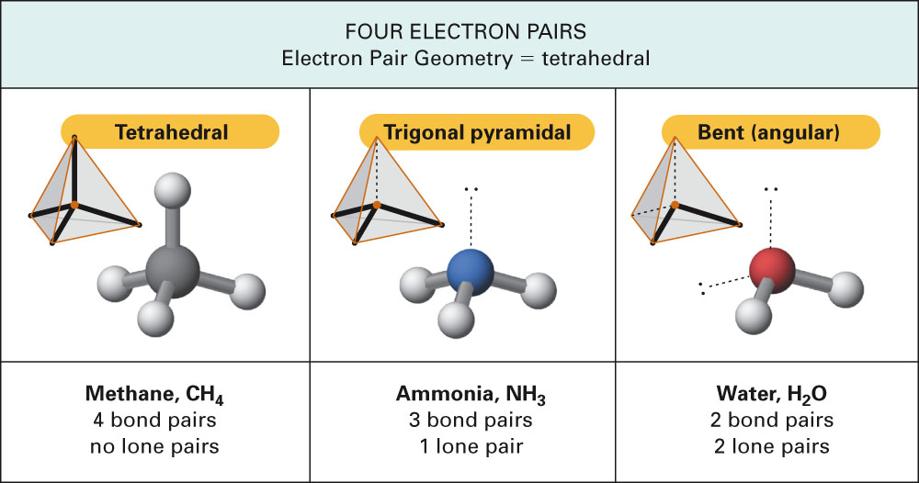
Fig. 13-5, p. 378

Slide 6
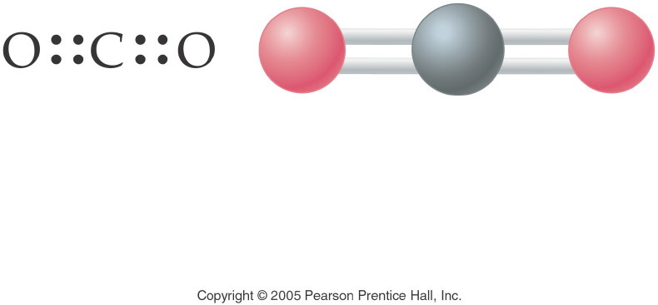
Notes:
Figure: 12-09-09UNa
Title:
Carbon Dioxide
Caption:
The electron pair geometry in carbon dioxide, CO₂, is linear. The molecular shape of CO₂ is linear; the bond angle is 180¡.
Notes:
The 4 electron pairs are all bonding and form bonds to only two atoms. Thus the angle between the bonds is 180¡.

Slide 7
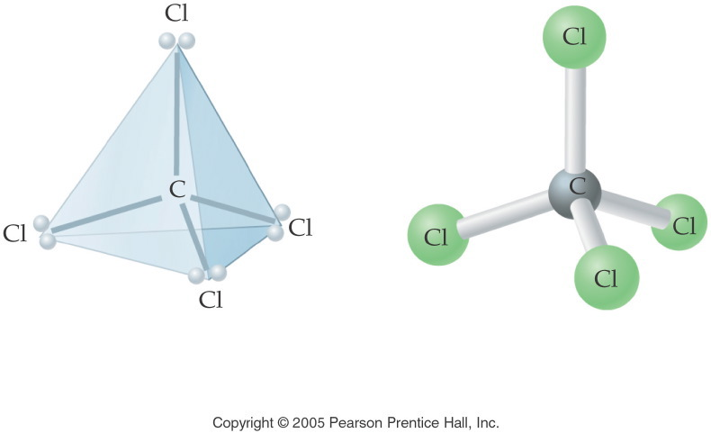
Notes:
Figure: 12-09-10UN
Title:
CCl₄ Molecular Shape
Caption:
This is the electron pair geometry and molecular shape of carbon tetrachloride.
Notes:
This diagram is part of an in-text example of electron pair geometry and molecular shape. In this example, carbon tetrachloride has 4 electron pairs and a tetrahedral molecular shape.

Slide 8
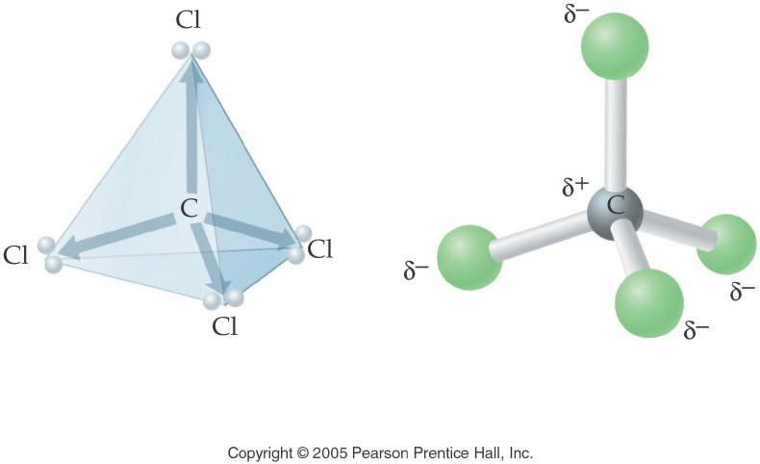
Notes:
Figure: 12-09-11UN
Title:
CCl₄ Polarity
Caption:
This is the electron pair geometry and molecular shape of carbon tetrachloride.
Notes:
This diagram is part of an in-text example of electron pair geometry and polarity. In this example, carbon tetrachloride is non-polar, although each bond is polar covalent. The carbon tetrachloride molecule contains polar bonds but is nonpolar as a molecule because the opposing directions of the attractive forces "cancel out".

Slide 9
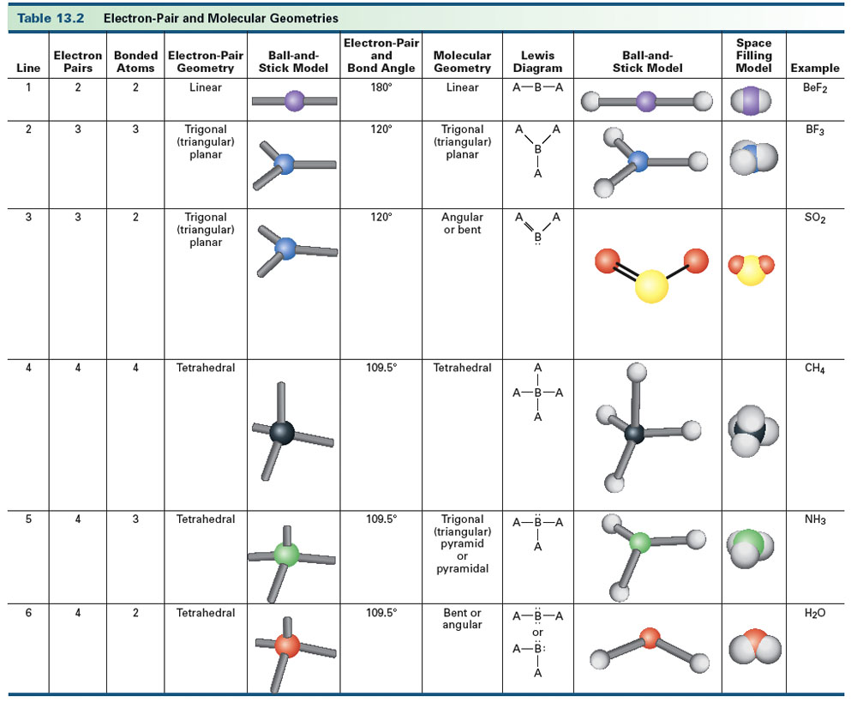
Table 13-2, p. 377

Slide 10
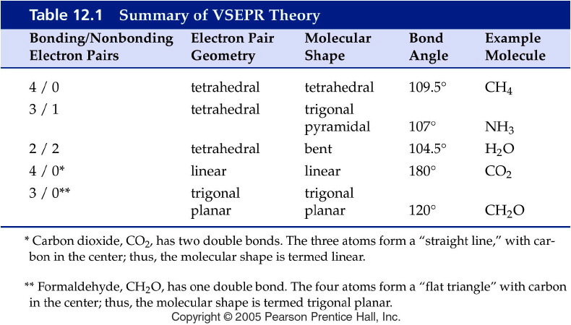
Notes:
Figure: 12-T01
Title:
Table 12.1
Caption:
Summary of VSEPR Theory
Notes:
The major molecular shapes from VSEPR are summarized. The number of bonding pairs and lone pairs determine the molecular shape.

Slide 11
Example – VSEPR Theory
What is the molecular geometry for hydrogen sulfide?
tetrahedral
trigonal planar
trigonal pyramidal
bent
linear

Slide 12
Example – VSEPR Theory
What is the bond angle for the thiocyanate ion, SCN⁻?
109.5°
107°
180°
104.5°
120°

Slide 13
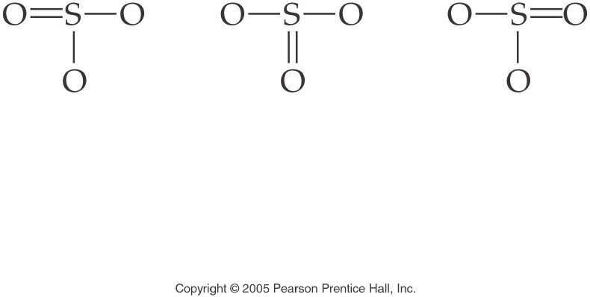
Notes:
Figure: 12-08-09UN
Title:
SO₃ Structural Formula
Caption:
This is the structural formula for the resonance structures of sulfur trioxide.
Notes:
This diagram is part of an in-text example for drawing Electron Dot Formulas and Structural Formulas. The three structures are equivalent and are known as resonance structures.

Slide 14
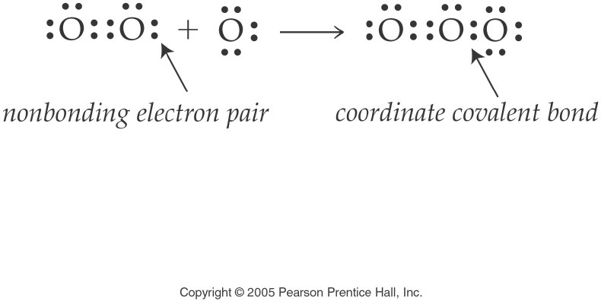
Notes:
Figure: 12-09-04UN
Title:
O₃ Electron Dot Formula
Caption:
This is the electron dot formula for ozone. The coordinate covalent bond is clearly noted.
Notes:
This diagram is part of an in-text example for drawing electron dot formulas and structural formulas. The coordinate covalent bond is formed by the O₂ molecule donating a pair of electrons to form a bond to an O atom.

Slide 15
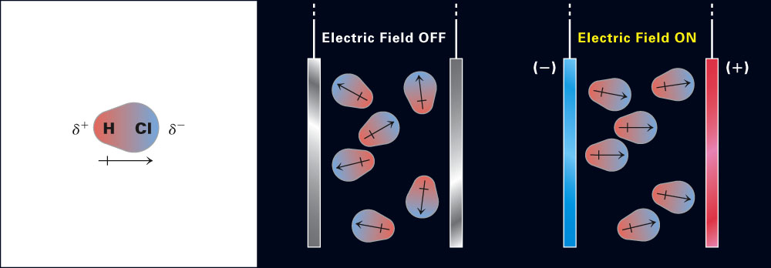
Fig. 13-9, p. 386

Slide 16
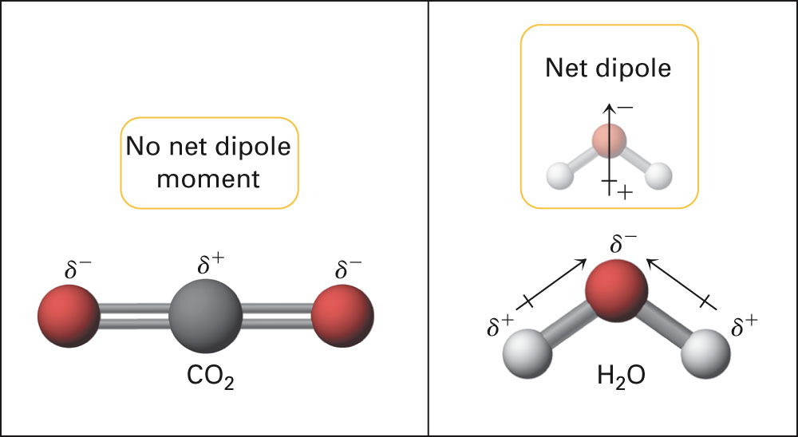
Fig. 13-10, p. 387

Slide 17
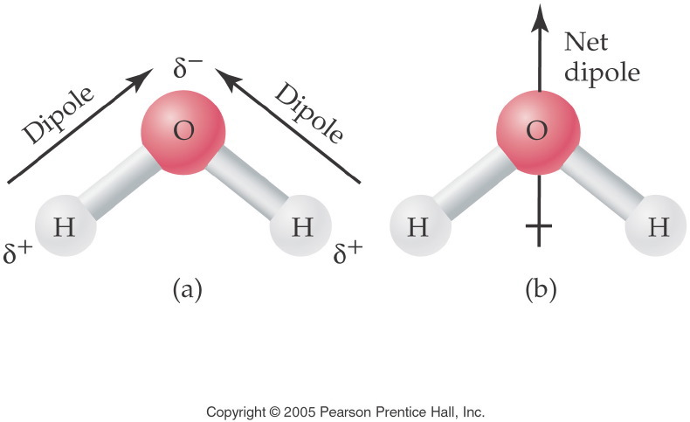
Notes:
Figure: 14-01
Title:
The Polar Water Molecule
Caption:
The two dipoles produce a net dipole for the entire water molecule.
Notes:
The high degree of polarity in water makes it an excellent solvent for the solvation of ionic compounds and other polar molecules.

Slide 18
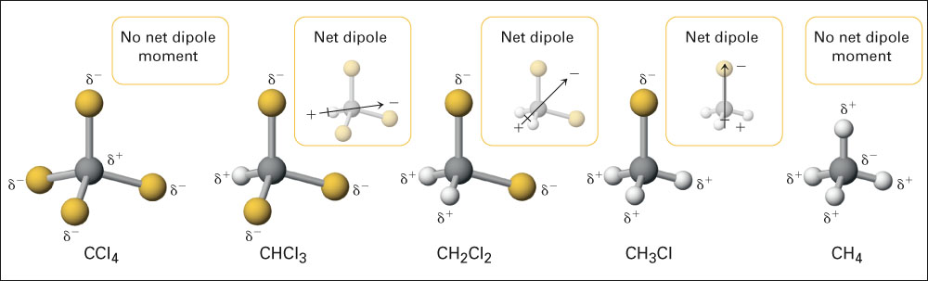
Fig. 13-11, p. 387

Slide 19
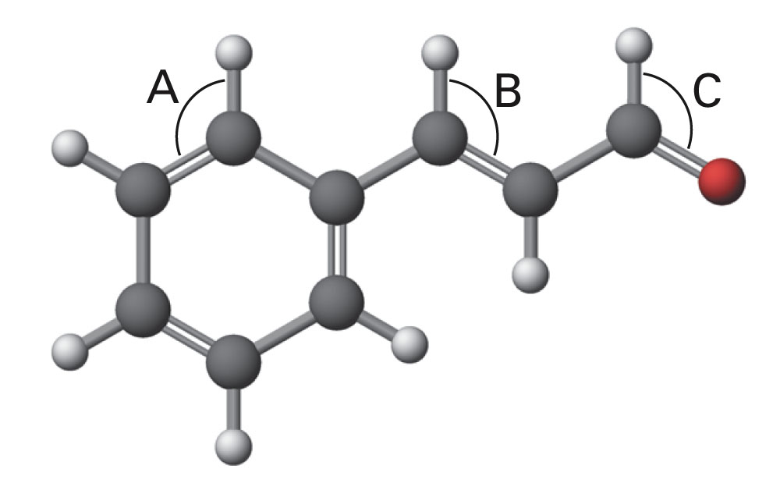
p. 397

Slide 20
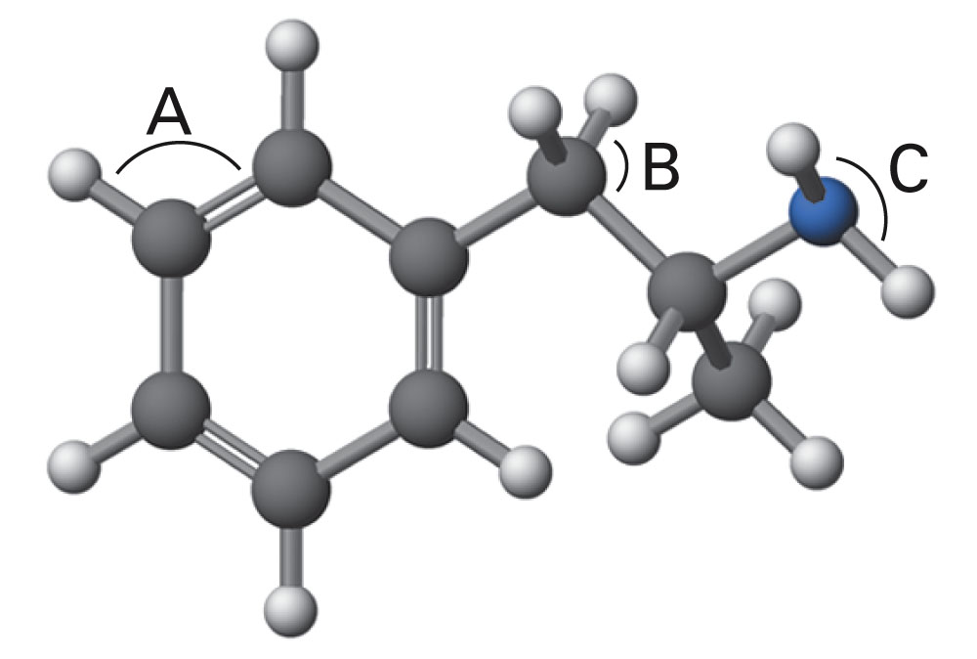
p. 397

