Slide 1
Chemistry 120
Chapter 12: Chemical Bonding

Slide 2
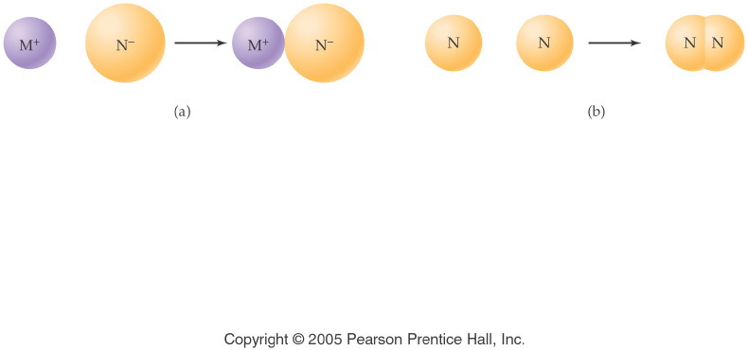
Notes:
Figure: 12-01
Title:
Chemical Bonds
Caption:
An ionic bond forms between a metal and nonmetal. Two nonmetal atoms form a covalent bond.
Notes:
In each compound, all atoms have filled their valence shell. It is only the method of filling (ion formation vs. electron sharing) that differs.

Slide 3
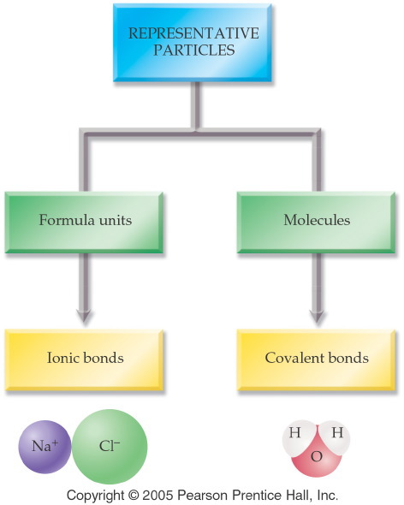
Notes:
Figure: 12-02
Title:
Representative Particles
Caption:
Particles can be formula units held together by ionic bonds, or molecules held by covalent bonds.
Notes:
This classification is also made in Ch. 7 (Nomenclature) between salts and binary molecules.

Slide 4
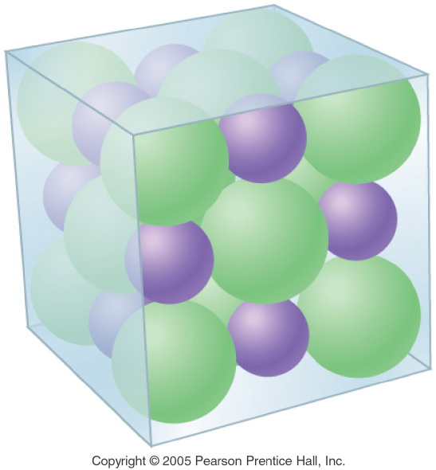
Notes:
Figure: 12-04
Title:
Crystalline Structure of NaCl
Caption:
A crystal of NaCl is composed of sodium and chloride ions which repeat regularly.
Notes:
This regulated, alternating pattern of ions is the reason that NaCl crystallizes in a cubic shape. Note that each cation is attracted to several anions and vice versa.

Slide 5
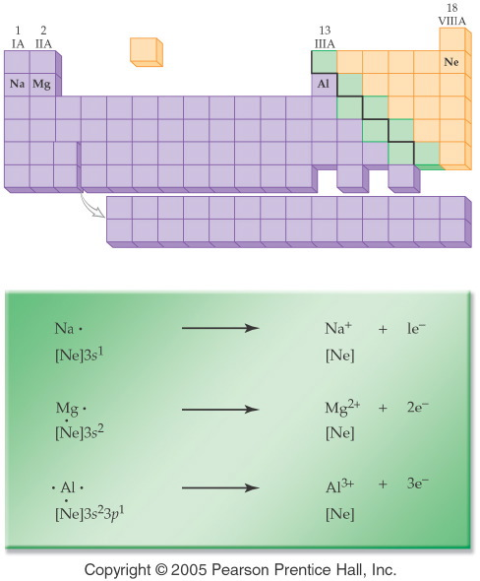
Notes:
Figure: 12-05
Title:
Formation of Metal Ions
Caption:
The atoms of the metals in Period 3 form cations by losing 1, 2, or 3 electrons, respectively.
Notes:
With all three metals, the stable cation formed is isoelectronic with neon, a noble gas with a filled valence shell.

Slide 6
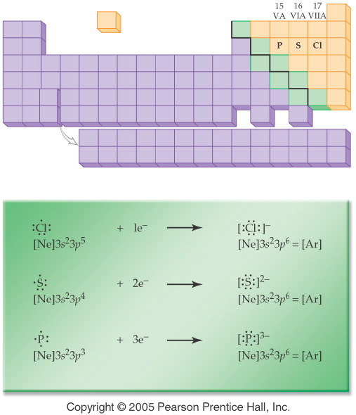
Notes:
Figure: 12-06
Title:
Formation of Nonmetal Ions
Caption:
The nonmetals in Period 3 gain 1, 2, or 3 electrons, respectively.
Notes:
With all three nonmetals, the stable anion formed is isoelectronic with argon, a noble gas with a filled valence shell.

Slide 7
Example – Ionic Bonding
What is the Lewis structure when aluminum and chlorine form an ionic compound?

Slide 8
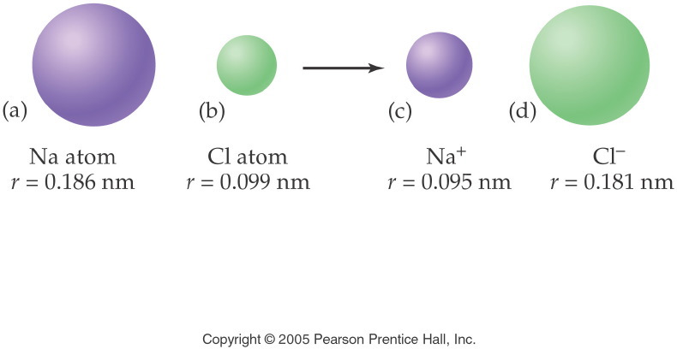
Notes:
Figure: 12-07
Title:
Formation of Na+ and Cl- Ions
Caption:
The radius of the sodium atom decreases, while the chloride atom increases when ionized.
Notes:
Losing an electron means that the positive nucleus can pull the other electrons in more strongly. Gaining an electron means that the positive nucleus is less effective in pulling the electrons in.

Slide 9
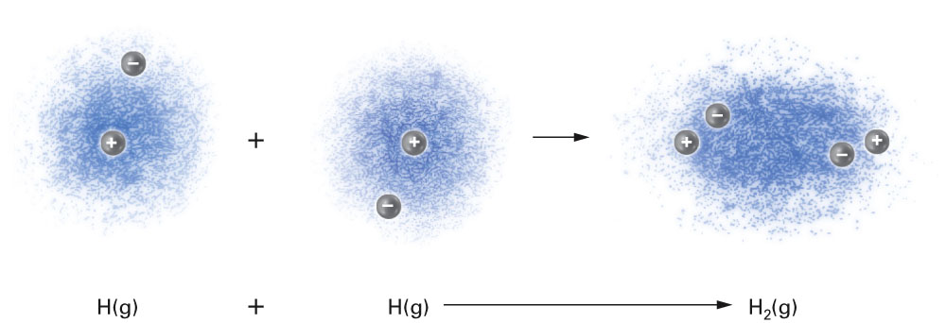
Fig. 12-6, p. 350

Slide 10
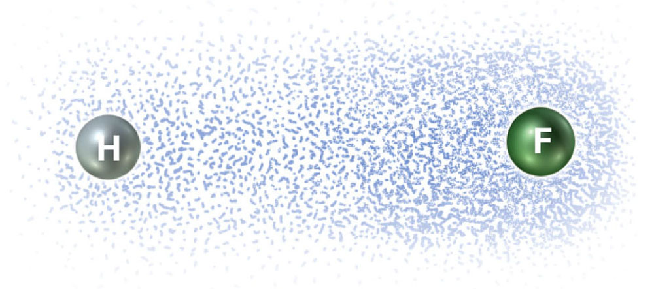
Fig. 12-7, p. 352

Slide 11
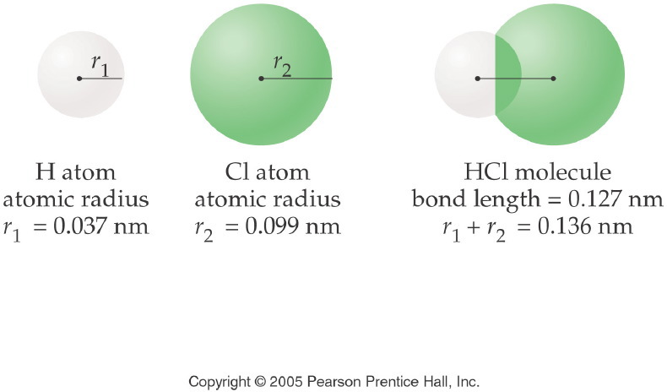
Notes:
Figure: 12-08
Title:
Formation of a Covalent Bond
Caption:
The sharing of an electron pair by a hydrogen atom and a chlorine atom produces a covalent bond.
Notes:
The bond length in a covalent bond is always less than the sum of the two atomic radii due to the overlap of the atoms' electron orbitals. The shortened distance between nuclei and electrons is related to the bond energy.

Slide 12
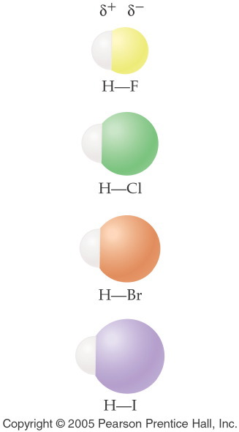
Notes:
Figure: 12-09-01UN
Title:
Hydrogen Halides
Caption:
The two atoms in each hydrogen halide molecule are joined by a polar covalent bond.
Notes:
The electrons in a polar covalent bond are pulled closer to the nucleus of the most electronegative element. This leads to bond polarity. In each of these molecules the halogen atom is more electronegative than the hydrogen atom.

Slide 13
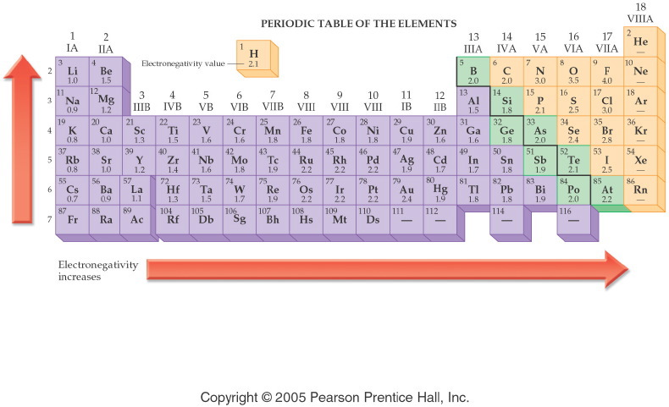
Notes:
Figure: 12-09
Title:
Electronegativity Values
Caption:
The electronegativity value for an element is shown below the symbol.
Notes:
Electronegativity values are related to atomic size. Small atoms, like F, hold their electrons tightly, as they are closer to the nucleus. Large atoms, like Cs, hold their electrons loosely. Electronegativity increases up a group and to the right across a period.

Slide 14
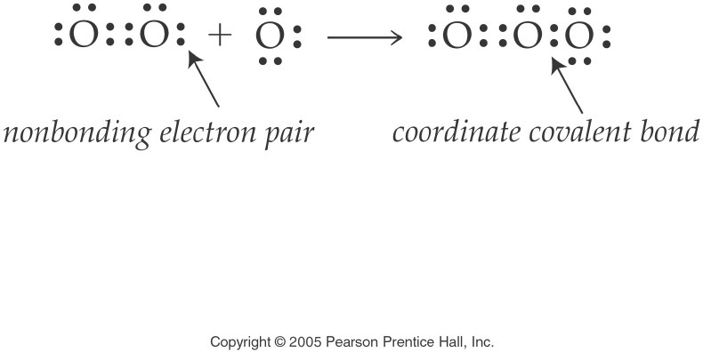
Notes:
Figure: 12-09-04UN
Title:
O₃ Electron Dot Formula
Caption:
This is the electron dot formula for ozone. The coordinate covalent bond is clearly noted.
Notes:
This diagram is part of an in-text example for drawing electron dot formulas and structural formulas. The coordinate covalent bond is formed by the O₂ molecule donating a pair of electrons to form a bond to an O atom.

Slide 15
Example – Covalent Bonding
What is the Lewis structure for formaldehyde, CH₂O?

Slide 16
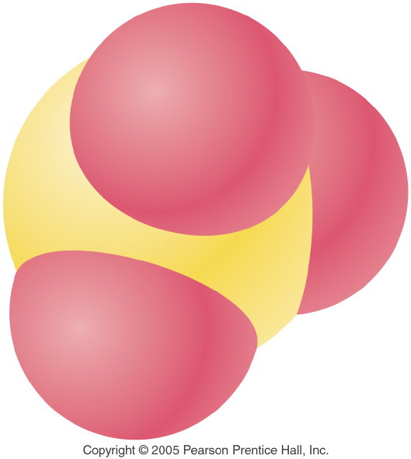
Notes:
Figure: 12-08-04UNa
Title:
Sulfur Trioxide
Caption:
Sulfur trioxide, SO₃
Notes:
This is a representation of sulfur trioxide, SO₃ showing the shape of the molecule and the relative sizes of the sulfur and oxygen atoms.

Slide 17
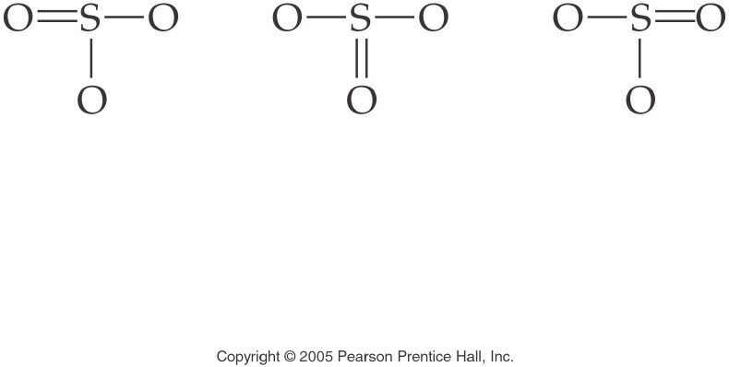
Notes:
Figure: 12-08-09UN
Title:
SO₃ Structural Formula
Caption:
This is the structural formula for the resonance structures of sulfur trioxide.
Notes:
This diagram is part of an in-text example for drawing Electron Dot Formulas and Structural Formulas. The three structures are equivalent and are known as resonance structures.

Slide 18
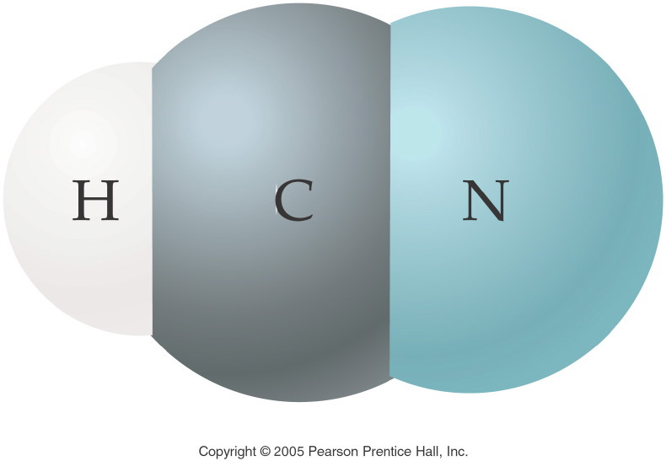
Notes:
Figure: 12-08-10UN
Title:
Hydrogen Cyanide Molecule
Caption:
This is a 3-D representation of hydrogen cyanide, HCN.
Notes:
This 3-D representation depicts an accurate model of the electron shell in each atom of a hydrogen cyanide molecule.

Slide 19
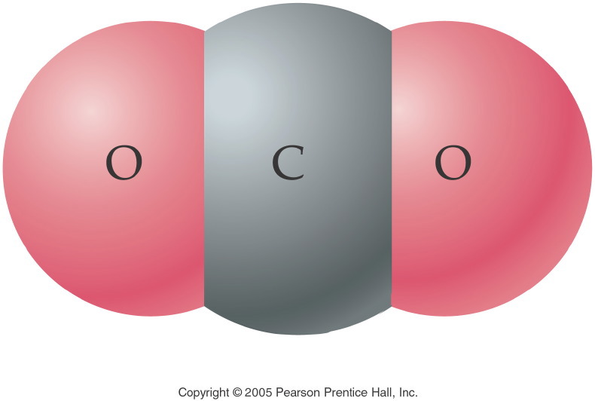
Notes:
Figure: 12-08-20UN
Title:
Carbon Dioxide Molecule
Caption:
This is a 3-D representation of carbon dioxide, CO₂.
Notes:
This 3-D representation depicts an accurate model of the electron shell in each atom of a carbon dioxide molecule.

Slide 20
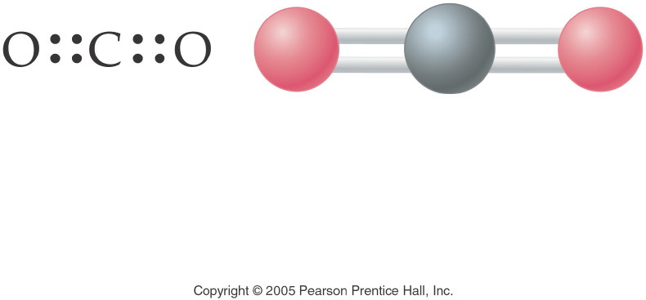
Notes:
Figure: 12-09-09UNa
Title:
Carbon Dioxide
Caption:
The electron pair geometry in carbon dioxide, CO₂, is linear. The molecular shape of CO₂ is linear; the bond angle is 180¡.
Notes:
The 4 electron pairs are all bonding and form bonds to only two atoms. Thus the angle between the bonds is 180¡.

