Slide 1
Chemistry 120
Chapter 11: Atomic Theory:
The Quantum Model of the Atom

Slide 2
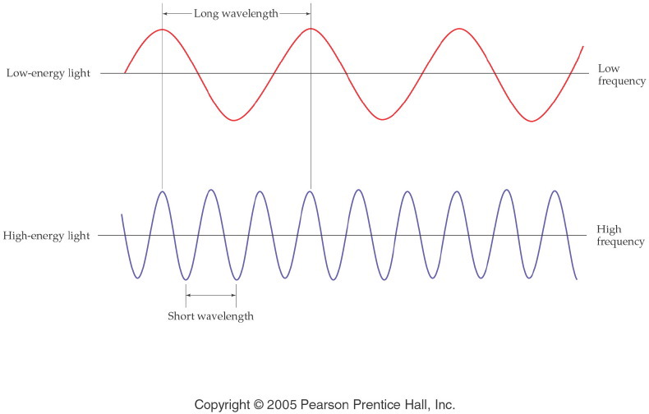
Notes:
Figure: 05-07
Title:
Wavelength and Frequency
Caption:
Notice that the wavelength is longer for low-energy light than for high-energy light. Frequency is opposite.
Notes:
Wavelength and frequency are inversely related to each other through the speed of light. A small wavelength means that more waves (i.e., more energy) pass through a point per second.

Slide 3
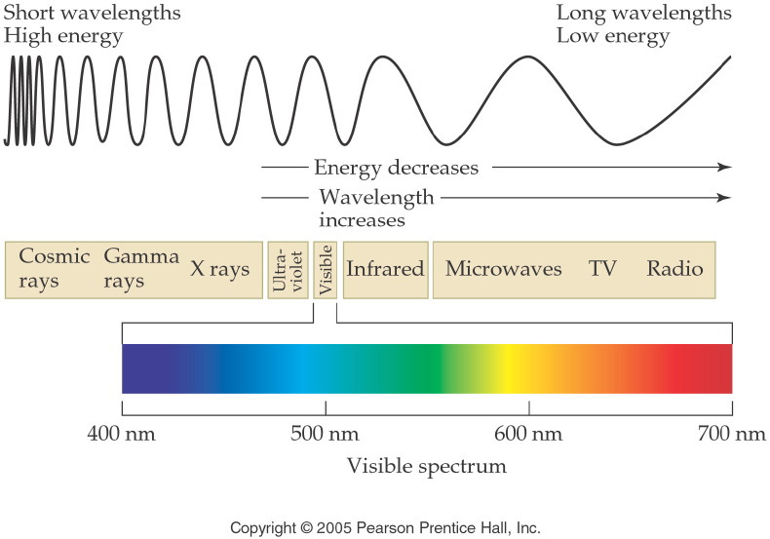
Notes:
Figure: 05-09
Title:
The Radiant Energy Spectrum
Caption:
The complete spectrum includes short-wavelength gamma rays to long-wavelength microwaves.
Notes:
The visible spectrum of light is just a narrow portion of the entire radiant energy spectrum.

Slide 4
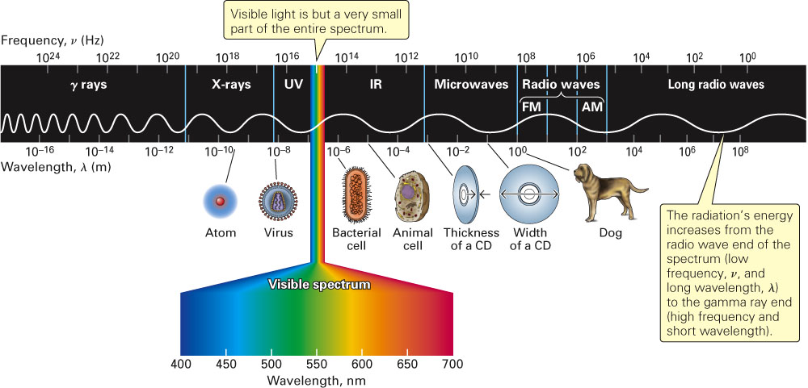
Fig. 11-1, p. 310

Slide 5
Example – Electromagnetic Spectrum
Using violet, green, and orange, which one has the longest wavelength?
Violet
Green
Orange
D. All of the above
E. None of the above

Slide 6
Example – Electromagnetic Spectrum
Using violet, green, and orange, which one is the most energetic?
Violet
Green
Orange
All of the above
None of the above

Slide 7
Example – Electromagnetic Spectrum
Using violet, green, and orange, arrange in order of increasing frequency.
violet < green < orange
green < violet < orange
orange < green < violet
All of the above
None of the above

Slide 8
Example – Electromagnetic Spectrum
Order the following in increasing wavelength: x-rays, ultraviolet light, FM radiowaves, and microwaves
X-rays < UV light < FM radiowaves < microwaves
X-rays < UV light < microwaves < FM radiowaves
FM radiowaves < microwaves < X-rays < UV light
FM radiowaves < microwaves < UV light < X-rays
None of the above

Slide 9
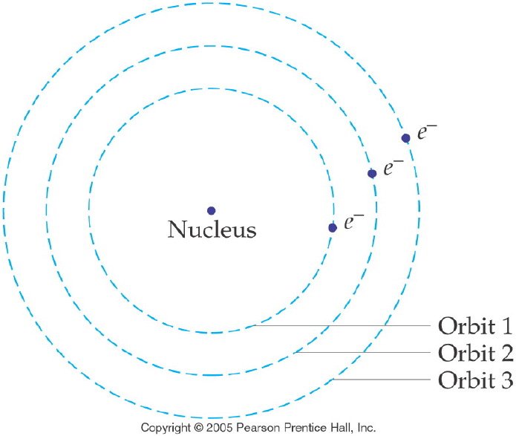
Notes:
Figure: 05-11
Title:
The Bohr Model of the Hydrogen Atom
Caption:
The electron is a specific distance from the nucleus and occupies an orbit of discrete energy.
Notes:
In the Bohr model, the energy of each electron is related to an exact distance from the nucleus. Only specific energies and distances are allowed.

Slide 10
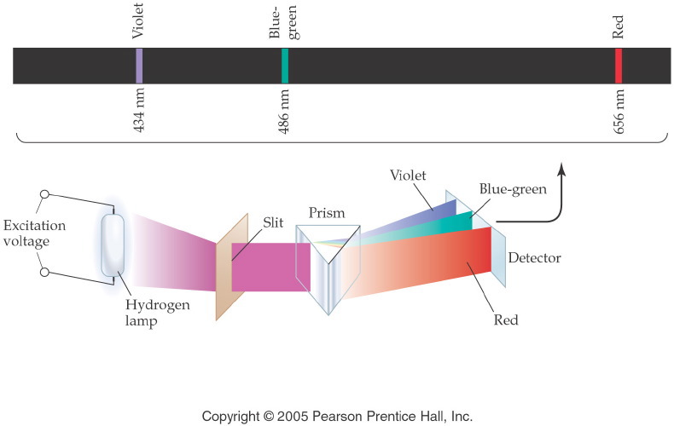
Notes:
Figure: 05-12
Title:
Hydrogen Emission Spectrum
Caption:
An emission line spectrum is produced when hydrogen gas is excited by electricity. Three lines are observed.
Notes:
Of course, there are more than three transitions that an electron can make, but only three (or four) produce energy in the visible spectrum.

Slide 11
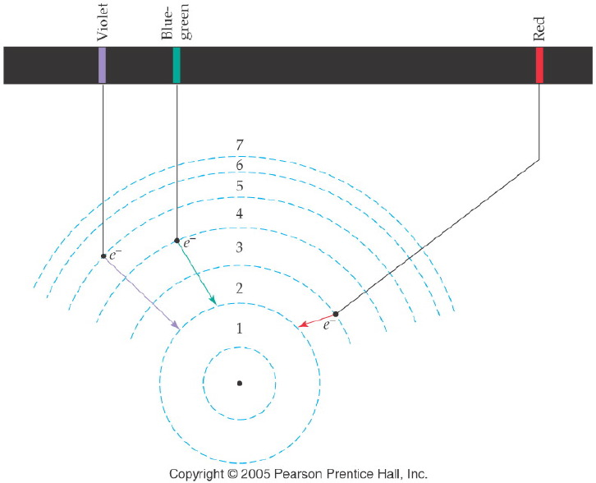
Notes:
Figure: 05-13
Title:
Spectral Lines in Hydrogen
Caption:
When electrons drop from energy level 5, 4, or 3 to level 2, visible light is produced.
Notes:
The largest drop (5 to 2) results in the highest energy photon (Violet light). The smallest drop (3 to 2) results in the lowest energy photon (Red light).

Slide 12
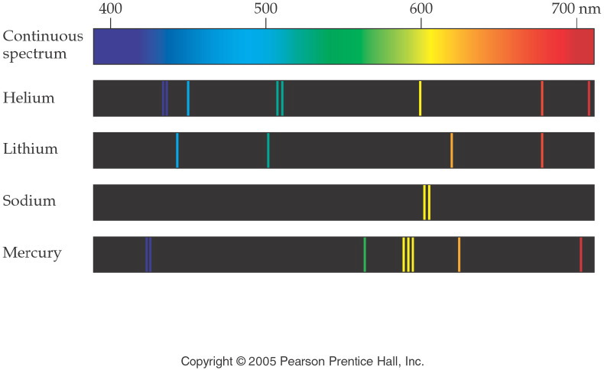
Notes:
Figure: 05-14
Title:
Continuous Spectrum versus Line Spectra
Caption:
The emission line spectra are produced by excited atoms of elements in the gaseous state.
Notes:
Each element provides its own distinct emission spectrum. This spectrum is often called an "atomic fingerprint."

Slide 13
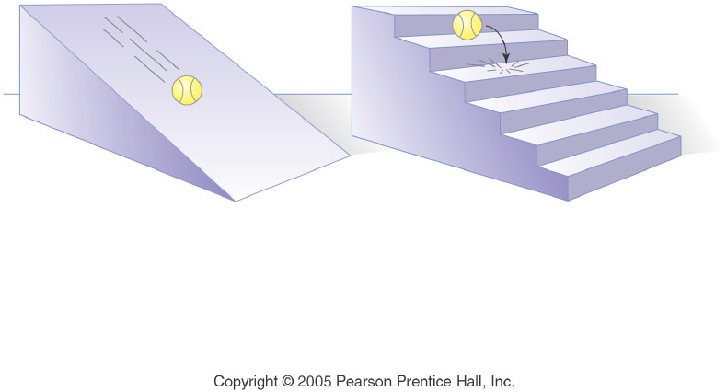
Notes:
Figure: 05-10
Title:
Stair Analogy for Quantum Principle
Caption:
A ball rolling down a ramp loses PE continuously. A ball rolling down stairs loses PE in specific units.
Notes:
This diagram introduces the concept of electrons existing in discrete energy levels, like steps on a flight of stairs.

Slide 14
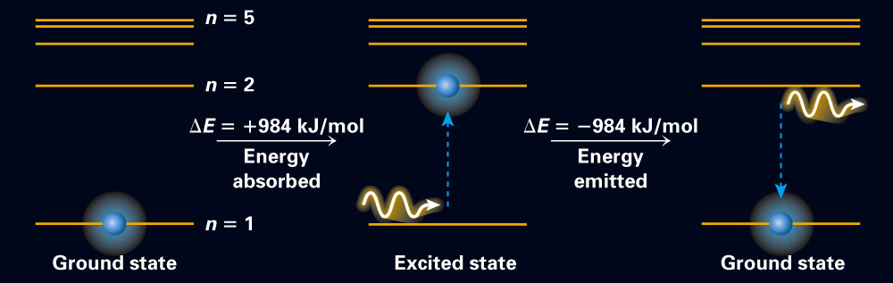
Fig. 11-8, p. 314

Slide 15
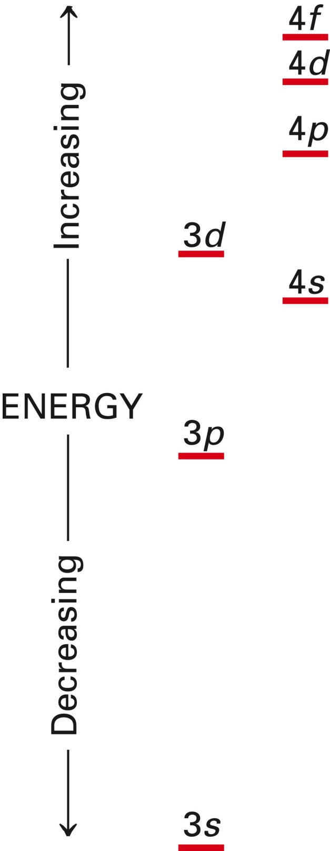
Fig. 11-9, p. 316

Slide 16
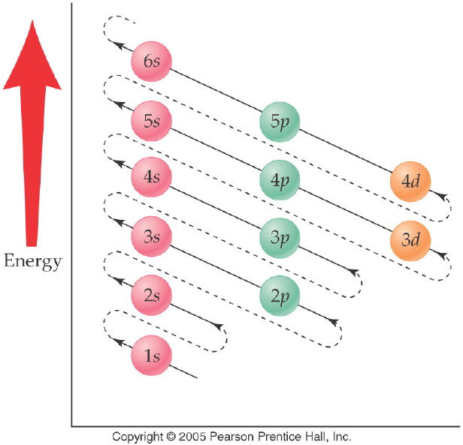
Notes:
Figure: 05-16
Title:
Filling Diagram for Sublevels
Caption:
The order of sublevel filling is arranged according to increasing energy.
Notes:
This diagonal filling diagram shows how the sublevels from different energy levels start to overlap.

Slide 17
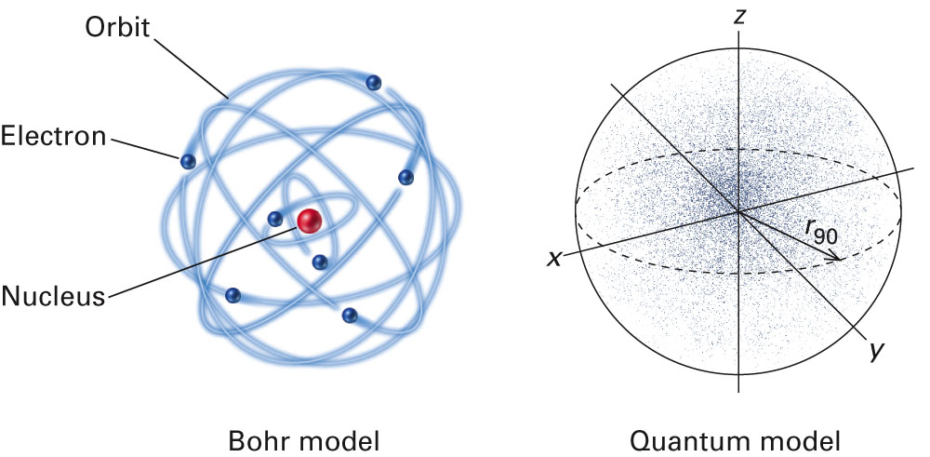
Fig. 11-10, p. 316

Slide 18
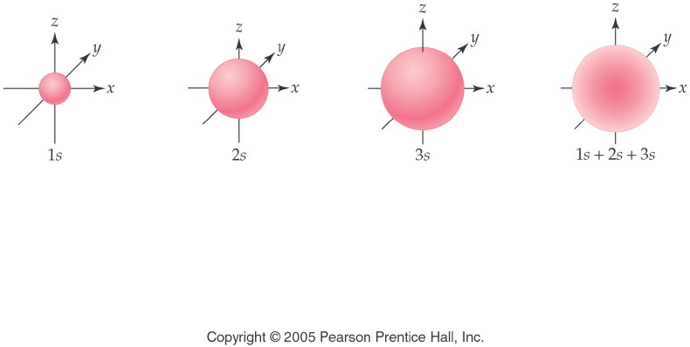
Notes:
Figure: 05-17
Title:
Relative Sizes of s Orbitals
Caption:
The relative sizes of 1s, 2s, and 3s orbitals are shown. As the main level increases, the size increases.
Notes:
The s orbitals have the same spherical shape, regardless of energy level. The spherical shape designates the area where the electrons are most likely to exist.

Slide 19
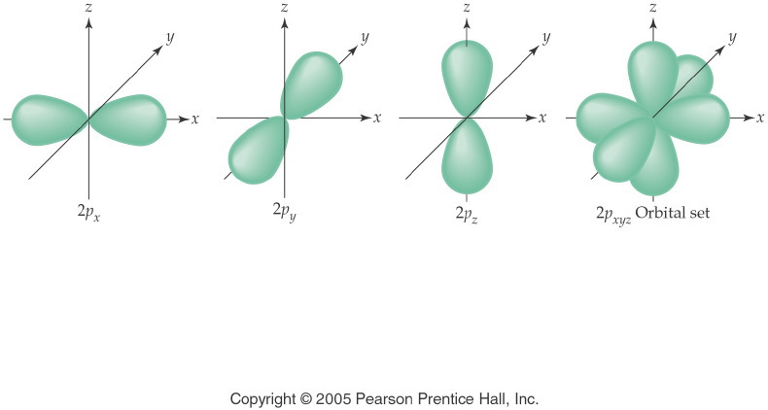
Notes:
Figure: 05-18
Title:
Orientation of 2p Orbitals
Caption:
The size and shape of the three 2p orbitals are identical, but they exist on separate axes.
Notes:
These three orbitals have electrons of the same energy. The distinctive shape represents the area where the electrons are most likely to exist. The orbital set shows all three 2p orbitals together.

Slide 20
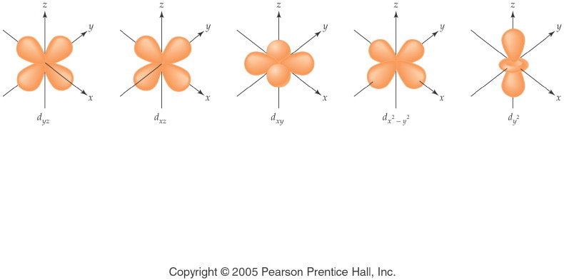
Notes:
Figure: 05-20
Title:
Shapes of 3d Orbitals
Caption:
The shapes of the five 3d orbitals are not the same, although four of the orbitals are similar.
Notes:
The five 3d orbitals mathematically represent a way that 10 electrons can all exist with the same average distance from the nucleus of the atom.

Slide 21
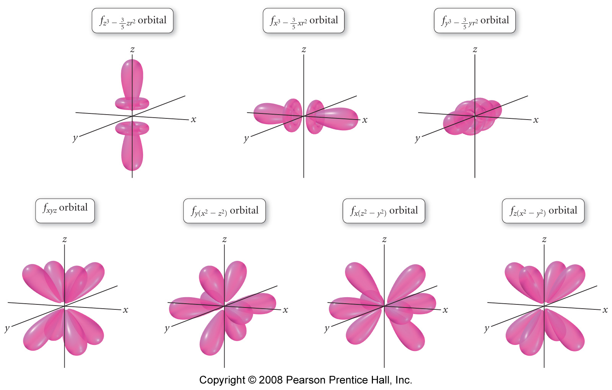
Notes:
Figure: 07-28
Title:
The 4f Orbitals
Caption:
The radial distribution function for all seven 4f orbitals.

Slide 22
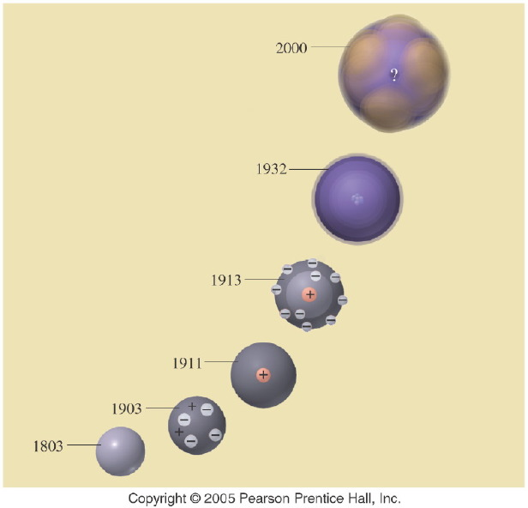
Notes:
Figure: 05-20-02UN
Title:
Atomic Models
Caption:
In the evolving model of the atom, what does the question mark (?) represent in the 2000 model?
Notes:
Atomic theory is one scientific theory that has been adjusted over the years as new evidence has come to light. It is still changing today.

Slide 23
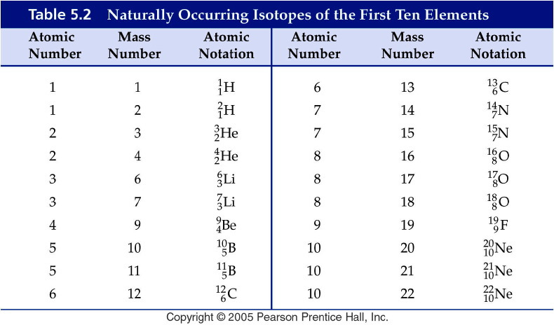
Notes:
Figure: 05-T02
Title:
Table 5.2
Caption:
Naturally Occurring Isotopes of the First Ten Elements
Notes:
Each element may have a different number of naturally occurring isotopes. Note that there are 3 isotopes of oxygen but only one of fluorine.

Slide 24
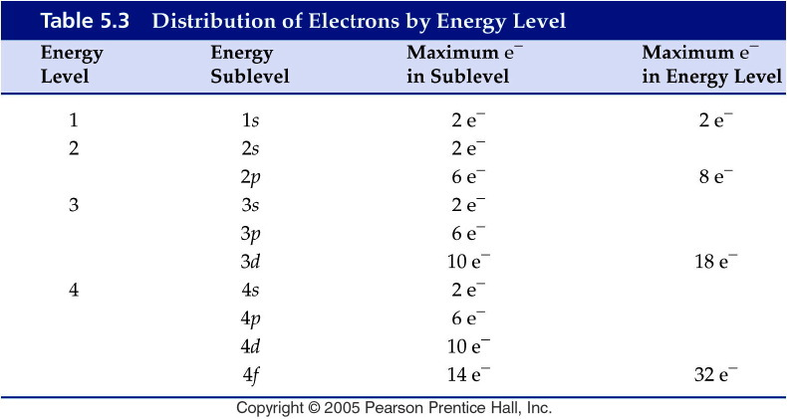
Notes:
Figure: 05-T03
Title:
Table 5.3
Caption:
Distribution of Electrons by Energy Level
Notes:
The higher the energy level, the more possible sublevels there are.

Slide 25
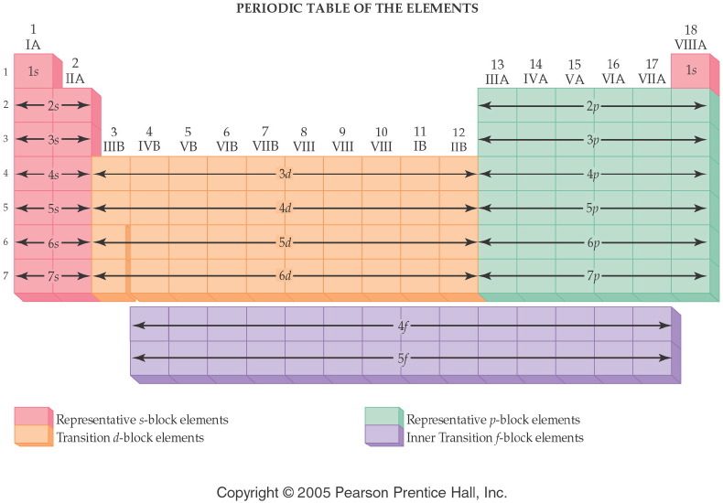
Notes:
Figure: 06-06
Title:
Blocks of Elements
Caption:
The relationship between energy sublevels and the s, p, d, and f blocks of elements is shown.
Notes:
Each block of elements represents a specific set of sublevels and is designated by a distinct color. THe indicated sublevel is the highest energy subshell in the atom.

Slide 26
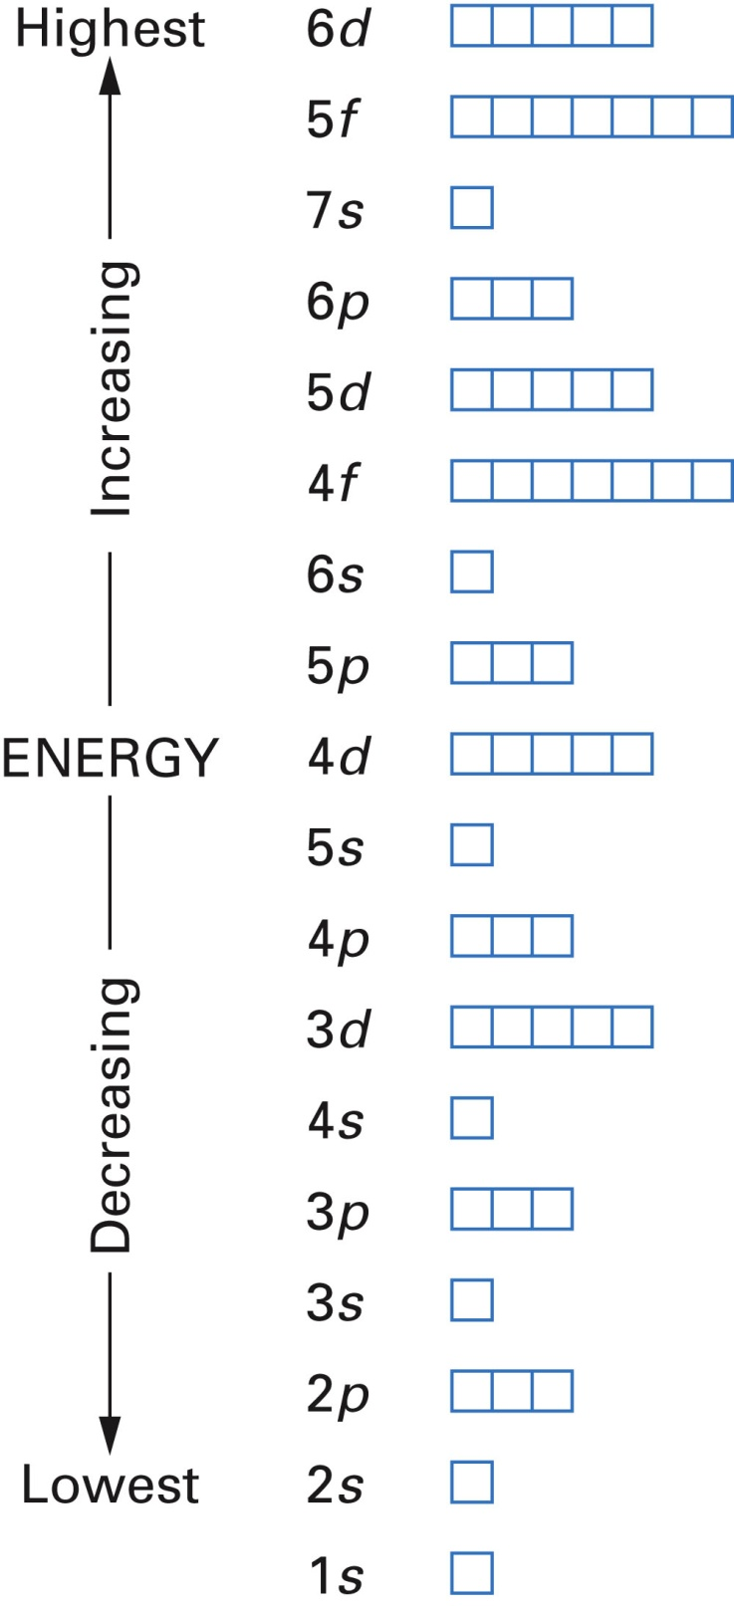
Fig. 11-13, p. 322

Slide 27
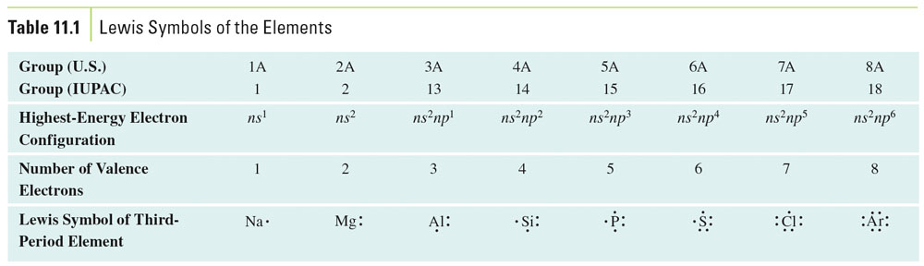
Table 11-1, p. 327

Slide 28
Example – Electron Configuration
What is the electron configuration of C?
1s² 2s² 2p²
1s² 1p⁴
2s² 2p²
1s⁶
None of the above

Slide 29
Example – Electron Configuration
What element has an electron configuration of 1s² 2s² 2p² 2p⁶ 3s¹?

Slide 30
Example – Electron Configuration
What is the electron configuration of V?
1s² 2s² 2p⁶ 3s² 3p⁶ 4s² 4d³
1s² 2s² 2p⁶ 3s2 3p⁶ 4s⁵
1s² 2s² 2p⁶ 3s³ 3p⁶ 4s² 3d²
1s² 2s² 2p⁶ 3s² 3p⁶ 4s² 3d³
None of the above

Slide 31
Example – Electron Configuration
How many core electrons does aluminum have?
2
3
4
6
10

Slide 32
Example – Electron Configuration
How many valence electrons does aluminum have?
2
3
4
6
10

Slide 33
Example – Electron Configuration
Write the core notation for Pb.
[Xe] 6s² 6p²
6s² 5d¹⁰ 4f¹⁴ 6p²
1s² 2s² 2p⁶ 3s² 3p⁶ 4s² 3d¹⁰ 4p⁶ 5s2 4d¹⁰ 5p⁶ 6s² 5d¹⁰ 4f¹⁴ 6p²
[Xe] 6s² 5d¹⁰ 4f¹⁴ 6p²
[Hg] 6p²

Slide 34
Example – Electron Configuration
Write the core notation for Pb²⁺.
[Xe] 5d¹⁰ 4f¹⁴ 6p²
[Xe] 6s²
6s² 5d¹⁰ 4f¹⁴
1s² 2s² 2p⁶ 3s² 3p⁶ 4s² 3d¹⁰ 4p⁶ 5s2 4d¹⁰ 5p⁶ 6s² 5d¹⁰ 4f¹⁴ 6p²
[Xe] 6s² 5d¹⁰ 4f¹⁴ 6p²

Slide 35
Example – Electron Configuration
Write the core notation for the oxide ion.
[Ne]
1s² 2s² 2p⁶ 3s² 3p⁶
[He] 3s² 3p⁶
[He] 3s² 3p⁴
A and C

Slide 36
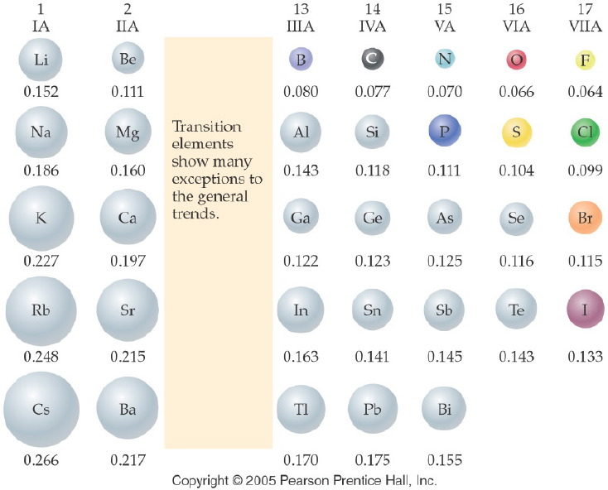
Notes:
Figure: 06-04
Title:
Atomic Radii of Elements
Caption:
Atomic radii decrease up a group and across a period. The values for radii are given in nanometers.
Notes:
Atomic size (radius) decreases as fewer energy levels are needed (up the table) and as the nucleus adds protons, pulling the electrons closer to the nucleus (to the right in the table).

Slide 37
Example – Atomic Size
Which has the larger atomic size?
Li or Na and N or P
Li, N
Na, N
Li, P
Na, P
Not enough information

Slide 38
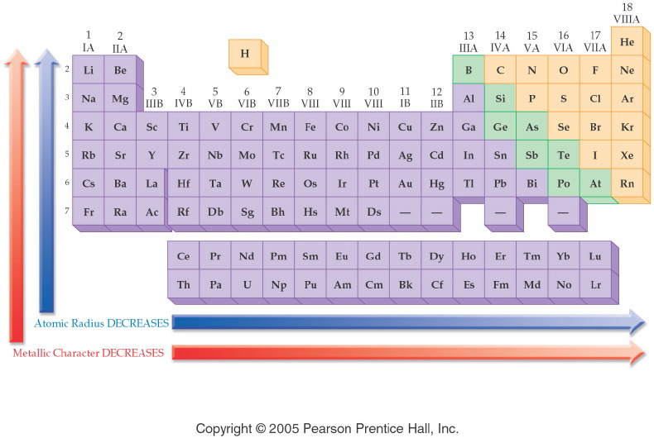
Notes:
Figure: 06-05
Title:
General Trends in Atomic Radii and Metallic Character
Caption:
The general trend for decreasing atomic radius and metallic character is up and to the right.
Notes:
Atomic size (radius) decreases as fewer energy levels are needed (up the table) and as the nucleus adds protons, pulling the electrons closer to the nucleus (to the right in the table). Since behavior as a metal involves loss of electrons, it becomes harder to remove the electrons as they get closer to the nucleus, so metallic behavior also decreases in the same way as atomic radius.

Slide 39
Example – Metallic Character
Which has more metallic character:
S or Na?

Slide 40
Example – Metallic Character
Which has more metallic character:
S or Na

Slide 41
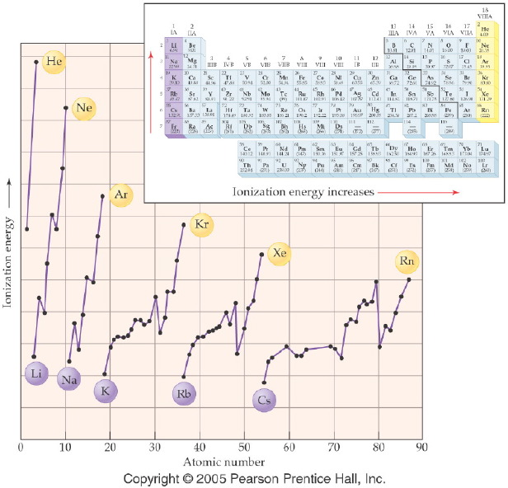
Notes:
Figure: 06-08
Title:
Ionization Energy
Caption:
This diagram shows the energy required to remove a single electron from a neutral atom.
Notes:
In general, the greater the number of protons in the nucleus in each period, the harder it is to remove an electron. Moving the electrons further from the nucleus decreases the energy required. The ionization energy generally increases as atomic radius decreases.

Slide 42
Example – Ionization Energy
Which has the higher ionization energy:
Mg or Ca?

Slide 43
Example – Ionization Energy
Which has the higher ionization energy:
Sn or Pb?

Slide 44
Example – Ionization Energy
Which has the higher ionization energy:
Se or S?

Slide 45
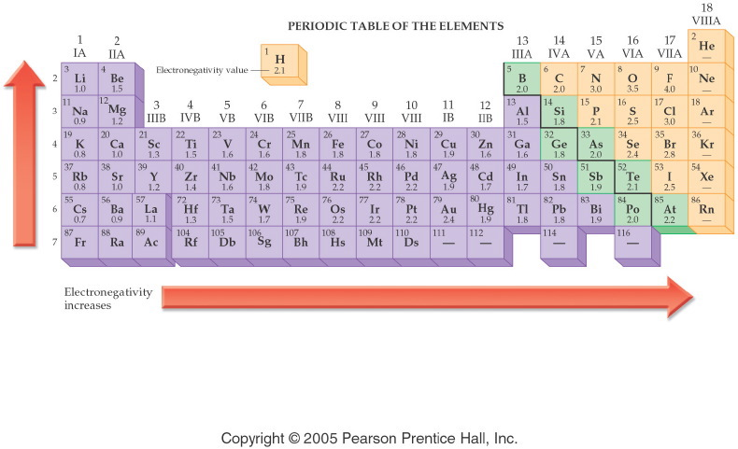
Notes:
Figure: 12-09
Title:
Electronegativity Values
Caption:
The electronegativity value for an element is shown below the symbol.
Notes:
Electronegativity values are related to atomic size. Small atoms, like F, hold their electrons tightly, as they are closer to the nucleus. Large atoms, like Cs, hold their electrons loosely. Electronegativity increases up a group and to the right across a period.

Slide 46
Example – Electronegativity
Rank the following in order of increasing electronegativity: F, Ga, K, Rb, and V.
F < Ga < K < Rb < V
Rb < K < V < Ga < F
V < Rb < Ga < K < F
F < Ga < Rb < V < K
Rb < F < K < V < Ga

