Slide 1
Chemistry 120
Chapter 10:
Quantity Relationships in Chemical Reactions

Slide 2
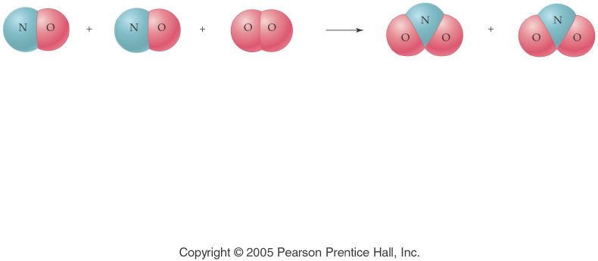
Notes:
Figure: 10-00-01UN
Title:
A Chemical Equation
Caption:
Nitrogen monoxide and oxygen gas combine to form nitrogen dioxide.
Notes:
This diagram reflects the correct stoichiometry for this balanced chemical equation. A ratio of 2:1:2 is established.

Slide 3
Moles & Equation Coefficients
2 NO(g) + O₂(g) → 2 NO₂(g)
NO (g) | O₂(g) | NO₂(g)
2 molecules | 1 molecule | 2 molecules
2000 molecules | 1000 molecules | 2000 molecules
12.04 × 10²³ molecules | 6.02 × 10²³ molecules | 12.04 × 10²³ molecules
2 moles | 1 mole | 2 moles

Slide 4
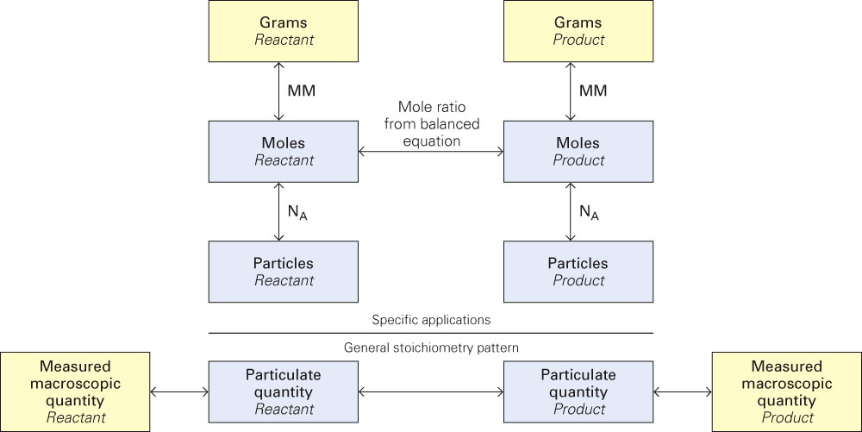
Fig. 10-2, p. 276

Slide 5
Example - Stoichiometry
Iron metal reacts with powdered sulfur, S, in the presence of heat to produce iron(III) sulfide.
How many moles of sulfur react with 1.50 moles of iron?

Slide 6
Example - Stoichiometry
How many liters of carbon dioxide are produced when 2.25 L of propane, C₃H₈, a hydrocarbon, undergo combustion.

Slide 7
Example - Stoichiometry
How many grams of oxygen gas must react with excess zinc to produce 1.28 g of zinc oxide?

Slide 8
Example - Stoichiometry
Calcium cyanamide, CaCN₂, reacts with water to form calcium carbonate and ammonia gas. How many grams of water are needed to react with 75.0 g of calcium cyanamide?

Slide 9
Example - Stoichiometry
When ferric oxide is heated with carbon, molten iron and carbon monoxide are produced.
How many kilograms of iron are produced if 1.0 pounds of carbon react with excess ferric oxide?

Slide 10
Example – Percent Yield
If 2.50 g of aqueous cadmium chloride reacts with excess aqueous sodium sulfide to produce 0.971 g of cadmium sulfide solid, what is the percent yield of cadmium sulfide?

Slide 11
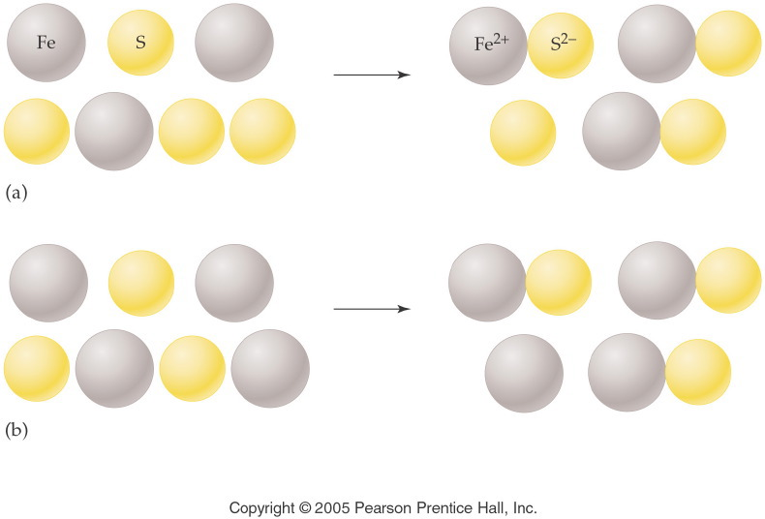
Notes:
Figure: 10-01
Title:
Model for Limiting Reactant
Caption:
Fe and S react to give FeS. If there is excess S, Fe is the limiting reactant. With excess Fe, S is the limiting reactant.
Notes:
The limiting reactant is used up completely as part of the chemical reaction. There is an excess of the other reactant left unreacted.

Slide 12
Example – Limiting Reagent
Suppose that 7.50 moles of iron are heated with 2.00 moles of sulfur, how many moles of iron(II) sulfide are produced? Use an ICE table.

Slide 13
Example – Limiting Reagent
Ammonia and fluorine gases react to form dinitrogen tetrafluoride and hydrogen fluoride gases.
If 5.00 g of ammonia and 20.0 g of fluorine gas react, how many grams of hydrogen fluoride gas are produced? Use an ICE table.

Slide 14
Example – Limiting Reagent
If 12.8 g of sodium react with 10.2 g of chlorine gas and 16.201 g of sodium chloride is produced, what is the percent yield? Use an ICE table.

Slide 15
Example – Thermochemical Equations
When octane, C₈H₁₈, in gasoline burns in an automobile engine 8.5 x 10³ J of heat are released. How many kJ of heat are released if 10.0 g of octane is combusted?

Slide 16
Example – Thermochemical Equations
The electrolysis of water is an endothermic reaction, absorbing 286 kJ for each mole of liquid water decomposed into its elements. How many grams of water are decomposed if 5,000 kJ of energy are absorbed?

Slide 17
Example – Thermochemical Equations
Solid sulfur reacts with carbon dioxide gas to produce sulfur dioxide gas and carbon solid, ∆H = -75.8 kJ. When 5.20 g of sulfur react with excess carbon dioxide, how many kJ of energy are evolved or absorbed?

