Slide 1
Chemistry 120
Chapter 1:
Introduction to Chemistry; Introduction to Active Learning
Outline
Introduction to Chemistry
Scientific Method

Slide 2
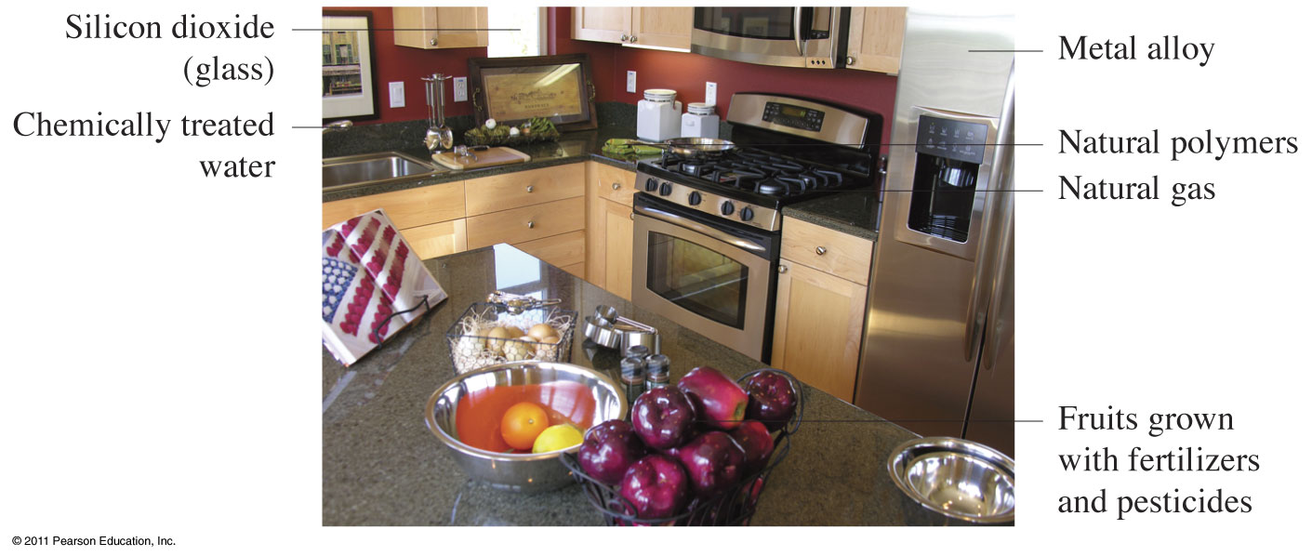
Where are chemicals found?

Slide 3
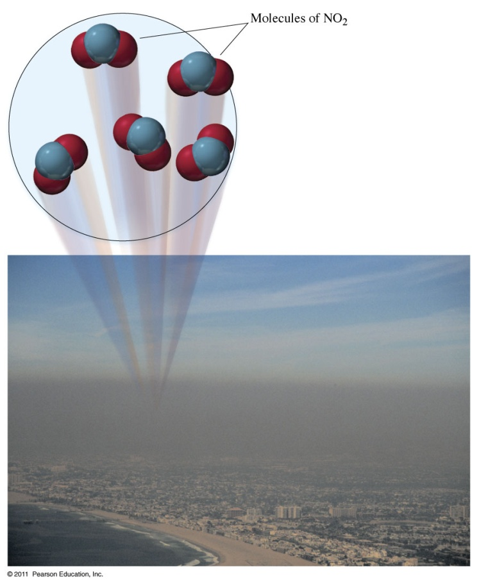
What is Chemistry?

Slide 4
What is the chemistry of today?
The Five Traditional Subdivisions of Chemistry
Inorganic - chemistry of compounds of all elements but carbon
Organic - chemistry of carbon compounds
Biochemistry - chemistry of living systems
Physical - physics of chemical change
Analytical - what and how much are in a sample

Slide 5
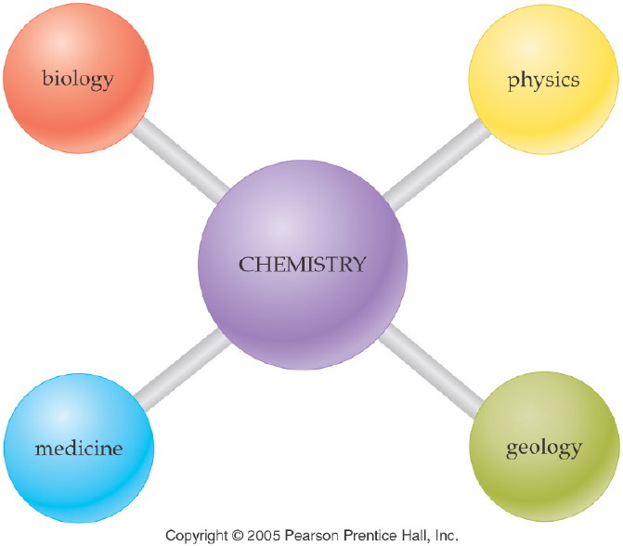
Notes:
Figure: Figure: 01-02
Title:
Chemistry - Central Science
Caption:
The principles of chemistry are fundamental to other physical and health sciences.
Notes:
Chemistry is the core of all scientific education, and is the starting point for most students learning biology, physics, geology and medicine.

Slide 6
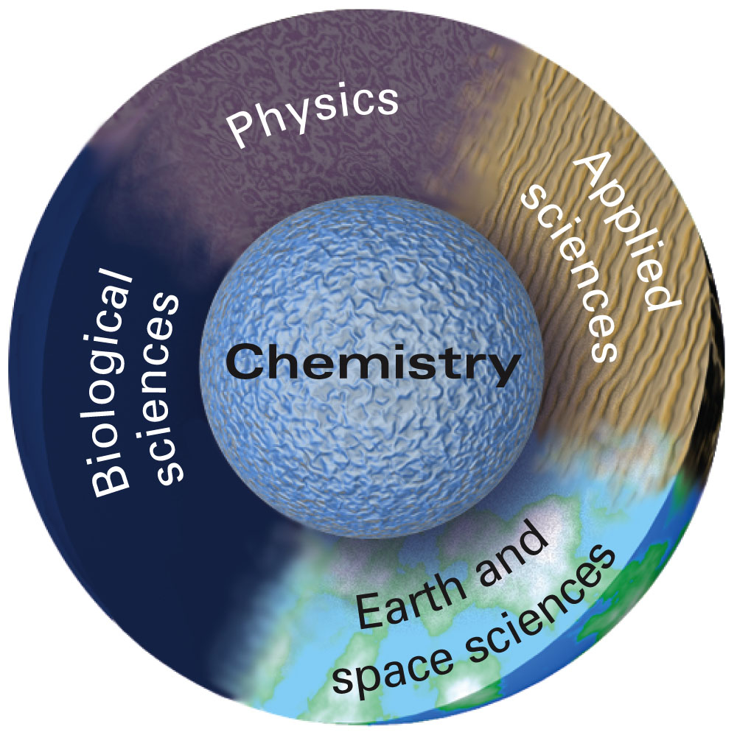
How does chemistry relate to other sciences?

Slide 7
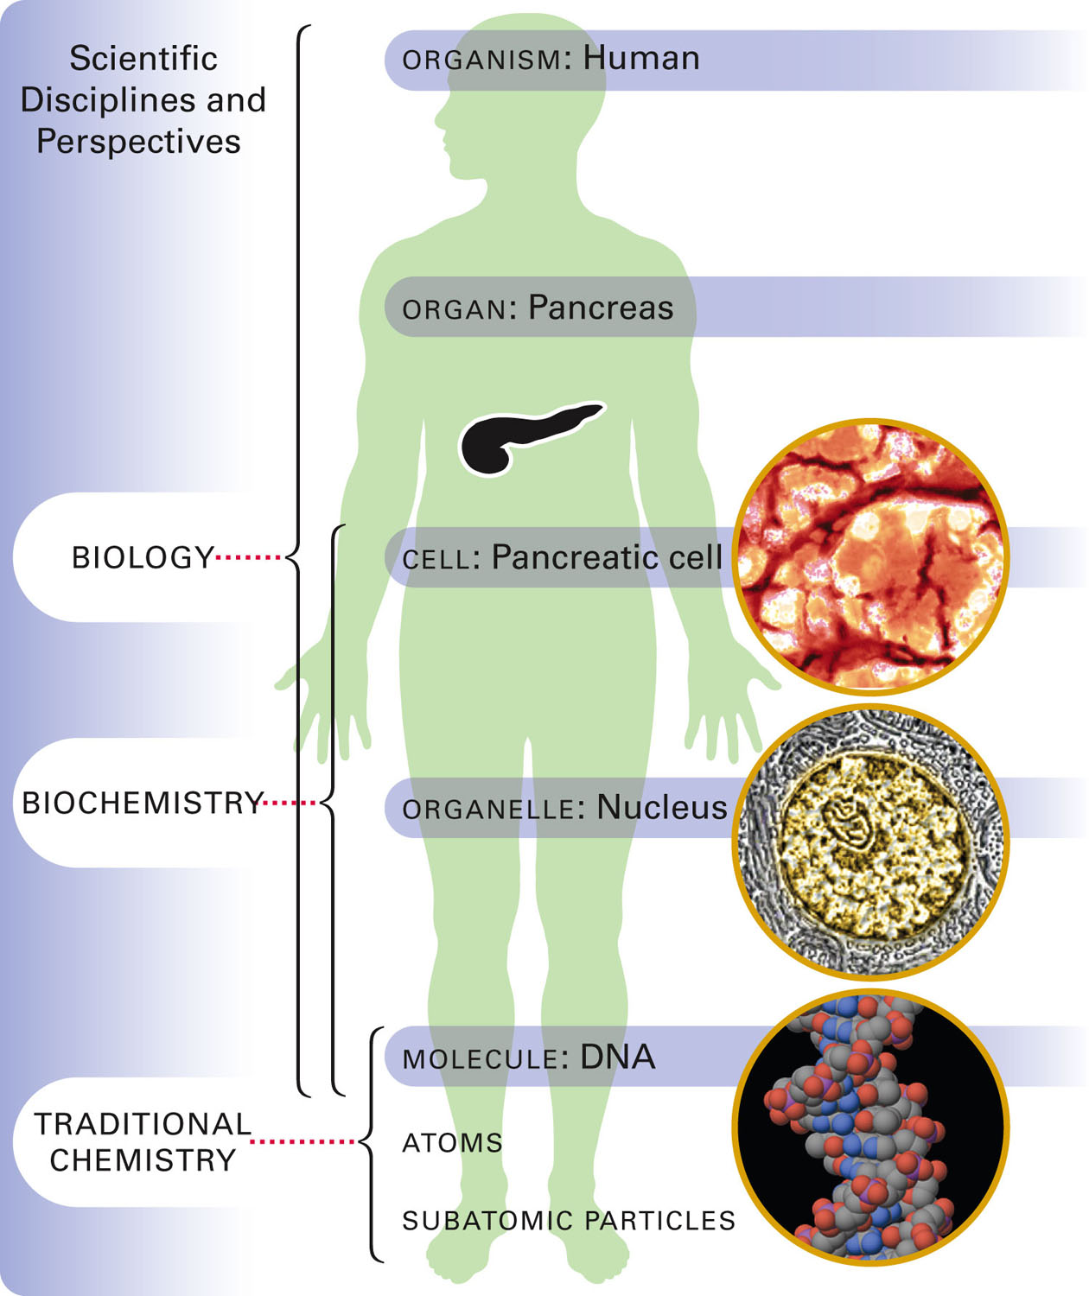
Figure 22-1 p702
Notes:
Figure 22.1 Biology, biochemis-try, and traditional chemistry. Bio-chemists are scientists who study problems of interest to both biolo-gists and chemists. Most biochem-ists use chemical techniques to study biologically relevant systems, ranging from a single cell to a large macromolecule.

Slide 8
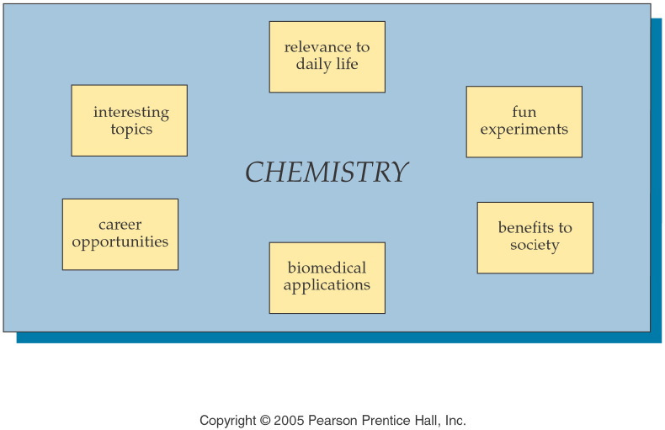
Notes:
Figure: Figure: 01-04-08UN
Title:
Chemistry is fun!
Caption:
There are many positive aspects to learning and understanding chemistry.
Notes:
Chemistry need not be intimidating. Success in a chemistry class starts with a positive attitude, and curiosity.

Slide 9
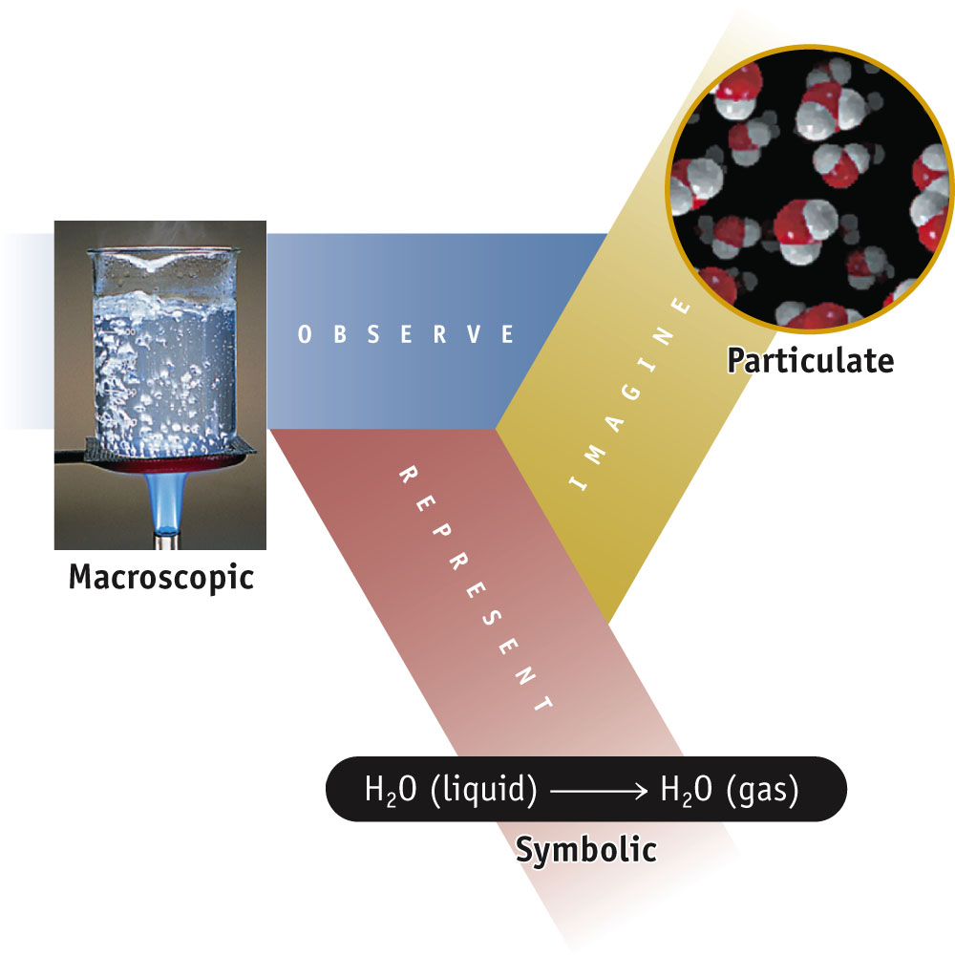
How are substances in Chemistry represented?
How to Think Like a Chemist:

Slide 10
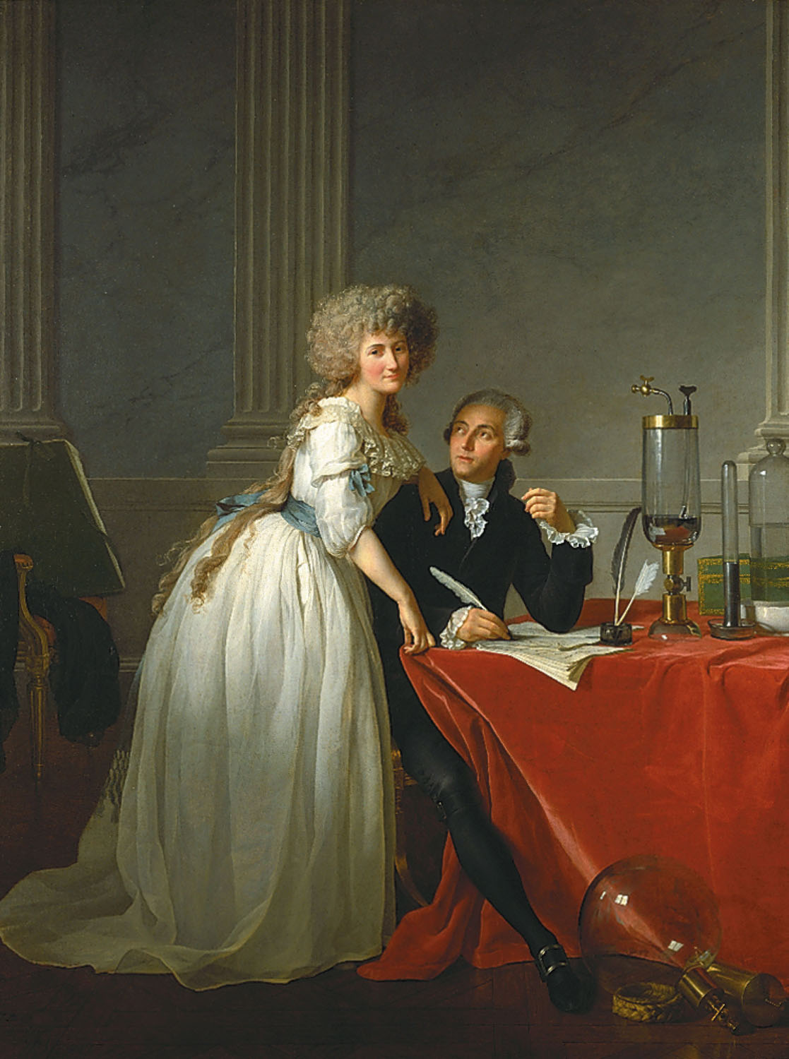
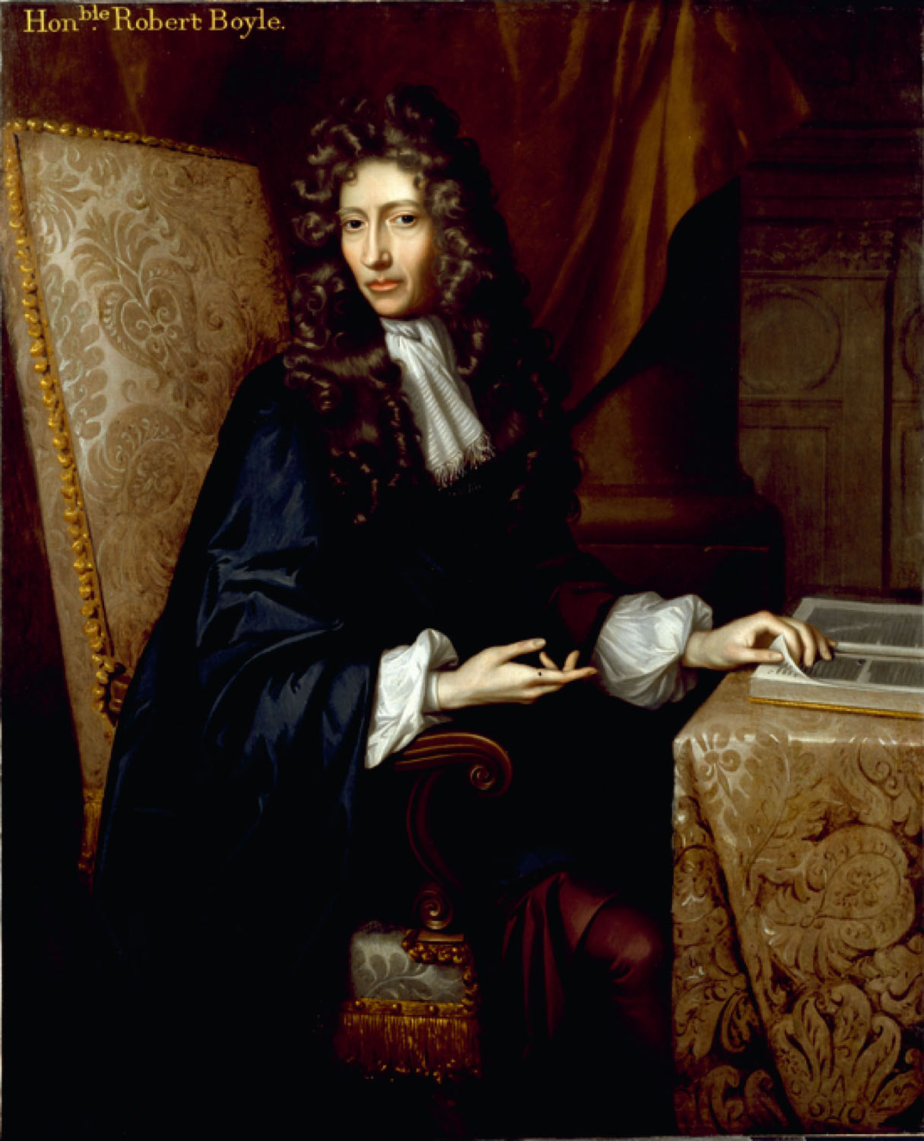
Antoine Lavoisier, the “Father of modern chemistry” and Marie Lavoisier
Robert Boyle, the “Grandfather of modern chemistry”
p2
Notes:
Robert Boyle’s (1627–1691) book The Sceptical Chymist argued for an experimental approach to scientific investigation. Although this seems to be obviously necessary today, it was a radical position in 1661.
Antoine Lavoisier and his wife, Marie. They were married in 1771, when he was 28 and she was only 14. Marie was Antoine’s laboratory assistant and secretary.

Slide 11
What is the Scientific Method?
Empirical facts
  (observations, data)
Scientific laws
  (tested generalizations, consistent observations)
Hypothesis
  (tentative explanation)
Experiments
Publish results
Theory or Models
  (tested explanation, unifying explanation for a set of observations, facts and laws)

Slide 12
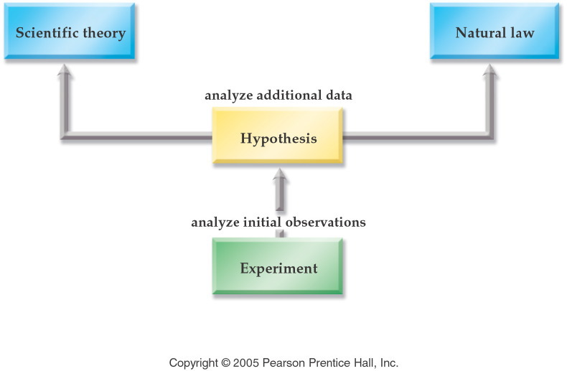
Notes:
Figure: 01-04
Title:
The Scientific Method
Caption:
Experiments are performed to form a Hypothesis, which if confirmed may lead to a Scientific Theory.
Notes:
Even a Scientific Theory is not considered to be absolute truth. Scientific Theories can be revised in the light of new, or more reliable research.

Slide 13
Scientific Method
The bicycle tire is flat. Represents
an observation.
an hypothesis.
an experiment.
a theory.

Slide 14
Scientific Method
If I add air to the bicycle tire, it will expand to the proper size. Represents
an observation.
an hypothesis.
an experiment.
a theory.

Slide 15
Scientific Method
When I added air to the bicycle tire, it was still flat. Represents
an observation.
an hypothesis.
an experiment.
a theory.

Slide 16
Scientific Method
The bicycle tire must have a leak in it. Represents
an observation.
an hypothesis.
an experiment.
a theory.

Slide 17
